Slide 1
Investing in Young Children to End Global Poverty 2016 RESULTS International Conference

Slide 2
What’s the problem?
Over 200 million children are failing to reach their full potential because of:
Poverty
Poor health and nutrition
Lack of quality care

Slide 3
What is early childhood development?
Targets children from before birth to age 8
Cross-sectoral
Nutrition
Interaction and parent support
Early learning
Notes:
https://www.youtube.com/watch?v=LHqUMqvL1RQ

Slide 4
Why now?
4.2 by 2030 ensure that all girls and boys have access to quality early childhood development, care and pre-primary education so that they are ready for primary education

Slide 5
Why now?
“Our failure to make the right investments in early childhood development is condemning millions of children to lives of exclusion. We can’t promise to equalize development outcomes, but we can insist on equalizing opportunity.”
-World Bank President Jim Kim
April 2016

Slide 6
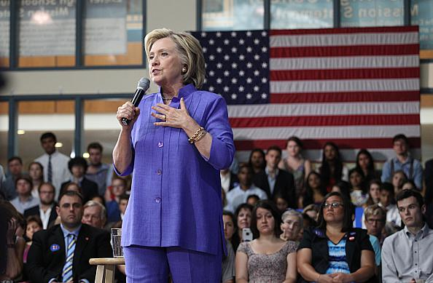
Setting the Stage
Engaging with U.S. presidential candidates
Notes:
http://www.c-span.org/video/?c4547791/clinton-early-childhood-development

Slide 7
Discussion
Katherine Merseth, Team Leader, Early Childhood Development, RTI International
Peter Kamau, Deputy Executive Director, KANCO
Lynette Okengo, Executive Director, Africa Early Childhood Network

