Slide 1
Local Media – Why? And How. International Conference | 2019

Slide 4
Opinion Media Madlibs
__________ should __________ . Person Action

Slide 5
 | News | Editorials | Letters to the Editor | Op-Eds
Who writes it? | Them | Them | Us | Us
What’s it say? | Facts | Facts & Opinion | Facts & Opinion | Facts & Opinion

Slide 8
BREAK

Slide 9
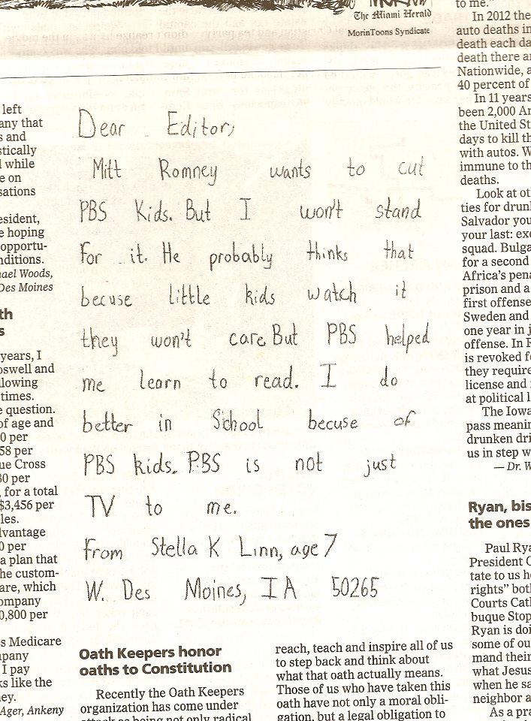

Slide 10
Letters to the Editor
150 – 200 words
3 key pieces:
Local or timely hook (best to respond to a story)
Why it matters
Call to action

Slide 11
Letters to the Editor
Structure
What it looks like
Local & timely hook
Why it matters
Call to action
How you write it
Call to action
Why it matters
Local & timely hook

Slide 12
Call to Action
To the editor:
Regarding your recent story on the stock market, a strong economy is good but only for those who feel it. While Wall Street celebrates, low-income workers see their wages flatlining as the cost of rent, health care, and food go up. Since 1960, renters have seen their wages rise a meager 5 percent, while rents have risen 61 percent.
But there’s help. The Earned Income Tax Credit and Child Tax Credit provide low-wage workers the resources to make ends meet. In 2017, these credits lifted 8.3 million people above the poverty line. Now a new bill in Congress, the Working Families Tax Relief Act, would significantly expand the EITC and CTC, benefitting 46 million working households and lifting 11 million children above the poverty line.
I’m glad some lawmakers in Washington are looking out for working Americans. I urge our members of Congress to support the Working Families Tax Relief Act and robust expansions of tax credits for low-income families in any new tax legislation.
Sincerely,
[Your Name]
[City, State]

Slide 13
Call to Action
To the editor:
In reference to your recent story on U.S. foreign policy, too often we as Americans see foreign policy through the narrow lens of trade and conflict. We forget the good comes from policy that uses international cooperation to solve some of our biggest problems. A perfect example is the Global Fund to Fight AIDS, TB, and Malaria.
In 2002, countries across the globe came together to form the Global Fund, an innovative, public-private partnership focused on fighting these deadly diseases. Since then, the Global Fund has helped save 27 million lives. If we remain vigilant, we can create a world where no one dies of AIDS, tuberculosis, and malaria ever again.
The Global Fund needs at least $14 billion to save 16 million lives by 2022 and continue on the path to ending these diseases. U.S. leadership has been critical to the Global Fund since the beginning. I urge our members of Congress and President Trump to step up by again funding at least one-third of total needed for the Global Fund.
Sincerely,
[Your Name]
[City, State]

Slide 14
Call to Action
U.S. Poverty
I’m glad some lawmakers in Washington are looking out for working Americans. I urge our members of Congress to support the Working Families Tax Relief Act and robust expansions of tax credits for low-income families in any new tax legislation.
Global Poverty
The Global Fund needs at least $14 billion to save 16 million lives by 2022 and continue on the path to ending these diseases. U.S. leadership has been critical to the Global Fund since the beginning. I urge our members of Congress and President Trump to step up by again funding at least one-third of total needed for the Global Fund.

Slide 15
Letters to the Editor
Structure
What it looks like
Local & timely hook
Why it matters
Call to action
How you write it
Call to action
Why it matters
Local & timely hook

Slide 16
Why it matters
These policies aren’t just decisions made in Washington. They affect the lives of people all over the country/world.
____________________________________________________________________________________________________________________________________________________________________________________________________________________________________________________________________________________________________________________________________________________________________________________________________________.

Slide 17
Why it matters
To the editor:
Regarding your recent story on the stock market, a strong economy is good but only for those who feel it. While Wall Street celebrates, low-income workers see their wages flatlining as the cost of rent, health care, and food go up. Since 1960, renters have seen their wages rise a meager 5 percent, while rents have risen 61 percent.
But there’s help. The Earned Income Tax Credit and Child Tax Credit provide low-wage workers the resources to make ends meet. In 2017, these credits lifted 8.3 million people above the poverty line. Now a new bill in Congress, the Working Families Tax Relief Act, would significantly expand the EITC and CTC, benefitting 114 million people and reducing child poverty by 28 percent.
I’m glad some lawmakers in Washington are looking out for working Americans. I urge our members of Congress to support the Working Families Tax Relief Act and robust expansions of tax credits for low-income families in any new tax legislation. Sincerely,
[Your Name]
[City, State]

Slide 18
Why it matters
To the editor:
In reference to your recent story on U.S. foreign policy, too often we as Americans see foreign policy through the narrow lens of trade and conflict. We forget the good comes from policy that uses international cooperation to solve some of our biggest problems. A perfect example is the Global Fund to Fight AIDS, TB, and Malaria.
In 2002, countries across the globe came together to form the Global Fund, an innovative, public-private partnership focused on fighting these deadly diseases. Since then, the Global Fund has helped save 27 million lives. If we remain vigilant, we can create a world where no one dies of AIDS, tuberculosis, and malaria ever again.
The Global Fund needs at least $14 billion to save 16 million lives by 2022 and continue on the path to ending these diseases. U.S. leadership has been critical to the Global Fund since the beginning. I urge our members of Congress and President Trump to step up by again funding at least one-third of total needed for the Global Fund.
Sincerely,
[Your Name]
[City, State]

Slide 19
Letters to the Editor
Structure
What it looks like
Local & timely hook
Why it matters
Call to action
How you write it
Call to action
Why it matters
Local & timely hook

Slide 21
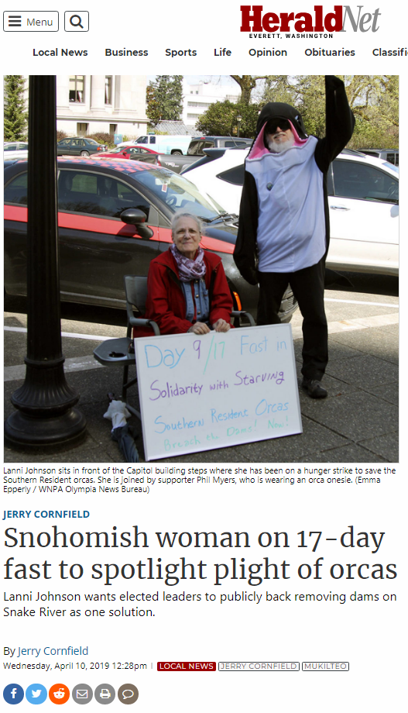
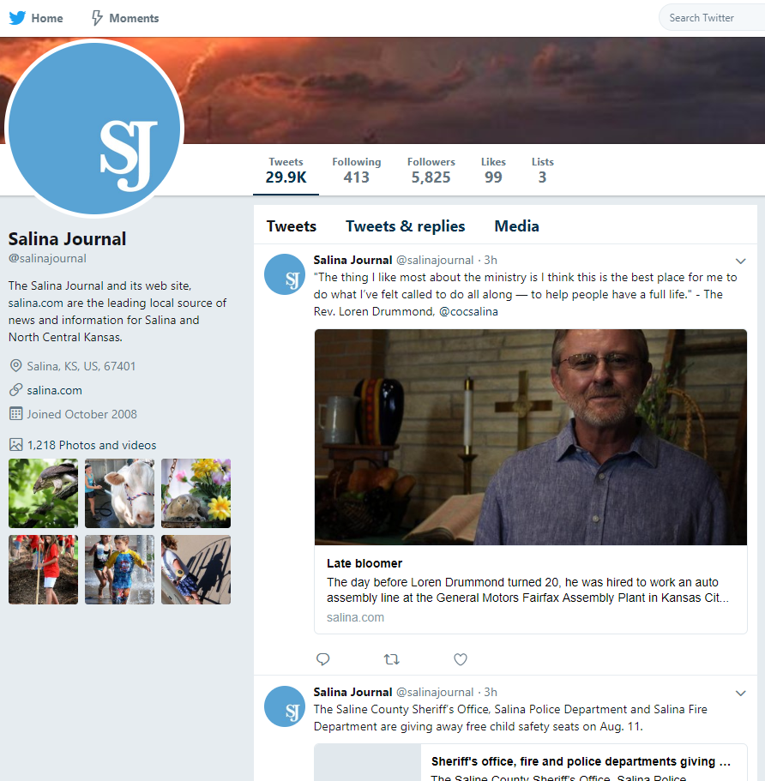

Slide 22
Local and timely hook
To the editor:
Regarding your recent story on the stock market, a strong economy is good but only for those who feel it. While Wall Street celebrates, low-income workers see their wages flatlining as the cost of rent, health care, and food go up. Since 1960, renters have seen their wages rise a meager 5 percent, while rents have risen 61 percent.
But there’s help. The Earned Income Tax Credit and Child Tax Credit provide low-wage workers the resources to make ends meet. In 2017, these credits lifted 8.3 million people above the poverty line. Now a new bill in Congress, the Working Families Tax Relief Act, would significantly expand the EITC and CTC, benefitting 114 million people and reducing child poverty by 28 percent.
I’m glad some lawmakers in Washington are looking out for working Americans. I urge our members of Congress to support the Working Families Tax Relief Act and robust expansions of tax credits for low-income families in any new tax legislation. Sincerely,
[Your Name]
[City, State]

Slide 23
Local and timely hook
To the editor:
In reference to your recent story on U.S. foreign policy, too often we as Americans see foreign policy through the narrow lens of trade and conflict. We forget the good comes from policy that uses international cooperation to solve some of our biggest problems. A perfect example is the Global Fund to Fight AIDS, TB, and Malaria.
In 2002, countries across the globe came together to form the Global Fund, an innovative, public-private partnership focused on fighting these deadly diseases. Since then, the Global Fund has helped save 27 million lives. If we remain vigilant, we can create a world where no one dies of AIDS, tuberculosis, and malaria ever again.
The Global Fund needs at least $14 billion to save 16 million lives by 2022 and continue on the path to ending these diseases. U.S. leadership has been critical to the Global Fund since the beginning. I urge our members of Congress and President Trump to step up by again funding at least one-third of total needed for the Global Fund.
Sincerely,
[Your Name]
[City, State]

Slide 24
Local and timely hook
New construction
Local election
Poverty and homelessness
New hospital
Local health issue
Back to school
New stadium spending
Athlete profiles
2020 election coverage
Candidate profiles
Candidate endorsement Gridlock in DC
Local or national budget cuts
Student housing
TKTKTKTKTKT
Parenting or pregnancy story

Slide 25
Putting it all together
Housing and the Global Fund LTE, April 22, 2019
While I am deeply respectful of Lanni Johnson’s fast for orca protection and hope it works, I have learned a different way to influence change (“Snohomish woman on 17-day fast to spotlight plight of orcas,” The Herald, April 10).
Currently, Congress is working on appropriations for the fiscal year 2020. As a volunteer with RESULTS, I have been asking representatives to sign letters to appropriators to support the Global Fund to Fight AIDS, Tuberculosis, and Malaria and to increase funding for the Housing Choice Vouchers program. The Global Fund has saved 27 million lives since its founding in 2002, no wonder 147 members of the House from both parties signed it. Many of them also signed in support increasing funding for the vouchers program, so 340,000 more families would receive vouchers and thus housing. (Currently only 25 percent of those who qualify receive vouchers.) Reps. Rick Larsen and Suzan DelBene signed both of letters in support of these initiatives and deserve thanks for their hard work to make a difference.
Wouldn’t that be a surprise if they received calls and emails just to thank them for taking these actions to create a better country and world?
Willie Dickerson
Snohomish

Slide 27
You Can Submit an LTE Anywhere, Anytime

Slide 28
Letters to the Editor
Find a hook
Write or edit the template
Check your word count
Check for 3 key pieces
Hit “send”!

Slide 29
Find a hook
Edit the template
Check your word count
Check for 3 key pieces
Hit “send”!
Send it to Congress
Send it to RESULTS staff
Repeat

