Slide 1
RESULTS National Webinar July 13, 2024 Welcome!

Slide 2
Our Values
At RESULTS we pledge to create space for all voices, including those of us who are currently experiencing poverty. We will address oppressive behavior in our interactions, families, communities, work, and world. Our strength is rooted in our diversity of experiences, not in our assumptions.
With unearned privilege comes the responsibility to act so the burden to educate and change doesn’t fall solely on those experiencing oppression. When we miss the mark on our values, we will acknowledge our mistake, seek forgiveness, learn, and work together as a community to pursue equity.
Read our full anti-oppression values statement here at results.org/values.
Notes:
Updated AO slide (2/22)

Slide 3
Resources
Find these resources and more at results.org/volunteers/anti-oppression:
Resource Guides from our Diversity & Inclusion trainings, including:
Interrupting Microaggressions
Creating Space for Critical Conversations
Information on how RESULTS responds to oppressive incidents
Notes:
Updated AO slide (2/22)

Slide 4
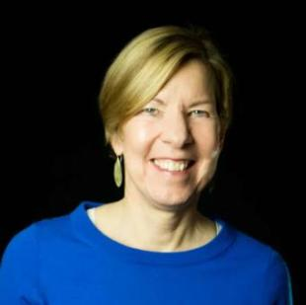
Welcome!
Joanne Carter Executive Director

Slide 5
Global Poverty Campaigns

Slide 7
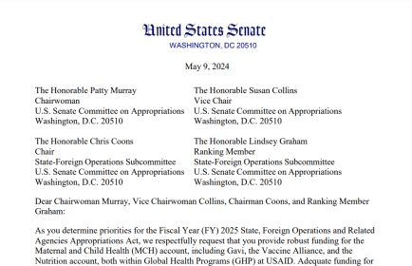
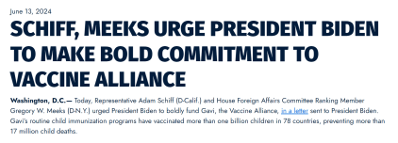
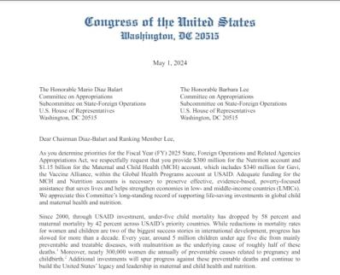
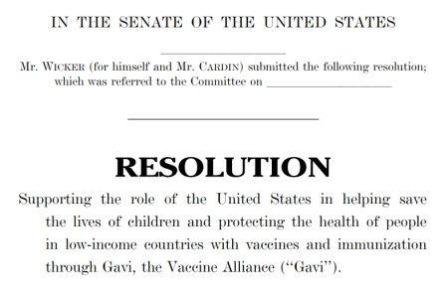
Rallying support for Gavi in Congress

Slide 8
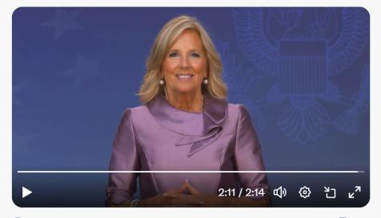
“President Biden, working with Congress, is pledging $1.58 billion over the next five years to support Gavi’s efforts. The United States is deeply committed to this work.“
U.S. First Lady Dr. Jill Biden

Slide 9
Keep at it on Gavi!
…and stay tuned for our next big push on global nutrition.

Slide 10
U.S. Poverty Campaigns

Slide 11
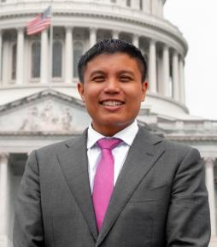
U.S. Poverty Campaigns
Michael Santos RESULTS Associate Director of US Policy
Msantos@results.org

Slide 12
U.S. Poverty Campaigns Update
Child Tax Credit
Still awaiting on Senate Leadership to put legislation on the floor
Nutrition
Awaiting possible extension of the Farm Bill, maybe beyond 2024.
Housing
City of Grants Pass v. Johnson: Grassroots Townhall and Conversation with Local Activists and Organizers (July 18)
Policy landscape post-SCOTUS debrief scheduled (July 9 and July 30)

Slide 13
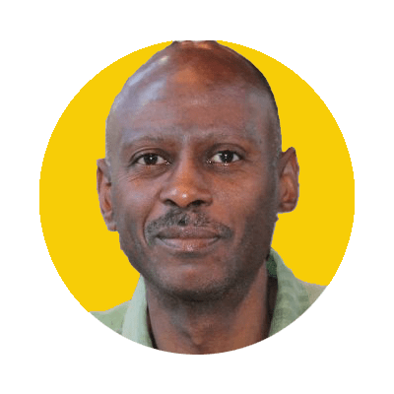
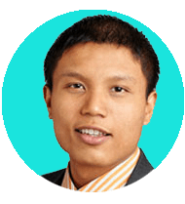
City of Grants Pass v. Johnson: Grassroots Townhall and Conversation with Local Activists and Organizers
Thursday, July 18 at 1:00 p.m. ET - REGISTER HERE
Michael Santos
RESULTS Educational Fund / ABA Commission on Homelessness & Poverty
Paul Boden
Western Regional Advocacy Project
David Peery
Miami Coalition to Advance Racial Equity
Mark Horvath
Invisible People

Slide 14
14
Take action on key
U.S. poverty priorities
SNAP / Farm Bill Continue to talk to Senate Agriculture Committee leaders and members of Congress to protect SNAP from reckless cuts and policies in Farm Bill discussions.
Housing
Submit a letter to the editor today decrying the Grants Pass decision and urging Congress to act.
Notes:
Substantive Policy & Review of Asks (3 min) - highlight different approaches between CTC vs. RTC – CTC is already a federal law, and we’re looking at ways to improve/expand it. There’s no federal RTC – we're working on it!
CTC (one slide for key take aways) - Tell your member to urge colleagues and leadership to expand the Child Tax Credit (CTC) with monthly payments and full refundability for all low-income families
RESULTS urges you to enact an extension of an expanded CTC to strengthen families and fight child poverty. It’s critical that you prioritize the needs of families with the lowest or no incomes in any tax package this year, and communicate that this is a top priority with leadership and colleagues on the Senate Finance Committee/House Ways and Means Committee.
RTC (one slide for key take aways)
RESULTS urges you and your staff to research renter tax credit policies that use the tax code to help lower-income renters, and meet directly with constituents struggling with rent costs to discuss policy solutions.
Important to remember that it’s not the policy detail you’re selling or asking members, but the general idea itself – so strategize accordingly.
Resources here: https://results.org/set-the-agenda

Slide 15
Grassroots Café

Slide 16
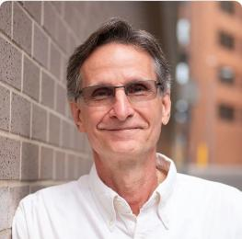
Election Engagement Campaign
Ken Patterson
Director of Grassroots Impact
kpatterson@results.org

Slide 17
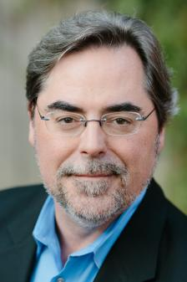
Guest Speaker
Brad Fitch
President and CEO
Congressional Management Foundation

Slide 18
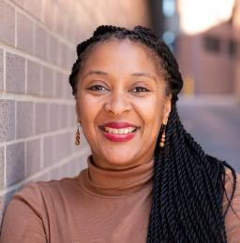
Election Engagement Campaign
Karyne Bury
Manager of Grassroots Impact
kbury@results.org

Slide 19
Election Engagement Campaign
August Perspectives on Democracy & In-District Meetings
September Importance of Candidate Engagement & Media Training
October Using Data to Combat Toxic Poverty Narratives
November Keeping Congress Accountable During End of Lame Duck Year
October

Slide 20
Election Engagement Campaign
Goals:
Interaction with candidates and incumbents
Continue getting them on the record on U.S. and Global poverty issues
Elevate poverty issues among the public discourse
Continue community base-building efforts launched this summer

Slide 21
Election Engagement Campaign
Key Activities:
Direct Advocacy
Generating media
More community outreach

Slide 22
Election Engagement Campaign
Direct Advocacy: “Birddog” candidates and show up ready to ask good questions on our domestic & global issues:
Housing
Child Tax Credit
U.S. Nutrition – SNAP/Farm Bill
Global Malnutrition
Global Fund to Fight AIDS, TB and Malaria

Slide 23
Election Engagement Campaign
Direct Advocacy: Research candidates, their positions, and prepare yourself
Sign up for campaign updates
Campaign vs. Congressional staff
Set Google alerts for your candidates, follow them in the news
Draft and practice your questions in EPIC Laser Talk format

Slide 24
Making the Elections About Poverty
Wednesday, July 17, 8:30 p.m. ET
Election season is an opportunity to build relationships with anyone running for office and to elevate poverty issues with the public.
Let’s learn and strategize the on the elections. We will share ideas on how to find candidates and engage with them. And we will learn how to effectively “birddog” candidates — show up at candidate events and be heard — so that we can raise our poverty issues during election season.
Register: https://tinyurl.com/MakeElectionsAboutPoverty

Slide 25
Election Engagement Campaign
Amplify your actions with media!
Build public awareness of poverty issues
Prompt concern and desire for action
Make a strong case for leadership to support solutions
Require candidates to take a position!

Slide 26
Election Engagement Campaign
More community outreach!
Continue making community connections and to meet in person
Invite others to take action with us
Work with your group to complete the community mapping tool

Slide 27
Election Engagement Campaign
Resources:
Community of Change website: “Make Elections About Poverty”
July 17 workshop – “Making the Elections About Poverty”
Check in with Group Leaders, Regional Coordinators, and RESULTS Elections Team

Slide 28
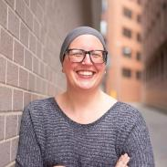
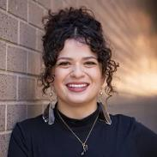
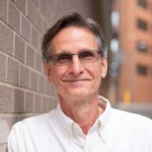
Election Engagement Campaign
RESULTS Elections Team Drop In Office Hours (all times Eastern Time)
Joanna DiStefano Wednesday, 8/7
5:00-7:00 p.m. ET
Sarah Leone Wednesday, 8/14
12:00-2:00 p.m. ET
Karyne Bury
Wednesday, 8/21
12:00-2:00 p.m. ET
Ken Patterson Monday, 8/26
5:00-7:00 p.m. ET
Join at: https://results.zoom.us/j/97873811515

Slide 29
Announcements

Slide 30
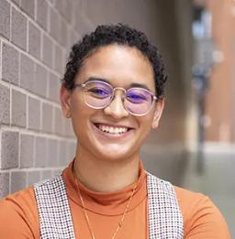
Announcements
Keisha Mcvey
Senior Associate, Experts on Poverty
lmcvey@results.org

Slide 31
Thank you for joining us!
Who is joining you in the room today?
In the poll, please respond with the number of people in the room with you (including yourself).

Slide 32
Making the Elections About Poverty
Wednesday, July 17, 8:30 p.m. ET
Election season is an opportunity to build relationships with anyone running for office and to elevate poverty issues with the public.
Let’s learn and strategize the on the elections. We will share ideas on how to find candidates and engage with them. And we will learn how to effectively “birddog” candidates — show up at candidate events and be heard — so that we can raise our poverty issues during election season.
Register: https://tinyurl.com/MakeElectionsAboutPoverty

Slide 33
City of Grants Pass v. Johnson
Thursday, July 18, 1:00 p.m. ET
Join us for this town hall to learn more about what to expect after the Grants Pass decision, what actions YOU can take with your lawmakers in the coming months as we head into election season, how you can engage others to push back on policies that punish people experiencing homelessness and poverty, and what resources are available to support your advocacy on stopping governments from punishing people living in poverty.
Register today.

Slide 34
Making an Impact on Capitol Hill
Thursday, July 25, 12:00 p.m. ET
You are invited to hear from three inspiring RESULTS fellows on July 25. Through stories, video, and photos taken from the day fellows came to Capitol Hill, they will describe what it’s like to walk the halls of Congress for the first time, how their meetings went, and the record $1.58 billion pledge for lifesaving vaccines that ensued. They will also share how RESULTS is transforming their lives, thanks to the support of our donors.
Register today.

Slide 35
Debriefing the Policy Landscape after the SCOTUS Term (Part 2)
Tuesday, July 30, 1:00 p.m. ET
Join to discuss some of the high-profile rulings from the Supreme Court of the United States that would affect millions of people living in poverty and their relationship with the federal government. This second installment of office hours debriefing the policy landscape would recap the ruling on Loper Bright Enterprises v. Raimondo and its impact on our mission. Feel free to come with questions you may have about the case and about other rulings of the Supreme Court and how these would affect our work with Congress.
Join on Zoom here. No registration required.

Slide 36
Partnership Calls
Together Women Rise Partnership Webinar
Tuesday, July 16, 8:30 p.m. ET
Click to learn more.

Slide 37
Office Hours
Media Office Hour
Wednesday, July 24, 2:00 p.m. ET
Join at https://results.zoom.us/j/93668005494
or call (312) 626-6799, meeting ID 936 6800 5494.

Slide 38
Support Calls
Global Poverty Free Agents
Monday, July 22, 7:00 p.m. ET
Contact Lisa Marchal at lmarchal@results.org for information.
U.S. Poverty Free Agents
Tuesday, July 23, 1:00 p.m. and 8:00 p.m. ET
Contact Jos Linn at jlinn@results.org for information.

Slide 39
Support Calls
Quarterly New Advocate Mentor Community Call
Wednesday, July 31, 8:00 p.m. ET
Register today.

Slide 40
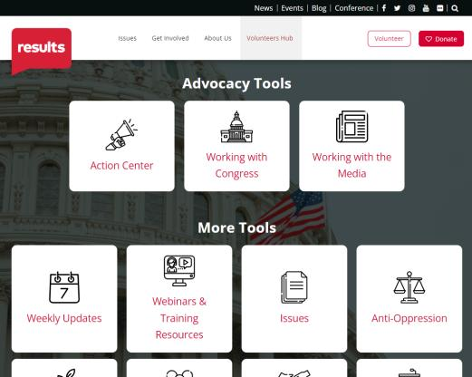
Find today’s slides
results.org/volunteers/national-webinars

Slide 41
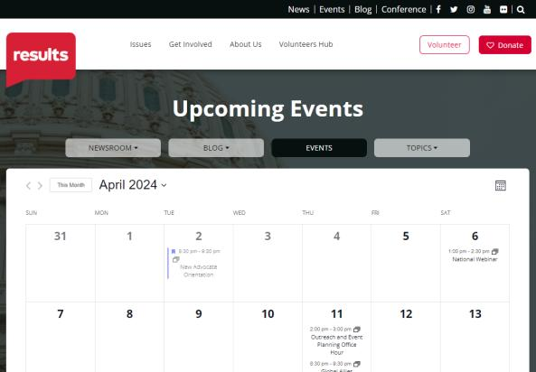
Find events
results.org/events

Slide 42
Join us for the August National Webinar
August 3 at 1:00 p.m. ET Register at: tinyurl.com/RESULTS2024
Focus:
August Recess and Election Season Engagement

Slide 43
RESULTS website and social media

