Slide 1
New Advocate Orientation

Slide 2
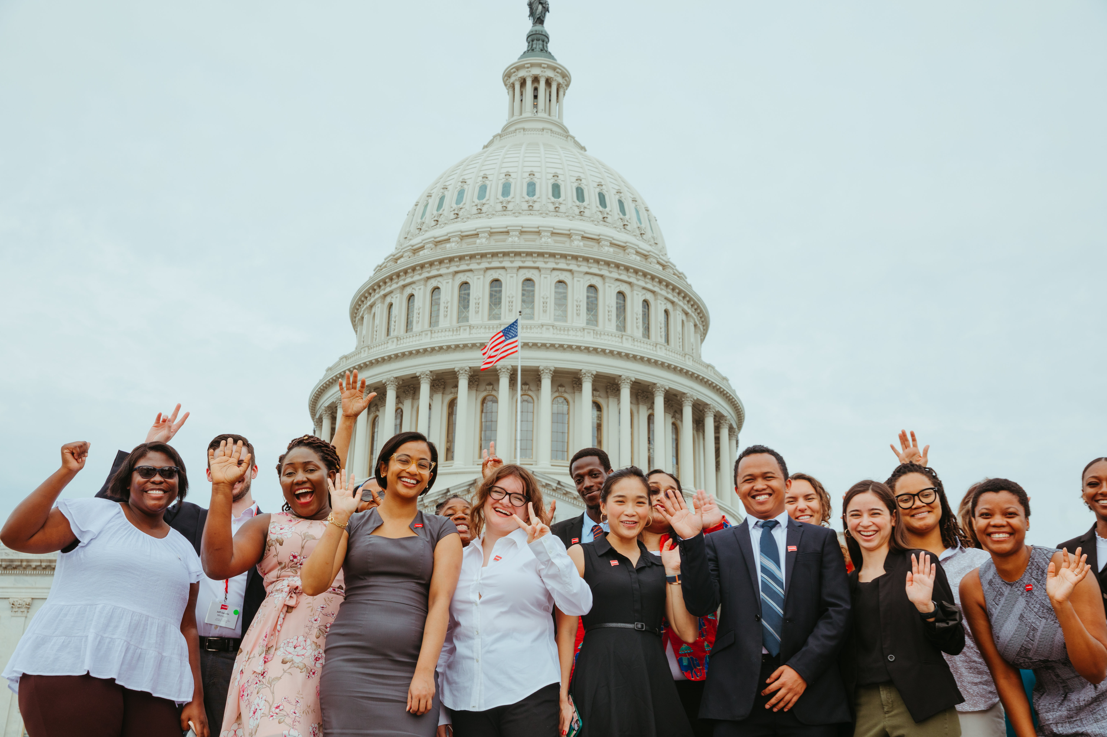
Welcome!
Use the chat to introduce yourself
Name
Pronoun
ONE WORD that describes why you're joining today

Slide 3
Our Goals
EMPOWERED
EQUIPPED
CONNECTED

Slide 4
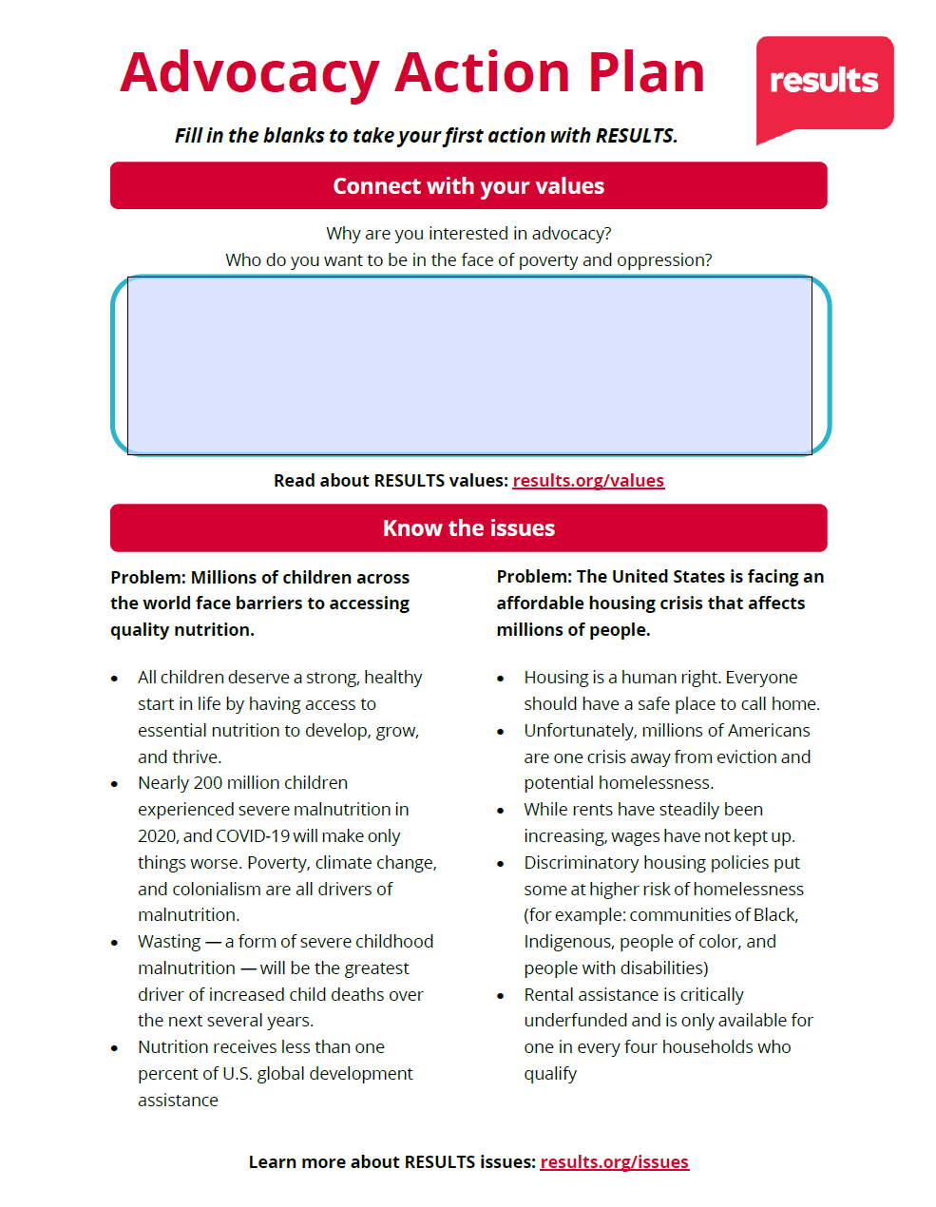
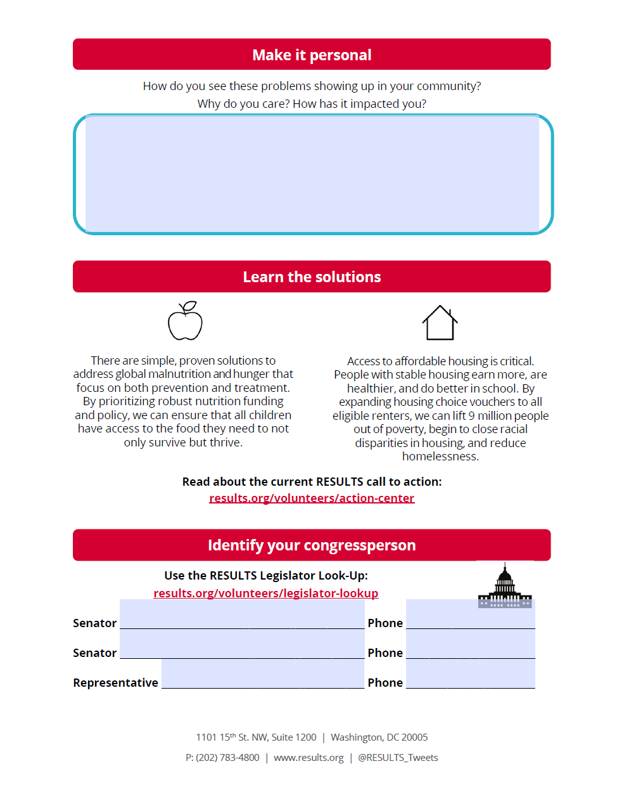

Slide 5
Poll

Slide 6
Keep in mind…
Stay on mute
Private chat us if you have tech issues
Live transcript available
Zoom tip
Want to rename yourself? Right click on your Zoom square and select “rename”

Slide 7
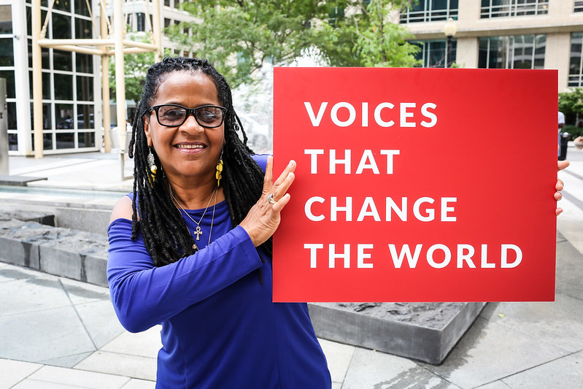
RESULTS is a movement of passionate, committed, everyday people. Together, we use our voices to influence political decisions that will bring an end to poverty.

Slide 8
RESULTS Values
We pledge to create space for all voices, including those of us who are currently experiencing poverty. We will address oppressive behavior in our interactions, families, communities, work, and world.
With unearned privilege comes the responsibility to act so the burden to educate and change doesn’t fall solely on those experiencing oppression. When we miss the mark on our values, we will acknowledge our mistake, seek forgiveness, learn, and work together as a community to pursue equity.
Find resources and more at results.org/values

Slide 9
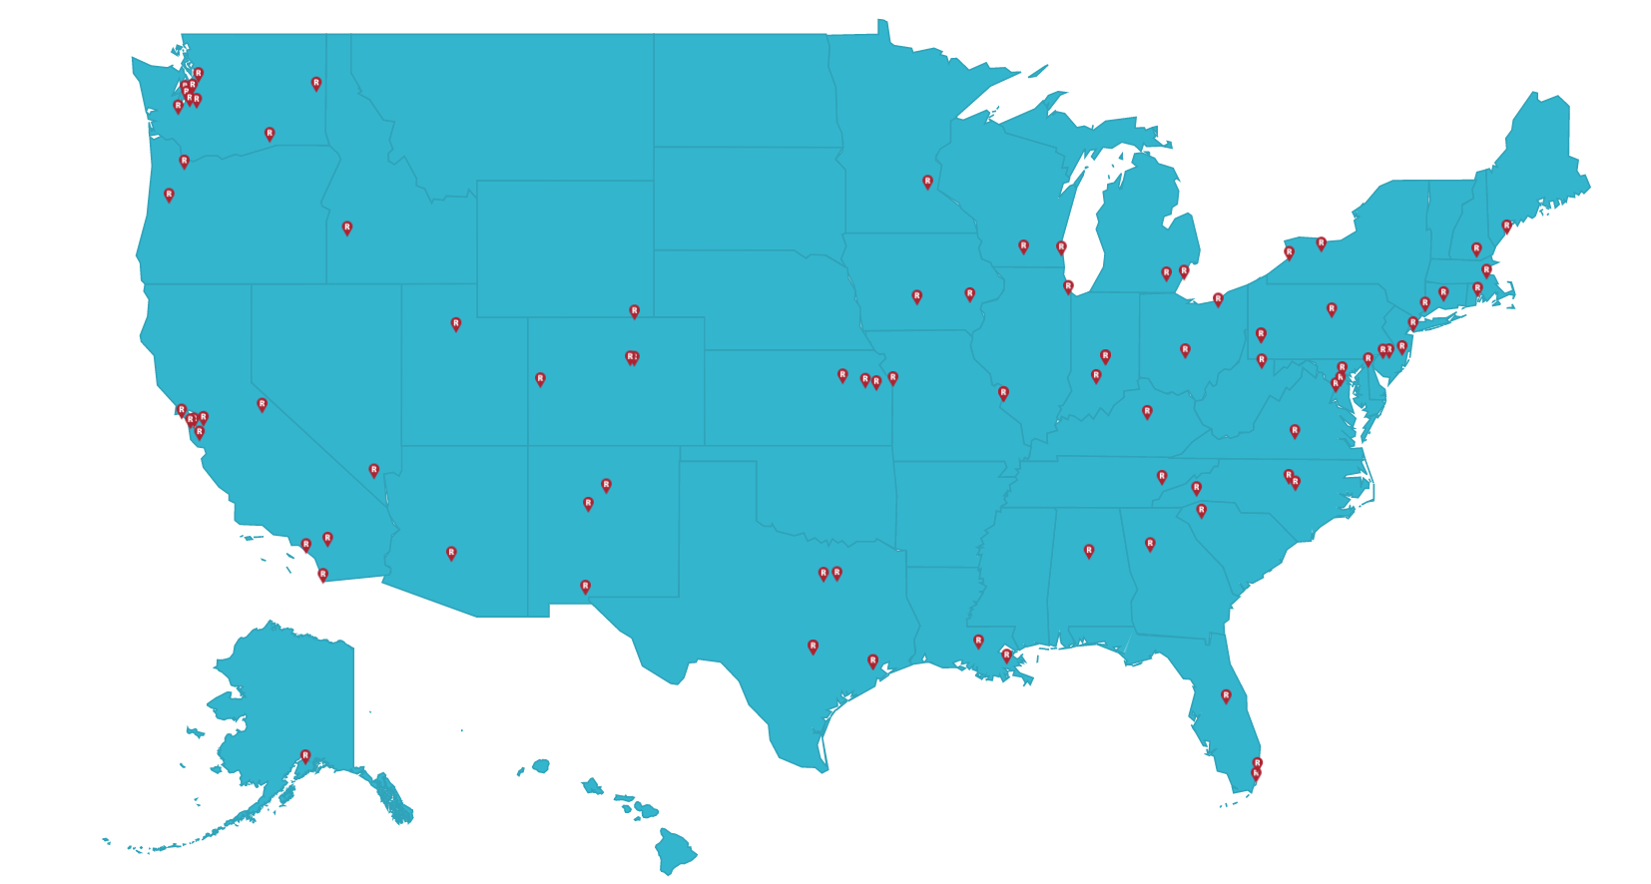
RESULTS Worldwide Movement
results.org/where-we-are/

Slide 10
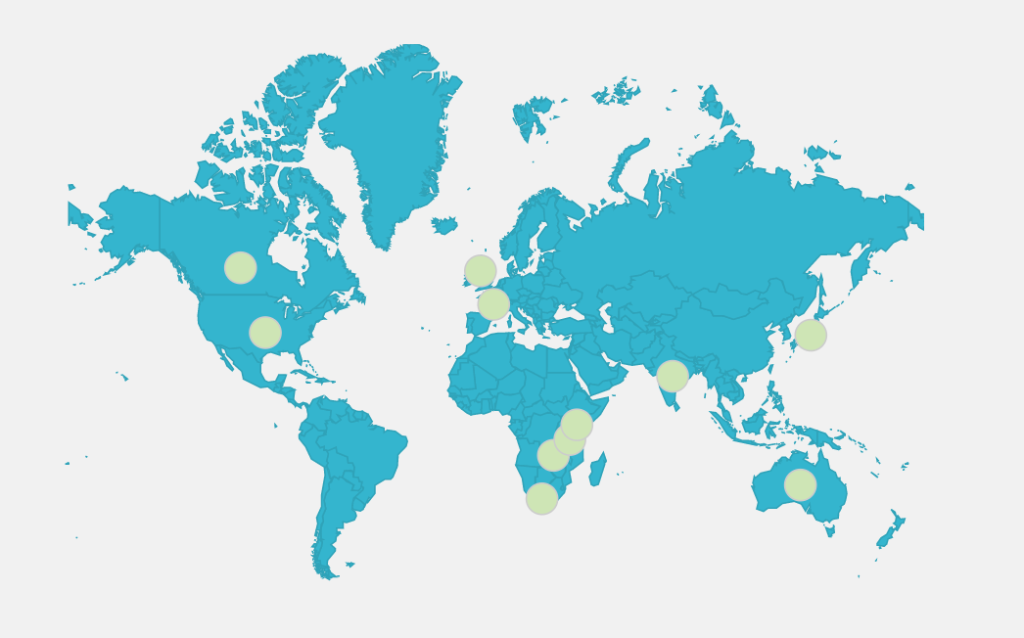
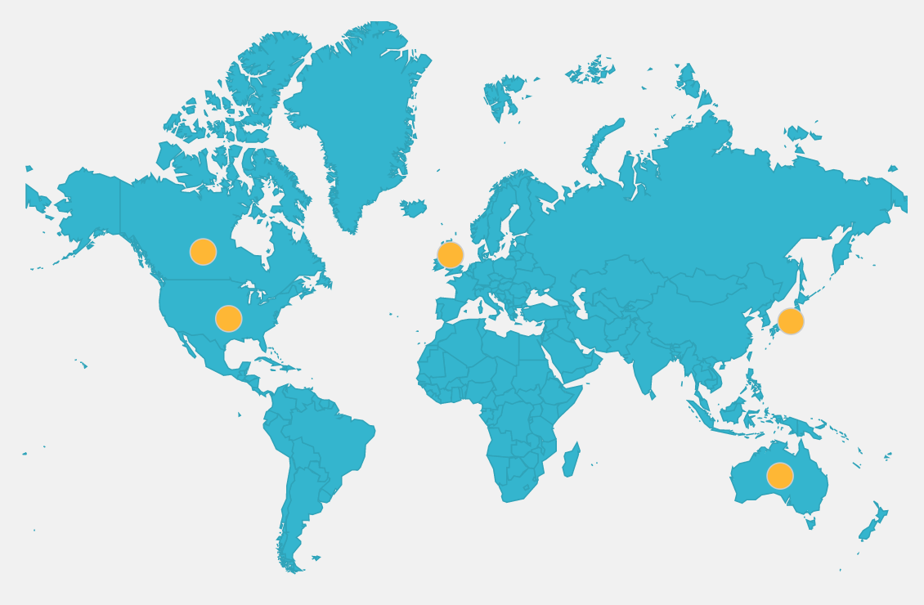
RESULTS Worldwide Movement (cont’d)
results.org/where-we-are/
ACTION Partners
RESULTS International

Slide 11
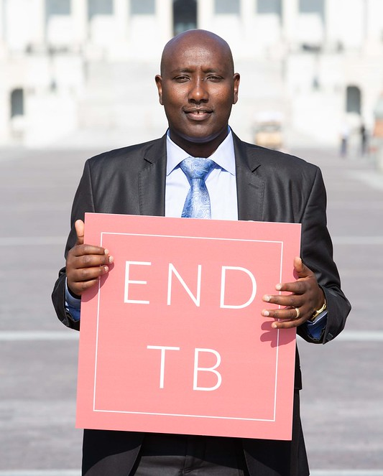
What’s your “why”?
Write your answers in the Advocacy Action Plan!

Slide 12
Advocacy Strategy

Slide 13
RESULTS Model
Advocacy Success
Community
Congress
Change
Informed, connected communities
+ Engaged in action with Congress
= Policy change

Slide 14
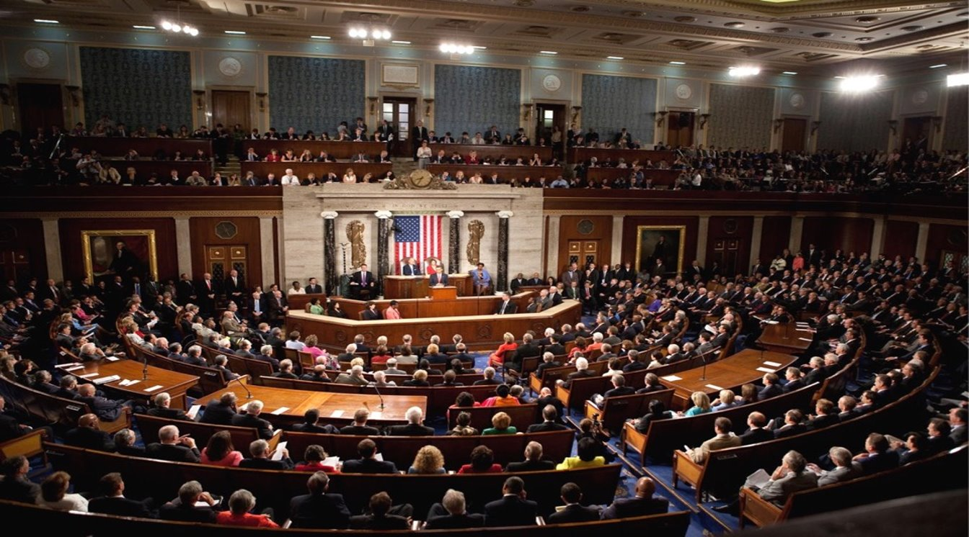
Why Congress?
The government makes decisions about EVERYTHING
Taxes Investments Voting Services
Yet, many people don’t know who represents them in Congress. Many will never contact their member of Congress or hold them accountable to their decisions.

Slide 15
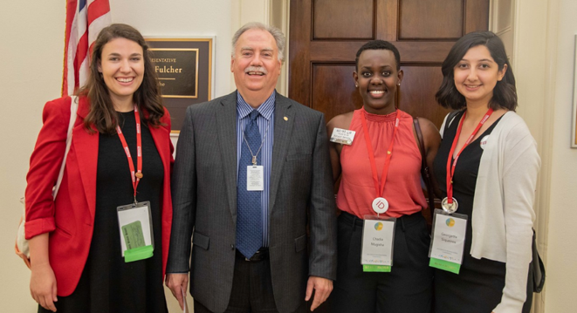
Influence
Trust
Relationships

Slide 16
RESULTS Advocacy Successes
Passed the Global Malnutrition Prevention and Treatment Act – Oct 2022
U.S. pledge to reach 45 million people with quality TB treatment and testing – Sep 2023
Passed Child Tax Credit expansion in the House - Feb 2024
Learn more at: results.org/our-impact

Slide 17
Volunteering

Slide 18
Join a RESULTS chapter and get into action fighting poverty
Meet regularly via Zoom
In-person opportunities
Learn about poverty issues
Take action together
Lobbying
Media writing
Community organizing

Slide 19
Volunteer Roles
Advocate
Congressional Point Person
Group Leaders
Regional Coordinators

Slide 20
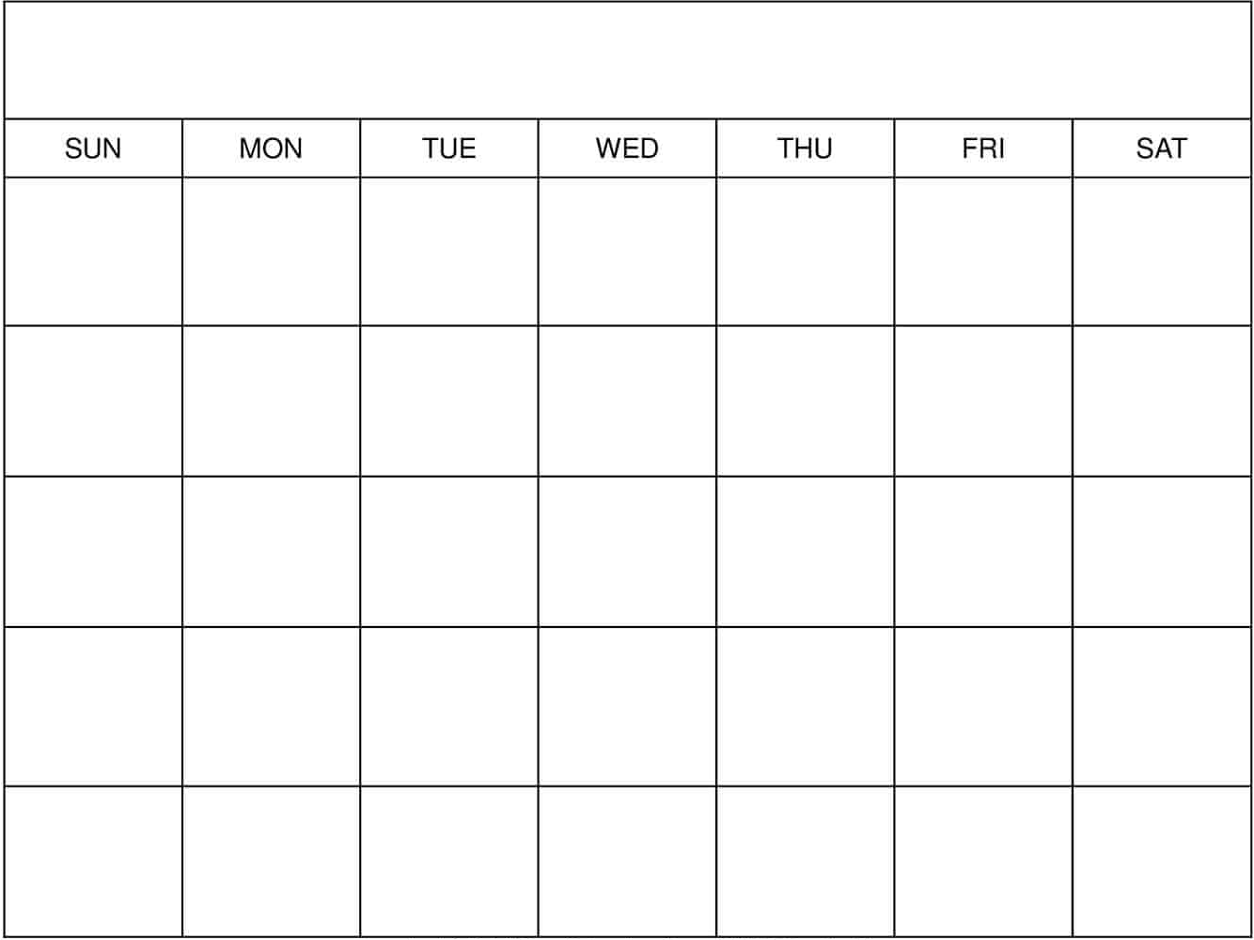
Month-at-a-glance
National Webinar
Volunteering is a combination of group work and individual actions
5 to 6 hours per month
Read about issues
Lobby Prep Call
Attend lobby meeting
Practice
Group meeting

Slide 21
Outreach & Partnership Coordinators (OPCs)
Be active in your community and represent RESULTS
Partner with organizations that share a vision for ending poverty
Show up at election-year events and connect with others in the audience who care about ending poverty
Facilitate new partners to take action with RESULTS
Contact Errolyn Gray for more details egray@results.org

Slide 22
Lived Experience Lunchtime Chat
12-12:45 p.m. ET
Third Friday of the month
Sign-up to get more info
Questions?
Contact Asia Olieman at athompson@results.org

Slide 23
Monthly RESULTS Webinars
National Webinar
Skills training, speakers, action
First Saturday of the month
1 p.m. ET, 12 p.m. CT, 10 a.m. PT
results.org/volunteers/national-webinars
All webinars are advertised on the RESULTS calendar: results.org/events
You must register via Zoom to attend RESULTS webinars. ​
Webinars are recorded and slides are available for download. ​

Slide 24
The Issues

Slide 25
Education
Economic Opportunity
& Security
Health & Nutrition

Slide 26
Use your Action Plans

Slide 27
U.S. Poverty

Slide 28
Our goal: Promote economic justice through the tax code

Slide 29
Child Tax Credit (CTC)

Slide 30
The Child Tax Credit works.

Slide 31
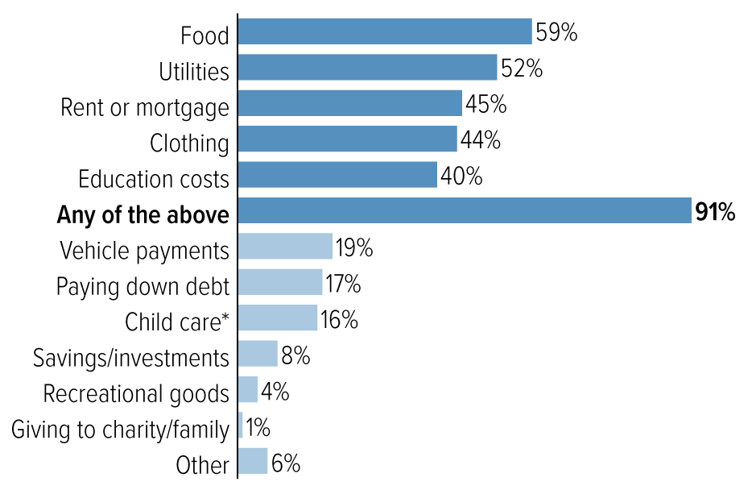
How families used the CTC
Percent of households with incomes below $35,000 who spent their payments on:
Source: Center on Budget and Policy Priorities (CBPP) analysis of U.S. Census Bureau’s Household Pulse Survey collected between July and September 2021

Slide 32
In 2021, the Child Tax Credit kept more than 4 million children out of poverty every months

Slide 33
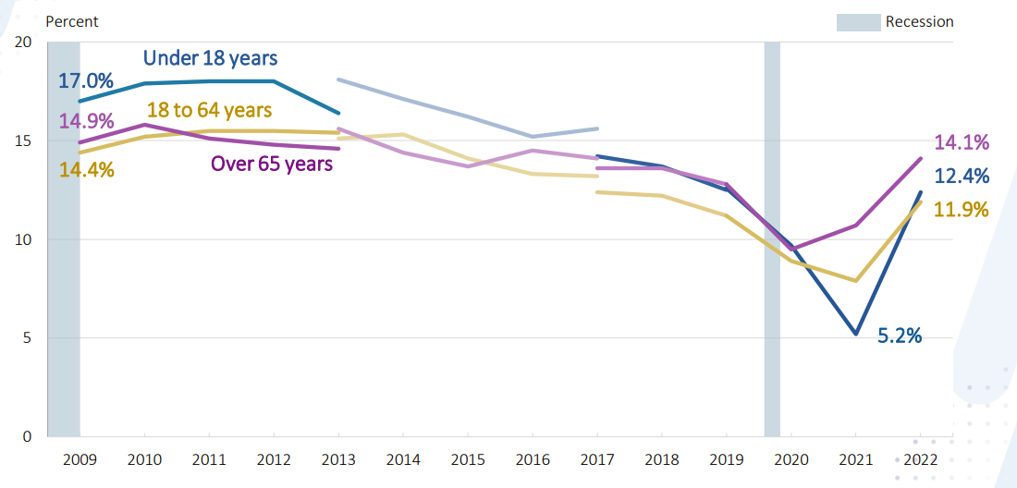
Percentage in poverty by age: 2009-2022
significant 2022 increase
2021 historic lows because of CTC and pandemic relief
Source: United Census Bureau data

Slide 34
Our call to action:
Make expansions to the CTC permanent

Slide 35
Global Poverty

Slide 36
Our goal:
Promote equity in international
anti-poverty programs

Slide 37
Ending the tuberculosis (TB) pandemic

Slide 38
Tuberculosis is preventable, treatable, and curable.

Slide 39
Without treatment, tuberculosis is often fatal.

Slide 40
Tuberculosis is largely stigmatized as a disease of poverty.

Slide 41
Tuberculosis infects over 10 million people each year.
Tuberculosis kills over 4,000 people every day.
Over 95% of infections and deaths are in low-income countries.

Slide 42
Our call to action:
Increase funding for Tuberculosis programs

Slide 43
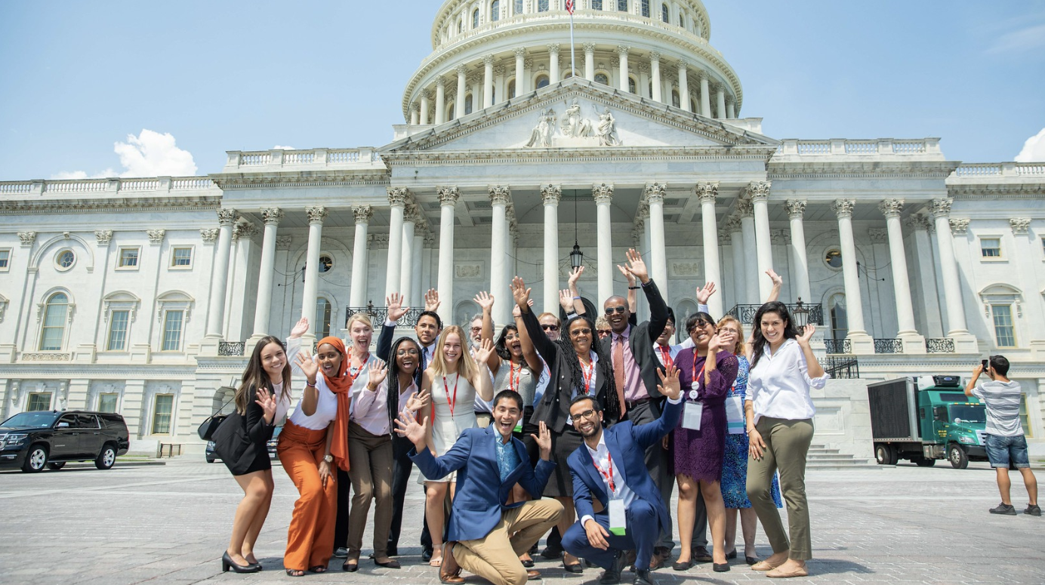
Why do you care about child poverty or ending tuberculosis?
How have these issues impacted you or your community?

Slide 44
Advocacy Skill

Slide 45
Do you know your members of Congress?

Slide 46
www.results.org/legislator-lookup
follow along!

Slide 47
Join the movement

Slide 48
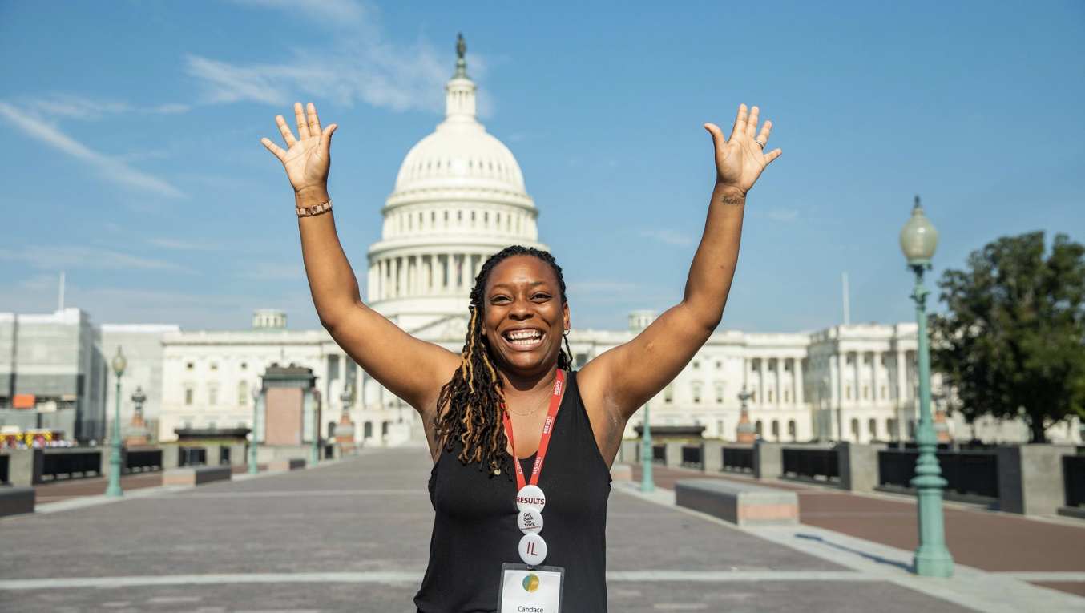
Be an advocate

Slide 49
How to get involved
Step 1
Questions? Email Alicia at astromberg@results.org
Step 2
Step 3
Fill out the volunteer onboarding form
You will receive an email with follow-up resources
We will introduce you via email to your group
Introductions happen last week of the month
Schedule a 1:1 if you still have questions

Slide 50
Nothing can stop the power of a committed and determined people to make a difference in our society.
-Rep. John Lewis

