Slide 1
September Grassroots Webinar: The Reach Act September 10, 2016, 2:00 pm ET https://www.fuzemeeting.com/fuze/f2988286/30204806 To join by phone only, dial (201) 479-4595, meeting ID 30204806 Closed captioning: http://west.typewell.com/faelapgb

Slide 2
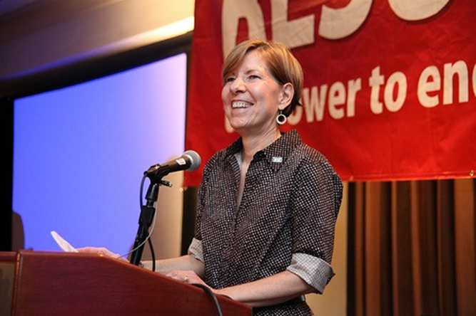
Welcome from Executive Joanne Carter
2
September 2016 RESULTS National Conference Call/Webinar Slides

Slide 3
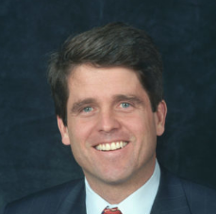
Mark Shriver
3
Mark K. Shriver is President of Save the Children Action Network, where he leads an effort to mobilize Americans to end preventable maternal, newborn and child deaths globally and to ensure that every child in the U.S. has access to high-quality early childhood education. Shriver’s career fighting for social justice in advocacy and service organizations, as well as elected office, has focused on advancing the right of every child to a safe and vibrant childhood.
Shriver joined Save the Children in 2003, serving as Senior Vice President for U.S. Programs until 2013. In that capacity, he created and oversaw the agency’s early childhood education, literacy, health, and emergency preparedness and response programs in the United States.
September 2016 RESULTS National Conference Call/Webinar Slides

Slide 4
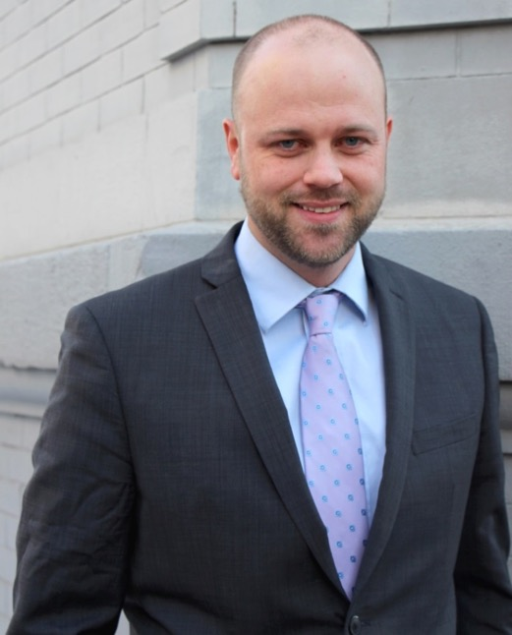
Campaigns Update John Fawcett - Director, Global Policy & Advocacy
4
September 2016 RESULTS National Conference Call/Webinar Slides

Slide 5
Campaigns Update
5
Global Fund Pledge
Education for All Act – On to the Senate!
Reach Every Mother and Child Act
September 2016 RESULTS National Conference Call/Webinar Slides

Slide 6
Reach Every Mother and Child Act
6
Media in all 50 states (plus DC and Puerto Rico)!
26 Cosponsors in the Senate (13 Republicans, 13 Democrats)
184 Cosponsors in the House (68 Republicans, 116 Democrats)
September 2016 RESULTS National Conference Call/Webinar Slides

Slide 7
The Reach Act has more support that 99% of the legislation introduced in the House this Congress.
7
September 2016 RESULTS National Conference Call/Webinar Slides

Slide 8
Reach Every Mother and Child Act
8
Our next goal: 200 House cosponsors
Ask members to speak to House Foreign Affairs Committee leadership
Town Halls
September 2016 RESULTS National Conference Call/Webinar Slides

Slide 9
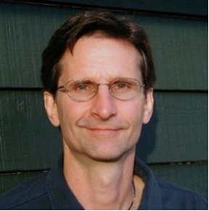
Grassroots Café Ken Patterson Director of Global Grassroots Advocacy
9
September 2016 RESULTS National Conference Call/Webinar Slides

Slide 10
Grassroots Strengthening Priorities
10
Sept-Nov Recess meetings and town halls
Fall/Winter Outreach
Fundraising
September 2016 RESULTS National Conference Call/Webinar Slides

Slide 11
Tell us your 2017 fundraising plans!
11
Due Sept 21st!
Four fundraising opportunities in 2017:
Spring Friends and Family Campaign (FFC) - April
Virtual Thanksgiving Feast FFC - November
Celebrations FFC – anytime
Fundraising Event – anytime
Development team is here for you!
1-on-1 support from Development staff
Customized invites, FB posts, scripts, & online donation page
Extra coaching for first time fundraising groups & First Time Fundraising Kit
Goal: Five New Fundraising Groups in 2017
Consider starting with $500 fundraising goal

Slide 12
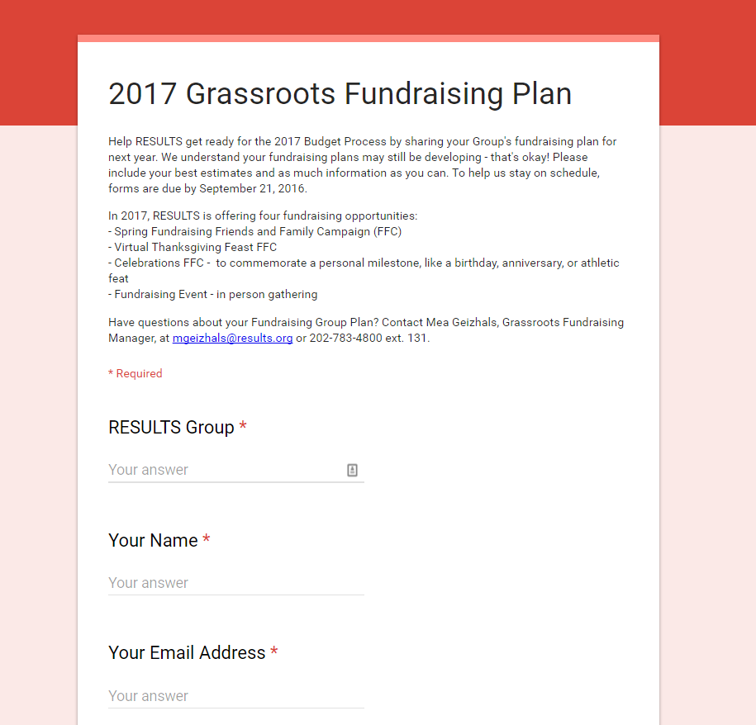
Google Form due September 21
12
Discuss your Group’s 2017 fundraising plans
Fill out the survey at: http://tinyURL.com/2017GRFundraising
Surveys due: Wed, Sept 21
Questions? Email Mea
at mgeizhals@results.org or call
202-783-4800 x131

Slide 13
Coming Soon: 2016 Virtual Thanksgiving Feast
13
Join the last Friends and Family Campaign of 2016 and help raise needed funds for RESULTS this November.
Is your group planning to participate?
Let us know!
Email development@results.org

Slide 14
Let’s Hear From You about Recess Meetings and Encounters!
14
What challenged you?
What inspired you?
What surprised you?
What did you learn?
To share, unmute your webinar line or hit *1 on your phone.
Give us your name, and group or city name.
September 2016 RESULTS National Conference Call/Webinar Slides

Slide 15
Mark Your Calendars!
15
September 14, 9 pm ET. RESULTS Introductory Call. The perfect RESULTS
primer. For more information, contact Amanda Beals, abeals@results.org.
On-going group leader trainings on group health and skill-building.
Next trainings with open spots: February in Dallas and March in Indianapolis.
Contact Lisa Marchal at lmarchal@results.org for more information.
Please fill out Lobby and Outreach reports—you want to be counted, Right?
And….
Wait for it…
September 2016 RESULTS National Conference Call/Webinar Slides

Slide 16
16
September 2016 RESULTS National Conference Call/Webinar Slides

Slide 17
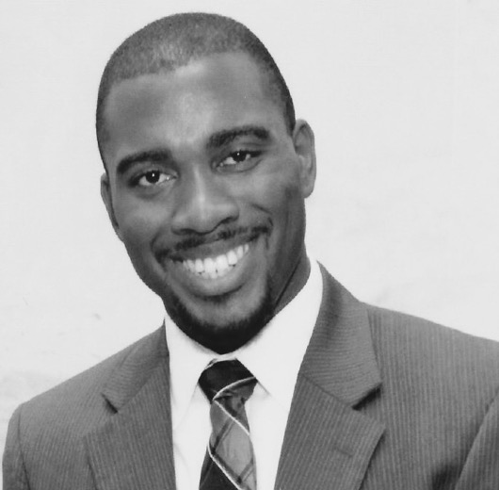
17
Mark Campbell
Global Health Associate
September 2016 RESULTS National Conference Call/Webinar Slides

Slide 18
18
Reach Act Laser Talk
Engage: Last year UNICEF announced that we’ve saved 50 million children’s lives since 2000.
Problem: Yet, 5.9 million children still die each year from mostly preventable causes.
Inform on the solution: We can end preventable maternal and child deaths by 2035 if we act now on the Reach Every Mother and Child Act (H.R. 3706). The Reach Act has 183 cosponsors, including 67 Republicans. This is more support than 99% of all the legislation introduced in the House.
Call to action: Will you please speak to the Chair and Ranking Member of the House Foreign Affairs Committee, Rep. Ed Royce (R-CA) and Eliot Engel (D-NY), and ask them to prioritize moving the Reach Act this year?
September 2016 RESULTS National Conference Call/Webinar Slides

Slide 19
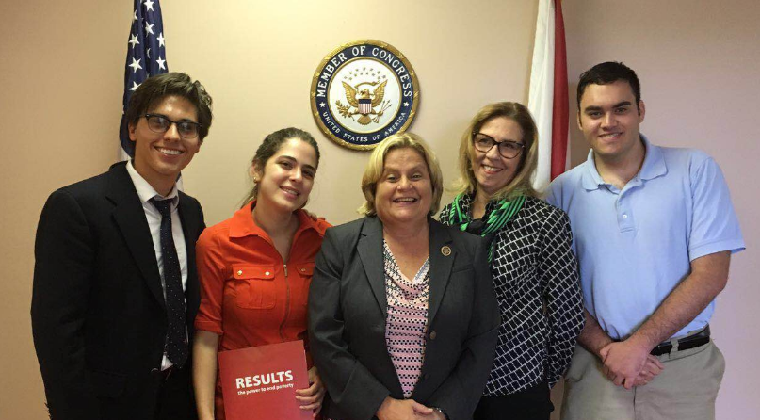
Group Photo of the Month:
RESULTS Miami Real Change Fellows with Rep. Ros-Lehtinen
“Energy and persistence conquer all things.”
- Benjamin Franklin

