Slide 1
Maternal/Child Health September 12, 2015, 2:00 pm ET Joining info: https://www.fuzemeeting.com/fuze/f2988286/30204806 Audio only: (201) 479-4595, passcode 30204806 Closed captioning: http://west.typewell.com/faelapgb

Slide 2
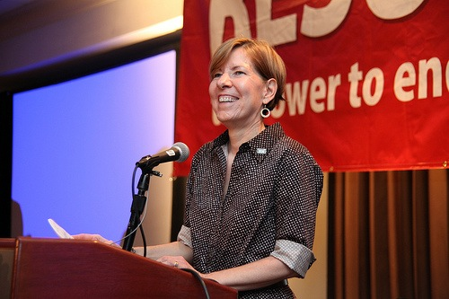
Welcome from RESULTS Executive Director Dr. Joanne Carter
September 2015 RESULTS National Conference Call/Webinar Slides

Slide 3
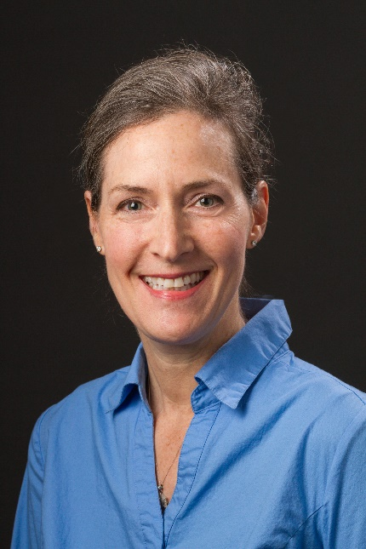
Our Guest: Dr. Linda Arnold
3
Associate Professor of Pediatrics in the Section of Emergency Medicine at Yale School of Medicine
Attending physician in the Pediatric Emergency Department of Yale-New Haven Children's Hospital
Founder the Global Health Track for Yale Pediatric residents and serves on the faculty for Yale University's Global Health Initiative
Chair of the American Academy of Pediatrics (AAP) Section on International Child Health
September 2015 RESULTS National Conference Call/Webinar Slides

Slide 4
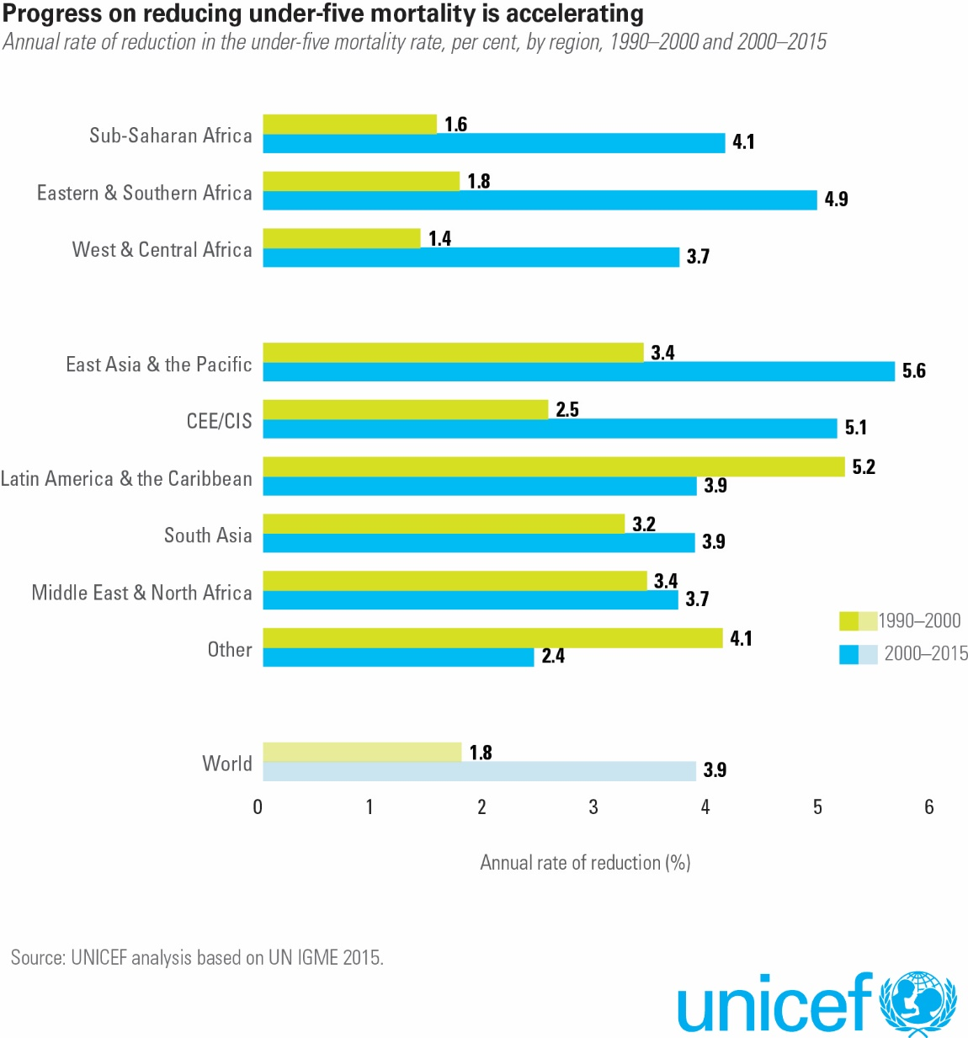
4
September 2015 RESULTS National Conference Call/Webinar Slides

Slide 5
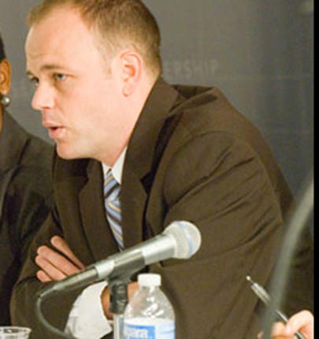
Campaigns Update Legislative Director, John Fawcett
5
September 2015 RESULTS National Conference Call/Webinar Slides

Slide 6
Taking Action on our Maternal/Child Health Campaign
6
Where are we on the House bill?
What we need to do on the Senate bill.
How media will help us.
September 2015 RESULTS National Conference Call/Webinar Slides

Slide 7
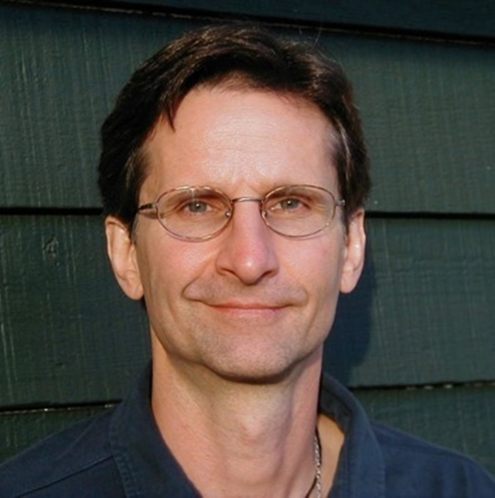
Grassroots Cafe Director of Global Grassroots Advocacy Ken Patterson
7
September 2015 RESULTS National Conference Call/Webinar Slides

Slide 8
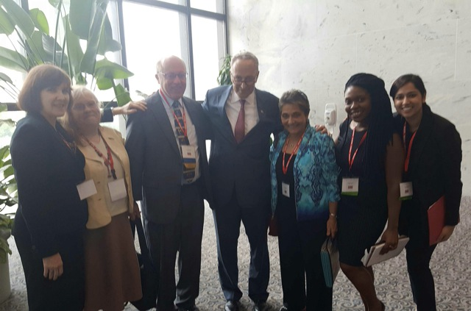
Group Photo of the Month RESULTS New York with Sen. Chuck Schumer
September 2015 RESULTS National Conference Call/Webinar Slides

Slide 9
Shares: Open Phones on Working with the Media
Yvonne Wyborny of RESULTS Detroit
kicks us off!
Then questions for you. . .
What have you done to develop a deeper relationship with a local paper
What advice to you have to help others
generate their own media—letters to the
editor, op-eds, or editorials?
September 2015 RESULTS National Conference Call/Webinar Slides

Slide 10
Media Relationship Tips
10
You need a relationship for editors to write or print your op-eds
Develop a relationship by making lots of regular contacts and getting them comfortable with our issues
Make positive comments on their editorials
Call & email on the UNICEF numbers & MCH
Call & email on the Global Nutrition Report (9/22) & MCH
Call & email on the Sustainable Development Goals & MCH
Continue polite calling and emailing until they agree to write or have you write an op-ed
Media is one of your most powerful voices because they can reach thousands!
Notes:
Greet person next to you

Slide 11
11
Maternal/Child Health Campaign Resources
Media toolkit (including editorial packet)
http://results.org/issues/maternal_and_child_health_media_toolkit
September action sheet
Write a letter to the editor to tell the Senate: Support S.1911!
http://www.results.org/uploads/files/September_2015_Global_Action_Sheet_-_Reach_Act_Letters_to_the_Editor.pdf
RESULTS’ press release on UNICEF’s latest child survival data
http://www.results.org/newsroom/new_data_shows_child_mortality_
rates_at_historic_low/
Watch the RESULTS listserve for letters & op-eds (“steal” ideas!)
If you aren’t a member, join here:
results-l+subscribe@googlegroups.com
September 2015 RESULTS National Conference Call/Webinar Slides

Slide 12
Outreach and Leadership Opportunities!
12
Outreach
Sept. 27 SDG Webinar with Jeffrey Sachs, Joanne Carter, Aaron Oxley!
World AIDS Day, Dec. 1, 2015
Leadership
MCH Media Training: Oct. 2-4 in Seattle
GL Training: October 2015, three dates 2016
Notes:
Greet person next to you

Slide 13
Live from NYC . . . The Sustainable Development Goals Summit
International Webinar
Sunday, September 27, 12:45 pm ET
Invite those who are curious about RESULTS, and who are inspired by the SDGs,
who are thinking about what they can do to end extreme poverty . .
get together and be part of this unique webinar.
Invitation flyers are already circulating.
Contact Lisa Marchal at lmarchal@results.org if you need one.
See the weekly update for more details
September 2015 RESULTS National Conference Call/Webinar Slides

Slide 14
World AIDS Day Outreach
World AIDS Day (December 1)
RESULTS’ Global Fund Replenishment Campaign Kick-off
We have set an ambitious goal of 50 community events nationwide
on World AIDS day. These events will be designed to educate and
organize our communities about RESULTS and the Global Fund
as well as grow our grassroots base.
Sign up to host a World AIDS Day event today!
http://tinyurl.com/RESULTSWAD2015
September 2015 RESULTS National Conference Call/Webinar Slides

Slide 15
Other Opportunities
15
RESULTS Introductory Call, 1 pm ET on September 25. Register online.
Free Agents, 8 pm ET on September 21. Are you a RESULTS activist with our global poverty campaigns with no RESULTS group? You are alone no more! To join, go to http://fuze.me/27781074 or (201) 479-4595, meeting ID 27781074. Contact Lisa Marchal, Senior Global Grassroots Associate, for more information on this monthly gathering.
On-going group leader trainings on group health and skill-building. Next training with open spots: October 23-25, 2015 – Port Orchard, WA
Contact Lisa Marchal at lmarchal@results.org for more information.
September 2015 RESULTS National Conference Call/Webinar Slides

Slide 16
Take Note!
16
REPORTING: We are quickly approaching the last quarter of the year.
Please proudly let us know all of the major actions you’ve taken with Congress, the media, and community by reporting your accomplishments so far this year:
Reporting a month's advocacy work? Here’s your form: http://www.tinyurl.com/2015GMR
Reporting just a lobby meeting? Here’s your form: http://www.tinyurl.com/2015GLRF
Reporting just a media piece? Here’s your form: http://www.tinyurl.com/2015GMRF
You can also see what’s been reported when you go to the forms!
September 2015 RESULTS National Conference Call/Webinar Slides

Slide 17
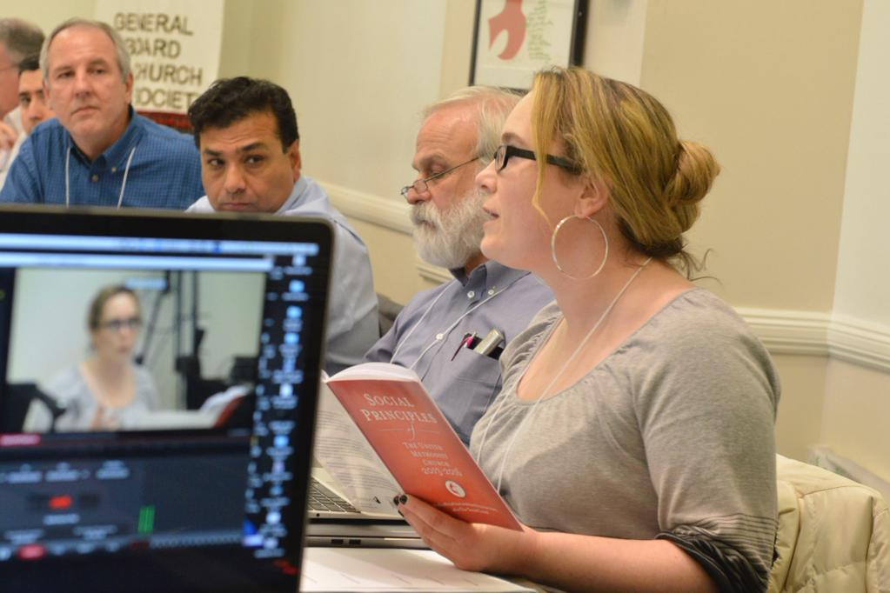
Laser Talk: Making that Maternal/Child Health Pitch to your Editor Lisa Marchal, Senior Global Grassroots Associate
17
September 2015 RESULTS National Conference Call/Webinar Slides

Slide 18
Laser Talk Here’s an example:
18
Hi, this is Veronica McDuffee. I wanted to quickly follow up on my email about healthy kids and the bill before Congress right now. Do you have a second to chat?
On Tuesday, just after I dropped my son off for his first day of school, I came home to see news from UNICEF that there are still eleven kids under 5 dying around the world every single minute. I could barely stand to leave my son behind for the day, and to think of losing him forever is unfathomable.
But right now there’s a new bill in Congress that has a plan to put an end to these kinds of senseless deaths for good – and Senator Risch will play a key role in deciding whether or not it gets passed. It’s called the “Reach Every Mother and Child Act.”
I know the Statesman’s voice would be hugely influential in pushing Sen. Risch to do the right thing. Do you think this is something you might take up?
September 2015 RESULTS National Conference Call/Webinar Slides

Slide 19
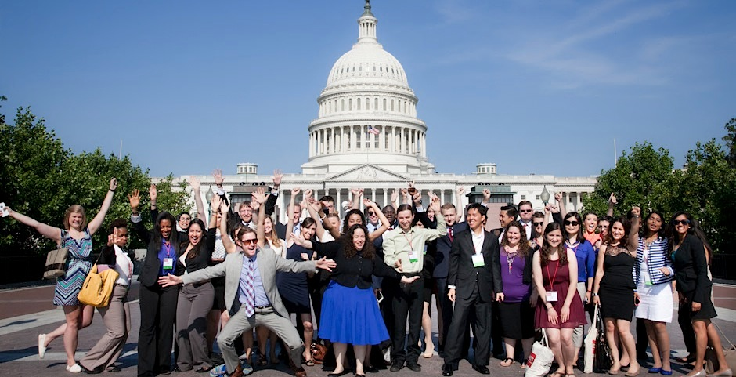
“If you have the feeling that something is wrong,
don't be afraid to speak up.”
Fred Korematsu

