Slide 1
Monthly Webinar September 12, 2024

Slide 2
Welcome everyone!
Let us know where you are joining us
from in the chat!
Share a greeting in another language if you know one.

Slide 3
Our Values & Resources
3
​At RESULTS we pledge to create space for all voices, including those of us who are currently experiencing poverty. We will address oppressive behavior in our interactions, families, communities, work, and world. Our strength is rooted in our diversity of experiences, not in our assumptions.
With unearned privilege comes the responsibility to act so the burden to educate and change doesn’t fall solely on those experiencing oppression. When we miss the mark on our values, we will acknowledge our mistake, seek forgiveness, learn, and work together as a community to pursue equity.
Read our full anti-oppression values statement here at results.org/values.
Check out the Anti-Oppression Workshop Schedule for training opportunities.
Find these resources and more at results.org/volunteers/anti-oppression:
Resource Guides from our Diversity & Inclusion trainings, including:
Interrupting Microaggressions
Creating Space for Critical Conversations
Information on how RESULTS responds to oppressive incidents

Slide 4
Overview of tonight’s webinar
Welcome & Introductions
Brief Campaigns Update
Guest Speaker, Sabina Rogers (Togo ‘01-’04)
September Advocacy Actions
Closing Announcements

Slide 5
Campaigns Updates
Notes:
Karyne
8:35-8:45 PM: Campaigns Updates (Ken)
World Bank advocacy action, letter that closed on 4/12 (maybe share a copy of the letter if we have it by then)
FY25 Appropriations
Dear Colleague Letters, with squishy deadlines - on the RESULTS blog linked here: https://results.org/blog/fy25-appropriations-tell-congress-to-fund-the-fight-against-poverty
House Basic Education letter closes 4/17 Close of Business (maybe take action on this one the night of the webinar)
Others are TBD, but give us some urgency
Scorecard for Dear Colleague letters can be found at the top of the page, direct link: https://docs.google.com/spreadsheets/d/1x35soUUCN2Io0sPfBvqIdjnQ6Sa6I_31HC-HVi2MlAo/edit?usp=sharing
Completing forms online (share about the training coming up by RESULTS on this?)
So you can see how the money we advocate for shows up on the ground, we will hear from Susan who will share a story from her work with USAID in Madagascar

Slide 6
vaccines save lives
Notes:
Globally, infectious diseases, including pneumonia, diarrhea, and malaria are the leading cause of deaths of kids under 5. Many of these are vaccine preventable.
Today, it costs $18 to fully immunize children in low-income countries. This price has reduced from $23 in 2013. This would not have happened on its own. It’s the result of sustained global partnership to save children’s lives. There is no reason why every child in the world should not receive the protection of lifesaving vaccines.
https://data.unicef.org/topic/child-survival/under-five-mortality/#:~:text=In%202022%2C%204.9%20million%20children,birth%20and%20intrapartum%2Drelated%20complications.

Slide 7
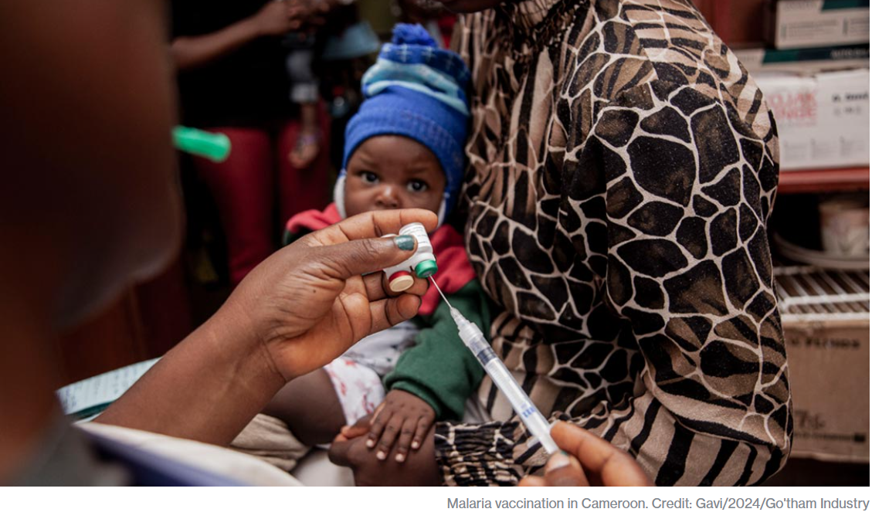

Slide 8
Gavi Resolutions – H.Res. 1286/ S. Res. 684
Senate Lead Sponsors: Sens. Wicker (R-MI) and Cardin (D-MD) House Lead Sponsors: Representatives Kean (R-NJ), Amo (D-RI), Salazar (R-FL), and Jacobs (D-CA).
Calls for United States to have supporting role in saving children’s lives of children and protecting people’s health through Gavi, the Vaccine Alliance.
Gavi has been a major contributor in reducing the number of childhood deaths in lower-income countries due to vaccine-preventable disease by 70 percent since 2000.
Country ownership and sustainability are at the core of the Gavi model.
Notes:
Gavi will launch their investment case to fund their next strategic period from 2026-2030.
https://www.gavi.org/our-alliance/strategy/phase-6-2026-2030

Slide 9
Nutrition is fundamental
Credit: USAID Malawi

Slide 10
Our big global moment
This Photo by Unknown Author is licensed under CC BY-SA

Slide 11
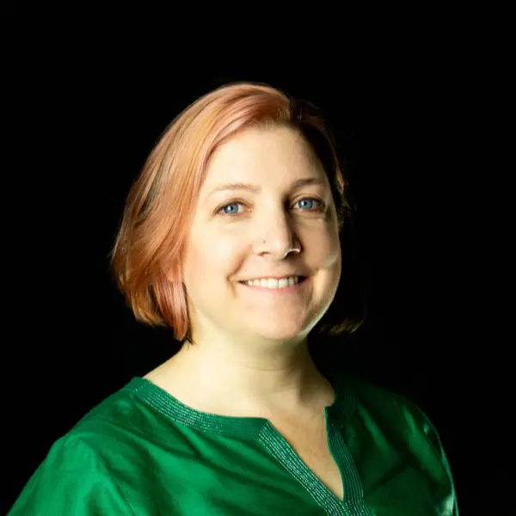
Sabina Rogers (Togo ‘01-’04)

Slide 12
September Advocacy Actions
Notes:
Karyne
8:35-8:45 PM: Campaigns Updates (Ken)
World Bank advocacy action, letter that closed on 4/12 (maybe share a copy of the letter if we have it by then)
FY25 Appropriations
Dear Colleague Letters, with squishy deadlines - on the RESULTS blog linked here: https://results.org/blog/fy25-appropriations-tell-congress-to-fund-the-fight-against-poverty
House Basic Education letter closes 4/17 Close of Business (maybe take action on this one the night of the webinar)
Others are TBD, but give us some urgency
Scorecard for Dear Colleague letters can be found at the top of the page, direct link: https://docs.google.com/spreadsheets/d/1x35soUUCN2Io0sPfBvqIdjnQ6Sa6I_31HC-HVi2MlAo/edit?usp=sharing
Completing forms online (share about the training coming up by RESULTS on this?)
So you can see how the money we advocate for shows up on the ground, we will hear from Susan who will share a story from her work with USAID in Madagascar

Slide 13
Our big global moment
This Photo by Unknown Author is licensed under CC BY-SA

Slide 14
We want the US Government to
Make a specific, bold, new financial pledge.
Make a powerful public signal to the world, encouraging others to be bold.
Ask your member of Congress to join the Dear Colleague Letter (open through 11:59pm tonight)
Phone script and sample email

Slide 15
Gavi Resolutions – H.Res. 1286/ S. Res. 684
Senate Lead Sponsors: Sens. Wicker (R-MI) and Cardin (D-MD) House Lead Sponsors: Representatives Kean (R-NJ), Amo (D-RI), Salazar (R-FL), and Jacobs (D-CA).
Calls for United States to have supporting role in saving children’s lives of children and protecting people’s health through Gavi, the Vaccine Alliance.
Gavi has been a major contributor in reducing the number of childhood deaths in lower-income countries due to vaccine-preventable disease by 70 percent since 2000.
Country ownership and sustainability are at the core of the Gavi model.
Notes:
Gavi will launch their investment case to fund their next strategic period from 2026-2030.
https://www.gavi.org/our-alliance/strategy/phase-6-2026-2030

Slide 16
Continue Taking Action on Gavi!
Check this scorecard see if your Representative or Senator has signed on to the Gavi Resolution (H. Res. 1286/ S. Res. 684).
Use Legislator Lookup (if you are unsure of who to reach out to, please don’t hesitate to reach out to us for support).
Email convention: Senate - FirstName_LastName@SenatorsLastName.Senate.Gov (example: alex_moree@rubio.senate.gov) House – FirstName.LastName@mail.house.gov (example: Max.Price@mail.house.gov)
Personalize this sample email requesting your members of Congress co-sponsor H. Res. 1286 or S. Res. 684.
Follow up! If you’ve taken one action today, take the other action tomorrow.
Notes:
Karyne

Slide 17
Why Focus on Elections?
Establish early relationships
Get to candidates when they are listening
Educate candidates and the public on poverty
Get candidates on the record
Set the agenda for the next Congress
Engage the community

Slide 18
Election Engagement Resources
RESULTS.org/Issues/Community of Change
https://results.org/resources/2024-election-engagement-resources
Tight races: https://www.cookpolitical.com/ratings

Slide 19
Global Poverty Questions
Global Nutrition
Global Fund to Fight AIDS, TB, and Malaria
Global Vaccines/Gavi

Slide 20
U.S. Poverty Questions
Child Tax Credit
Nutrition
Housing

Slide 21
Register here

Slide 22
Join our next webinar
Tuesday, October 10 8:30 PM ET – 9:30 PM ET
Register here: https://tinyurl.com/GAP2024Webinars

Slide 23
Thank you for taking action with us tonight!

