Slide 1
RISE Advocacy Chapter with RESULTS September Webinar
September 20, 2022
Notes:
Leslye

Slide 2
Welcome & Introductions

Slide 3
Mission & Vision
Together Women Rise’s Mission
Together Women Rise cultivates the collective power of community to achieve global gender equality.
OUR VISION
Together Women Rise envisions a world where every person has the same opportunities to thrive regardless of their gender or where they live.
Notes:
Leslye

Slide 4
RESULTS Anti-Oppression Values
​RESULTS is a movement of passionate, committed everyday people. Together
we use our voices to influence political decisions that will bring an end to poverty.
Poverty cannot end as long as oppression exists.
We commit to opposing all forms of oppression, including racism, classism, colonialism, white saviorism, sexism, homophobia, transphobia, ableism, xenophobia, and religious discrimination. ​
At RESULTS we pledge to create space for all voices, including those of us who are currently experiencing poverty. We will address oppressive behavior in our interactions, families, communities, work, and world. Our strength is rooted in our diversity of experiences, not in our assumptions. ​
With unearned privilege comes the responsibility to act so the burden to educate and change doesn’t fall solely on those experiencing oppression. When we miss the mark on our values, we will acknowledge our mistake, seek forgiveness, learn, and work together as a community to pursue equity.
There are no saviors — only partners, advocates, and allies. We agree to help make the RESULTS movement a respectful, inclusive space.​
Find all our anti-oppression resources at: https://results.org/volunteers/anti-oppression/

Slide 5
Fall 2022 Campaigns Updates
Notes:
Ken

Slide 6
Great work!
COVID Supplemental funding
Appropriations
Global Fund Replenishment
Global Malnutrition bill: H.R. 4693
Global Education bill: H.R.7240; S.3938
Global Tuberculosis bills: H.R.8654; S.3386
Notes:
Fall Campaigns: https://results.org/fall2022/
Global Malnutrition Prevention and Treatment Act
Global Fund conference getting pushed back to later date in September

Slide 7
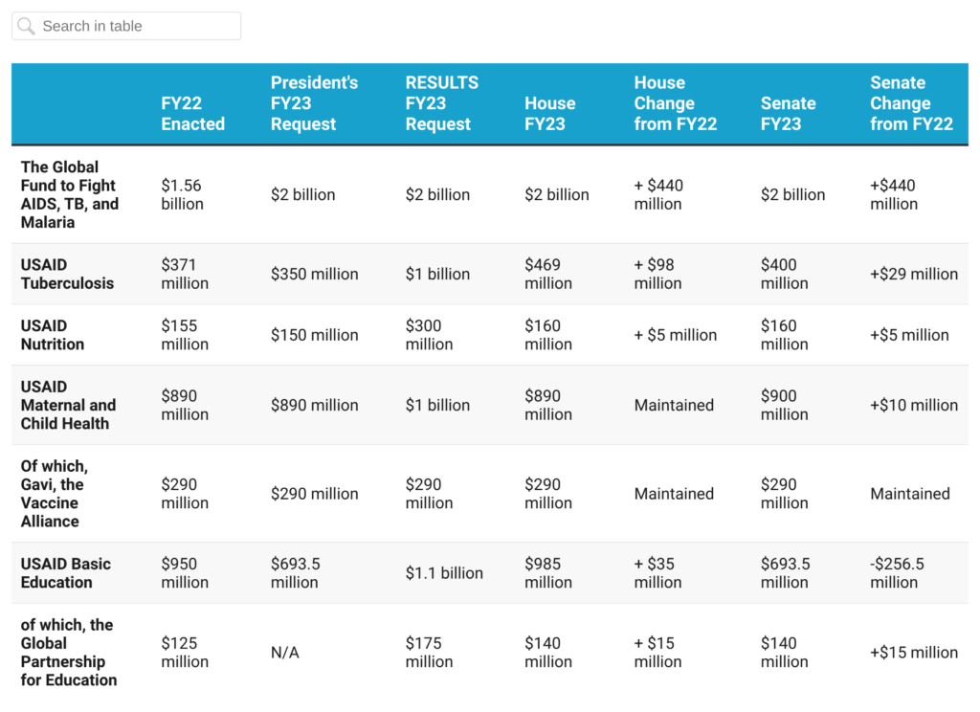
Funding Our Priorities
Notes:
Ken - Appropriations

Slide 8
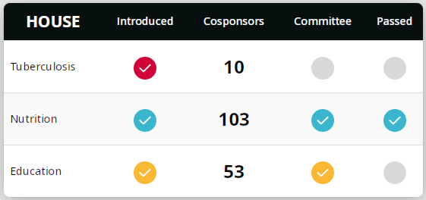
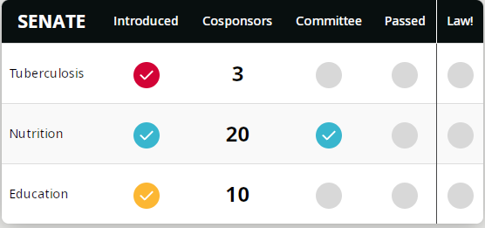
Global Nutrition Bills
HR 4693 passed in House
HR 4693 passed Senate Foreign Relations Committee
HR 4693 in queue for “unanimous consent” consideration in Senate.
Global Education Bills
HR 7420 passed House Foreign Affairs
HR 7420 in queue for “unanimous consent” consideration in House.
S 3938 needs cosponsors
Notes:
Vote count: https://clerk.house.gov/Votes/2022137

Slide 9
Fall 2022 Campaigns: End TB Now Act
Notes:
Ken

Slide 10
TB Challenge
In 2020, over 10 million people fell ill with TB and 1.5 million people died even though most TB cases are curable. Over 95 percent of TB cases and deaths are in developing countries.
Since COVID, TB detection has dropped by 50 percent and an estimated 1 million fewer people have been diagnosed and enrolled on TB treatment.
The lack of investment and added stress on the health systems means the global End TB Strategy and United Nations High Level Meeting targets for TB are off track.
The Stop TB Partnership estimates that delaying or failing to implement the goals will mean an additional 43 million people would develop TB, leading to 6.6 million additional TB deaths by 2030.
This will cost countries, communities, and families their loved ones and upwards of $1 trillion in economic loss by 2030. Humanity would lose a projected 234 million disability-adjusted life years.
Notes:
Vote count: https://clerk.house.gov/Votes/2022137

Slide 11
End TB Now Act (H.R.8654, S.3386)
Requires U.S. to establish bold goals for reaching the most vulnerable TB populations to detect, cure and prevent all forms of TB globally
Strengthens U.S. bilateral coordination with global organizations, including the Global Fund, to develop and implement a comprehensive global TB response
Catalyzes support for research and development (R&D) of new tools to prevent, diagnose, treat, and control TB, including drug-resistant TB worldwide
Improves the capacity of countries and affected communities with high burdens of TB to implement programs to prevent and control the spread of TB
Requires annual reporting to Congress on U.S. TB activities and their impact, including progress in recovering from the negative effects of COVID-19 on TB
Evaluates the performance and the focus on impact of TB programs that are supported by U.S. bilateral assistance funding
Notes:
https://results.org/wp-content/uploads/READ-Act-Reauthorization-Fact-Sheet.pdf

Slide 12
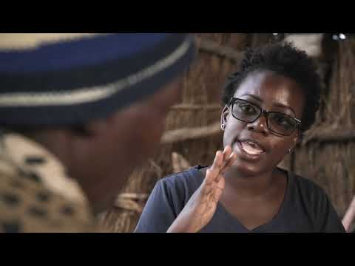
End TB Now
Global Fund Advocates Network Loyce Maturu, Advocacy Officer at Zvandiri
Notes:
Ken, Video - https://www.youtube.com/watch?v=2YR6nBG3994

Slide 13
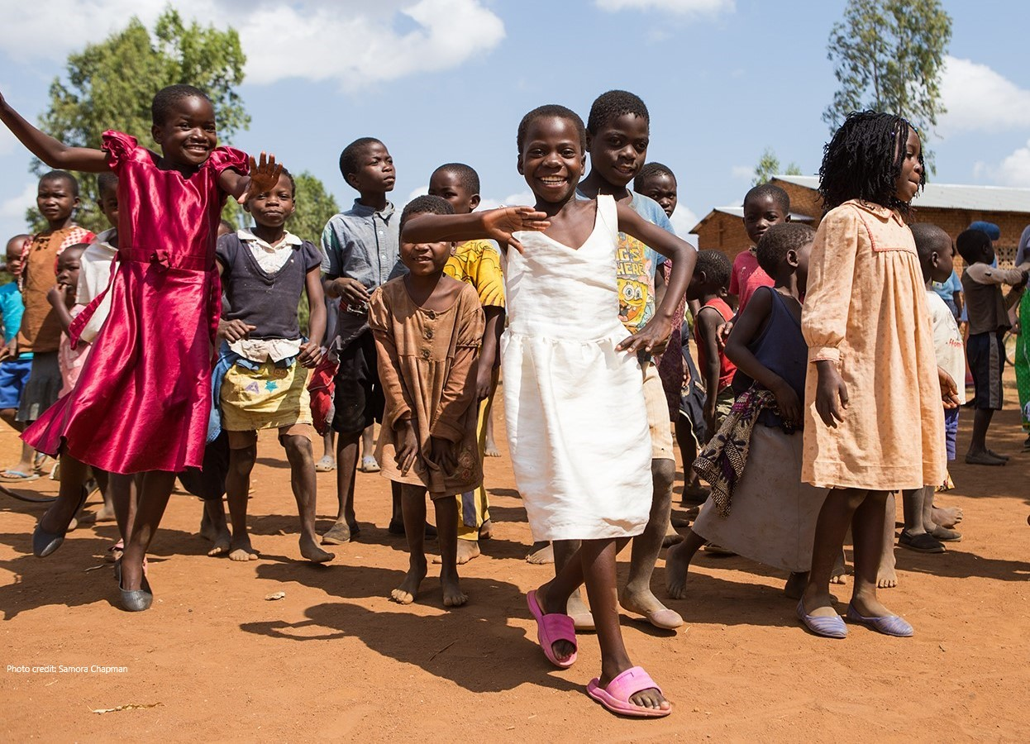
Grantee Spotlight
GAIA Malawi
Notes:
Grantee Spotlight - Chris GAIA in Malawi (Ruth Thurmond Scott on the board)

Slide 14
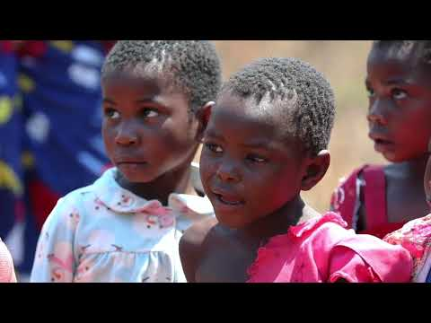
Grantee Spotlight
GAIA Malawi
Together with the communities it serves, GAIA, a secular nonprofit, develops innovative and caring healthcare programs in resource-deprived regions in Africa, especially those most affected by HIV/AIDS, tuberculosis, and malaria.
The purpose of the project is to fund 20 nurses (10 per year) in the fourth and final year of nursing school and to help their transition to careers as nurses. The first 10 graduated and transitioned in January 2020. Timing!!!
Notes:
Grantee Spotlight - Chris GAIA in Malawi (Ruth Thurmond Scott on the board)
video link - https://youtu.be/AFT54CQ1WPA

Slide 15
Thanks for your continued advocacy actions!!
Notes:
Karyne
Thank you everyone for taking prior actions over the last few months on our Fall 2022 global campaigns, including global malnutrition and most recently on global education with the READ Act Reauthorization. We’ve gotten lots of great feedback from you all who have contacted your Senators, working collectively all across your respective states. Thank you!

Slide 16
Sept. Advocacy Action
Let’s hit send!
End TB Now Act (S. 3386 / H.R. 8654)
Notes:
Karyne - taking action on End TB Now act
Sample email to foreign relations aides: https://results.org/wp-content/uploads/Together-Women-Rise-Sept.-Webinar-Sample-letters-to-Senate-Offices-End-TB-Now.docx

Slide 17
Check the Congressional scorecard of past support on Tuberculosis
Legislator Lookup
Personalize this sample letter to your Senator’s Foreign Policy aide
Hit send!
Follow up, Follow up, Follow up
Sept. Advocacy Action
Contact your representatives on H.R. 8654

Slide 18
Sept. Advocacy Action
Repeat steps 1 to 5 with your Senators and request cosponsorship of S. 3386

Slide 19
Want more coaching support to deepen your advocacy action?
Contact your mentors!
Anne Child
Karyne Bury
Ken Patterson
Leslye Heilig
Sarah Leone

Slide 20
UNGA in NYC - September 13 to 26 Learn more here.
Thursday, September 22 RESULTS Global Policy Forum, Register here.
Join us for our webinar next month: October 18 - 8:30 PM ET Bring a friend to take action with you!
Upcoming Events

Slide 21
Thank you for joining!

