Slide 1


September Webinar
September 14, 2023

Slide 2
Our Values & Resources
2
​At RESULTS we pledge to create space for all voices, including those of us who are currently experiencing poverty. We will address oppressive behavior in our interactions, families, communities, work, and world. Our strength is rooted in our diversity of experiences, not in our assumptions.
With unearned privilege comes the responsibility to act so the burden to educate and change doesn’t fall solely on those experiencing oppression. When we miss the mark on our values, we will acknowledge our mistake, seek forgiveness, learn, and work together as a community to pursue equity.
Read our full anti-oppression values statement here at results.org/values.
Check out the Anti-Oppression Workshop Schedule for training opportunities.
Find these resources and more at results.org/volunteers/anti-oppression:
  Resource Guides from our Diversity & Inclusion trainings, including:
    Interrupting Microaggressions
    Creating Space for Critical Conversations
  Information on how RESULTS responds to oppressive incidents

Slide 3
Tonight’s Webinar
Welcome and Introductions
Celebrations: Senate TB Letter
Keeping Momentum: TB in the Media, Making Local Connections & UN HLM Meeting
Advocacy Action
Closing
Notes:
Karyne

Slide 4
Senate TB Letter
Prioritizing the following five priorities:
  a measurable goal to reach everyone sick with TB with quality testing and treatment;
  specific, bold new financial commitments to close the global funding gap;
  priority for a human rights and a person-centered approach to the pandemic;
  faster development and broad access to new tools, including diagnostics, treatments, and vaccines; and
  commitment to ongoing high-level accountability against the declaration’s
Notes:
Updates on Senate TB Letter to the Biden Administration (Karyne)

Slide 5

Senate TB Letter
Closed with just over 1/3 of the Senate signed on! (34 Senators)
Lead Senators were Senators Sherrod Brown (D-OH) and
Todd Young (R-IN)
Check out this link to the final letter here.
Photo Courtesy: Oskars Sylwan (Unsplash)

Slide 6
Senate TB Letter
Signers:
Brown, Young, Markey, Feinstein, Coons, Tillis, Klobuchar, Cantwell, Murray, Kaine, Booker, Padilla, Reed, Warren, Rosen, Duckworth, Cardin, Van Hollen, Casey, Capito, Hickenlooper, Manchin, Shaheen, Whitehouse, Lujan, Hirono, Merkley, Sanders, Warner, Menendez, Peters, Blumenthal, Murkowski, and Fetterman.
Notes:
https://results.org/wp-content/uploads/Tuberculosis-UN-High-Level-Meeting-Senate-Dear-Colleague-FINAL.pdf

Slide 7
Asks on TB Right Now
Ask Reps and Senators to cosponsor the End TB Now Act and speak to House/Senate leadership about passing it ASAP.
Tip: Leverage your work on the House and Senate TB sign-on letters:
Share final letter and thank those who signed. Ask them to cosponsor End TB Now Act and speak to leadership.
Share final letter with those who didn't sign as well and let them know they can still make a difference on TB by cosponsoring the End TB Now Act.

Slide 8
Progress on End TB Now Act
(S. 288/ H.R. 1776)
Passed House Foreign Affairs Committee & Senate Foreign Relations Committee!
More co-sponsors = more support to move bill to floor for a vote in both chambers
Current co-sponsors, congressional scorecard
Rep signed House letter? Ask them to co-sponsor the bill! Any Global Fund or TB action!
Notes:
Karyne

Slide 9
End TB Now Act (S.288, H.R.1776)
Requires the U.S. to establish bold goals for reaching the most vulnerable populations
Strengthens U.S. bilateral coordination to develop comprehensive global TB response
Catalyzes support for TB research and development (R&D)
Improves TB capacity of high-burden countries & affected communities
Requires annual report to Congress on U.S. TB activities and impact
Evaluates the performance of TB programs that are supported by U.S.

Slide 10

UN High-Level Meeting on TB
September 22, 2023

Slide 11
TB in the Media
8/28/23: NY Times: "We Thought We'd Beat These Three Diseases, But They Are Still Killing Us."
Article reminds us that we ended smallpox, but we still have malaria, TB, and polio to end. And somehow, ending diseases has been politicized. We're also less concerned about diseases not affecting us, even though we can end them (like TB). There are new tools in development that can help us, like GeneXpert, better drugs, shorter treatments.
"The lack of determination is really the stumbling block." "But donors still fall short by more than half on the funding the W.H.O. says it needs to end the TB epidemic by 2030"
Notes:
Ken

Slide 12
TB in the Media
8/28/23: NY Times: "We Thought We'd Beat These Three Diseases, But They Are Still Killing Us."
"Until we get the job done, we need to have a broader sense of what “our share” could yet entail: Up to 13 million Americans currently live with latent TB infection, according to estimates from the Centers for Disease Control and Prevention. The realities of modern travel mean that none of us is protected from a TB resurgence until we have protected people everywhere."
"Appealing only to our selfishness, though, is a mistake. What we need is a powerful sense of our shared humanity in the fight against some of our most ancient killers, and the courage and determination to win this fight now."
Notes:
Ken

Slide 13
TB in the Media
Stop TB’s Global Drug Facility Announces Historic Price Reductions up to 55% for Bedaquiline, a Life-Saving Drug to Treat Drug-Resistant TB (Stop TB)
An investigational TB vaccine candidate (M72/AS01E) was found to be significantly protective against TB disease in a Phase IIb trial conducted in Kenya, South Africa and Zambia, in individuals with evidence of latent tuberculosis infection. The point estimate of vaccine efficacy was 50% over approximately three years of follow-up (Lancet)
Among family members living with a person with active lung TB, improving nutrition resulted in a 40 to 50% reduction in new TB cases. (Forbes)
Notes:
Ken

Slide 14
Making the Local Case for TB
TB cases in your state: check your state department of health and the CDC for data:
      --https://www.cdc.gov/tb/default.htm
      --https://www.cdc.gov/tb/statistics/default.htm
Does your states university system have involvement in global health? Research? Vaccines? It's worth sharing your state's connection to global health.
Notes:
Ken

Slide 15
Advocacy Action
Notes:
Ken

Slide 16

Let’s take action!
Notes:
Karyne

Slide 17
Next Steps: Choose your own adventure…
Send a follow up email or make a phone call on the End TB Now Act
Inform other RPCVs in your network about the impact of TB in
your country of service and how they can make a difference through advocacy (online action)
Write a letter to the editor (LTE) or other media
Notes:
Karyne
Resources:
Congressional Scorecard - https://docs.google.com/spreadsheets/d/1QF2HKawtGx1kYYfYwGibPpKKnFs0jmX5-RxcpWyEpsk/edit#gid=2081581321
Legislator Lookup - https://results.org/volunteers/legislator-lookup
Sample email (Sept 2023) - https://docs.google.com/document/d/1Vw8OGsFb6kdvpEZAguWWBT14GCsZkj_YAtCPl2fH4UA/edit
Share - https://results.org/volunteers/action-center/action-alerts?vvsrc=%2fcampaigns%2f97042%2frespond

Slide 18

Global policy
Our Fall Goal
Congress prioritizes equity and impact in the fight against global poverty
Notes:
Do we want to preview this at the end of the call??

Slide 19
Equity & Impact
Who does it reach? Who gets left out?
Are we working in partnership?
How is funding delivered?
Are interventions based on evidence?

Slide 20
Part 1
How the U.S. government spends money and designs programs
Part 2
How the World Bank spends money and designs programs

Slide 21



Global Advocacy Campaigns
Malnutrition Prevention & Treatment Act
The End
Tuberculosis Now Act
The
READ Act

Slide 22
Asks on TB Right Now
Ask Reps and Senators to cosponsor the End TB Now Act and speak to House/Senate leadership about passing it ASAP.
Tip: Leverage your work on the House and Senate TB sign-on letters:
Share final letter and thank those who signed. Ask them to cosponsor End TB Now Act and speak to leadership.
Share final letter with those who didn't sign as well and let them know they can still make a difference on TB by cosponsoring the End TB Now Act.

Slide 23
Asks on READ Act Right Now
READ in the House: Ask Reps. to cosponsor the READ Act and speak to Foreign Affairs leadership (McCaul, Meeks) about moving the bill out of committee ASAP.
READ in the Senate: Ask Senators to cosponsor READ Act and speak to Senate leadership about passing it ASAP.

Slide 24

Global Allies Program Coaching Support
Sign up for additional coaching support between webinars!
https://results.salsalabs.org/globalalliesprogram
Notes:
Sign Up - https://results.salsalabs.org/globalalliesprogram

Slide 25
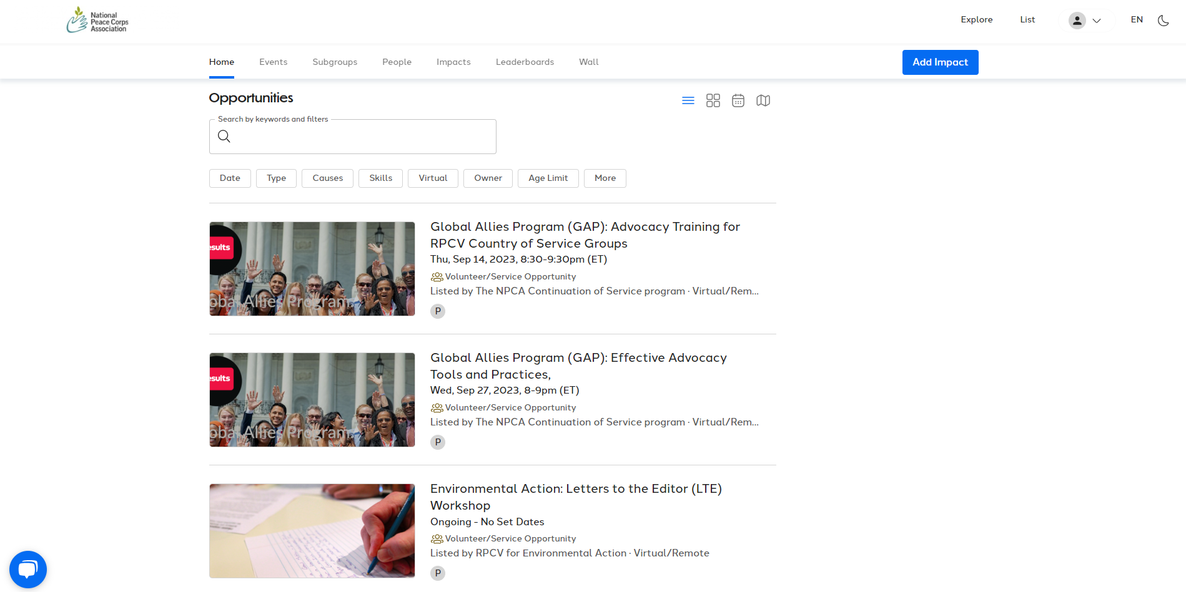
Additional Volunteer Opportunities
Notes:
GivePulse, opportunity to learn about additional volunteer opportunities with Peace Corps Affiliate groups, including ours! Sign up and research opportunities here: https://npca.givepulse.com/group/860706-the-npca-continuation-of-service-program

Slide 26

Notes:
Sign Up - https://results.salsalabs.org/globalalliesprogram

Slide 27
- Next GAP Webinar: October 12, 8:30 PM ET
Register here: https://bit.ly/GAP2023Webinars
- RESULTS Global Policy Forum, September 21 at 9:00 PM ET
We will be going live from the UN High Level Meeting in New York
Register here.
- Effective Advocacy Tools and Practices
Advocacy Training for Country of Service Groups
September 27, 8:00PM ET
Learn more and register here.
Upcoming Events

Slide 28
Thanks for
joining us tonight!

