Slide 1


Securing the Future: Turning Vaccine Progress into Policy Impact
April 15, 2026

Slide 2

Welcome
Please let us know in the chat where you are joining us from!

Slide 3
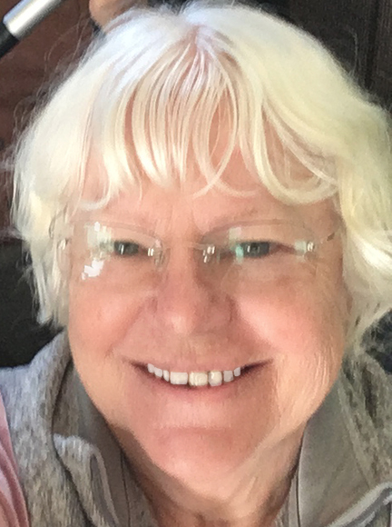
Susan Wright Chair Together Women Rise Advocacy Chapter

Slide 4
Mission & Vision
Together Women Rise’s Mission Together Women Rise cultivates the collective power of community to achieve global gender equality.
OUR VISION Together Women Rise envisions a world where every person has the same opportunities to thrive regardless of their gender or where they live. Rise Anti Oppression Commitment:
At Together Women Rise, we come together as a community dedicated to equality and justice for women and girls everywhere. Read full statement here.

Slide 5

Karyne Bury
Manager Grassroots Team RESULTS

Slide 6

Global Allies Program: Partners Ending Poverty with RESULTS
Cause Related Affiliate Group of NPCA.
Gain advocacy skills in support of global health, education, and economic development.
Open group, no paid membership, everyone welcome!
Notes:
Karyne

Slide 7
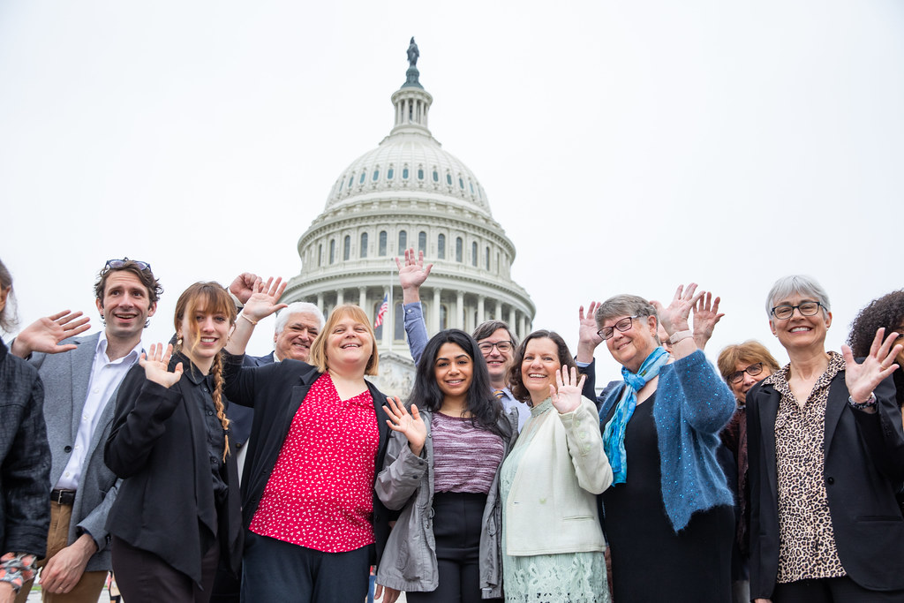
RESULTS is a movement of passionate, committed, everyday people. Together, we use our voices to influence political decisions that will bring an end to poverty.
Read our full anti-oppression values statement at results.org/values.
.
Notes:
Karyne

Slide 8
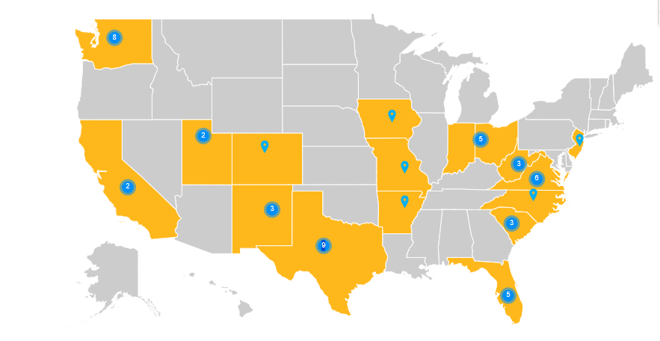
52 meetings
48 offices
Senate: 19 House: 28
(1 candidate)
As of April 14, 2025

Slide 9
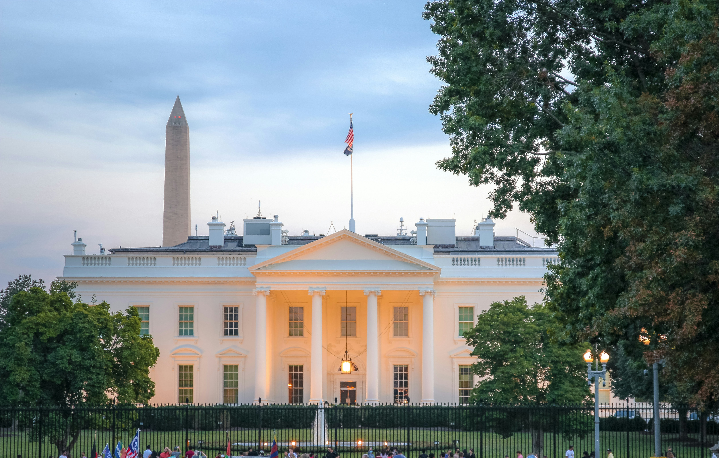
President's budget targets health & poverty programs for cuts in FY27. Congress must reject them (RESULTS Blog, April 10, 2026)

Slide 10
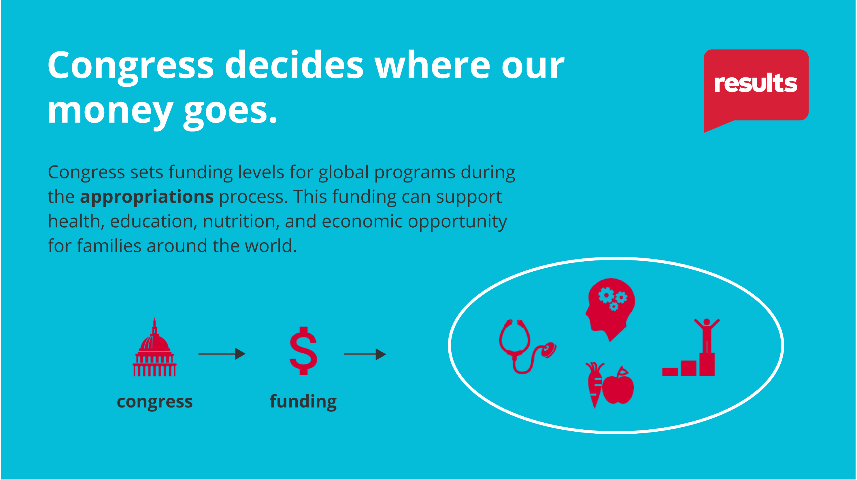
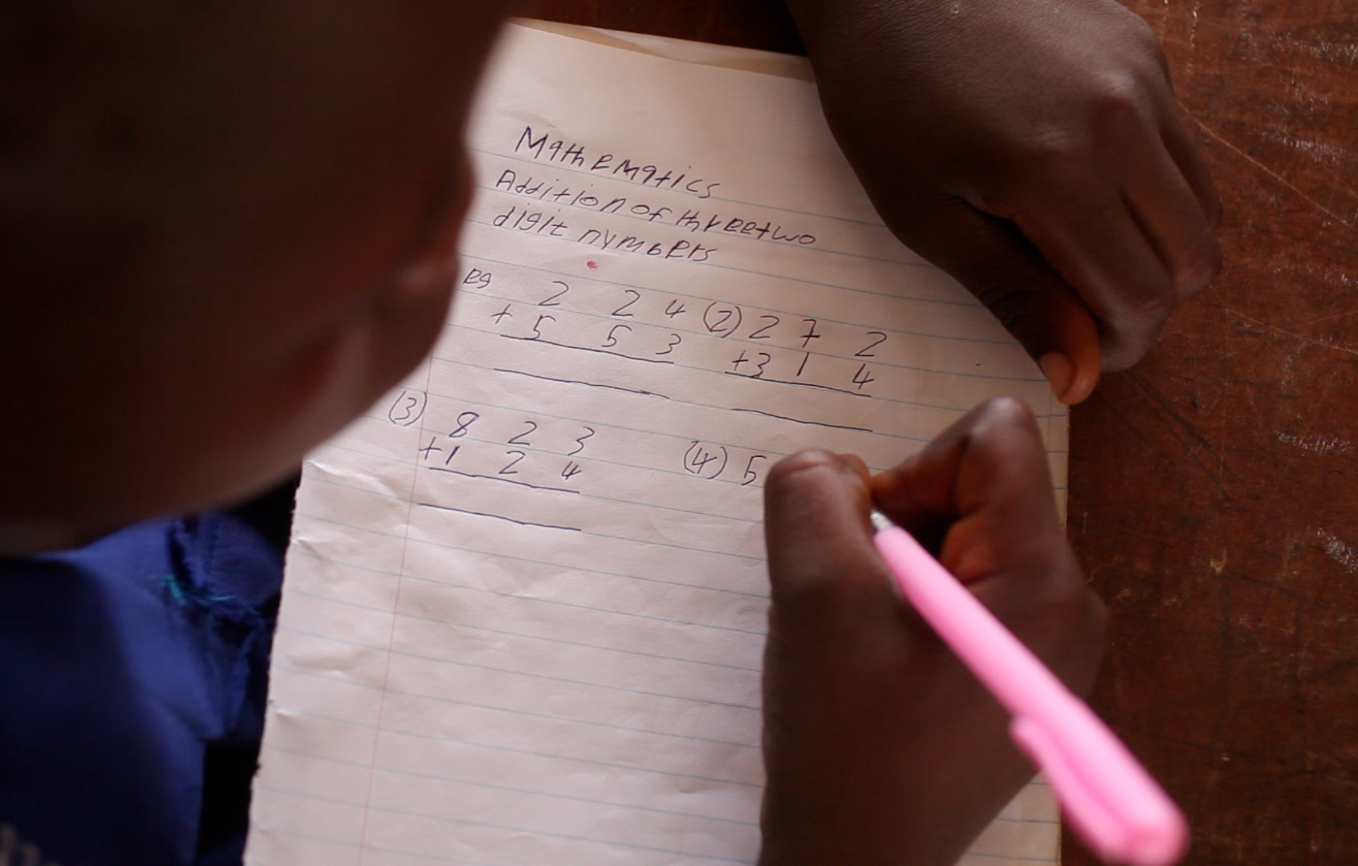
The U.S. must raise its hand for global education
This July, the UK and Kenya are co-hosting GPE’s replenishment conference. The global goal for the next 5-year strategic period is $5 billion. The U.S. should provide $1 billion over 5 years toward that goal.
Photo credit: GPE/Stephan Bachenheimer, via Flickr

Slide 11
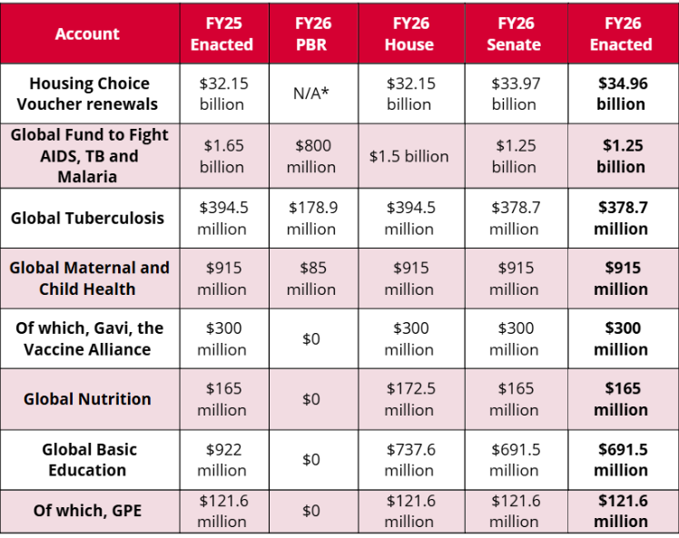
Notes:
Final FY26 Budget (February 2026)

Slide 12
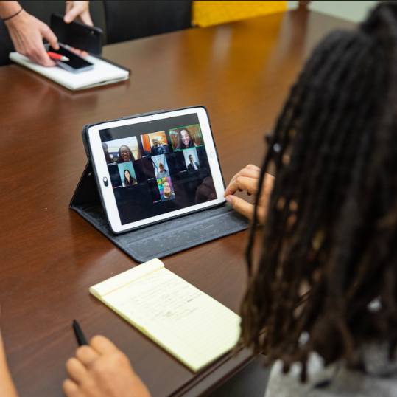
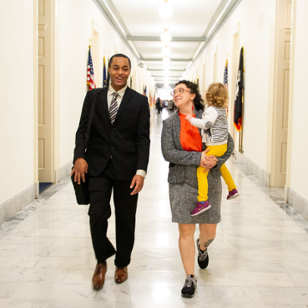
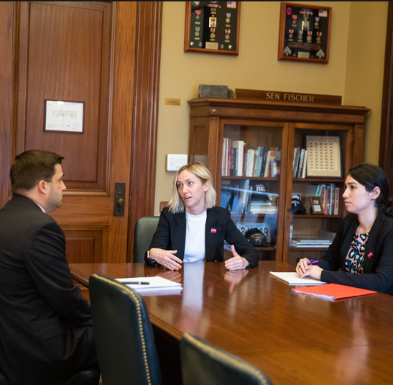
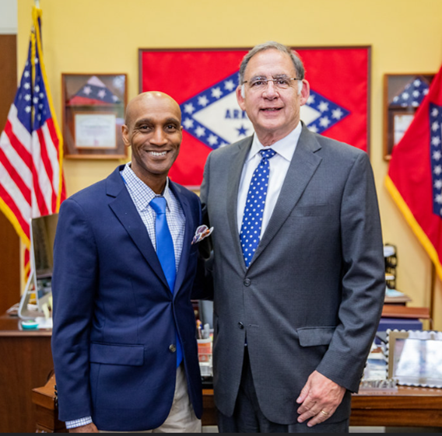
Advocacy still matters!

Slide 13
Account | FY25 Enacted | FY26 House | FY26 Senate | FY26 Enacted | FY27 Requests
Housing Choice Vouchers | $32.15 billion | $32.15 billion | $33.97 billion | $34.96 billion | Fully renew + add 250,000 new vouchers
Global Fund to Fight AIDS, TB and Malaria | $1.65 billion | $1.5 billion | ------ | $1.25 billion | $1.53 billion
Global Tuberculosis | $394.5 million | $394.5 million | ------ | $378.7 million | $1 billion
Global Maternal and Child Health | $915 million | $915 million | ------ | $915 million | $1.15 billion
Of which, Gavi, the Vaccine Alliance | $300 million | $300 million | ------ | $300 million | $340 million
Global Nutrition | $165 million | $172.5 million | ------ | $165 million | $300 million
Global Basic Education | $922 million | $737.6 million | ------ | $691.5 million | $970 million
Of which, GPE | $121.6 million | $121.6 million | ------ | $121.6 million | $150 million

Slide 14
FY27 House Dear Colleague Letters
Global Fund:
171 signers
9 Republicans (+2)
Tuberculosis:
133 signers
7 Republicans (-1)
MCH, Gavi, Nutrition:
118 signers
9 Republicans (+3)
Basic Education, GPE:
110 signers
4 Republicans (+3)

Slide 15
Senate Dear Colleague Letters
FY27 Senate Tuberculosis Dear Colleague
Bipartisan letter led by Sens. Todd Young (R-IN) and Jacky Rosen (D-NV)
Asks appropriators for increased funding for bilateral TB programs
Deadline: TBD
Coming soon:
FY27 Senate Global Fund to Fight AIDS, TB and Malaria
FY27 Senate Maternal and Child Health, Gavi, and Nutrition
FY27 Senate Basic Education and GPE

Slide 16
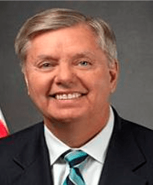
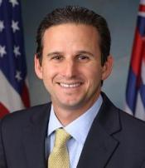
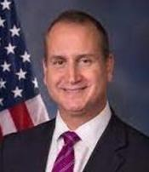
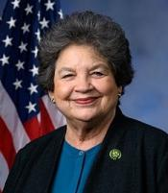
Leadership of the State, Foreign Operations, and Related Programs Subcommittee of Appropriations (SFOPS)
U.S. Senate
U.S. House
Lindsey Graham (R-SC)
Chairman
Brian Schatz (D-HI)
Ranking Member
Mario Diaz-Balart (R-FL)
Chairman
Lois Frankel (D-FL)
Ranking Member
Photos via Wikimedia Commons

Slide 17
What are the key actions?
Submit official Senate appropriations request forms. This urges offices to include our asks in their submissions to Appropriations subcommittees.
Deadlines for Senators to submit: April 20 (T-HUD), April 30 (SFOPS)
Send Senate offices "Dear Colleague" letters.
The more bipartisan signers, the stronger the message.

Slide 18
FY27 Appropriations Resources
FY27 Appropriations form cheat sheets and leave behinds: https://results.org/resources/fy27-appropriations-memos
FY27 Dear Colleague letters: https://results.org/blog/fy27-appropriations-tell-congress-to-fund-the-fight-against-global-poverty
Build a Better Future campaign page: https://results.org/2026-campaign
Find links to lobby meeting requests, laser talks, and more!
Understanding Appropriations: https://results.org/resources/understanding-appropriations

Slide 19
Humanitarian Funding
New FY27 request: $6.5 billion for International Humanitarian Assistance
Can be included in your Senate Member forms and any follow up with congressional offices on FY27 appropriations
Cheat sheet and leave-behind now available: https://results.org/resources/fy27-appropriations-memos

Slide 20

Dorothy Monza RESULTS Global Policy Team
Notes:
Dorothy with share her slides

Slide 21
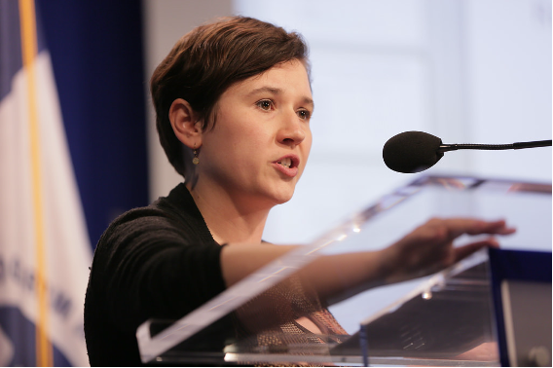
Guest Speaker
Chloe Cooney Director, U.S. Strategy
Gavi, The Vaccine Alliance

Slide 22
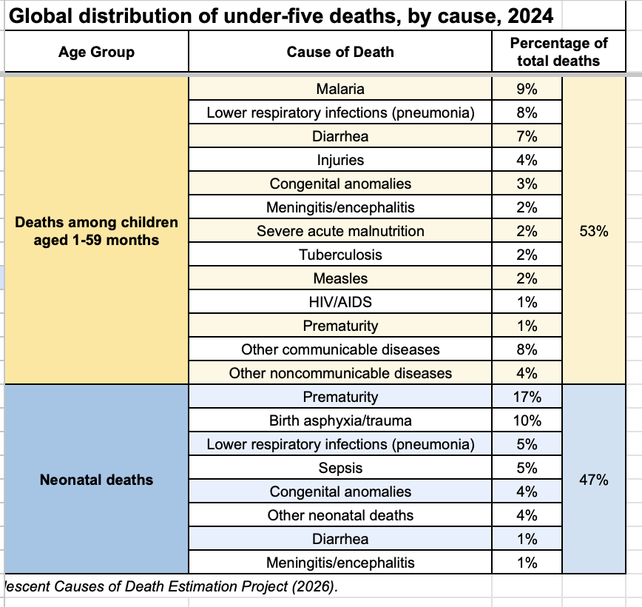
Why this matters
Notes:
Dorothy

Slide 23
The Advocacy Trifecta
Media
Congress
Community

Slide 24


Slide 25
Why Media?
Cut through the noise!
Grabs attention of the community (fellow constituents!)
Thank or call out your member of Congress.
Leverage published media during lobby meetings.

Slide 26
Amplify Every Voice Media Campaign
Every volunteer submits at least one media piece (LTE, Op Ed) between now and July.
Every group invites others to submit media: new volunteers, action network members, and local partners.

Slide 27
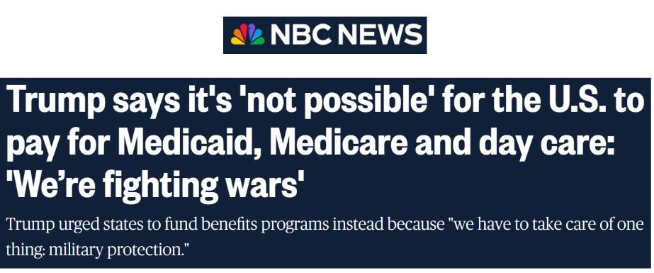
Getting Started: Find a hook

Slide 28
Getting started: Find a hook
Mark important dates and observances:
April 7: World Health Day
April 11-17: Black Maternal Health Week
April 15: Tax Day
April 24-30: World Immunization Week

Slide 29

World Immunization Week 2026
April 24 – April 30

Slide 30

Tips for writing LTEs
Keep it short, 150 to 200 words.
Personalize it – why is this issue important to you? Your district? Your state?
Mention your members of Congress by name in your letter.
Photo by Glenn Carstens-Peters at Unsplash.com

Slide 31
EPIC Format makes an epic LTE
Use the EPIC format structure
Engage (Hook)
Problem
Inform on Solution
Call to action for the reader or your members of Congress

Slide 32
Media resources
Working with Media page
Find LTE templates at the RESULTS Action Center
Media & Democracy Project: Journalism Directory
LTEs & Op Eds published by RESULTS Volunteers

Slide 33
Media Office Hour
Wednesday, April 22, 2-3 p.m. ET
Grassroots media is a powerful tool to influence lawmakers and strengthen democracy. If you need help brainstorming, writing, editing, or submitting a media piece, RESULTS staff welcomes you to bring your questions to this open office hour.
Join via Zoom at https://results.zoom.us/j/91601524175
or dial (312) 626-6799, meeting ID 916 0152 4175.

Slide 34
Join our community of changemakers! https://tinyurl.com/JoinRiseAdvocacy

Slide 35

Register: https://togetherwomenrise.org/event/2027-featured-grants-information-session-1/

Slide 36

2026 RESULTS National Conference

Slide 37


Slide 38
2026 Webinars: Save the Date
Join our next quarterly webinar
July 22 at 8:00 PM ET

Slide 39
Thank you!

Slide 40

HPV & Cervical Cancer
In 2022, more than one woman died every two minutes from cervical cancer (nearly 350,000)
More than 90% of them were in low- and middle-income countries
HPV vaccine can prevent 90% of all cervical cancer cases

Slide 41
2025 BIG WIN: HPV
By the end of 2025, with Gavi’s support, 53 countries will have national, public HPV programs
Goal for Gavi 6.0 (2026-2030)—support more than 120 million girls to be vaccinated, saving more than 1.5 million lives

Slide 42
2025 BIG WIN: Malaria & Market Shaping
A new deal lowering the price per dose of malaria vaccines will generate up to 90 million in savings, equivalent to nearly 30 million doses
Over the next 5 years, nearly 7 million children will be fully vaccinated against malaria, for no additional cost

Slide 43
2025 BIG WIN: HIV
Global Fund working with Gilead and partners for breakthrough HIV prevention drug, Lenacapavir (2x yearly injection)
For the first time, a new HIV medicine is reaching communities in sub-Saharan Africa in the same year as its US approval
First shipments to Eswatini and Zambia

