Slide 1
SaverLife’s CTC Findings
Impacts on Financial Security: Voices of Families and Households
Danielle Bautista | Senior Policy Associate

Slide 2
The SaverLife Community
82%
women
$31K
average income
82%
Do not have a college degree
60%
BIPOC

Slide 3
How members used the CTC

Slide 4
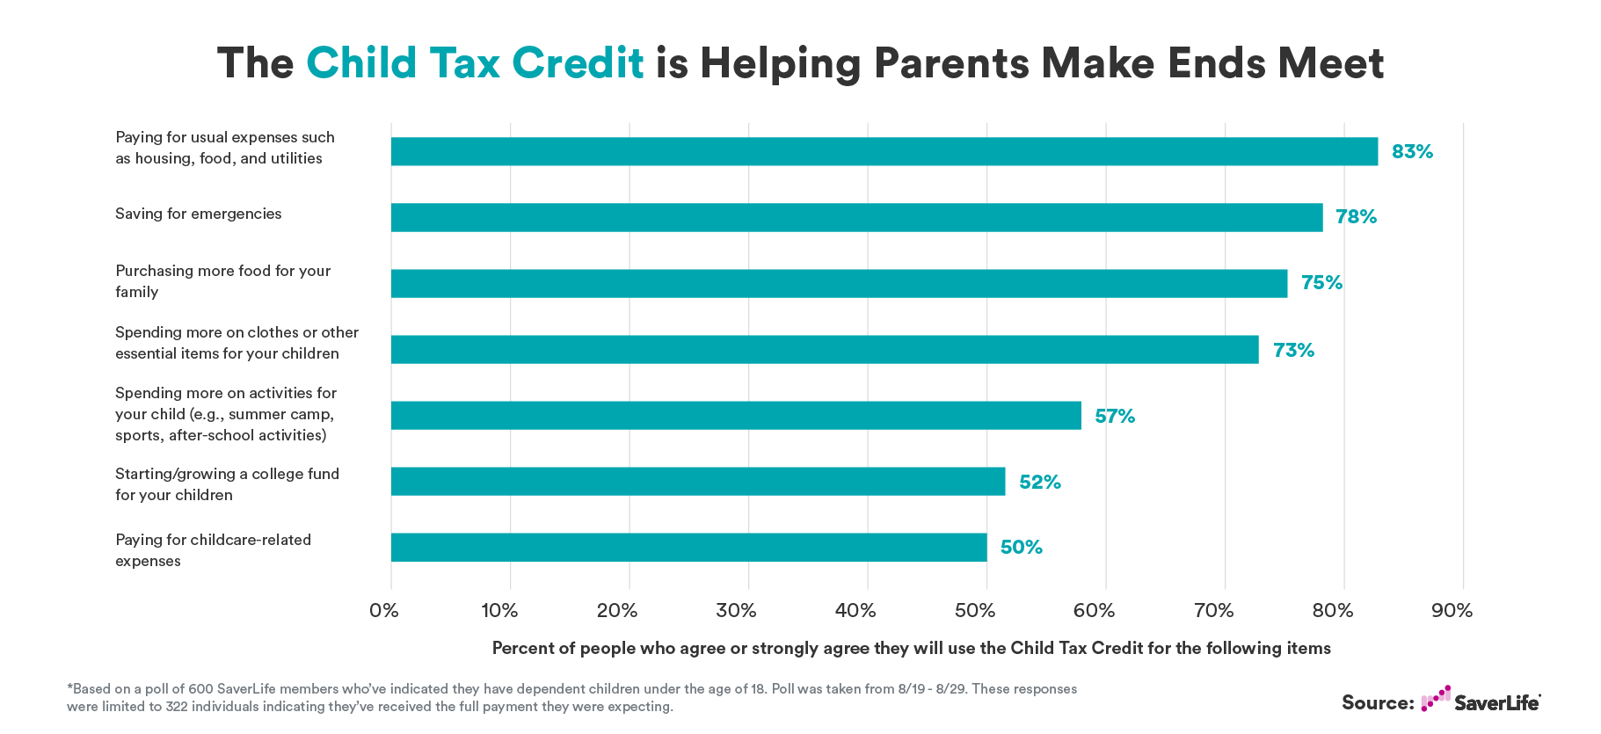

Slide 5
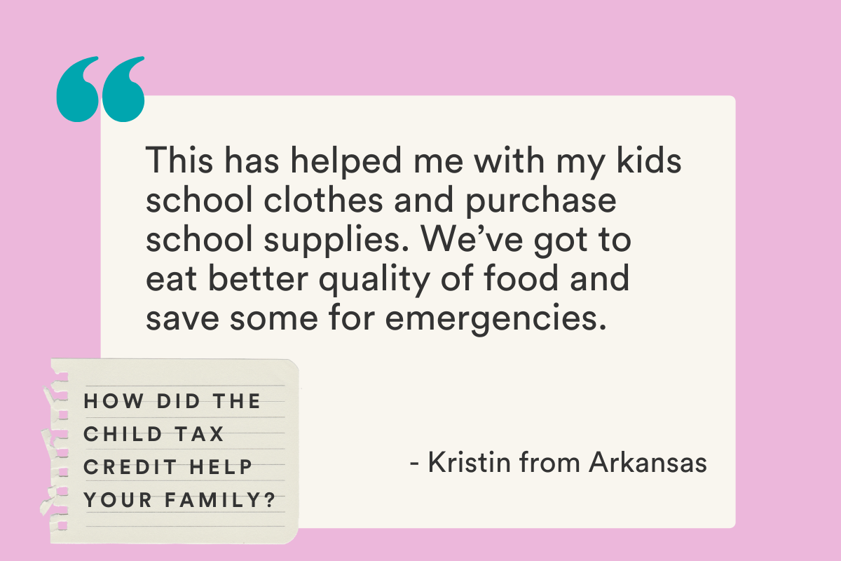
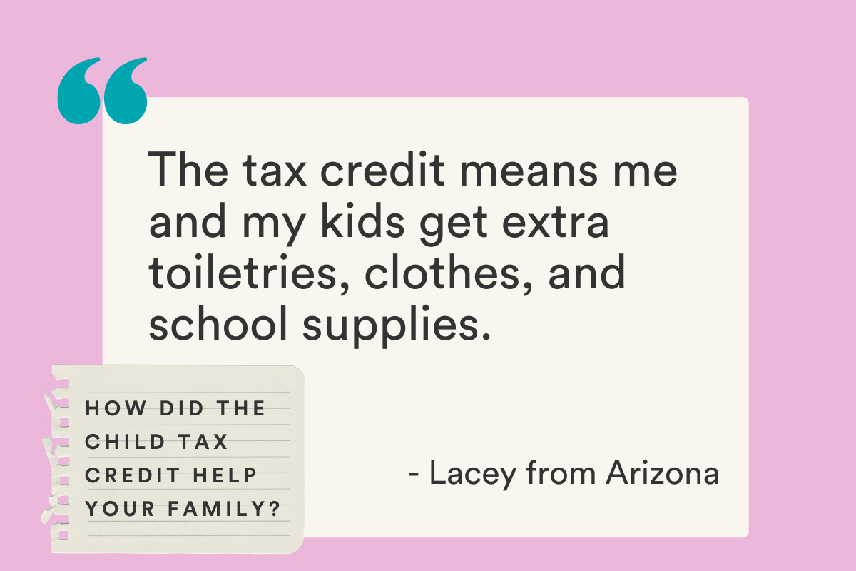

Slide 6
Staying afloat
“The CTC helps you set your kid up for success, whether it is for [a] future down payment on [my daughter’s] house, future educational pursuit, or anything she wants to do, [my daughter] has that cushion.”
— Gabriella, Nevada
CTC payments helped families pay their bills. In a recent poll of CTC recipients, 49% said since receiving CTC payments, they are “much more likely to pay them {utility bills} on time and in full.”*
* Based on 123 survey responses collected between 12/16/21 and 1/1/22.

Slide 7
The CTC and Housing

Slide 8
Background
We surveyed our members in January 2022 and found that over half our members were spending more than 30% on housing, which is consistent with 2021 SHED data*
32% spent between 30-50% of their income on housing
19% spent over half of their income on housing
Since July 2021
30% received an eviction notice
24% stayed with a friend or relative while looking for housing
11% used a hotel, motel, or shelter as temporary housing for financial reasons
*Survey of Household Economic Decisionmaking (SHED)
*Based on 543 responses collected between 1/25 and 1/28

Slide 9
SaverLife member Tiffaney said housing is her biggest monthly expense
Prior to July 2021, the rent for her two-bedroom, two-bathroom apartment cost $1,385. Last summer, her rent increased to a staggering $2,100.
2021 median rent in FL for a 2BR: $1,321 (RentData.org)
2022 median rent in FL for a 2BR: $1,530 (RentData.org)

Slide 10
Background
SaverLife recently partnered with Commonwealth to develop a deep dive tax refund + CTC overview
Over half said their tax refund—which includes the remainder of the CTC—will make it more likely that they’re able to make full housing payment

Slide 11
“I used much of my tax refund to make advanced mortgage payments. Actually, I’ve paid my mortgage through September 2022 in preparation for a rainy day.” — Gabriella, Nevada

Slide 12
Looking to the future

Slide 13
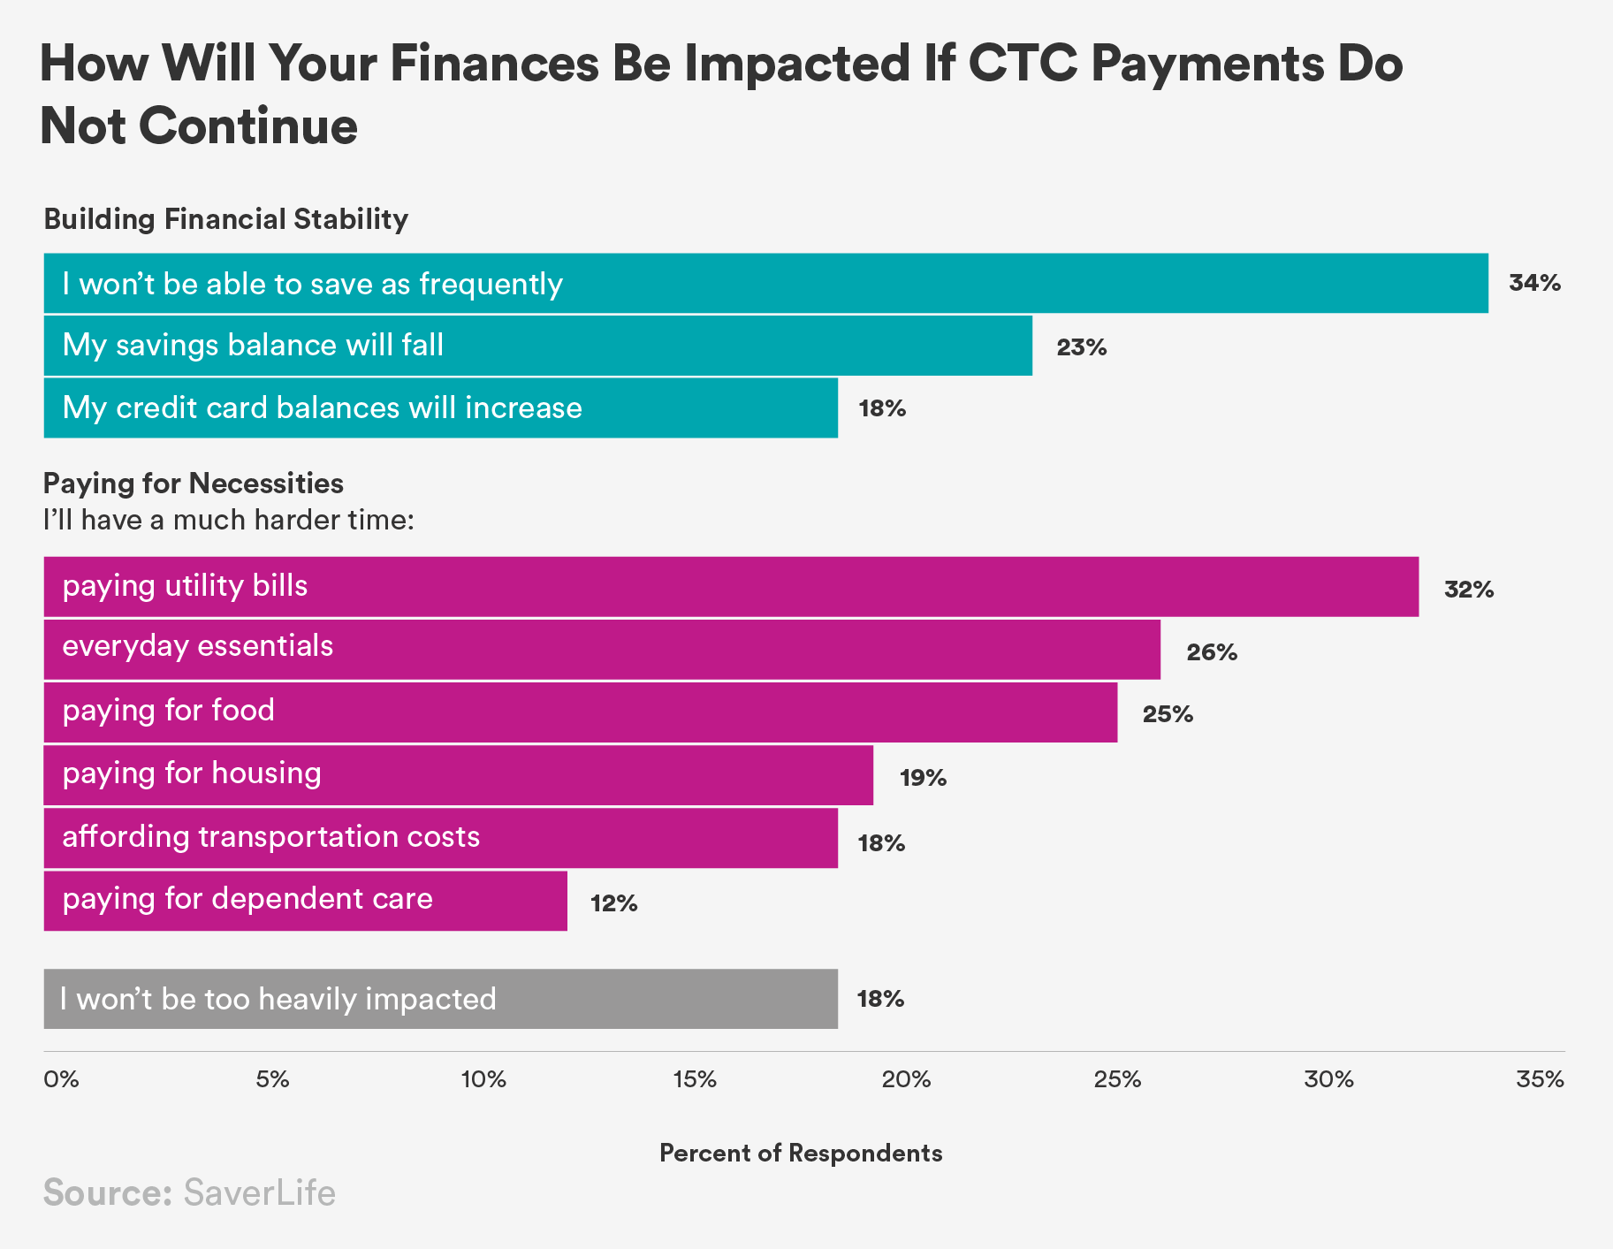

Slide 15
Looking to the future
The Child Tax Credit should remain fully refundable
Offering monthly payments makes sense because these regular payments meet families’ monthly needs
Statewide CTC efforts are underway, but millions more would benefit from a federally expanded CTC
Read SaverLife’s full, 6-month overview report here

Slide 16
Thank you
Danielle Bautista, Senior Policy Associate at SaverLife
danielle@saverlife.org

