Slide 1
February 2025 Webinar: The State of Foreign Aid & Its Impact on Women and Girls
February 18, 2025
Notes:
Susan

Slide 2
Welcome
Please let us know in the chat where you are joining us from! Is this your first time to advocate for foreign aid?
Notes:
8:30-8:34 PM: Welcome/Introductions (Susan)

Slide 3
Mission & Vision
Together Women Rise’s Mission Together Women Rise cultivates the collective power of community to achieve global gender equality.
OUR VISION Together Women Rise envisions a world where every person has the same opportunities to thrive regardless of their gender or where they live. Rise Anti Oppression Commitment:
At Together Women Rise, we come together as a community dedicated to equality and justice for women and girls everywhere. Read full statement here.
Notes:
Susan
Together Women Rise:
Vision
Together Women Rise envisions a world where every person has the same opportunities to thrive regardless of their gender or where they live.
Gender Equality Beliefs
Together Women Rise champions gender equality because women’s rights are human rights. When women and girls are treated equally, the world is healthier, safer, more peaceful, inclusive, and economically just for everyone.
https://togetherwomenrise.org/our-anti-oppression-commitment/

Slide 4
Our Values & Resources
​At RESULTS we pledge to create space for all voices, including those of us who are currently experiencing poverty. We will address oppressive behavior in our interactions, families, communities, work, and world. Our strength is rooted in our diversity of experiences, not in our assumptions.
With unearned privilege comes the responsibility to act so the burden to educate and change doesn’t fall solely on those experiencing oppression. When we miss the mark on our values, we will acknowledge our mistake, seek forgiveness, learn, and work together as a community to pursue equity.
Read our full anti-oppression values statement here at results.org/values.
Notes:
Susan
RESULTS Anti-Oppression Statement: https://results.org/volunteers/anti-oppression
Hello everyone, my name is Karyne Bury and I am a manager with RESULTS Grassroots Impact Team who has had the pleasure in supporting the growth and vision for the Together Women Rise Advocacy Chapter, working alongside chairs Susan Wright and Margaret Moodian and previously with our past chair, Leslye Heilig.

Slide 5
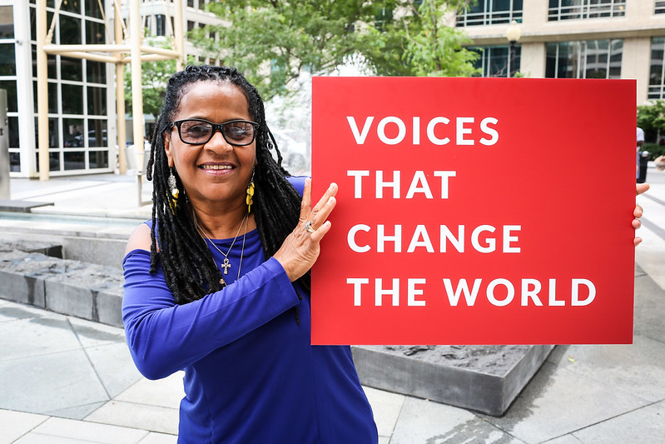
RESULTS is a movement of passionate, committed, everyday people. Together, we use our voices to influence political decisions that will bring an end to poverty.

Slide 6
Together Women Rise Transformation Partnership
Chris Jochnick President & CEO of Landesa

Slide 7
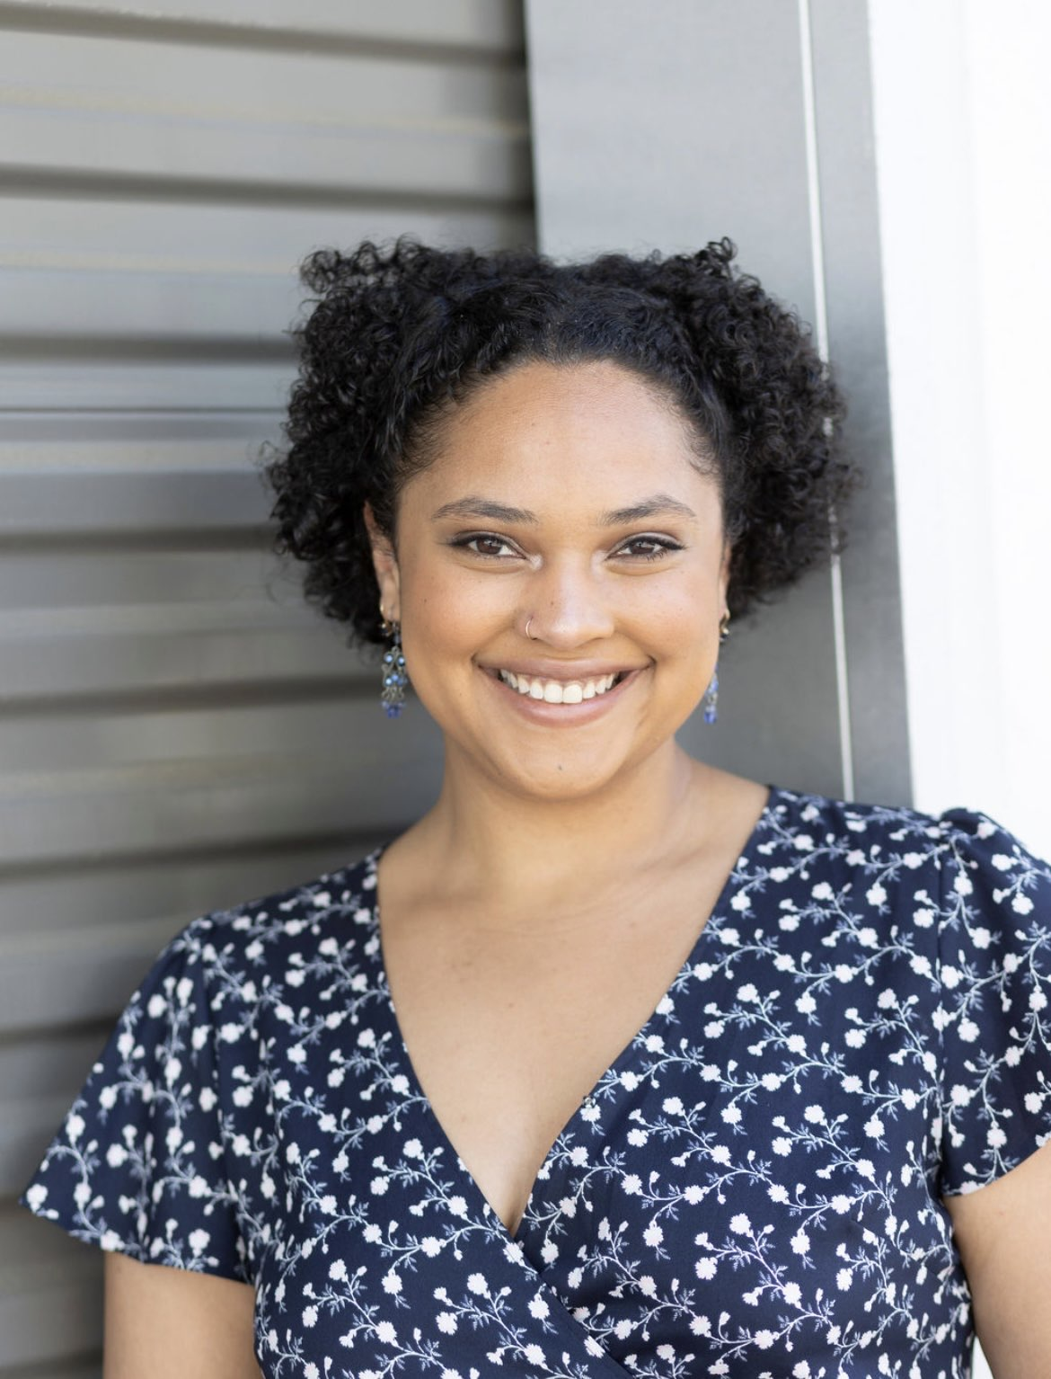
Dorothy Monza Global Nutrition & Child Health Policy RESULTS
Notes:
8:45 - 9:05 PM: Impact of Foreign Aid Cuts on Women & Girls (Dorothy)
What is USAID? Why was it created? What benefit has it had on US foreign relations? https://vimeo.com/1052680025?share=copy#t=0
How have the executive orders impacted development programs which support women and girls?
What are we doing about it?
What has been Please put in the chat with your name, where you are joining from, and whether this is your first time to join the advocacy efforts of Rise or RESULTS,
saying? Rs and Ds? Examples of the messaging from R’s who have spoken out in support of USAID and foreign aid
Such as the USAID news conference* (Jaime Raskin press conference) can share link in chat https://www.youtube.com/watch?v=m_KPogja_DE
What is the most important thing for advocates and the global community to gather from this moment?
* Transition to Dorothy’s Slides*

Slide 8
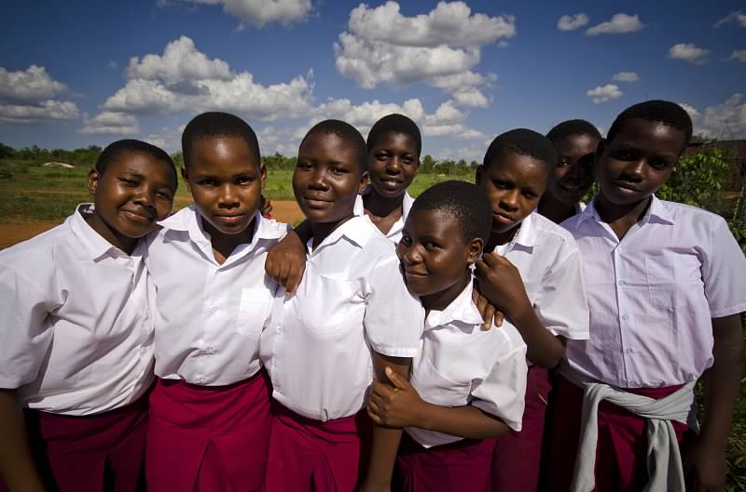
Featured Grantee
Polly Dolan, Co-Founder Nurturing Minds (The Sega Girls’ School)

Slide 9
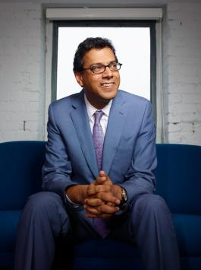
“…there is always a way forward” Dr. Atul Gawande RESULTS National Webinar (February 1)
Notes:
Karyne

Slide 10
Advocacy Action
Contact your members of Congress, request that:
End the stop-work order, and reinstate critical programs and staff to carry them out.
Push the State Department to verify that programs under the waiver have restarted, and expand the waiver to all global health and development programs.
Ensure Congress is involved in shaping the future of foreign aid — standing up for programs that are focused on ending poverty and creating good health, and committed to humanitarian and lifesaving impact.
Notes:
Karyne

Slide 11
Take action now!
Notes:
Karyne
Screenshare of RESULTS Action center ( (chat monitors can drop direct link into chat)

Slide 12
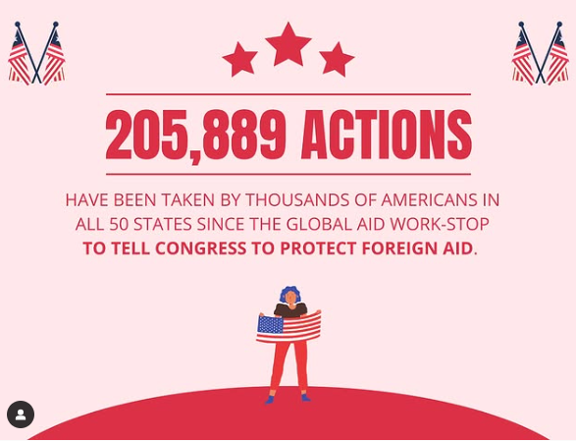

Slide 13
Invite others to join us in
changing the world together!
Sign up here: http://tinyurl.com/JoinRiseAdvocacyChapter
Notes:
Leslye
If you would like to learn more and take action with us, we would like to invite you to fill out our sign up, Karyne will drop it in the chat http://tinyurl.com/JoinRiseAdvocacyChapter Karyne drop the link to sign up in the chat

Slide 14
Next Meeting Together Women Rise Advocacy Chapter Tuesday, March 18 at 8:30 PM ET
Save the Date!
Notes:
Karyne

Slide 15
Legislator Look Up

Slide 16
Congressional Scorecard

Slide 17
RESULTS Bill Tracker Congress.gov

