Slide 1


Rise Advocacy Chapter
Monthly Webinar
July 15, 2025
Notes:
Susan

Slide 2

Welcome
Please let us know in the chat where you are joining us from!

Slide 3
Mission & Vision
Together Women Rise’s Mission
Together Women Rise cultivates the collective power of community to achieve global gender equality.
OUR VISION
Together Women Rise envisions a world where every person
has the same opportunities to thrive
regardless of their gender or where they live.
Rise Anti Oppression Commitment:
At Together Women Rise, we come together as a community dedicated to equality and justice for women and girls everywhere. Read full statement here.

Slide 4
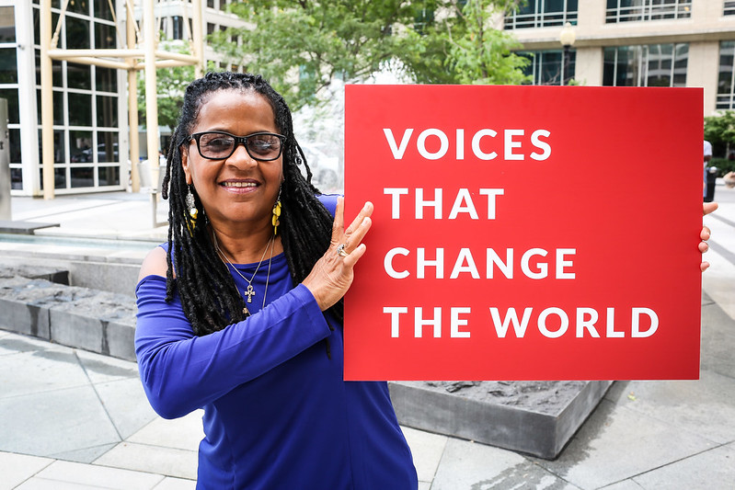
RESULTS is a movement of passionate, committed, everyday people. Together, we use our voices to influence political decisions that will bring an end to poverty.
Notes:
Karyne

Slide 5
Our Values & Resources
​At RESULTS we pledge to create space for all voices, including those of us who are currently experiencing poverty. We will address oppressive behavior in our interactions, families, communities, work, and world. Our strength is rooted in our diversity of experiences, not in our assumptions.
With unearned privilege comes the responsibility to act so the burden to educate and change doesn’t fall solely on those experiencing oppression. When we miss the mark on our values, we will acknowledge our mistake, seek forgiveness, learn, and work together as a community to pursue equity.
Read our full anti-oppression values statement here at results.org/values.
Notes:
Karyne

Slide 6
Pulse Check: How are you?
Notes:
Karyne & Susan

Slide 7
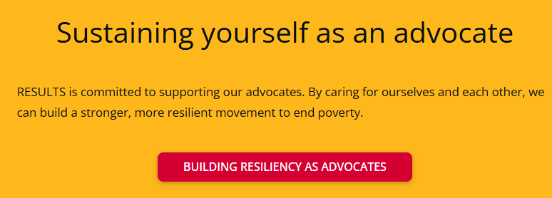
Notes:
Building resiliency as advocates: https://results.org/wp-content/uploads/Building-Resilience-as-an-Advocate_resources.pdf

Slide 8
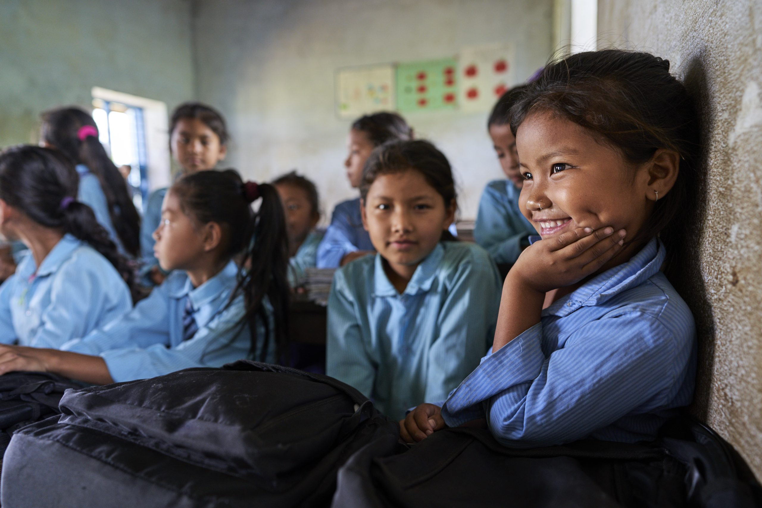
Grantee Spotlight
Rural Health & Education Service Trust (RHEST)
Notes:
Susan

Slide 9
Campaigns Update
Notes:
Karyne

Slide 10
This Just In!
House FY26 Appropriations Bill
Notes:
Karyne

Slide 11

Notes:
Karyne

Slide 12
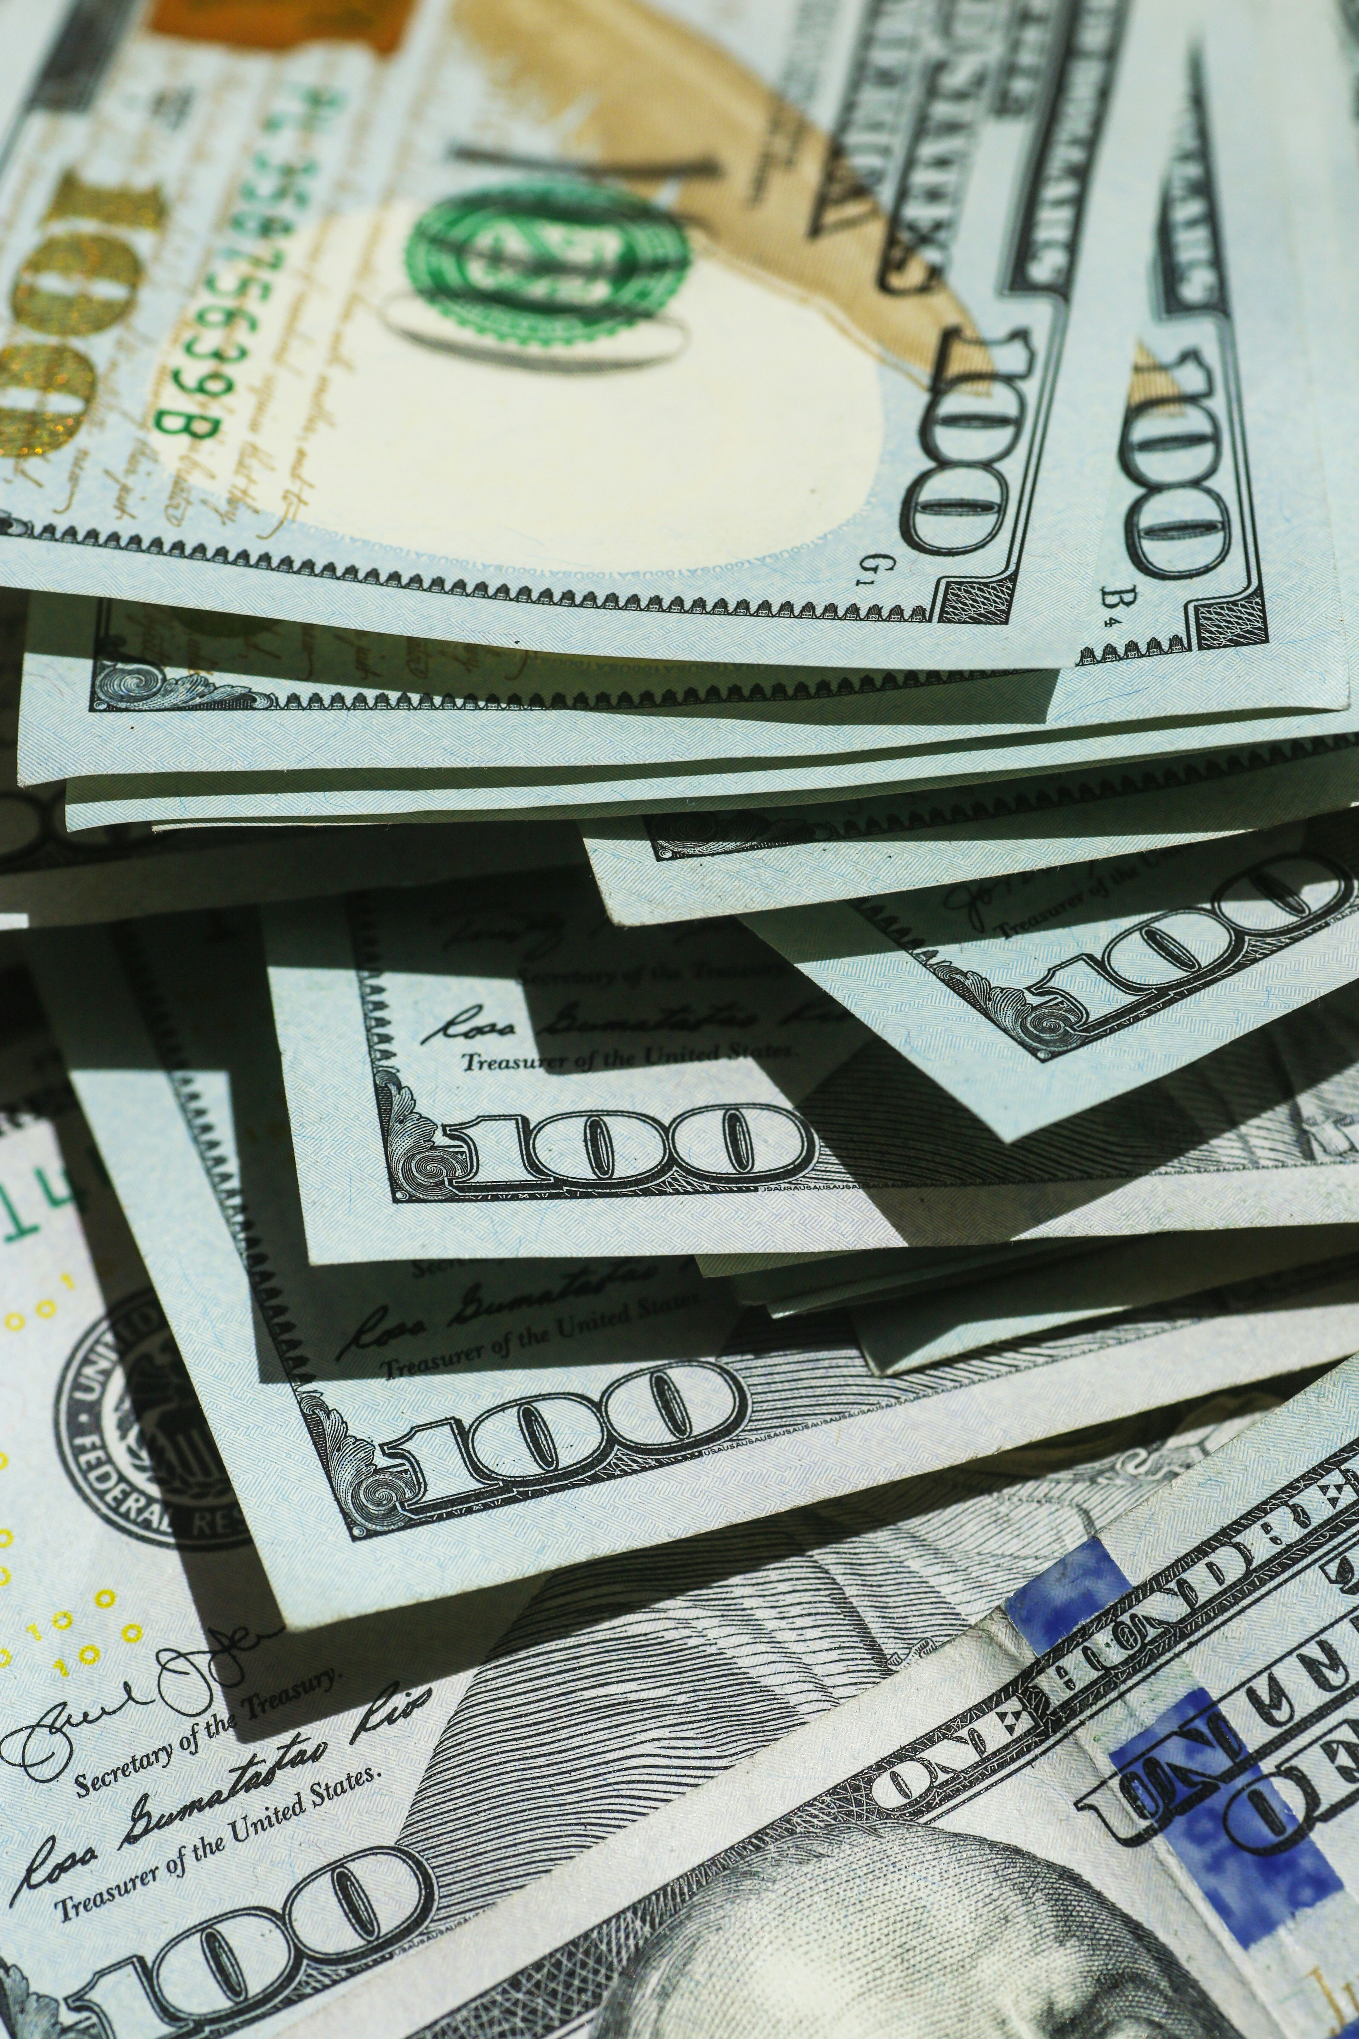
      Senate Rescissions Vote:
      Protect remaining funds!
      Contact your Senator now at
      (202) 224-3121 and tell them
      to vote “No” on rescissions.
      Senate will vote no later than July 18
      (this Friday)

Slide 13
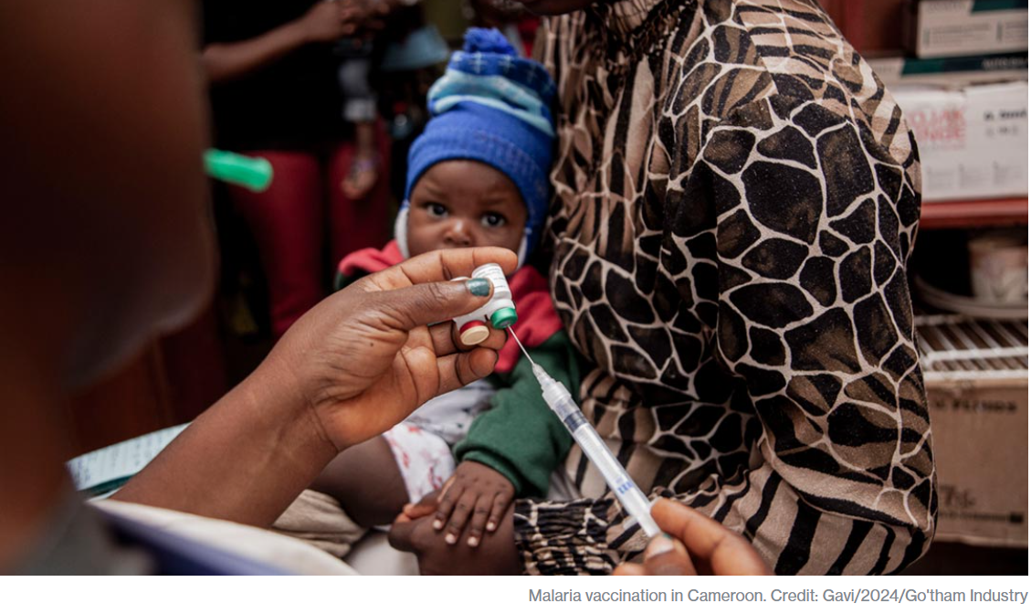
      Protect key programs!
      Gavi, the Vaccine Alliance
1 billion children immunized
17 million future deaths prevented
50% of the world’s children vaccinated by Gavi
$54 returned for every $1 invested
19 countries transitioned out of support
Over 8 million lives saved through 2023

Slide 14

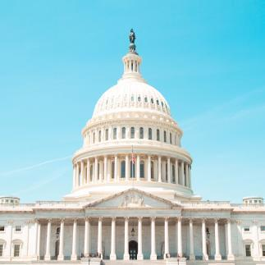

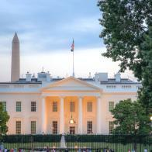
Championing the Global Fund

Slide 15
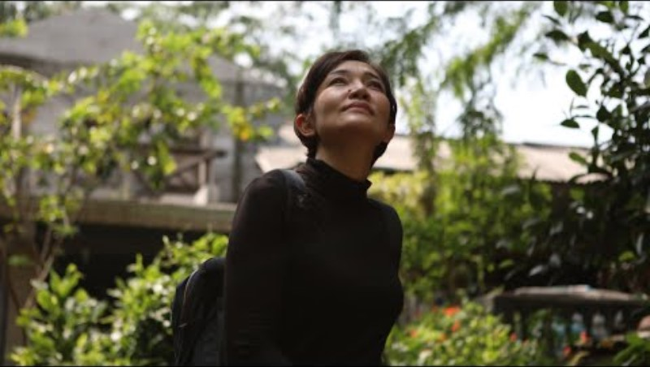
Mei’s Fight: Hard Work and Hope to
End TB for Good

Slide 16

65 million lives saved
Global Fund raises money
Global Fund provides oversight
Countries & communities make plans
Local experts lead the programs
Global Fund reviews and approves
Notes:
The global fund is a worldwide partnership where world leaders meet at a conference every 3 years to pledge a specific amount of money to last the following three years.
Countries in need of assistance take the lead in determining where and how to best fight AIDs, TB, and malaria, tailoring their own response and taking into consideration their political, cultural, and epidemiological context.
Once a plan has been proposed for a specific country, the Global fund has to review and approve of the plan
After approval, local healthcare workers, government, and communities are elected to lead the program
In the background, the global fund is providing oversight and making sure that their plan can become a success
This has led to millions of saved lives and success in low income countries.
This is all done efficiently with only 6.2% of funds going secretariat overhead costs meaning the vast majority goes directly to countries and programs being implemented

Slide 17
Championing the Global Fund

Slide 18

      Take action now!
Personalize this sample email to your member of Congress’ Foreign Policy aide
Or take this online action

Slide 19
      Take action now!
Take this online action

Slide 20

Join our media action webinar!
Write to Fight Back:
RESULTS Media Action Webinar
Protecting SNAP, Medicaid, and Global health programs
Tuesday, July 22 at 8:00 PM ET
Join us for an advocacy webinar where you'll learn how to write and submit a letter to the editor (LTE) that calls on Congress to protect critical anti-poverty programs.
Register here: https://tinyurl.com/WritetoFight
Notes:
Invite others to join:
https://tinyurl.com/2025GAPWebinars

Slide 21
Save the Date
Celebrate International Day of the Girl
With Together Women Rise
Alexandria, VA (in-person event)
Saturday October 11, 2 PM to 4 PM ET
Registration information coming soon!
Notes:
Invite others to join:
https://tinyurl.com/2025GAPWebinars

Slide 22
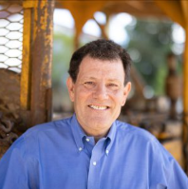
Save the Date
International Day of the Girl
With Nicholas Kristof
Webinar
Tuesday, October, 14 12:00 PM ET
Registration coming soon!
Nicholas Kristof is the author of six books, including the No. 1 best-seller Half the Sky, A Path Appears (in which he mentions Together Women Rise!), and his most recent, Chasing Hope. He has had a longstanding interest in health, poverty and women’s rights.
The Waste Musk Created, Nicholas Kristof, New York Times (June 23, 2025)
Notes:
Invite others to join:
https://tinyurl.com/2025GAPWebinars

Slide 23
Tuesday, August 19 at 8:30 PM ET
Next Together Women Rise Advocacy Chapter Webinar
Notes:
Karyne

Slide 24
Invite others to join us in
changing the world together!
Sign up here:
http://tinyurl.com/JoinRiseAdvocacyChapter
Notes:
Leslye
If you would like to learn more and take action with us, we would like to invite you to fill out our sign up, Karyne will drop it in the chat http://tinyurl.com/JoinRiseAdvocacyChapter
Karyne drop the link to sign up in the chat

Slide 25

      Additional advocacy actions you can take now!
Personalize and submit this draft “Letter to the Editor”
Or take this online action

