Slide 1
Rise Advocacy Chapter March 2025 Webinar
March 18, 2025
Notes:
Susan

Slide 2
Welcome
Please let us know in the chat where you are joining us from! Is this your first time to advocate for foreign aid?
Notes:
8:30-8:34 PM: Welcome/Introductions (Susan)

Slide 3
Mission & Vision
Together Women Rise’s Mission Together Women Rise cultivates the collective power of community to achieve global gender equality.
OUR VISION Together Women Rise envisions a world where every person has the same opportunities to thrive regardless of their gender or where they live. Rise Anti Oppression Commitment:
At Together Women Rise, we come together as a community dedicated to equality and justice for women and girls everywhere. Read full statement here.
Notes:
Susan
Together Women Rise:
Vision
Together Women Rise envisions a world where every person has the same opportunities to thrive regardless of their gender or where they live.
Gender Equality Beliefs
Together Women Rise champions gender equality because women’s rights are human rights. When women and girls are treated equally, the world is healthier, safer, more peaceful, inclusive, and economically just for everyone.
https://togetherwomenrise.org/our-anti-oppression-commitment/

Slide 4
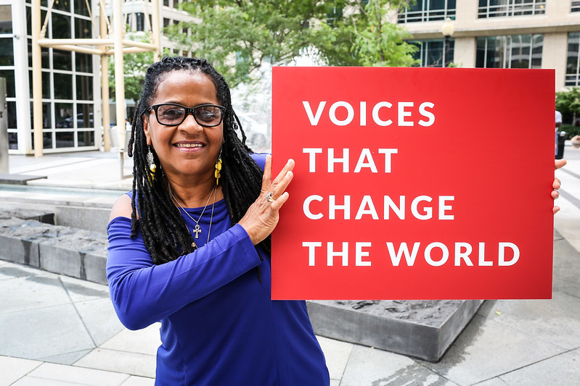
RESULTS is a movement of passionate, committed, everyday people. Together, we use our voices to influence political decisions that will bring an end to poverty.

Slide 5
Our Values & Resources
​At RESULTS we pledge to create space for all voices, including those of us who are currently experiencing poverty. We will address oppressive behavior in our interactions, families, communities, work, and world. Our strength is rooted in our diversity of experiences, not in our assumptions.
With unearned privilege comes the responsibility to act so the burden to educate and change doesn’t fall solely on those experiencing oppression. When we miss the mark on our values, we will acknowledge our mistake, seek forgiveness, learn, and work together as a community to pursue equity.
Read our full anti-oppression values statement here at results.org/values.
Notes:
Susan
RESULTS Anti-Oppression Statement: https://results.org/volunteers/anti-oppression
Hello everyone, my name is Karyne Bury and I am a manager with RESULTS Grassroots Impact Team who has had the pleasure in supporting the growth and vision for the Together Women Rise Advocacy Chapter, working alongside chairs Susan Wright and Margaret Moodian and previously with our past chair, Leslye Heilig.

Slide 6
How do you feel about where we are in the world? How can your advocacy play a role in changing it?
Reflection

Slide 7
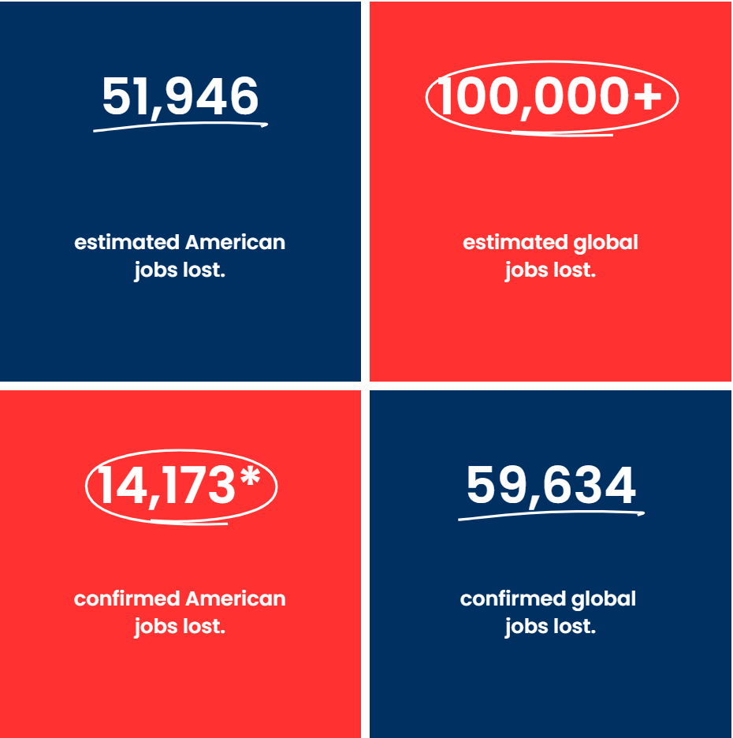
Source: www.usaidstopwork.com/documents

Slide 8
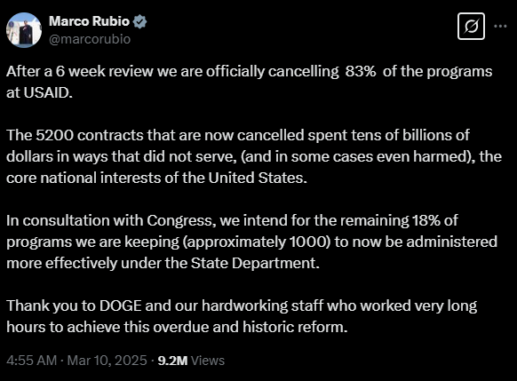

Slide 9
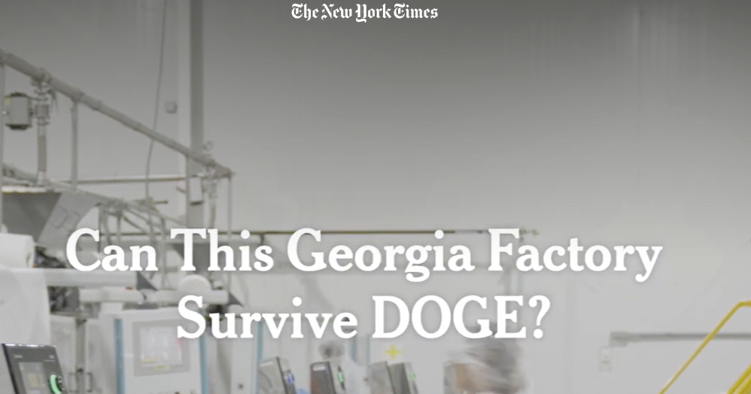
Notes:
https://www.nytimes.com/video/us/politics/100000009999341/georgia-factory-trump-doge-usaid.html

Slide 10
The First 100 Days campaign

Slide 11
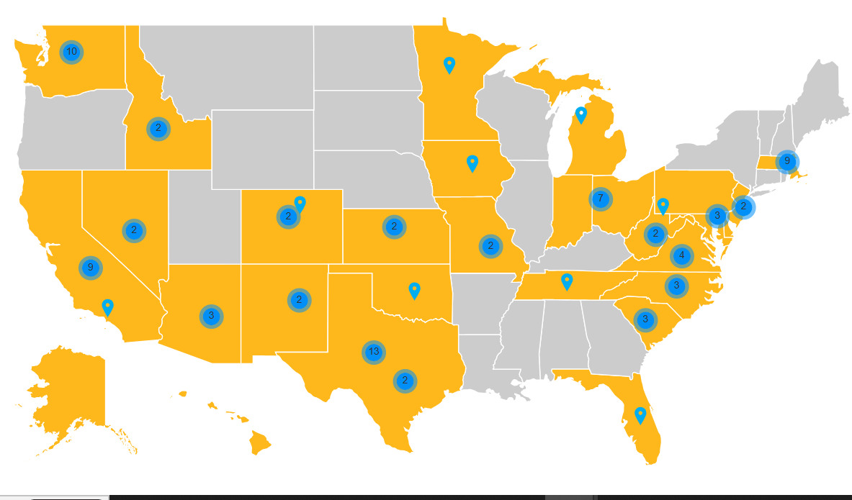
As of 3/18/2025

Slide 12
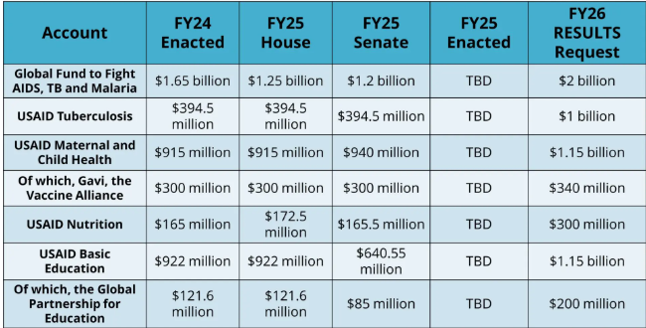
FY26 Appropriations
Notes:
Fiscal year 2026 appropriation memos: https://results.org/resources/fy26-global-appropriations-memos

Slide 13
FY26 Appropriations
How we advocate:
Dear Colleague Letters
Appropriations request forms
Direct Outreach to Legislators (Phone calls, emails, lobby meetings)
Media (Letters to the editor, Op Eds, etc.)

Slide 14
Take action now!

Slide 15
Advocacy Action
Contact your members of Congress, request that:
End the stop-work order, and reinstate critical programs and staff to carry them out.
Push the State Department to verify that programs under the waiver have restarted, and expand the waiver to all global health and development programs.
Ensure Congress is involved in shaping the future of foreign aid — standing up for programs that are focused on ending poverty and creating good health, and committed to humanitarian and lifesaving impact.
Notes:
https://results.org/blog/emergency-action-to-protect-lifesaving-foreign-aid

Slide 16
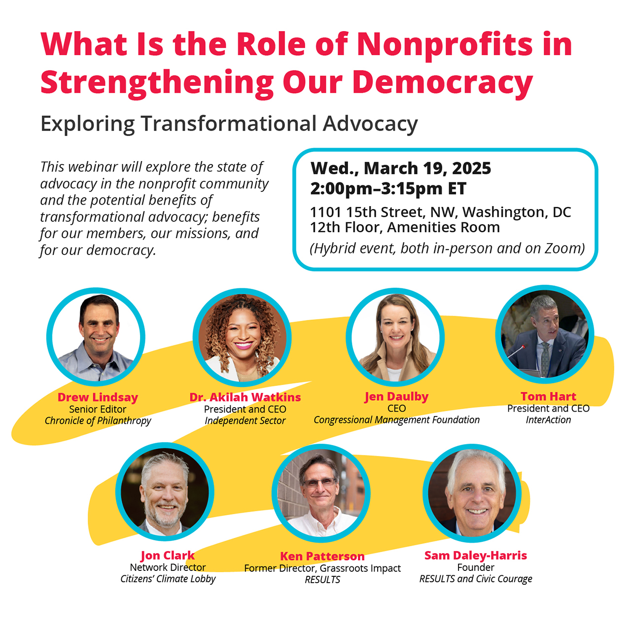

Slide 17
Together Women Rise Advocacy Chapter Office Hours: Week of March 31 & April 7
Save the Date!
Notes:
Karyne

Slide 18
Next Meeting Together Women Rise Advocacy Chapter Tuesday, April 15 at 8:30 PM ET
Save the Date!
Notes:
Karyne

Slide 19
Invite others to join us in
changing the world together!
Sign up here: http://tinyurl.com/JoinRiseAdvocacyChapter
Notes:
Leslye
If you would like to learn more and take action with us, we would like to invite you to fill out our sign up, Karyne will drop it in the chat http://tinyurl.com/JoinRiseAdvocacyChapter Karyne drop the link to sign up in the chat

Slide 20
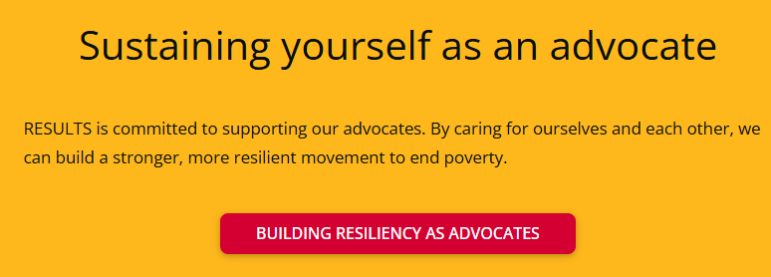
Notes:
Building resiliency as advocates: https://results.org/wp-content/uploads/Building-Resilience-as-an-Advocate_resources.pdf

Slide 21
Legislator Look Up

Slide 22
Congressional Scorecard

Slide 23
RESULTS Bill Tracker Congress.gov

