Slide 1
Maximize Your Impact for Change
October 15, 2024

Slide 2
Welcome
Please let us know in the chat where you are joining us from!
Notes:
Susan

Slide 3
Mission & Vision
Together Women Rise’s Mission
Together Women Rise cultivates the collective power of community to achieve global gender equality.
OUR VISION
Together Women Rise envisions a world where every person has the same opportunities to thrive regardless of their gender or where they live.
Notes:
Susan

Slide 4
Our Values & Resources
​At RESULTS we pledge to create space for all voices, including those of us who are currently experiencing poverty. We will address oppressive behavior in our interactions, families, communities, work, and world. Our strength is rooted in our diversity of experiences, not in our assumptions.
With unearned privilege comes the responsibility to act so the burden to educate and change doesn’t fall solely on those experiencing oppression. When we miss the mark on our values, we will acknowledge our mistake, seek forgiveness, learn, and work together as a community to pursue equity.
Read our full anti-oppression values statement here at results.org/values.
Find these resources and more at results.org/volunteers/anti-oppression:
Resource Guides from our Diversity & Inclusion trainings, including:
Interrupting Microaggressions
Creating Space for Critical Conversations
Information on how RESULTS responds to oppressive incidents
Notes:
Susan

Slide 5
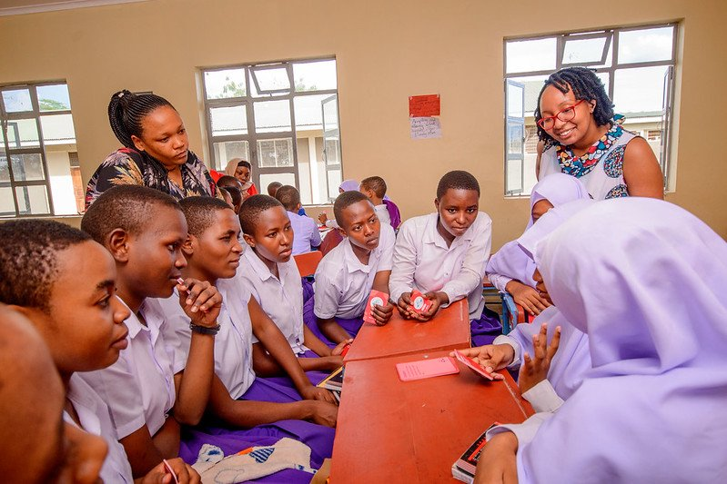
Grantee Spotlight
She’s the First
Notes:
Margaret

Slide 6
118th Congress Global Poverty Campaigns
Notes:
Karyne

Slide 7
End TB Now Act (S. 228 / H.R. 1776)
Notes:
Karyne

Slide 8
End TB Now Act (S.288, H.R. 1776)
Requires the U.S. to establish bold goals for reaching the most vulnerable populations
Strengthens U.S. bilateral coordination to develop comprehensive global TB response
Catalyzes support for TB research and development (R&D)
Improves TB capacity of high-burden countries & affected communities
Requires annual report to Congress on U.S. TB activities and impact
Evaluates the performance of TB programs that are supported by U.S.
Notes:
Karyne

Slide 9
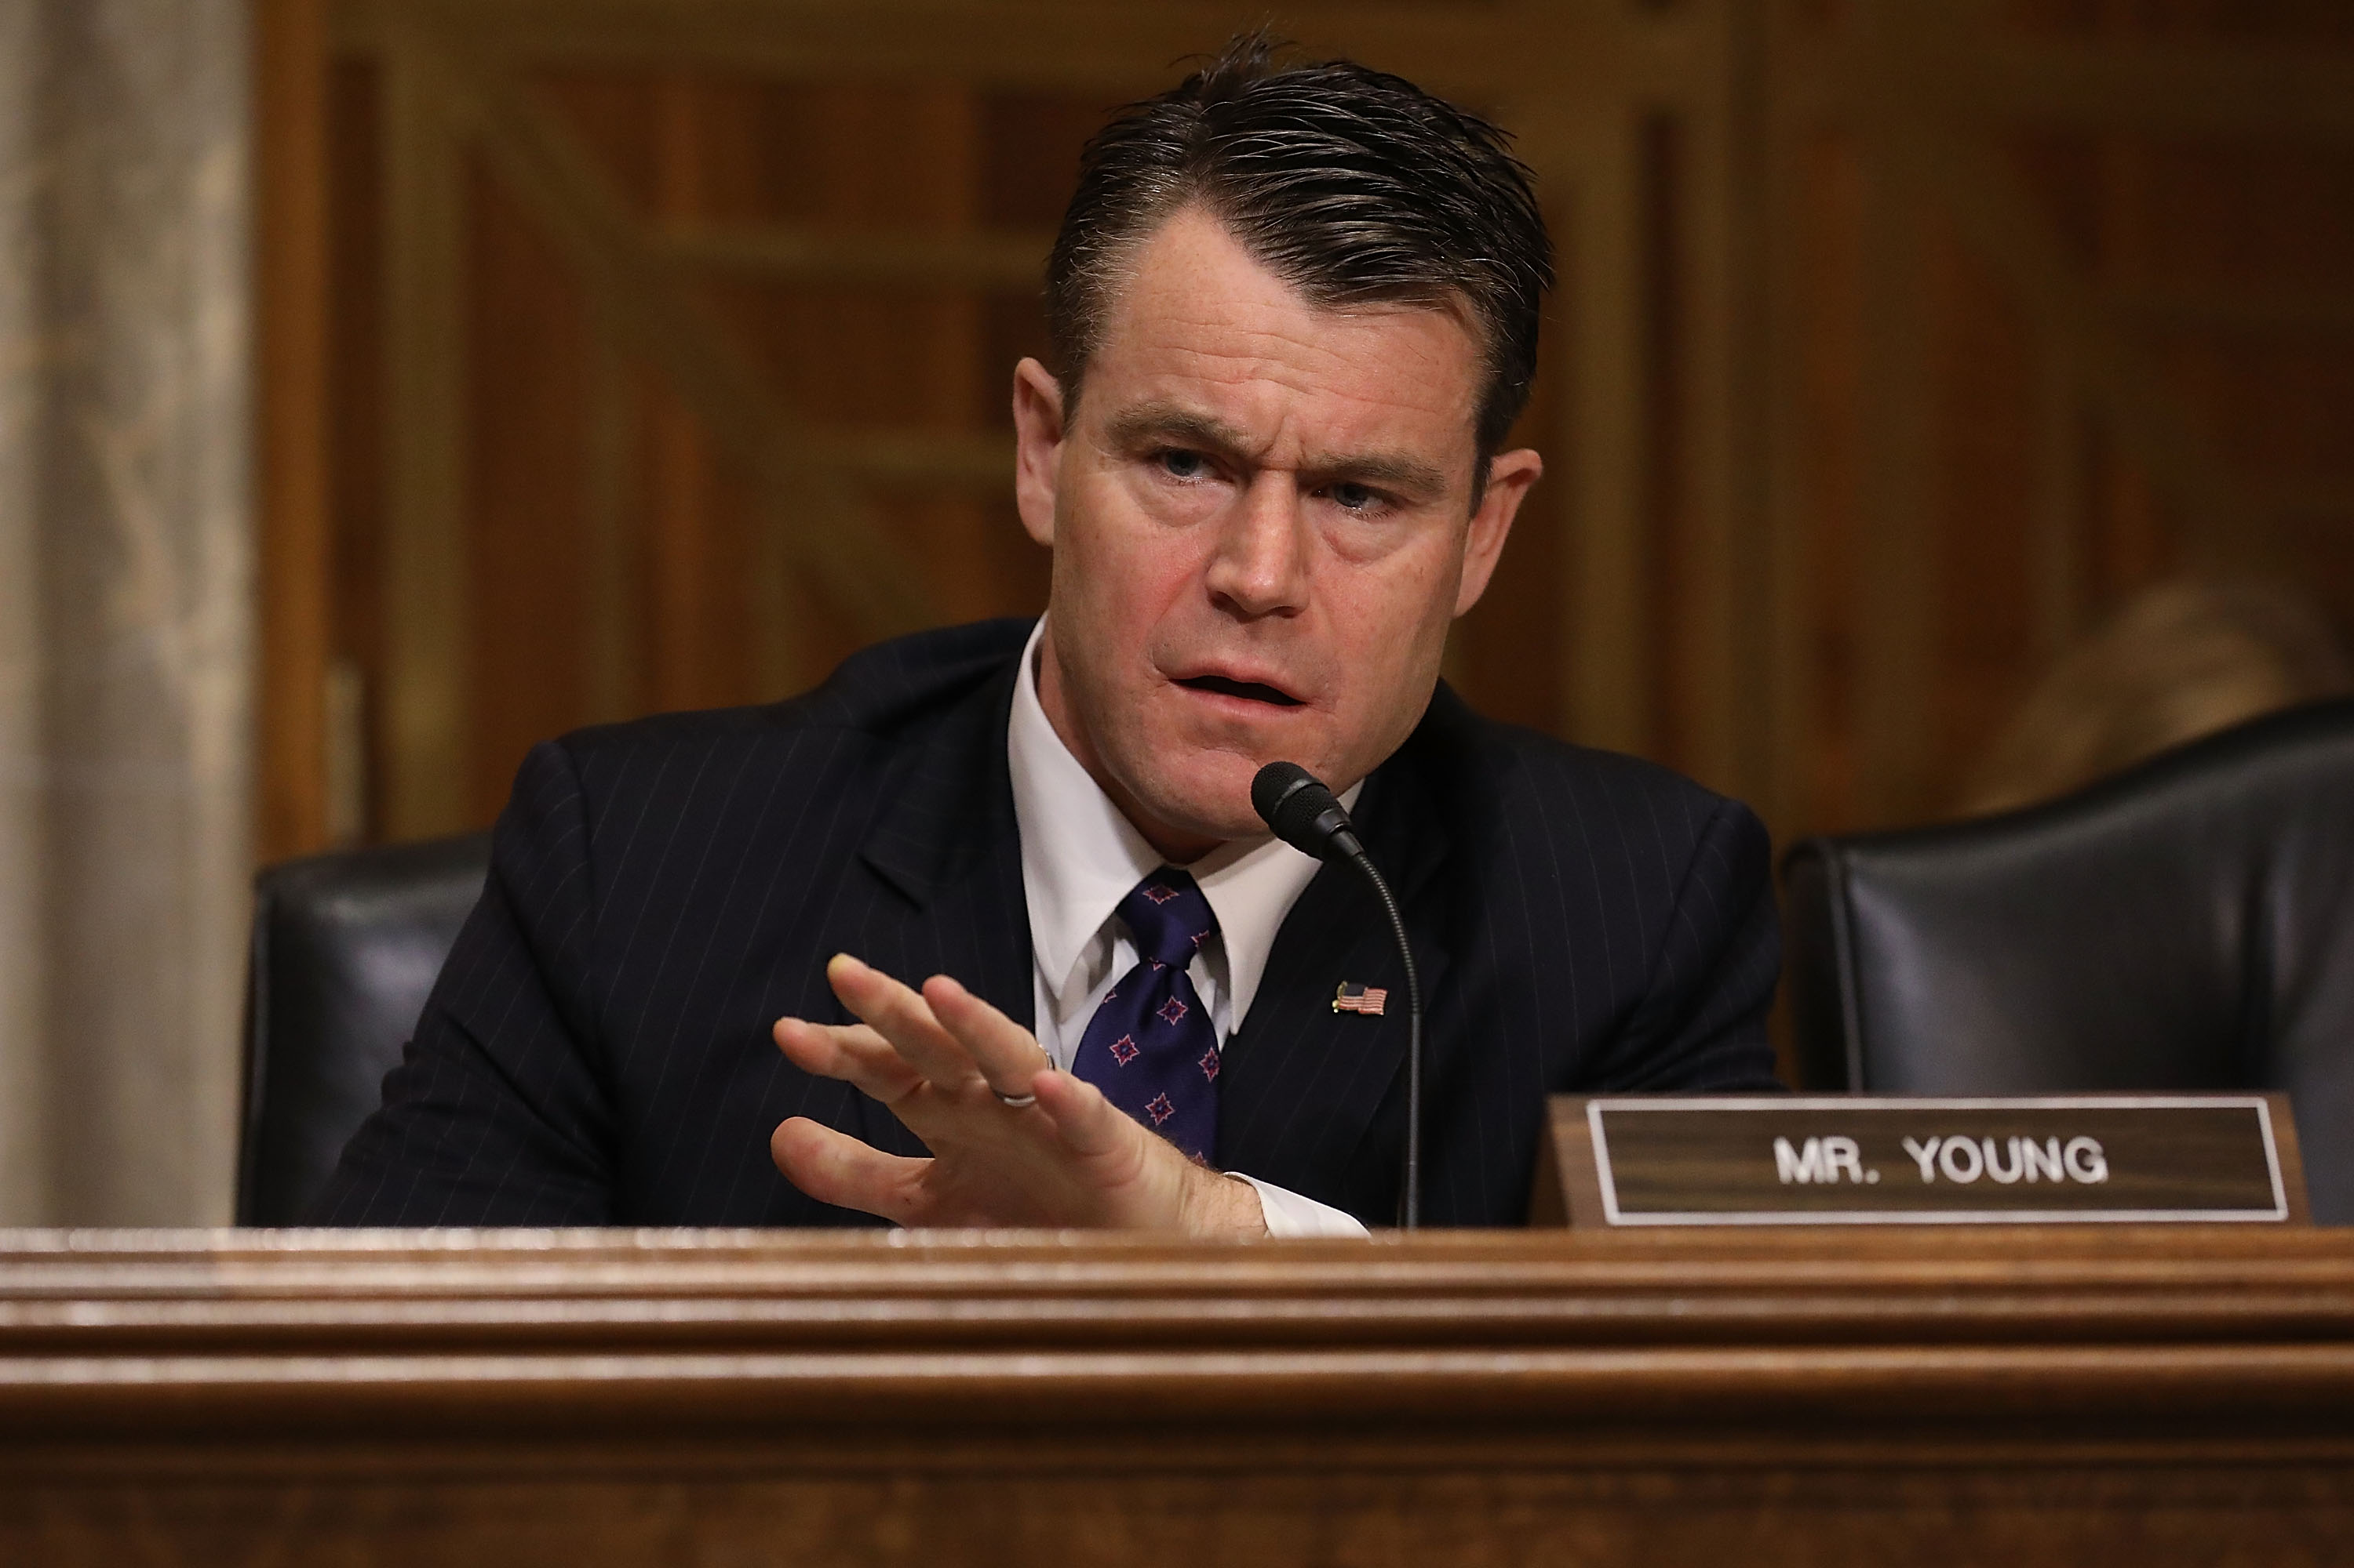
Young Praises Senate Passage of End Tuberculosis Now Act
Notes:
Karyne

Slide 10
End TB Now Act
S.288 introduced
by Sens. Young (R-IN) and Menendez (D-NJ)
Passed Senate Foreign Relations Committee
5 cosponsors
Passed full Senate
by unanimous consent
H.R.1776 introduced
by Reps. Bera (D-CA) and Salazar (R-FL)
Passed House Foreign Affairs Committee
91 cosponsors
Goal:
Pass full House by December 2024

Slide 11
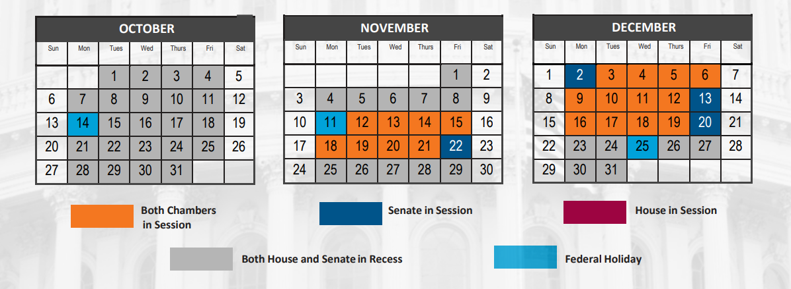
Final 20 days in session!

Slide 12
The READ Act Reauthorization (S.41, H.R. 681)
Notes:
Karyne

Slide 13
The READ Act (S.41, H.R. 681)
Developing a comprehensive integrated U.S. strategy that improves educational opportunities and addresses key barriers to children’s school attendance, retention and completion, especially for girls;
Ensuring education services for children affected by conflict and other emergencies;
Coordinating U.S. government efforts to efficiently and effectively manage resources;
Working with countries to strengthen systems in order to build long-term sustainability;

Slide 14
The READ Act (S.41, H.R. 681)
Engaging with key partners including other donors, civil society and multilateral initiatives, including the Global Partnership for Education, to leverage U.S. contributions to achieve a greater overall impact;
Requiring specific indicators and objectives with which to measure progress; and
Improving the transparency and accountability of our basic education programs, ensuring taxpayer dollars have the most impact for children worldwide.

Slide 15
The READ Act
S.41 introduced
by Sens. Rubio (R-FL) and Durbin (D-IL)
Passed Senate Foreign Relations Committee
6 cosponsors
Passed full Senate
By unanimous consent (Nov. 2023)
H.R.681 introduced
by Reps. Meng (D-NY) and Smith (R-NJ)
Passed House Foreign Affairs Committee
(May 2024)
74 cosponsors
Goal:
Pass full House by December 2024

Slide 16
Gavi, the Vaccine Alliance Resolutions (S. Res. 684/ H. Res. 1286)
Notes:
Karyne

Slide 17
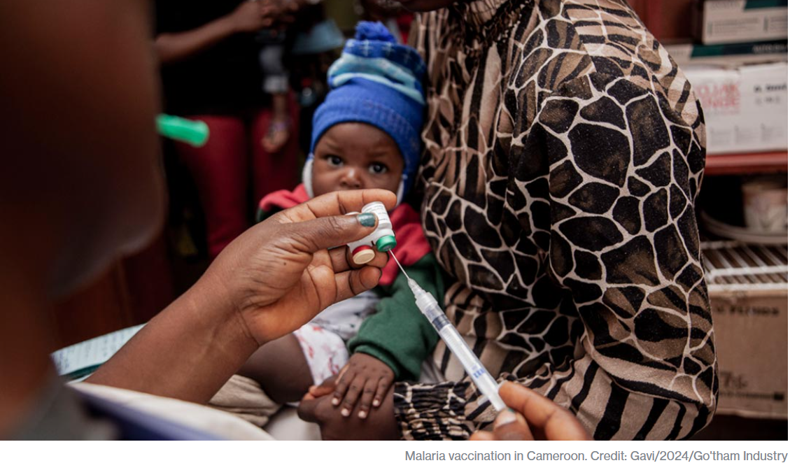
Notes:
Karyne

Slide 20
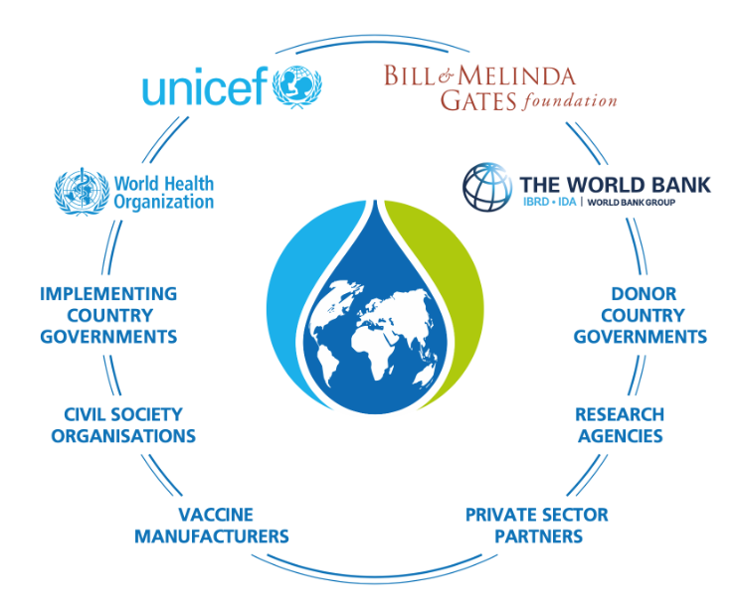

Slide 21
Gavi by the numbers
1 billion children immunized
17 million future deaths prevented
50% of the world’s children vaccinated by Gavi
$54 returned for every $1 invested
19 countries transitioned out of support

Slide 22
Gavi’s 6th Replenishment Strategy
At June 20 conference, Gavi officially introduced a new 5-year strategy and aims to protect 500 million children save more than 8 million lives between 2026-2030
60 % by 2040 - Launch of the African Vaccine Manufacturing Accelerator (AVMA), African Union has a goal to produce 60% of the continents’ vaccines by 2040
The Biden Administration’s figure of $1.58 billion over 5 years sets us up for historic success.
Now we’ll need Congress to deliver that funding — and push the amount even higher.
Notes:
https://www.gavi.org/news/media-room/protecting-more-children-gavi-vaccine-alliance-plans-next-5-year-period

Slide 23
Gavi Resolutions – H.Res. 1286/ S. Res. 684
Senate Lead Sponsors: Sens. Wicker (R-MI) and Cardin (D-MD) House Lead Sponsors: Representatives Kean (R-NJ), Amo (D-RI), Salazar (R-FL), and Jacobs (D-CA).
Calls for United States to have supporting role in saving children’s lives of children and protecting people’s health through Gavi, the Vaccine Alliance.
Gavi has been a major contributor in reducing the number of childhood deaths in lower-income countries due to vaccine-preventable disease by 70 percent since 2000.
Notes:
Karyne

Slide 24
Breaking through the noise with effective media
Notes:
Ken

Slide 27
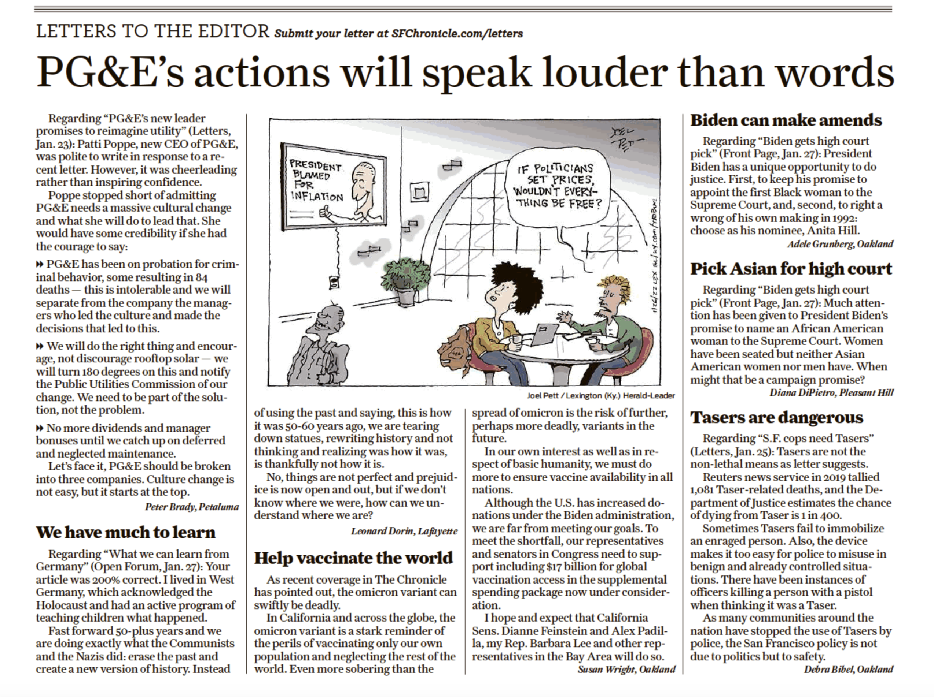
Notes:
Susan

Slide 28
Why do we use media?
Making connections between the issues we advocate on and current events
Bringing awareness of these issues to our community (more constituents & voters)
Puts pressure on MOCs to act (they monitor what is being said about them in the media)
Notes:
Karyne

Slide 29
How to get started
Find a local hook
Articles in the paper? Make the connection to other global issues that intersect with education, nutrition, and health
Important statistic relevant to your district or state?
Respond to other published media
Thank you to your Rep. or Senator
Looking for relevant hooks? Check out this resource.
Notes:
Karyne – here are some ideas of hooks, any one?
Walk through the resource so we can find hooks about Gavi, Nutrition, and TB

Slide 30
How to get started
Use sample LTE template to get you started, personalize it. Why is this issue important to you? Why should it be important to our members of Congress & Candidates?
Gavi, the Vaccine Alliance: Media: Congress should support Gavi's life-saving work
Nutrition & Nutrition for Growth: Media: The US must make a strong, early pledge to Nutrition for Growth
Education: Media: Every child deserves an education
Tuberculosis: The House must pass the End TB Now Act
Notes:
Karyne – here are some ideas of hooks, any more?

Slide 31
Tips on writing LTEs
Remember your C’s
Be current – respond to recent article or current event
Construct your LTE in EPIC format
Keep it concise: Rule of thumb is 150 - 200 words or less (follow the paper’s guidelines on word count)
Connect the dots: How is this relevant to your community/district/state?
Notes:
Karyne – here are some ideas of hooks, any one?

Slide 32
Tips on writing LTEs
Remember your C’s
Be challenging - ask a question (but don’t make a personal attack), name your member of Congress
Have a call to action whether for Congress or from the reader
Be creative!
Be contagious: Submit to as many newspapers as possible
When you’re ready to submit
Don’t forget your contact information!
Notes:
Karyne – here are some ideas of hooks, any more?

Slide 33
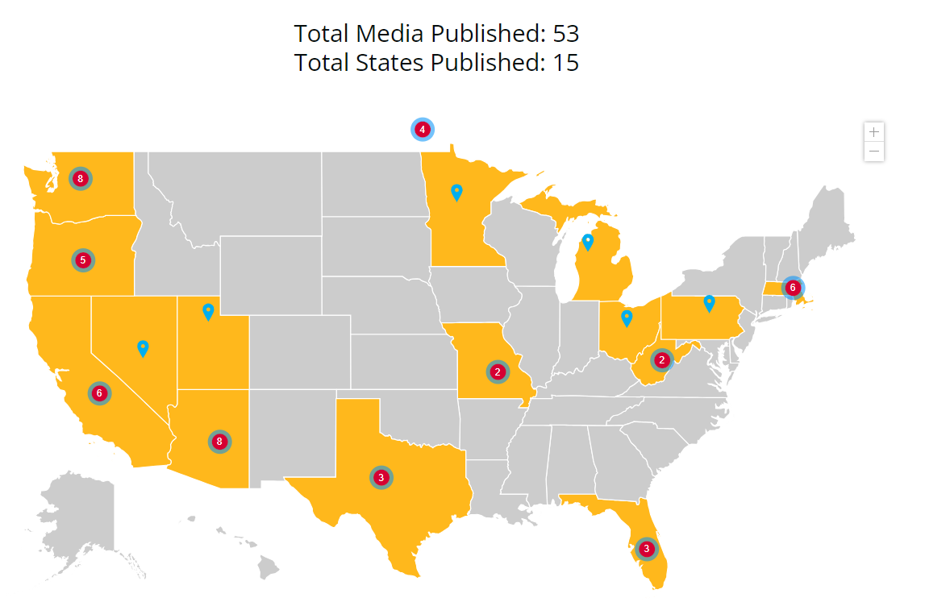
What has been published?
2024 RESULTS Global Media Packet
Published as of 10/15/2024
Notes:
Karyne – here are some ideas of hooks, any more?

Slide 34
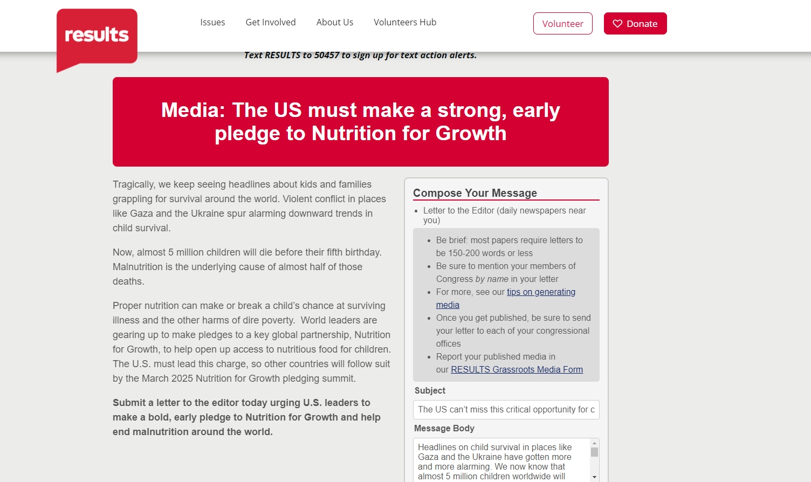
Submitting an LTE
Notes:
Karyne
Gavi the Vaccine Alliance: https://results.org/volunteers/action-center/action-alerts?vvsrc=%2fcampaigns%2f60670%2frespond
Nutrition for Growth: https://results.org/volunteers/action-center/action-alerts?vvsrc=%2fcampaigns%2f59439%2frespond
READ Act: https://results.org/volunteers/action-center/action-alerts?vvsrc=%2fcampaigns%2f87023%2frespond
End TB Now: https://results.org/volunteers/action-center/action-alerts?vvsrc=%2fcampaigns%2f63557%2frespond

Slide 35
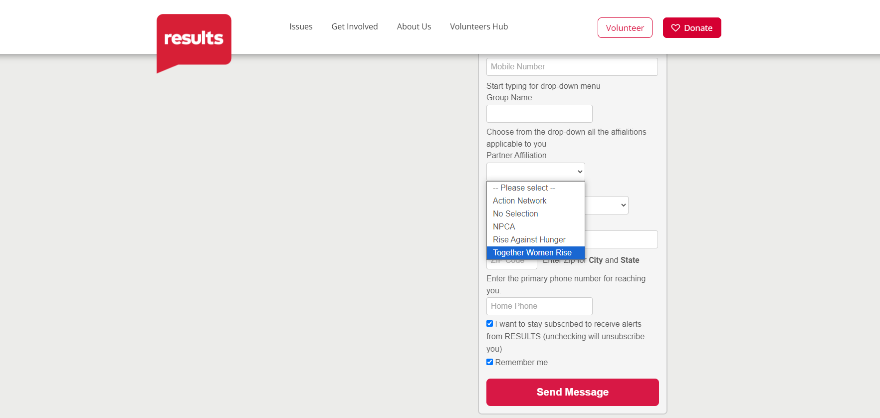

Slide 36
Q&A

Slide 37
Notes:
Susan

Slide 38
Notes:
Susan

Slide 39
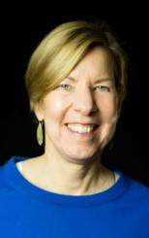
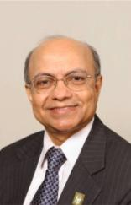
Join us for the RESULTS November National Webinar
A conversation with…
Kul Gautam Former Deputy Executive Director of UNICEF and Chair of the RESULTS Board
Joanne Carter Executive Director of RESULTS
November 2 at 1:00 p.m. ET Register at: tinyurl.com/RESULTS2024

Slide 40
Together Women Rise Advocacy Chapter November Meeting Tuesday, November 19 at 8:30 PM ET
Save the Date!
Notes:
Susan

Slide 41
Invite others to join us in
changing the world together!
Sign up here: http://tinyurl.com/JoinRiseAdvocacyChapter
Notes:
Susan
If you are inspired, share link to sign up with other volunteers in your Rise chapter: http://tinyurl.com/JoinRiseAdvocacyChapter Karyne drop the link to sign up in the chat

