Slide 1
Rise Advocacy Chapter November Webinar
November 19, 2024

Slide 2
Welcome
Please let us know in the chat where you are joining us from!
Notes:
Susan

Slide 3
Mission & Vision
Together Women Rise’s Mission
Together Women Rise cultivates the collective power of community to achieve global gender equality.
OUR VISION
Together Women Rise envisions a world where every person has the same opportunities to thrive regardless of their gender or where they live.
Notes:
Susan

Slide 4
Our Values & Resources
​At RESULTS we pledge to create space for all voices, including those of us who are currently experiencing poverty. We will address oppressive behavior in our interactions, families, communities, work, and world. Our strength is rooted in our diversity of experiences, not in our assumptions.
With unearned privilege comes the responsibility to act so the burden to educate and change doesn’t fall solely on those experiencing oppression. When we miss the mark on our values, we will acknowledge our mistake, seek forgiveness, learn, and work together as a community to pursue equity.
Read our full anti-oppression values statement here at results.org/values.
Find these resources and more at results.org/volunteers/anti-oppression:
Resource Guides from our Diversity & Inclusion trainings, including:
Interrupting Microaggressions
Creating Space for Critical Conversations
Information on how RESULTS responds to oppressive incidents
Notes:
Susan

Slide 5
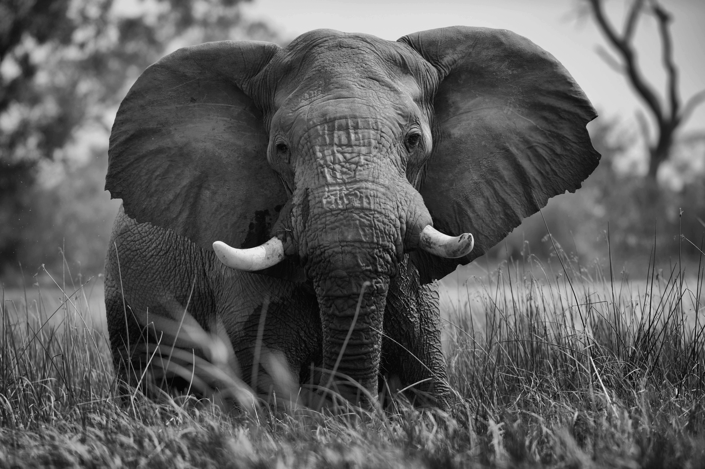
How are you feeling post-election?
photo courtesy of Joaquin Rivero (Unsplash.com)
Notes:
Susan

Slide 6
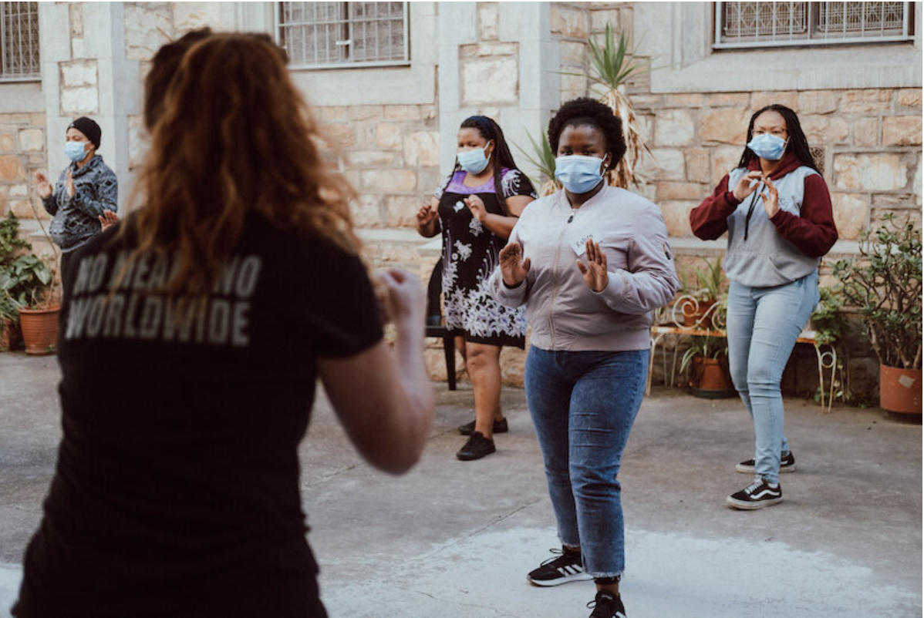
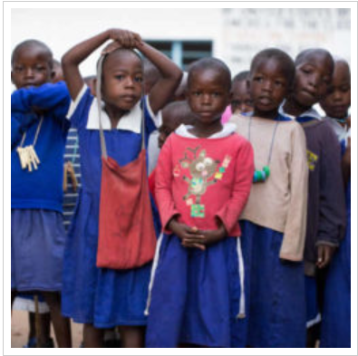
Grantee Spotlights: Protecting girls from sexual violence
No Means No (South Africa)
Project Zawadi (Tanzania)
Notes:
Susan

Slide 7
Annual Appeal
Notes:
Susan/Betsy

Slide 8
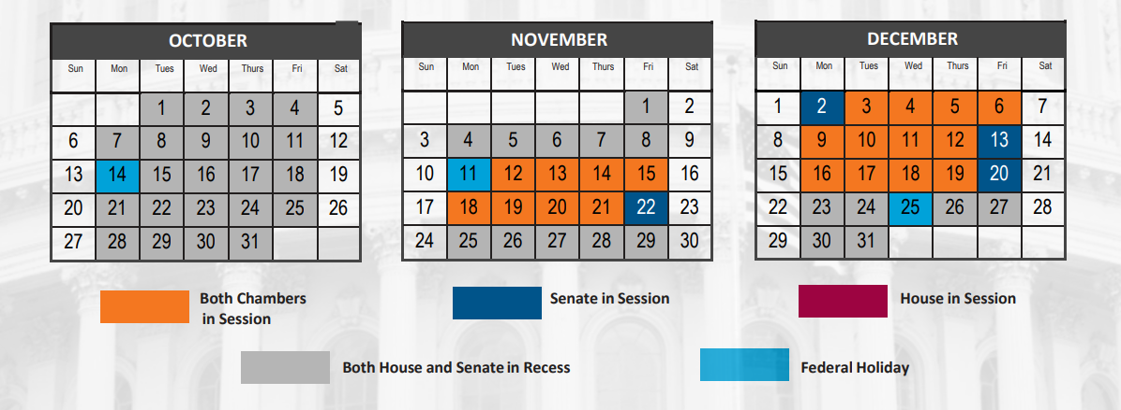
Final 14 days in session!

Slide 9
14 Days of Lame Duck Congress
Primary action: Encourage action on Gavi Resolution
Two global bills:
H.R. 1776 - End TB Now Act
H.R. 681- The READ Act Reauthorization
Post-election action: Congratulate newly elected and re-elected MOCs, and urge them to take these actions
Notes:
Karyne

Slide 10
Gavi Resolutions – H.Res. 1286/ S. Res. 684
Senate Lead Sponsors: Sens. Wicker (R-MI) and Cardin (D-MD) House Lead Sponsors: Representatives Kean (R-NJ), Amo (D-RI), Salazar (R-FL), and Jacobs (D-CA).
Calls for United States to have supporting role in saving children’s lives of children and protecting people’s health through Gavi, the Vaccine Alliance.
Gavi has been a major contributor in reducing the number of childhood deaths in lower-income countries due to vaccine-preventable disease by 70 percent since 2000.
Notes:
Karyne

Slide 11
End TB Now Act (S.288, H.R. 1776)
Requires the U.S. to establish bold goals for reaching the most vulnerable populations
Strengthens U.S. bilateral coordination to develop comprehensive global TB response
Catalyzes support for TB research and development (R&D)
Improves TB capacity of high-burden countries & affected communities
Requires annual report to Congress on U.S. TB activities and impact
Evaluates the performance of TB programs that are supported by U.S.
Notes:
Karyne

Slide 12
End TB Now Act
S.288 introduced
by Sens. Young (R-IN) and Menendez (D-NJ)
Passed Senate Foreign Relations Committee
5 cosponsors
Passed full Senate
by unanimous consent
H.R.1776 introduced
by Reps. Bera (D-CA) and Salazar (R-FL)
Passed House Foreign Affairs Committee
91 cosponsors
Goal:
Pass full House by December 2024

Slide 13
The READ Act (S.41, H.R. 681)
Developing a comprehensive integrated U.S. strategy that improves educational opportunities and addresses key barriers to children’s school attendance, retention and completion, especially for girls;
Ensuring education services for children affected by conflict and other emergencies;
Coordinating U.S. government efforts to efficiently and effectively manage resources;
Working with countries to strengthen systems in order to build long-term sustainability;

Slide 14
The READ Act (S.41, H.R. 681)
Engaging with key partners including other donors, civil society and multilateral initiatives, including the Global Partnership for Education, to leverage U.S. contributions to achieve a greater overall impact;
Requiring specific indicators and objectives with which to measure progress; and
Improving the transparency and accountability of our basic education programs, ensuring taxpayer dollars have the most impact for children worldwide.

Slide 15
The READ Act
S.41 introduced
by Sens. Rubio (R-FL) and Durbin (D-IL)
Passed Senate Foreign Relations Committee
6 cosponsors
Passed full Senate
By unanimous consent (Nov. 2023)
H.R.681 introduced
by Reps. Meng (D-NY) and Smith (R-NJ)
Passed House Foreign Affairs Committee
(May 2024)
74 cosponsors
Goal:
Pass full House by December 2024

Slide 16
Breaking through the noise with effective media
Notes:
Ken

Slide 17
Elevate your Voice on Global Health LTE Writing Party
Notes:
Karyne

Slide 18
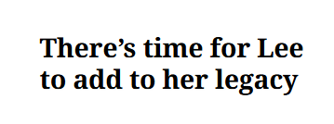
Notes:
Karyne
There’s time for Lee to add to her legacy - https://www.mercurynews.com/2024/11/04/letters-1920/
Hunger in America haunts Farm Bill extension - https://www.masslive.com/westernmass/2024/11/hunger-in-america-haunts-farm-bill-extension-letters-to-the-republican.html
Past LTEs
Leslye - Boston Globe https://www.bostonglobe.com/2024/09/03/opinion/letters-to-the-editor-global-health-equity/?event=event12 Archive link - https://archive.ph/UnEsB

Slide 19
Why do we use media?
Making connections between the issues we advocate on and current events
Bringing awareness of these issues to our community
Puts pressure on MOCs to act (they monitor what is being said about them in the media)
Notes:
Karyne

Slide 20
How to get started
Find a local hook
Articles in the paper? Make the connection to other global issues that intersect with education, nutrition, and health
Important statistic relevant to your district or state?
Respond to other published media
Thank you to your Rep. or Senator
Looking for relevant hooks? Check out this resource.
Notes:
Karyne – here are some ideas of hooks, any one?
Walk through the resource so we can find hooks about Gavi, Nutrition, and TB

Slide 21
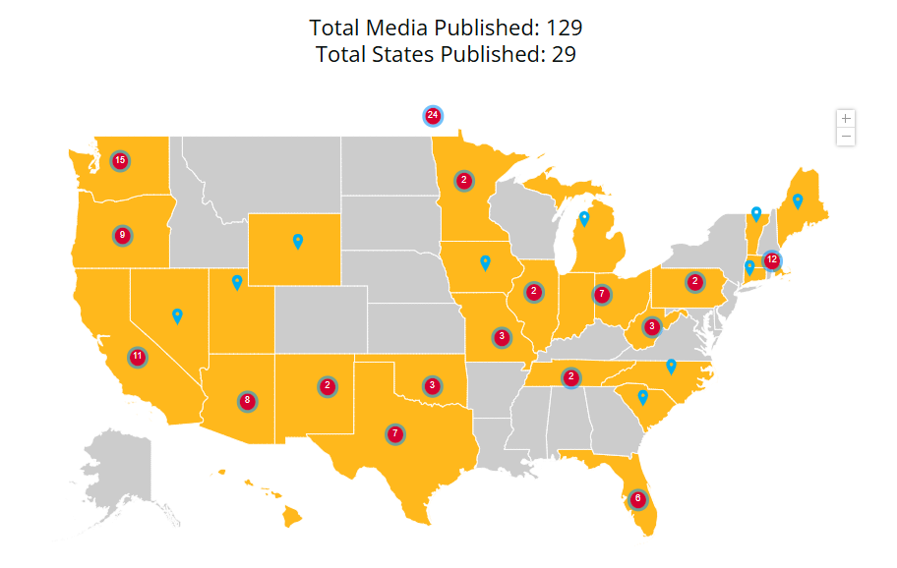
What has been published?
2024 RESULTS Global Media Packet
Published as of 11/19/2024
Notes:
Karyne to add the updated map on Tuesday 11/19

Slide 22
How to get started
Use sample LTE template to get you started, personalize it. Why is this issue important to you? Why should it be important to our members of Congress & Candidates?
Gavi, the Vaccine Alliance: Media: Congress should support Gavi's life-saving work
Nutrition & Nutrition for Growth: Media: The US must make a strong, early pledge to Nutrition for Growth
Education: Media: Every child deserves an education
Tuberculosis: The House must pass the End TB Now Act
Notes:
Karyne – here are some ideas of hooks, any more?

Slide 23
Tips on writing LTEs
Remember your C’s
Be current – respond to recent article or current event
Construct your LTE in EPIC format
Keep it concise: Rule of thumb is 150 - 200 words or less (follow the paper’s guidelines on word count)
Connect the dots: How is this relevant to your community/district/state?
Notes:
Karyne – here are some ideas of hooks, any one?

Slide 24
Tips on writing LTEs
Remember your C’s
Be challenging - ask a question (but don’t make a personal attack), name your member of Congress
Have a call to action whether for Congress or from the reader
Be creative!
Be contagious: Submit to as many newspapers as possible
When you’re ready to submit
Don’t forget your contact information!
Notes:
Karyne – here are some ideas of hooks, any more?

Slide 25
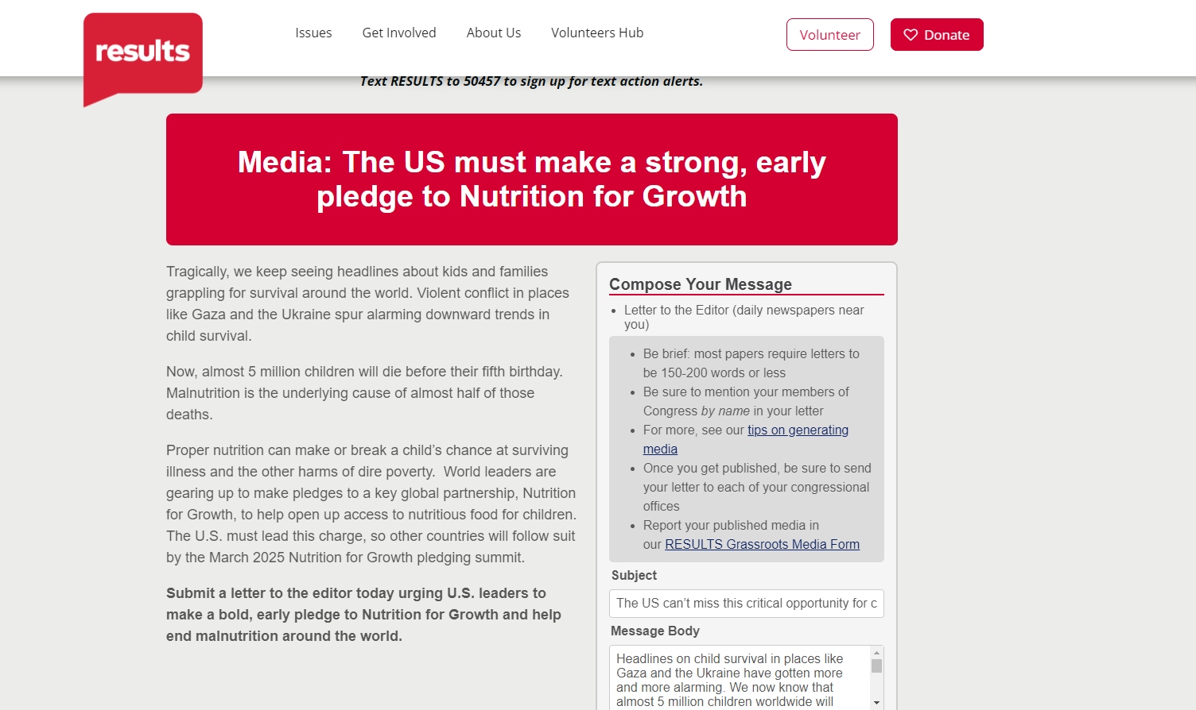
Submitting an LTE
Notes:
Karyne
Gavi the Vaccine Alliance: https://results.org/volunteers/action-center/action-alerts?vvsrc=%2fcampaigns%2f60670%2frespond
Nutrition for Growth: https://results.org/volunteers/action-center/action-alerts?vvsrc=%2fcampaigns%2f59439%2frespond
READ Act: https://results.org/volunteers/action-center/action-alerts?vvsrc=%2fcampaigns%2f87023%2frespond
End TB Now: https://results.org/volunteers/action-center/action-alerts?vvsrc=%2fcampaigns%2f63557%2frespond

Slide 26
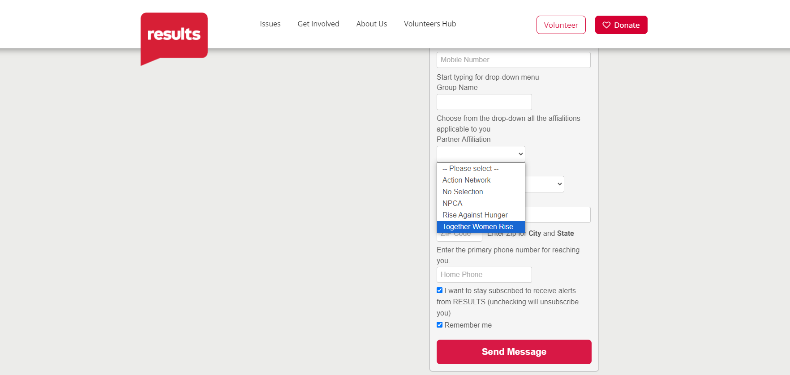

Slide 27
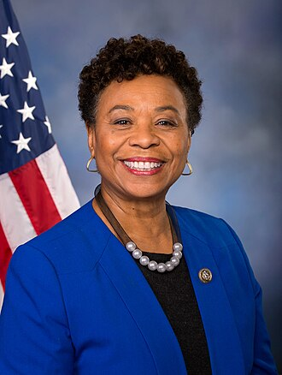
RESULTS December National Webinar
Guest Speaker, Rep. Barbara Lee
December 7 at 1:00 p.m. ET Register at: tinyurl.com/RESULTS2024

Slide 28
Together Women Rise Advocacy Chapter Last meeting of 2024 Tuesday, December 17 at 8:30 PM ET
Notes:
Susan

Slide 29
We want to hear from you!
Please stay tuned for a survey in our follow up email.
Notes:
Susan

Slide 30
Invite others to join us in
changing the world together!
Sign up here: http://tinyurl.com/JoinRiseAdvocacyChapter
Notes:
Susan
If you are inspired, share link to sign up with other volunteers in your Rise chapter: http://tinyurl.com/JoinRiseAdvocacyChapter Karyne drop the link to sign up in the chat

