Slide 1


Rise Advocacy Chapter Monthly Webinar
September 16, 2025
Notes:
Susan

Slide 2

Welcome
Please let us know in the chat where you are joining us from!

Slide 3
Mission & Vision
Together Women Rise’s Mission Together Women Rise cultivates the collective power of community to achieve global gender equality.
OUR VISION Together Women Rise envisions a world where every person has the same opportunities to thrive regardless of their gender or where they live. Rise Anti Oppression Commitment:
At Together Women Rise, we come together as a community dedicated to equality and justice for women and girls everywhere. Read full statement here.

Slide 4
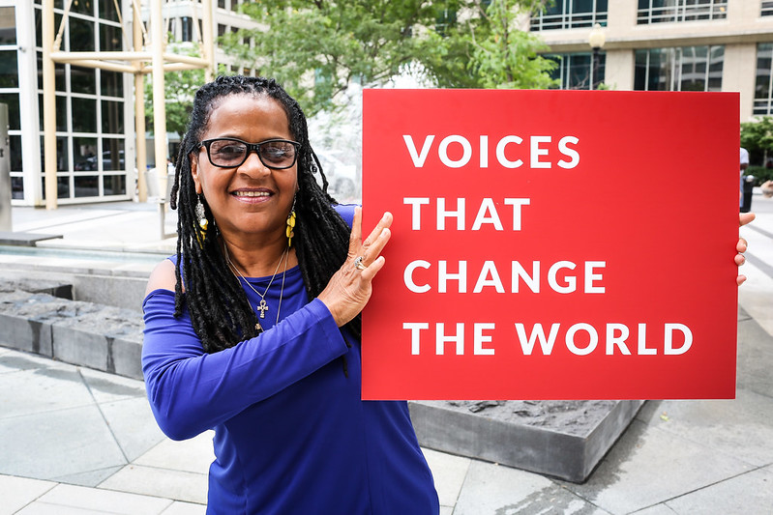
RESULTS is a movement of passionate, committed, everyday people. Together, we use our voices to influence political decisions that will bring an end to poverty.
Notes:
Karyne

Slide 5
Our Values & Resources
​At RESULTS we pledge to create space for all voices, including those of us who are currently experiencing poverty. We will address oppressive behavior in our interactions, families, communities, work, and world. Our strength is rooted in our diversity of experiences, not in our assumptions.
With unearned privilege comes the responsibility to act so the burden to educate and change doesn’t fall solely on those experiencing oppression. When we miss the mark on our values, we will acknowledge our mistake, seek forgiveness, learn, and work together as a community to pursue equity.
Read our full anti-oppression values statement here at results.org/values.
Notes:
Karyne

Slide 6
Global Poverty Campaign Update: Funding the fight against global poverty
Notes:
Agenda
Tonight’s agenda (1 min)
Welcome and introductions
Recent Advocacy Updates: How have folks engaged with advocacy since our March meeting?
FY 26 Appropriations
Closing

Slide 7



House FY 26 Appropriations
 | President’s budget | House bill
Maternal and Child Health | 90% cut | Restored
Gavi, the Vaccine Alliance | $0 | Restored
Nutrition | $0 | Increased
Tuberculosis | 50% cut | Restored
Global Fund to Fight AIDS, TB & Malaria | 50% cut | Restored
Global Partnership for Education | $0 | Restored

Slide 8
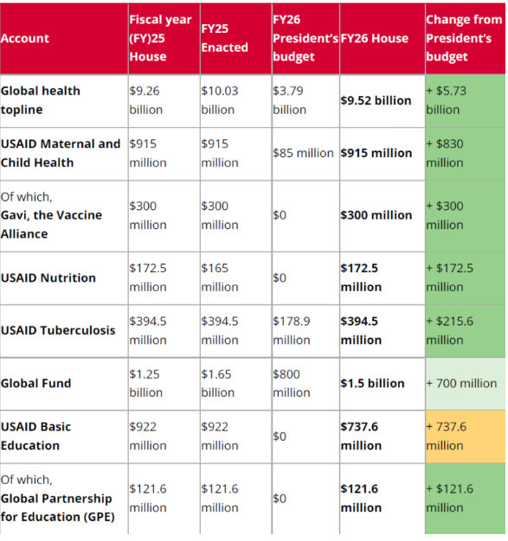
House FY26 Appropriations Bill

Slide 9
Congressional Actions
Senate: Finalize FY26 bill with strong investments
Both Chambers: Hold the White House accountable to spend the money it already has for the fight against global poverty.
Champions for the Global Fund
Standing up for the U.S. 1:2 match, and making sure the U.S. does its part to help save 23 million lives.

Slide 10
The White House is trying to claw back money Congress had already set aside for global health. Again, Congress gets final say. So again, that’s where we stayed focused.

Slide 11
The Senate’s red-line on cuts:
...Provided, That none of the amounts rescinded under this paragraph shall be from the unobligated balances for the following programs: HIV/AIDS, Tuberculosis, Malaria, Nutrition, or Maternal and Child Health
S.Amdt.2853 — 119th Congress

Slide 12
This isn’t a sign that we’re done. The first $9 billion rescissions package still passed. The House bill still cut other global funding. And the White House has now sent a second rescissions package to Congress to claw back another almost $5 billion additional foreign aid funding, which includes $3.2 billion for Development Assistance. But it’s a sign that you are making a difference. And that we need to keep going.

Slide 13
Humanitarian Action for Gaza
“This unthinkable is not looming - it is already here. The escalation is underway. The collapse of essential services is leaving the youngest and most vulnerable fighting for survival.
UNICEF Staff in Gaza
Take our online action on Gaza!

Slide 14
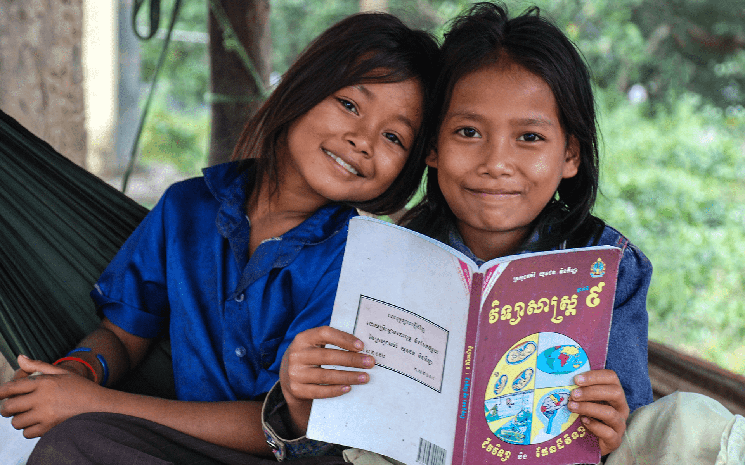
Grantee Spotlight
Lotus Outreach (Cambodia)
Notes:
Susan

Slide 15
Advocacy Training: Speaking powerfully using EPIC Laser Talks

Slide 16
EPIC Laser Talks: A Tool for Speaking and Writing
A laser talk: A very succinct, crisp 4-part piece about what you care about, why you care about it, and the action you wish a lawmaker to take in response
EPIC: A way to focus and organize what you want to say in your laser talk

Slide 17
Laser Talks: A Tool for Speaking and Writing
Engage
Problem
Inform
Call to action

Slide 18
E = Engage
How can you capture the attention of your reader or listener?
Perhaps a startling statistic?
Perhaps a personal story about how a policy has personally affected you or why you are passionate about it?

Slide 19
P = Problem
How can you articulate the problem you would like the legislator to help solve?
Can you describe how poverty is being created or exacerbated? Is it lack of access to nutrition? A tax policy piece that punishes family?
How would you explain the issue in a sentence or two to someone as if they are hearing it for the first time?

Slide 20
I = Inform
How can I inform my reader/listener on the solution for which I'm advocating?
Are you asking for the policymaker to speak up to colleagues about a policy change? Maybe you are eager for the passage of a certain bill? Be clear about what you want.
Describe this solution as a positive, proactive step.

Slide 21
C = Call to Action
What am I asking the member of Congress to do?
Can you describe the action you're wishing the legislator to take in the form of a yes or no question? (i.e., "Will you co-sponsor . . ." or "Will you speak to . . .”
Remember that your outreach to a congressional office isn't complete until you get a clear "yes" or "no" answer.

Slide 22
Global Fund Laser Talk
Listen for the EPIC elements:
Engage
Problem
Inform
Call to action

Slide 23
Global Fund Laser Talk
Engage: At the height of the AIDS crisis, the world came together to create the Global Fund to Fight AIDS, Tuberculosis and Malaria. Over the past two decades, this partnership has helped save 65 million lives and has always received bipartisan support in Congress.

Slide 24
Global Fund Laser Talk
Problem: Despite recent progress in global health, millions of people are still suffering and left behind by their health systems. For example, tuberculosis (TB) — the world’s leading infectious disease killer — sickened almost 11 million and killed 1.25 million people in 2023 alone.

Slide 25
Global Fund Laser Talk
Inform: This fall, world leaders will make new pledges to the Global Fund. The U.S. has played a key leadership role for decades. Our pledges bring other donors to the table by committing to matching $1 for every $2 from other countries.

Slide 26
Global Fund Laser Talk
Call to Action: We need bipartisan leadership in Congress to deliver vital funding for the Global Fund. This also encourages other donors to come forward. Can we count on you to commit to continuing the U.S. 1:2 match, and will you also reach out to appropriators to ensure that this is included in the FY26 spending bill?

Slide 27
Personalize your EPIC Laser Talk
The budget reconciliation bill passed this summer holds vast potential to do real harm. And the push for the U.S. to stand up for the Global Fund to Fight AIDS, Tuberculosis and Malaria is on now.
RESULTS Laser Talks (updated soon):
https://results.org/volunteers/laser-talks
The Global Fund to Fight AIDS TB and Malaria
Gavi, The Vaccine Alliance

Slide 28
Additional Resources
2024 Global Fund Report: https://tinyurl.com/GF2024Report

Slide 29

Additional advocacy actions you can take now!
Personalize and submit this draft “Letter to the Editor”
Or take this online action

Slide 30

Take action now!
Personalize this sample email to your member of Congress’ Foreign Policy aide
Or take this online action

Slide 31
Take action now!
Take this online action

Slide 32
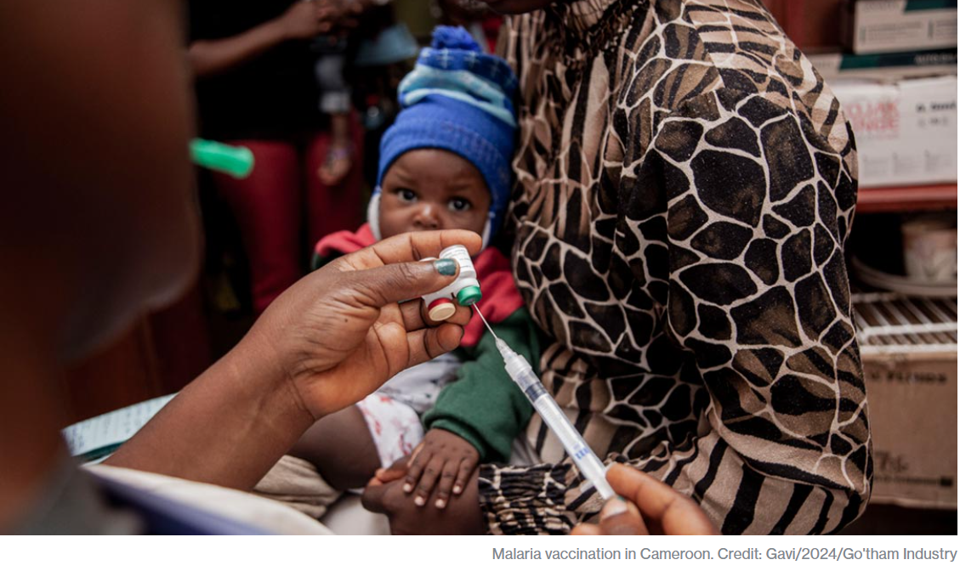
Protect key programs! Gavi, the Vaccine Alliance
1 billion children immunized
17 million future deaths prevented
50% of the world’s children vaccinated by Gavi
$54 returned for every $1 invested
19 countries transitioned out of support
Over 8 million lives saved through 2023

Slide 33

Take action now!
Personalize this sample email to your member of Congress’ Foreign Policy aide
Online action: Vote NO on Rescissions

Slide 34
Save the Date
Celebrate International Day of the Girl
With Together Women Rise Alexandria, VA (in-person event)
Saturday October 11, 2 PM to 4 PM ET
More information and registration here.

Slide 35
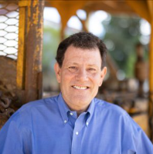
Save the Date
International Day of the Girl
With Nicholas Kristof Webinar
Tuesday, October, 14 12:00 PM ET
More info and registration here.
Nicholas Kristof is the author of six books, including the No. 1 best-seller Half the Sky, A Path Appears (in which he mentions Together Women Rise!), and his most recent, Chasing Hope. He has had a longstanding interest in health, poverty and women’s rights.
The Waste Musk Created, Nicholas Kristof, New York Times (June 23, 2025)

Slide 36
Tuesday, October 21 at 8:30 PM ET
Next Together Women Rise Advocacy Chapter Webinar
Notes:
Karyne

Slide 37
Invite others to join us in
changing the world together!
Sign up here: http://tinyurl.com/JoinRiseAdvocacyChapter
Notes:
If you would like to learn more and take action with us, we would like to invite you to fill out our sign up, Karyne will drop it in the chat http://tinyurl.com/JoinRiseAdvocacyChapter Karyne drop the link to sign up in the chat

