Slide 1


Rise Advocacy Chapter Monthly Webinar
August 19, 2025
Notes:
Susan

Slide 2

Welcome
Please let us know in the chat where you are joining us from!

Slide 3
Mission & Vision
Together Women Rise’s Mission Together Women Rise cultivates the collective power of community to achieve global gender equality.
OUR VISION Together Women Rise envisions a world where every person has the same opportunities to thrive regardless of their gender or where they live. Rise Anti Oppression Commitment:
At Together Women Rise, we come together as a community dedicated to equality and justice for women and girls everywhere. Read full statement here.

Slide 4
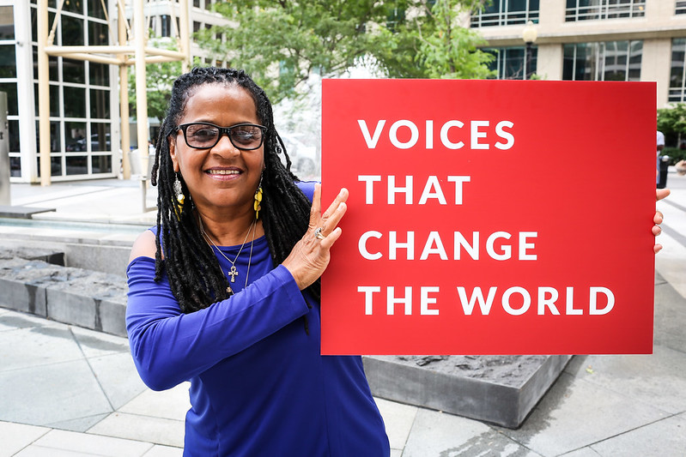
RESULTS is a movement of passionate, committed, everyday people. Together, we use our voices to influence political decisions that will bring an end to poverty.
Notes:
Karyne

Slide 5
Our Values & Resources
​At RESULTS we pledge to create space for all voices, including those of us who are currently experiencing poverty. We will address oppressive behavior in our interactions, families, communities, work, and world. Our strength is rooted in our diversity of experiences, not in our assumptions.
With unearned privilege comes the responsibility to act so the burden to educate and change doesn’t fall solely on those experiencing oppression. When we miss the mark on our values, we will acknowledge our mistake, seek forgiveness, learn, and work together as a community to pursue equity.
Read our full anti-oppression values statement here at results.org/values.
Notes:
Karyne

Slide 6
August Recess (now through Aug 30)
Notes:
Karyne & Susan

Slide 7
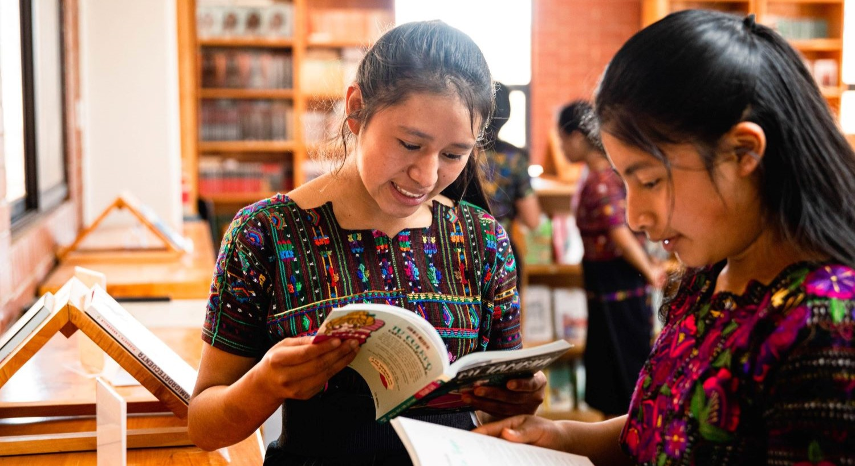
Grantee Spotlight
MAIA (maiaimpact.org)
Notes:
Susan

Slide 8
Campaign Update: Funding the fight against global poverty
FY 26 Appropriations House Bill
The Global Fund to Fight AIDS, TB, and Malaria
Notes:
Agenda
Tonight’s agenda (1 min)
Welcome and introductions
Recent Advocacy Updates: How have folks engaged with advocacy since our March meeting?
FY 26 Appropriations
Closing

Slide 9



House FY 26 Appropriations
 | President’s budget | House bill
Maternal and Child Health | 90% cut | Restored
Gavi, the Vaccine Alliance | $0 | Restored
Nutrition | $0 | Increased
Tuberculosis | 50% cut | Restored
Global Fund to Fight AIDS, TB & Malaria | 50% cut | Restored
Global Partnership for Education | $0 | Restored

Slide 10
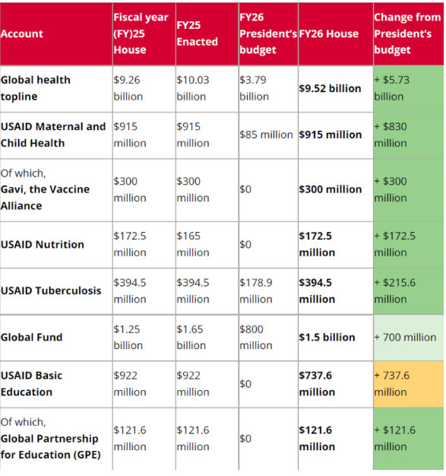
House FY26 Appropriations Bill

Slide 11
This isn’t a sign that we’re done. The rescissions package still passed. The House bill still gutted other critical work. Millions of people are still being denied TB treatment, nutrition, education, and more. But it’s a sign that you are making a difference. And that we need to keep going.

Slide 12
The Senate’s red-line on cuts:
...Provided, That none of the amounts rescinded under this paragraph shall be from the unobligated balances for the following programs: HIV/AIDS, Tuberculosis, Malaria, Nutrition, or Maternal and Child Health
S.Amdt.2853 — 119th Congress

Slide 13
What’s next?
On to the Senate!
Bold new investments, and holding the White House accountable to spend the money it already has for the fight against global poverty.
Champions for the Global Fund
Standing up for the U.S. 1:2 match, and making sure the U.S. does its part to help save 23 million lives.

Slide 14
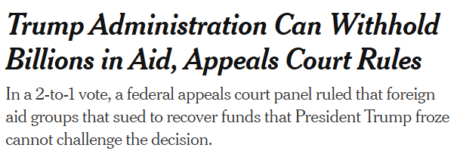
NYT, August 13, 2025
Notes:
NYT Article 8/13 - https://www.nytimes.com/2025/08/13/us/politics/foreign-aid-trump-appeals-ruling.html?unlocked_article_code=1.eE8.2EEq.ZXjdjUhvwk31&smid=url-share

Slide 15
Write to Fight Back: Breaking through the noise with effective media
Notes:
Ken

Slide 16
Why do we use media?
Making connections between the issues we advocate on and current events
Bringing awareness of these issues to our community (more constituents & voters)
Puts pressure on MOCs to act (they monitor what is being said about them in the media)
Notes:
Karyne

Slide 17
How to get started
Find a local hook
Articles in the paper? Make the connection to other global issues that intersect with education, nutrition, and health
Important statistic relevant to your district or state?
Respond to other published media
Thank you to your Rep. or Senator
Looking for relevant hooks? Check out this resource.
Notes:
Karyne – here are some ideas of hooks, any one?
Walk through the resource so we can find hooks about funding foreign aid, the Global Fund, Gavi, o

Slide 18
How to get started
Use sample LTE template to get you started, personalize it. Why is this issue important to you? Why should it be important to our members of Congress & Candidates?
Gavi, the Vaccine Alliance: Media: Congress should support Gavi's life-saving work
Nutrition & Nutrition for Growth: Media: The US must make a strong, early pledge to Nutrition for Growth
Education: Media: Every child deserves an education
Tuberculosis: The House must pass the End TB Now Act
Notes:
Karyne – here are some ideas of hooks, any more?

Slide 19
Tips on writing LTEs
Remember your C’s
Be current – respond to recent article or current event
Construct your LTE in EPIC format
Keep it concise: Rule of thumb is 150 - 200 words or less (follow the paper’s guidelines on word count)
Connect the dots: How is this relevant to your community/district/state?
Notes:
Karyne – here are some ideas of hooks, any one?

Slide 20
Tips on writing LTEs
Remember your C’s
Be challenging - ask a question (but don’t make a personal attack), name your member of Congress
Have a call to action whether for Congress or from the reader
Be creative!
Be contagious: Submit to as many newspapers as possible!
When you’re ready to submit
Don’t forget your contact information!
Notes:
Karyne – here are some ideas of hooks, any more?

Slide 21
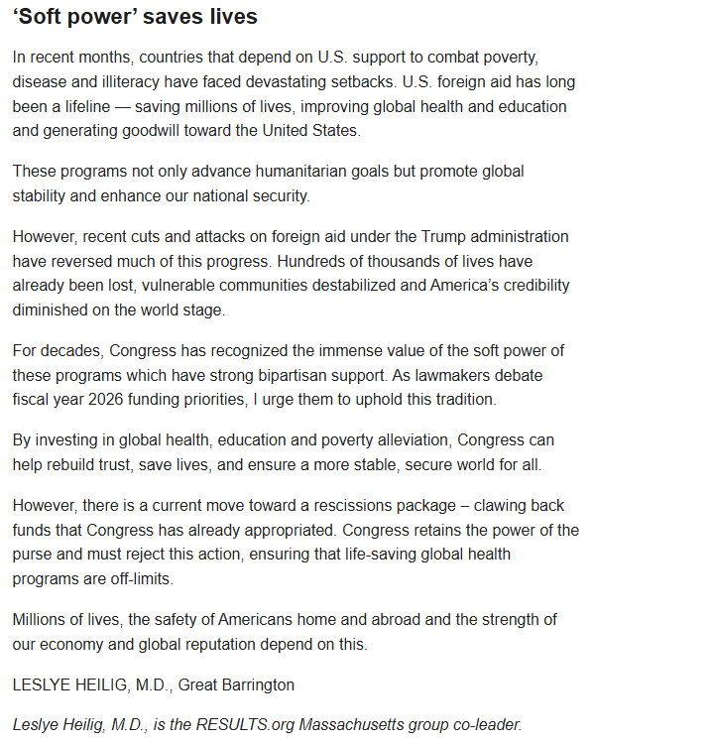

“Soft power” saves lives”
Leslye Heilig, M.D.
The Republican (Springfield)
June 15, 2025
Notes:
Sample of Rise media

Slide 22
What has been published?
Together Women Rise Letters to the Editor
Notes:
Karyne – here are some ideas of hooks, any more?

Slide 23
Submitting an LTE: Using RESULTS Action Center
Notes:
Karyne
Gavi the Vaccine Alliance: https://results.org/volunteers/action-center/action-alerts?vvsrc=%2fcampaigns%2f60670%2frespond
Nutrition for Growth: https://results.org/volunteers/action-center/action-alerts?vvsrc=%2fcampaigns%2f59439%2frespond
READ Act: https://results.org/volunteers/action-center/action-alerts?vvsrc=%2fcampaigns%2f87023%2frespond
End TB Now: https://results.org/volunteers/action-center/action-alerts?vvsrc=%2fcampaigns%2f63557%2frespond

Slide 24
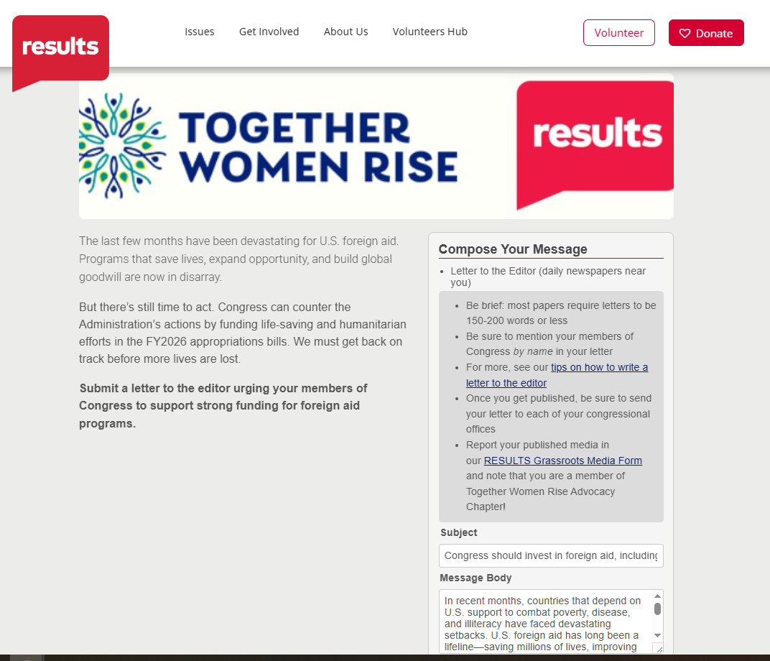
Submitting an LTE: Using RESULTS Action Center
Notes:
Karyne
Link to action center - https://results.org/volunteers/action-center/action-alerts?vvsrc=%2fcampaigns%2f74353%2frespond

Slide 25
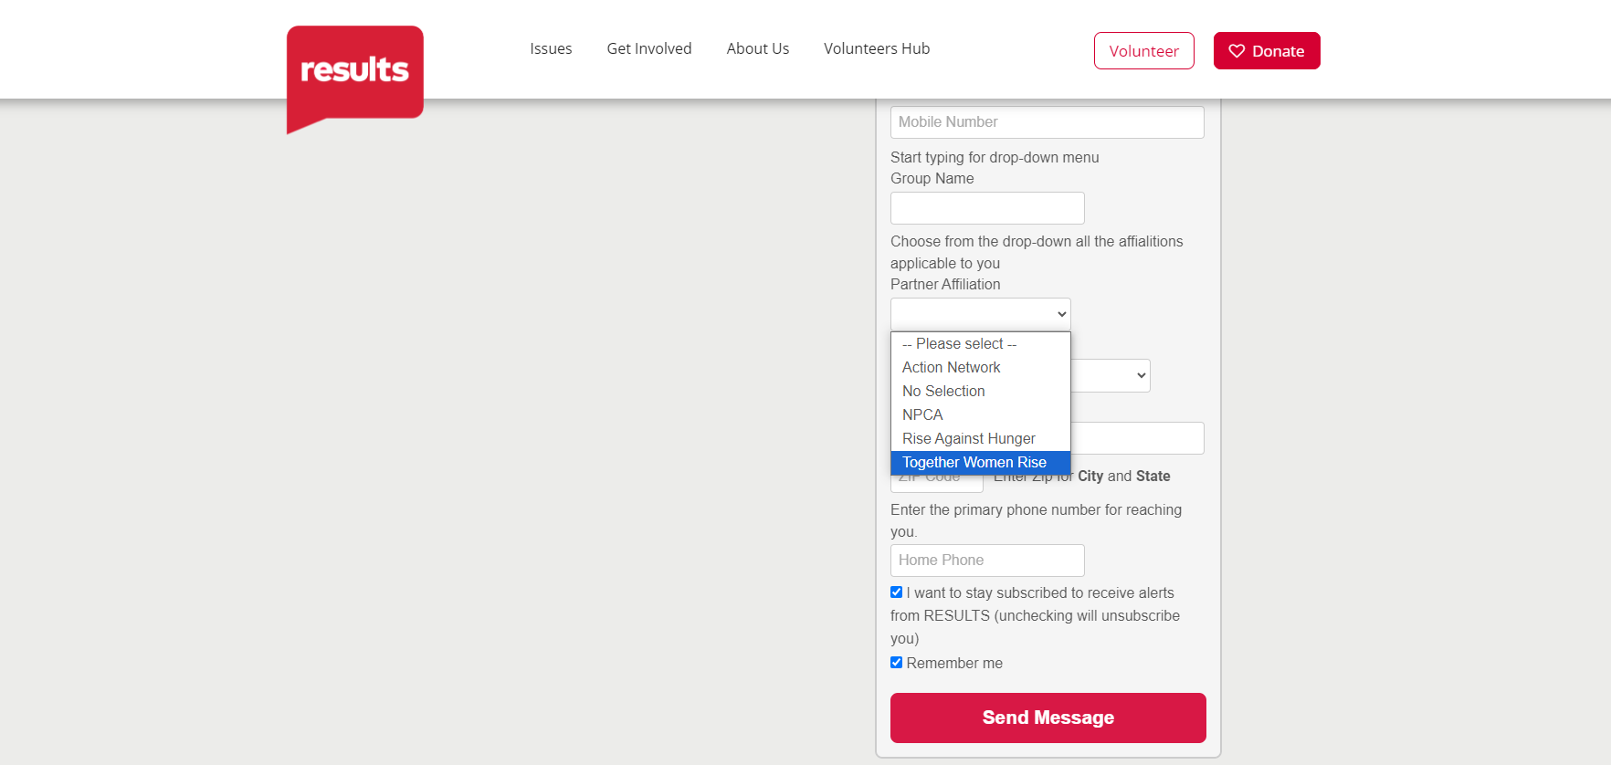

Slide 26
Submitting an LTE: Directly to newspaper outlet

Slide 27
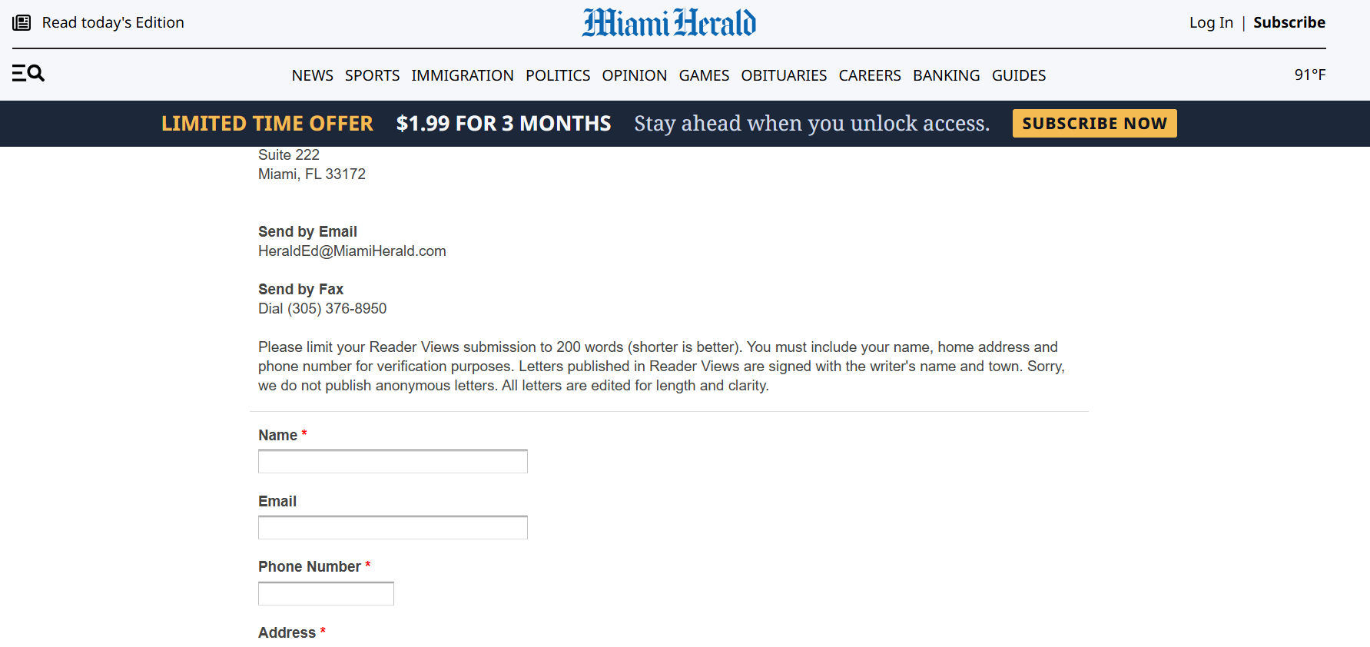

Submitting an LTE: Directly to newspaper outlet
Notes:
Karyne
Gavi the Vaccine Alliance: https://results.org/volunteers/action-center/action-alerts?vvsrc=%2fcampaigns%2f60670%2frespond
Nutrition for Growth: https://results.org/volunteers/action-center/action-alerts?vvsrc=%2fcampaigns%2f59439%2frespond
READ Act: https://results.org/volunteers/action-center/action-alerts?vvsrc=%2fcampaigns%2f87023%2frespond
End TB Now: https://results.org/volunteers/action-center/action-alerts?vvsrc=%2fcampaigns%2f63557%2frespond

Slide 28
Choose one method, not both!
Notes:
Karyne
Gavi the Vaccine Alliance: https://results.org/volunteers/action-center/action-alerts?vvsrc=%2fcampaigns%2f60670%2frespond
Nutrition for Growth: https://results.org/volunteers/action-center/action-alerts?vvsrc=%2fcampaigns%2f59439%2frespond
READ Act: https://results.org/volunteers/action-center/action-alerts?vvsrc=%2fcampaigns%2f87023%2frespond
End TB Now: https://results.org/volunteers/action-center/action-alerts?vvsrc=%2fcampaigns%2f63557%2frespond

Slide 29
Q&A

Slide 30

Additional advocacy actions you can take now!
Personalize and submit this draft “Letter to the Editor”
Or take this online action

Slide 31

Take action now!
Personalize this sample email to your member of Congress’ Foreign Policy aide
Or take this online action

Slide 32
Take action now!
Take this online action

Slide 33
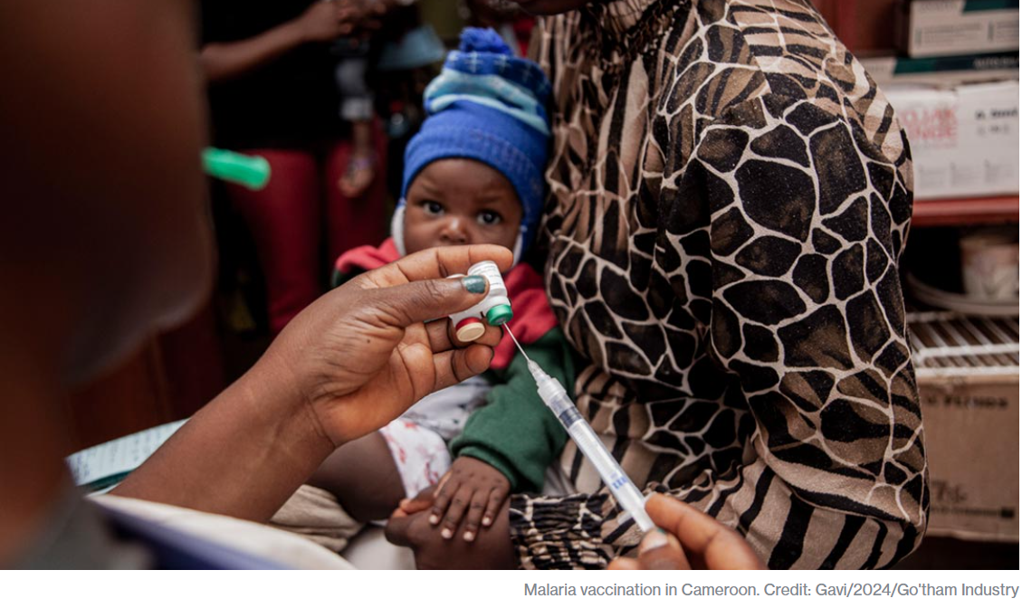
Protect key programs! Gavi, the Vaccine Alliance
1 billion children immunized
17 million future deaths prevented
50% of the world’s children vaccinated by Gavi
$54 returned for every $1 invested
19 countries transitioned out of support
Over 8 million lives saved through 2023

Slide 34

Take action now!
Personalize this sample email to your member of Congress’ Foreign Policy aide
Online action: Vote NO on Rescissions

Slide 35

Continue writing LTEs!
Write to Fight Back: RESULTS Media Action Webinar Protecting SNAP, Medicaid, and Global health programs
Recording and resources
Find resources from our July “Write to Fight Back” webinar linked here.
Notes:
Invite others to join: https://tinyurl.com/2025GAPWebinars

Slide 36
Tuesday, Sept. 16 at 8:30 PM ET
Next Together Women Rise Advocacy Chapter Webinar
Notes:
Karyne

Slide 37
Invite others to join us in
changing the world together!
Sign up here: http://tinyurl.com/JoinRiseAdvocacyChapter
Notes:
Leslye
If you would like to learn more and take action with us, we would like to invite you to fill out our sign up, Karyne will drop it in the chat http://tinyurl.com/JoinRiseAdvocacyChapter Karyne drop the link to sign up in the chat

Slide 38

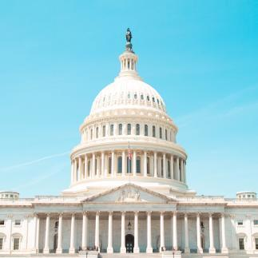

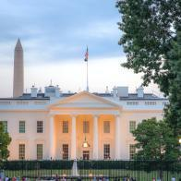
Championing the Global Fund

Slide 39
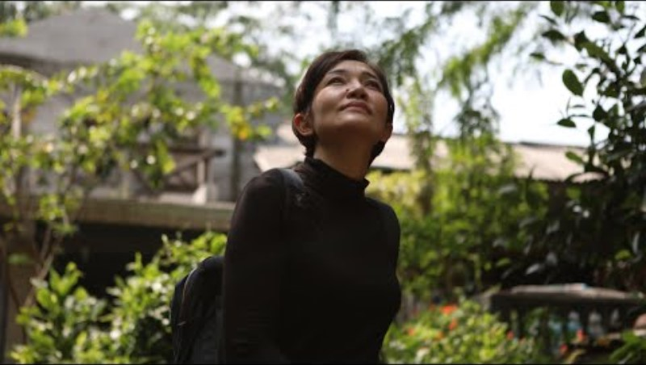
Mei’s Fight: Hard Work and Hope to End TB for Good

Slide 40

65 million lives saved
Global Fund raises money
Global Fund provides oversight
Countries & communities make plans
Local experts lead the programs
Global Fund reviews and approves
Notes:
The global fund is a worldwide partnership where world leaders meet at a conference every 3 years to pledge a specific amount of money to last the following three years.
Countries in need of assistance take the lead in determining where and how to best fight AIDs, TB, and malaria, tailoring their own response and taking into consideration their political, cultural, and epidemiological context.
Once a plan has been proposed for a specific country, the Global fund has to review and approve of the plan
After approval, local healthcare workers, government, and communities are elected to lead the program
In the background, the global fund is providing oversight and making sure that their plan can become a success
This has led to millions of saved lives and success in low income countries.
This is all done efficiently with only 6.2% of funds going secretariat overhead costs meaning the vast majority goes directly to countries and programs being implemented

Slide 41
Championing the Global Fund

Slide 42
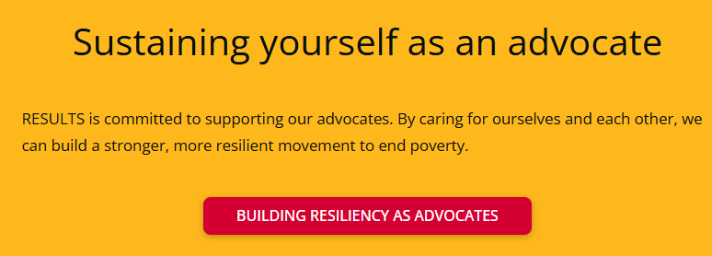
Notes:
Building resiliency as advocates: https://results.org/wp-content/uploads/Building-Resilience-as-an-Advocate_resources.pdf

