Slide 1

Rise Advocacy Chapter Monthly Webinar
November 18, 2025
Notes:
Susan

Slide 2

Welcome
Please let us know in the chat where you are joining us from!

Slide 3
Mission & Vision
Together Women Rise’s Mission Together Women Rise cultivates the collective power of community to achieve global gender equality.
OUR VISION Together Women Rise envisions a world where every person has the same opportunities to thrive regardless of their gender or where they live. Rise Anti Oppression Commitment:
At Together Women Rise, we come together as a community dedicated to equality and justice for women and girls everywhere. Read full statement here.

Slide 4
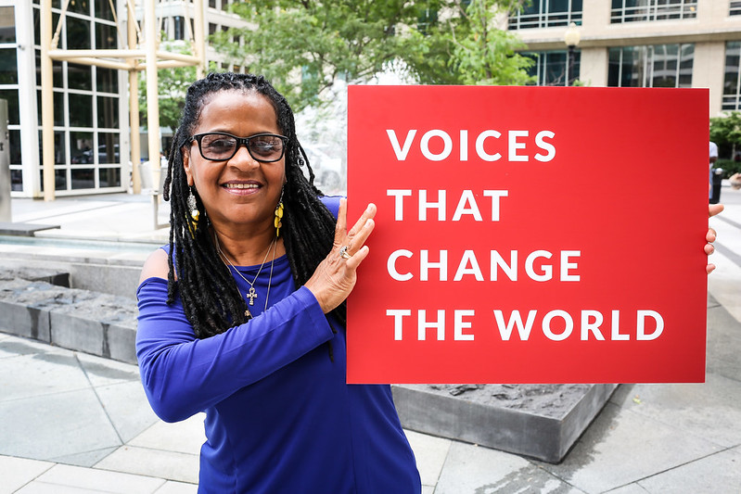
RESULTS is a movement of passionate, committed, everyday people. Together, we use our voices to influence political decisions that will bring an end to poverty.
Notes:
Karyne

Slide 5
Our Values & Resources
​At RESULTS we pledge to create space for all voices, including those of us who are currently experiencing poverty. We will address oppressive behavior in our interactions, families, communities, work, and world. Our strength is rooted in our diversity of experiences, not in our assumptions.
With unearned privilege comes the responsibility to act so the burden to educate and change doesn’t fall solely on those experiencing oppression. When we miss the mark on our values, we will acknowledge our mistake, seek forgiveness, learn, and work together as a community to pursue equity.
Read our full anti-oppression values statement here at results.org/values.
Notes:
Karyne

Slide 6
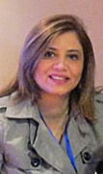
Guest Speaker
Guest Speaker, Dr. Oraib Al Smadi President Jordan Society of Family Medicine (JSFM)
Notes:
Susan

Slide 7
Government Shut Down October 1, 2025 – November 12, 2025

Slide 8
Last week’s House Vote
Government reopened after a 43-day shut down (the longest in U.S. history)
Funds most of the federal government through January 30,2026
Hundreds of thousands of furloughed and/or work without pay will receive back pay and return to work.
Agriculture
Military Construction & Veterans Affairs (Mil-Con)
Legislative branch

Slide 9
Unfinished business
Stabilized federal operations; resumption of important programs however extension of health-care subsidies remains unaddressed.
Foreign affairs budget is still in flux:
The window to influence final appropriations is still open while Senate markup negotiations proceed.
House FY26 Appropriations bill – H.R. 4779 (July 2025)
Senate FY26 Appropriations bill still pending

Slide 10



House FY 26 Appropriations
 | President’s budget | House bill
Maternal and Child Health | 90% cut | Restored
Gavi, the Vaccine Alliance | $0 | Restored
Nutrition | $0 | Increased
Tuberculosis | 50% cut | Restored
Global Fund to Fight AIDS, TB & Malaria | 50% cut | Restored
Global Partnership for Education | $0 | Restored

Slide 11
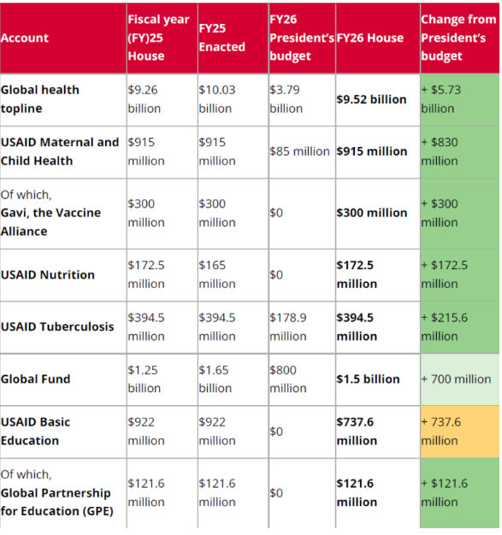
House FY26 Appropriations Bill

Slide 12
Our asks of Congress remain
Fund high-impact global health and poverty programs
→ with a top focus on Global Fund
Hold the administration accountable for outcomes

Slide 13
Global congressional actions
Senate: Finalize FY26 bill with strong investments
Both Chambers: Hold the White House accountable to spend the money it already has for the fight against global poverty.
Champions for the Global Fund: Standing up for the U.S. 1:2 match, and making sure the U.S. does its part to help save 23 million lives.

Slide 14

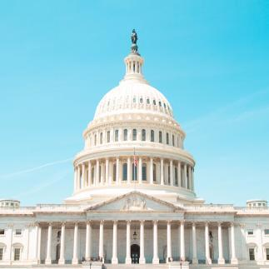

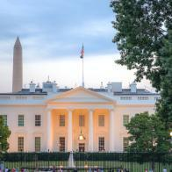
Championing the Global Fund

Slide 15


Slide 16

Global Fund impact:
In 2024 alone…
7.4 million people treated for TB
25.6 million people on HIV/AIDS treatment

Slide 17
What can a sufficiently funded Global Fund do?
Support countries to save 23 million lives in the next 3 years
The partnership can avert 400 million infections in this period
Build sustainable health systems capable of reaching those most in need

Slide 18
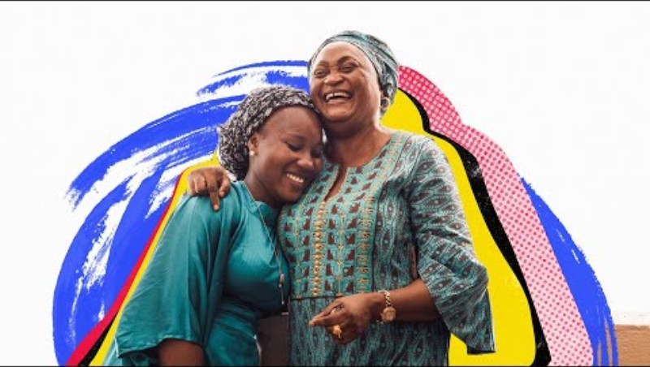

Slide 19


Slide 20

Take action now!
Personalize this sample email to your member of Congress’ Foreign Policy aide
Or take this online action

Slide 21
Take action now!
Take this online action

Slide 22

Take action now!
Personalize this sample email to your member of Congress’ Foreign Policy aide
Or take this online action

Slide 23

Take action now!
Take this online action

Slide 24
Humanitarian Action for Gaza
“This unthinkable is not looming - it is already here. The escalation is underway. The collapse of essential services is leaving the youngest and most vulnerable fighting for survival.
UNICEF Staff in Gaza
Take our online action on Gaza!

Slide 25
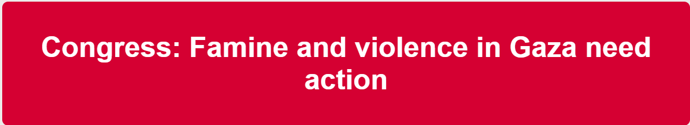
Take action now!
Take this online action

Slide 26

Take action now!
Personalize and submit this draft “Letter to the Editor”
Or take this online action

Slide 27
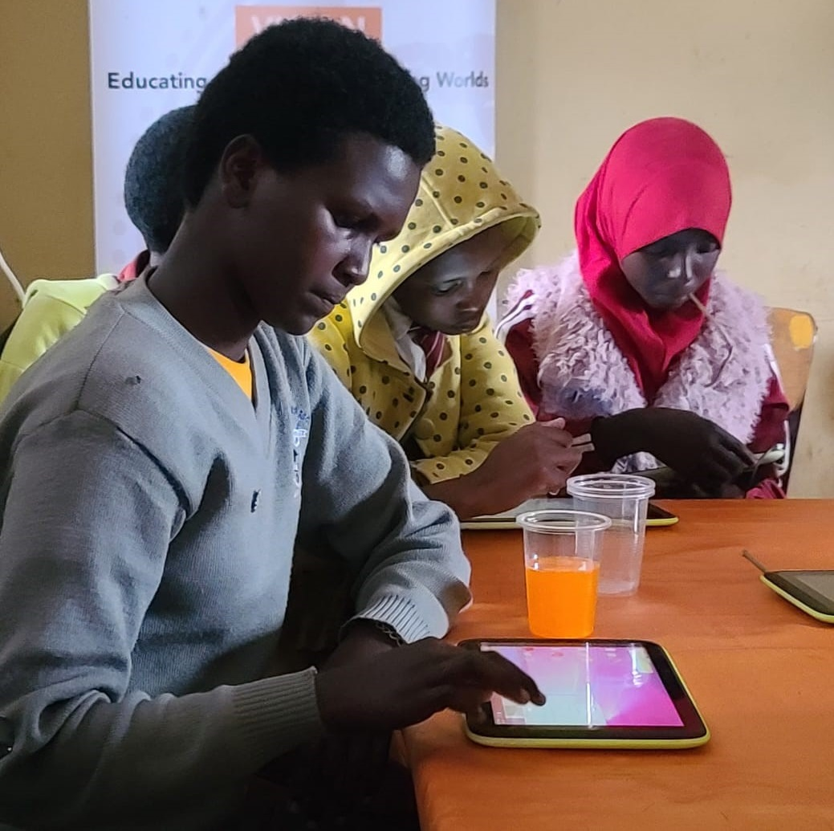
Grantee Spotlight
Asante Africa Foundation (Kenya)
Notes:
Susan

Slide 28
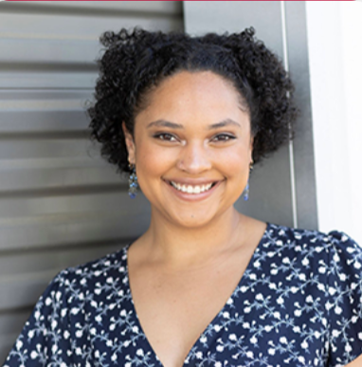
Tuesday, December 9 at 8:30 PM ET
December Webinar
Conversation on the Gender Nutrition Gap
Guest Speaker: Dorothy Monza RESULTS Global Policy Team
Register here
Notes:
Susan

Slide 29
Invite others to join us in
changing the world together!
Sign up here: http://tinyurl.com/JoinRiseAdvocacyChapter
Notes:
If you would like to learn more and take action with us, we would like to invite you to fill out our sign up, Karyne will drop it in the chat http://tinyurl.com/JoinRiseAdvocacyChapter Karyne drop the link to sign up in the chat

Slide 30
Can we still take action?

Slide 31
The good news…

Slide 32

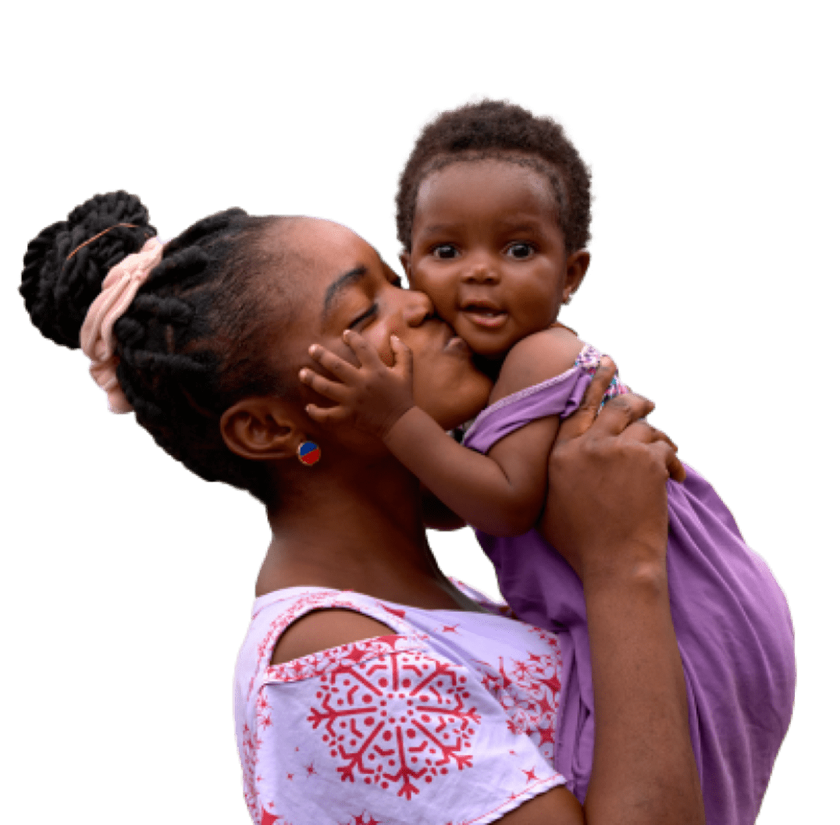
Gavi has helped immunize over 72 million in 2024 alone.
Every 5 minutes, 6 people's lives will have been saved by Gavi-supported vaccines.
Gavi impact report
Notes:
Extraordinary success in the past from both Gavi and GF – we are advocating for things that work and that are making an impact

Slide 33
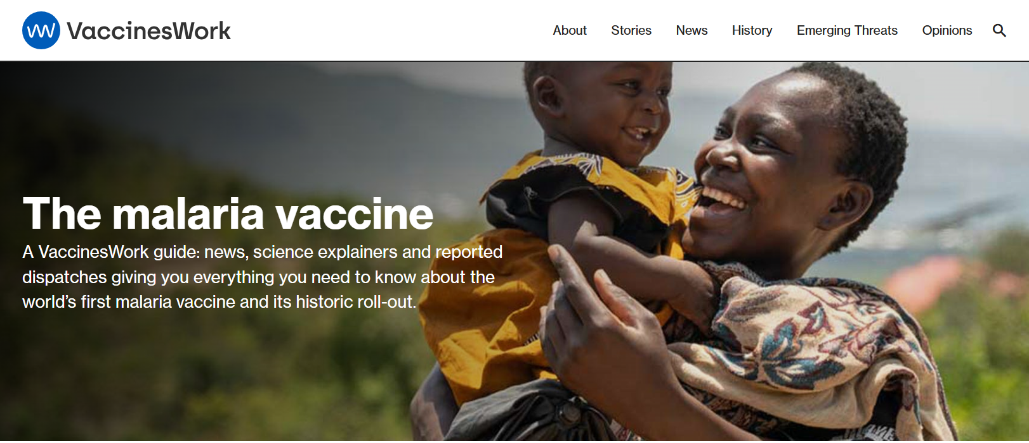
Malaria Vaccine Roll Out

Slide 34
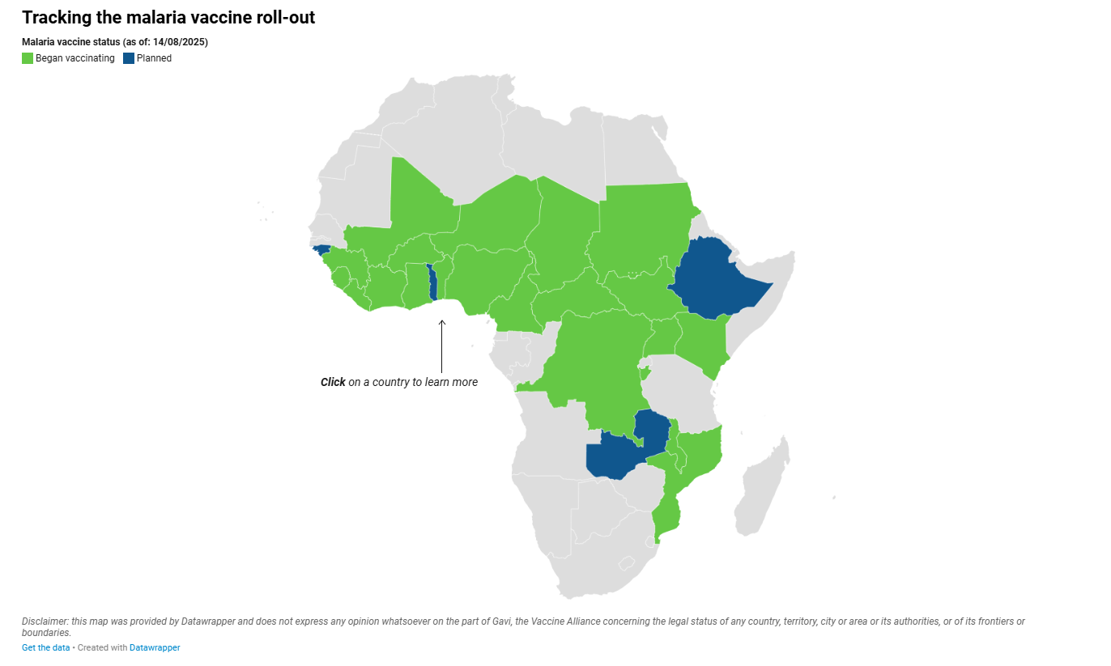

Slide 35
Championing the Global Fund

Slide 37
Global Fund impact
In 2024 alone…
7.4 million people treated for TB
25.6 million people on HIV/AIDS treatment

Slide 38


Slide 39
House FY 26 Appropriations
 | President’s budget | House bill
Maternal and Child Health | 90% cut | Restored
Gavi, the Vaccine Alliance | $0 | Restored
Nutrition | $0 | Increased
Tuberculosis | 50% cut | Restored
Global Fund to Fight AIDS, TB & Malaria | 50% cut | Restored
Global Partnership for Education | $0 | Restored

Slide 40
House FY26 Appropriations Bill

Slide 41
Congressional Actions
Senate: Finalize FY26 bill with strong investments
Both Chambers: Hold the White House accountable to spend the money it already has for the fight against global poverty.
Champions for the Global Fund
Standing up for the U.S. 1:2 match, and making sure the U.S. does its part to help save 23 million lives.

Slide 42
The White House is trying to claw back money Congress had already set aside for global health. Again, Congress gets final say. So again, that’s where we stayed focused.

Slide 43
The Senate’s red-line on cuts:
...Provided, That none of the amounts rescinded under this paragraph shall be from the unobligated balances for the following programs: HIV/AIDS, Tuberculosis, Malaria, Nutrition, or Maternal and Child Health
S.Amdt.2853 — 119th Congress

Slide 44
This isn’t a sign that we’re done. The first $9 billion rescissions package still passed. The House bill still cut other global funding. And the White House has now sent a second rescissions package to Congress to claw back another almost $5 billion additional foreign aid funding, which includes $3.2 billion for Development Assistance. But it’s a sign that you are making a difference. And that we need to keep going.

Slide 45
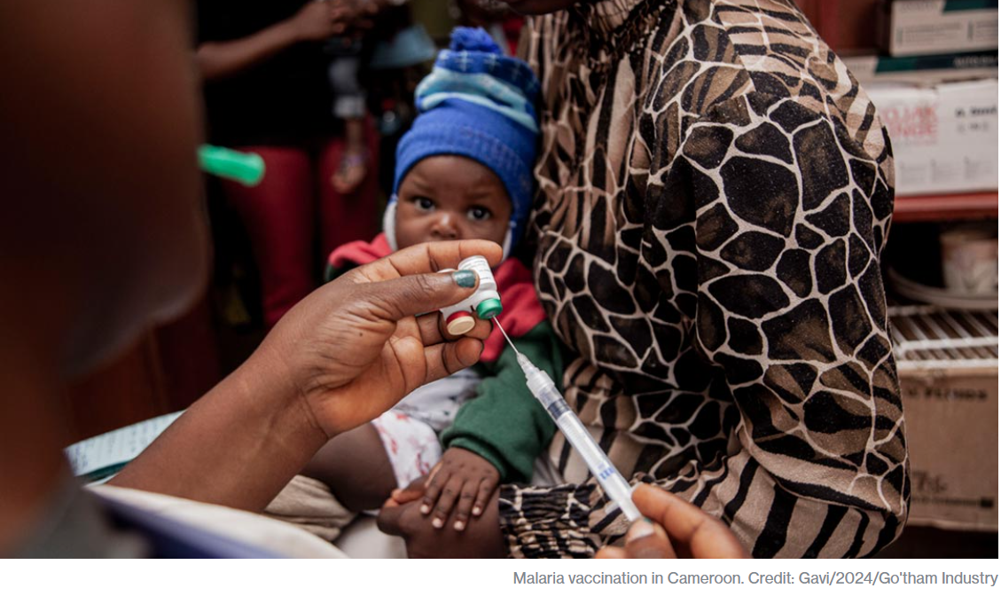
Protect key programs! Gavi, the Vaccine Alliance
1 billion children immunized
17 million future deaths prevented
50% of the world’s children vaccinated by Gavi
$54 returned for every $1 invested
19 countries transitioned out of support
Over 8 million lives saved through 2023

Slide 46
Advocacy Training: Speaking powerfully using EPIC Laser Talks

Slide 47
EPIC Laser Talks: A Tool for Speaking and Writing
A laser talk: A very succinct, crisp 4-part piece about what you care about, why you care about it, and the action you wish a lawmaker to take in response
EPIC: A way to focus and organize what you want to say in your laser talk

Slide 48
Laser Talks: A Tool for Speaking and Writing
Engage
Problem
Inform
Call to action

Slide 49
E = Engage
How can you capture the attention of your reader or listener?
Perhaps a startling statistic?
Perhaps a personal story about how a policy has personally affected you or why you are passionate about it?

Slide 50
P = Problem
How can you articulate the problem you would like the legislator to help solve?
Can you describe how poverty is being created or exacerbated? Is it lack of access to nutrition? A tax policy piece that punishes family?
How would you explain the issue in a sentence or two to someone as if they are hearing it for the first time?

Slide 51
I = Inform
How can I inform my reader/listener on the solution for which I'm advocating?
Are you asking for the policymaker to speak up to colleagues about a policy change? Maybe you are eager for the passage of a certain bill? Be clear about what you want.
Describe this solution as a positive, proactive step.

Slide 52
C = Call to Action
What am I asking the member of Congress to do?
Can you describe the action you're wishing the legislator to take in the form of a yes or no question? (i.e., "Will you co-sponsor . . ." or "Will you speak to . . .”
Remember that your outreach to a congressional office isn't complete until you get a clear "yes" or "no" answer.

Slide 53
Global Fund Laser Talk
Listen for the EPIC elements:
Engage
Problem
Inform
Call to action

Slide 54
EPIC Laser Talk, part deux
Choose your topic.
Choose your audience. (friend/family, MOC, media?)
Write your first draft, practice with partner, revise. (20 mins)
Share in the main room (5 mins)

Slide 55
Personalize your EPIC Laser Talk
The budget reconciliation bill passed this summer holds vast potential to do real harm. And the push for the U.S. to stand up for the Global Fund to Fight AIDS, Tuberculosis and Malaria is on now.
RESULTS Laser Talks (linked here):
The Global Fund to Fight AIDS TB and Malaria
Gavi, The Vaccine Alliance

Slide 56
Global Fund Laser Talk
Engage: At the height of the AIDS crisis, the world came together to create the Global Fund to Fight AIDS, Tuberculosis and Malaria. Over the past two decades, this partnership has helped save 65 million lives and has always received bipartisan support in Congress.

Slide 57
Global Fund Laser Talk
Problem: Despite recent progress in global health, millions of people are still suffering and left behind by their health systems. For example, tuberculosis (TB) — the world’s leading infectious disease killer — sickened almost 11 million and killed 1.25 million people in 2023 alone.

Slide 58
Global Fund Laser Talk
Inform: This fall, world leaders will make new pledges to the Global Fund. The U.S. has played a key leadership role for decades. Our pledges bring other donors to the table by committing to matching $1 for every $2 from other countries.

Slide 59
Global Fund Laser Talk
Call to Action: We need bipartisan leadership in Congress to deliver vital funding for the Global Fund. This also encourages other donors to come forward. Can we count on you to commit to continuing the U.S. 1:2 match, and will you also reach out to appropriators to ensure that this is included in the FY26 spending bill?

Slide 60
Additional Resources
2024 Global Fund Report: https://tinyurl.com/GF2024Report
Gavi, the Vaccine Alliance Progress Report: https://www.gavi.org/progress-report

