Slide 1
RISE Advocacy Chapter Monthly Webinar
March 19, 2024
Notes:
Ken

Slide 2
Welcome
Please let us know in the chat where you are joining us from!
Notes:
Susan
Welcome new folks, Please let us know in the chat where you are based. Introduce yourself since first time you are doing this. Introduce Ken and Karyne and the rest of the Advocacy team of mentors and committee –Anne Child, Sarah Leone, Joanna Distefano, Susan Wright, Leslye Heilig, Margaret Moodian
This is a non-partisan space where we learn how to build relationships with our members of Congress to influence policy. We center ourselves around mutual respect and inclusion.
Invite Rise members to learn more about RESULTS by exploring their website, and RESULTS members to do the same with Together Women Rise. Review mission/vision/anti-oppression (only feel need to read full statement if there is time, but share links in any case)

Slide 3
Mission & Vision
Together Women Rise’s Mission
Together Women Rise cultivates the collective power of community to achieve global gender equality.
OUR VISION
Together Women Rise envisions a world where every person has the same opportunities to thrive regardless of their gender or where they live.
Notes:
Susan
Can share any or all of the text and links below in chat if needed:
Together Women Rise:
Vision
Together Women Rise envisions a world where every person has the same opportunities to thrive regardless of their gender or where they live.
Gender Equality Beliefs
Together Women Rise champions gender equality because women’s rights are human rights. When women and girls are treated equally, the world is healthier, safer, more peaceful, inclusive, and economically just for everyone.
Every woman and girl deserves to live freely and pursue her dreams, free from all forms of discrimination, exploitation, and social exclusion.
Women should have equal economic power, political voice, and leadership representation across the world.
When women and girls are better educated and become leaders and decision-makers, they drive positive change in their families, communities, and countries.
Gender-based violence and harmful practices, such as child and forced marriage, female genital cutting (FGM/C), and human trafficking, harm women’s health, safety, and quality of life. They must be eliminated world-wide.
Sexual and reproductive health is essential to women and girls across their lifespans.
Gender equality and climate justice must go hand-in-hand if we are to ensure we have a clean, healthy, and sustainable planet for future generations.
Men and boys are essential partners and allies in achieving global gender equality.

Slide 4
Our Values & Resources
​At RESULTS we pledge to create space for all voices, including those of us who are currently experiencing poverty. We will address oppressive behavior in our interactions, families, communities, work, and world. Our strength is rooted in our diversity of experiences, not in our assumptions.
With unearned privilege comes the responsibility to act so the burden to educate and change doesn’t fall solely on those experiencing oppression. When we miss the mark on our values, we will acknowledge our mistake, seek forgiveness, learn, and work together as a community to pursue equity.
Read our full anti-oppression values statement here at results.org/values.
Find these resources and more at results.org/volunteers/anti-oppression:
Resource Guides from our Diversity & Inclusion trainings, including:
Interrupting Microaggressions
Creating Space for Critical Conversations
Information on how RESULTS responds to oppressive incidents
Stay tuned for 2024 workshop schedule!
Notes:
Susan
https://togetherwomenrise.org/our-anti-oppression-commitment/
Our Anti-Oppression Values - RESULTS

Slide 5
Review of 2024 Campaigns
Notes:
Ken

Slide 6
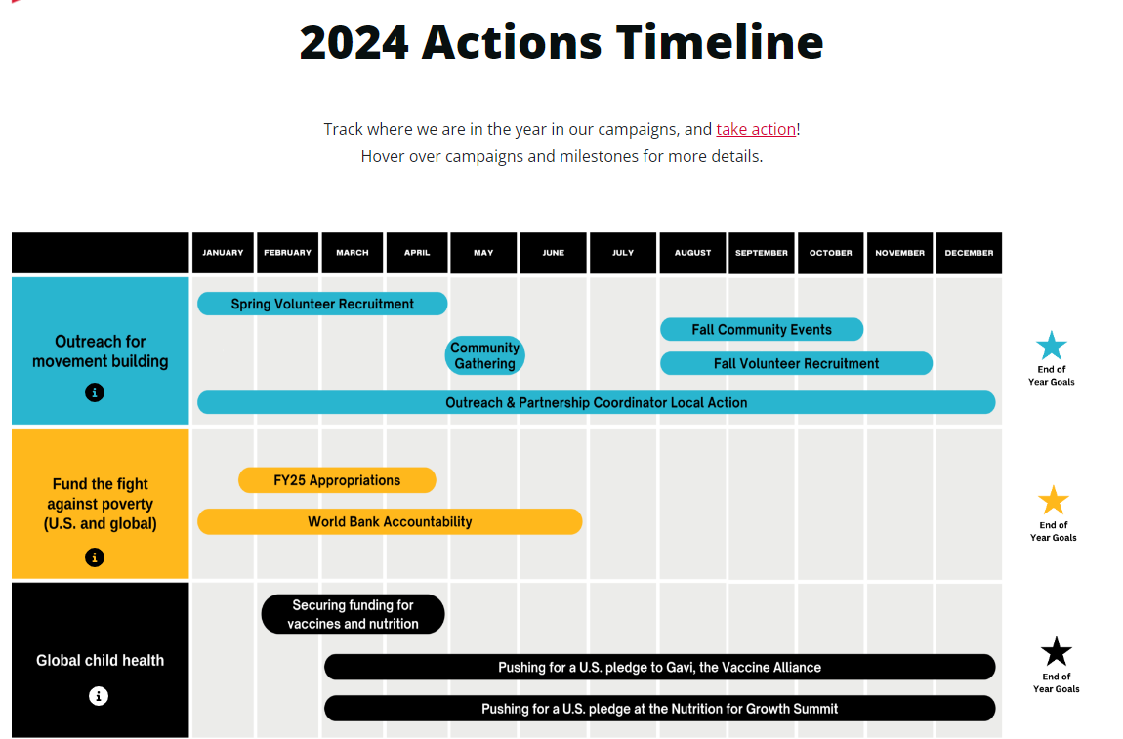
Notes:
Ken

Slide 7
FY25 Appropriations
Notes:
Ken
-Explain what the lay of the land looks like for the full year of advocating with us:
Introduction for newer advocates to explain that 1) we are in the funding portion of our advocacy work via FY25 appropriations, and 2) legislative work is still happening with advocating on bills (End TB Now Act and READ Act) - Invite folks to sign up for Global Policy forum on 2/22 at 9PM (add link)
Q&A time

Slide 8
FY25 Appropriations
Notes:
Ken

Slide 9
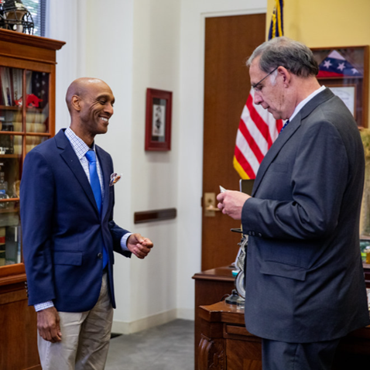
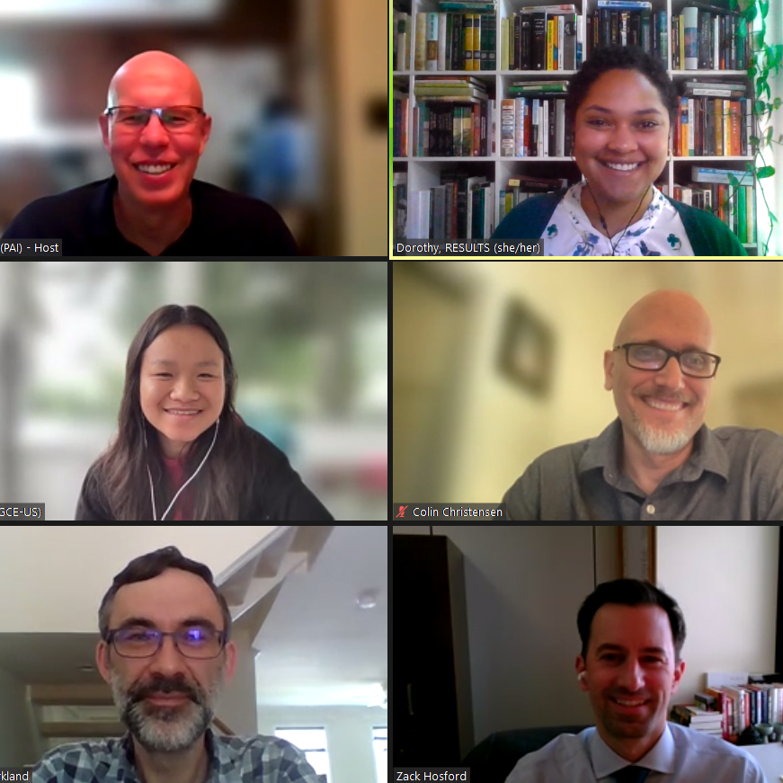
We influence appropriations by…
1) Asking MoCs/staff to include our requests in their submissions to SFOPS and following up 2) Meeting with MoC/staff at home & in DC to make our requests
Notes:
Ken

Slide 10
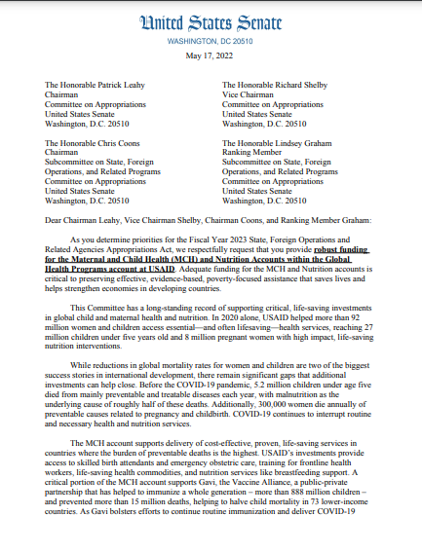
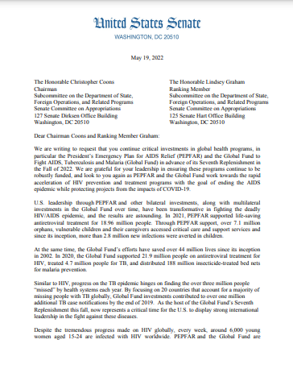
We influence appropriations by…
3) Asking MoCs to sign “dear colleague” letters on our appropriations asks
Notes:
Ken Mention lobby prep, Set the Agenda resources
Most Americans don’t follow the Appropriations process, meaning members of Congress don’t always feel pressure from their constituents to fight for specific programs. But you can get our issues on their radar by sending an email, calling their offices, and asking for a meeting with their Foreign Policy staffers. Your goal is to introduce our appropriations asks, share why those issues matter to you, and ask your senator or representative to speak to members of SFOPs about our requests.

Slide 11
The Impact of Dear Colleague Letters
Account | FY17 Signers | FY17 Funding | FY20 Signers | FY20 Funding | FY23 Signers | FY23 Funding
USAID Maternal and Child Health | 146 House 27 Senate | $814.5 million | 146 House 37 Senate | $851 million | 178 House 35 Senate | $910 million
USAID Tuberculosis | 71 House 16 Senate | $241 million | 77 House 29 Senate | $310 million | 120 House 30 Senate | $394.5 million
Notes:
Ken

Slide 12
FY 2025 Requests
Account | FY23 Enacted | FY24 House | FY24 Senate | RESULTS FY25 Request
USAID Tuberculosis | $394.5 million | $394.5 million | $394.5 million | $1 billion
Global Fund | $2 billion | $2 billion | $1.65 billion | $1.65 billion
USAID Maternal & Child Health | $910 million | $910 million | $920 million | $1.15 billion
–Of which, Gavi, the Vaccine Alliance | $290 million | $300 million | $300 million | $340 million
USAID Nutrition | $160 million | $172.5 million | $160 million | $300 million
USAID International Basic Education | $970 million | $970 million | $640.55 million | $1.15 billion
–Of which, GPE | $130 million | $130 million | $130 million | $200 million
Notes:
Ken

Slide 13
You don't have to ask for everything!
Check the RESULTS Scorecard
Do a little research:
What do they care about?
Connect what they care about with our issues
Ask for one more thing than they've supported in the past
Notes:
Ken

Slide 14
Take Action on Global Health & Education Appropriations!
Take the online action in the RESULTS Action Center.
Send a message directly to the foreign policy aide. Find the message here.
Notes:
Ken Links: Action Center - https://results.org/volunteers/action-center/action-alerts?vvsrc=%2fCampaigns
Sample letter to foreign policy aide - https://docs.google.com/document/d/1ONArIPiY40GY5nRaM8NuES2hDOqUWjPtfI_u-QPkwuo/edit

Slide 15
Grantee Spotlight
Notes:
Margaret

Slide 16
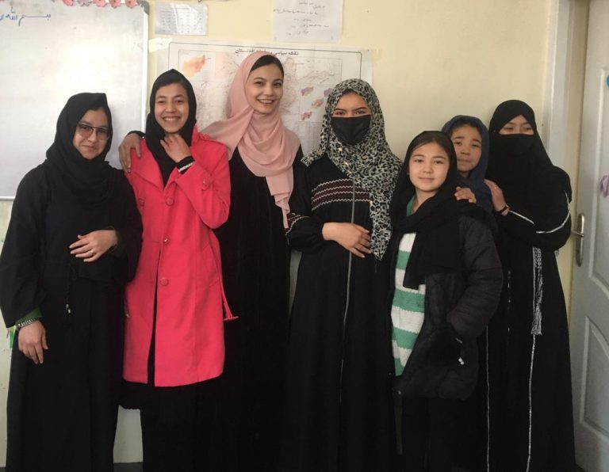
Grantee Spotlight
International Action Network For Gender Equity and Law (I ANGEL)
Notes:
Margaret

Slide 17
Grantee Spotlight
Project Title: BRIDGE - Building Real Interactions Driving Gender Equality
Grant Amount: $50,000 Mission of Equality Now The mission of Equality Now is to achieve legal and systemic change that addresses violence and discrimination against women and girls around the world.
Project Summary
This partnership supports Equality Now’s work to achieve legal gender equality by bringing about specific changes in unjust laws, advocating for needed changes, and supporting collaborative networks to amplify gender equality work. Equality Now’s campaigns focus on the following four critical goals: achieving legal equality; ending harmful practices such as female genital mutilation (FGM/C) and child marriage; ending sexual exploitation; and ending sexual violence.
Notes:
Margaret
Together Women Rise’s Transformation Partnerships are designed to make the biggest impact on achieving global gender equality by addressing the root causes of gender inequality. Almost every country in the world has laws that treat women and girls as second-class citizens. It may take another 286 years to remove discriminatory laws and close prevailing gaps in legal protection for women and girls (Source: UN Women). Together Women Rise and Equality Now share a common belief that legal equality is critical for achieving gender equality and creating a better world for everyone. We are proud to partner with such an impactful, global leader in using the law to create a just world for women and girls. Since 1999, almost 60% of the discriminatory laws highlighted by Equality Now have been fully or partially reformed. The passage of the Palermo Protocol – which enshrined protection from trafficking in international law — is just one example of Equality Now’s incredible impact over the years.

Slide 18
Advocacy Training: Effective Introductions & Storytelling
Notes:
Karyne

Slide 19
Advocacy Training: Introductions
Introducing yourself (tonight)
Sharing a story (homework for next webinar)
Notes:
Karyne

Slide 20
Advocacy Training: Introductions
“Hello, My Name Is…”
The public narrative is a framework which helps you outline your why and answers the question “what brought you here?”
Story of self – Your purpose
Story of us – connection to your community
Story of now – why it’s important to take action now!

Slide 21
Advocacy Training: Introduction
Draft and practice your 20-second introduction
Think of 2-3 adjectives/roles to describe yourself, passionate retired pediatrician, hopeful volunteer advocate, etc.
Think about 1 or 2 issues you care about, girls’ education, nutrition, women’s health, etc.
Think about what we need to do to take action now, support bold funding for the global partnership for education

Slide 22
Who wants to share their 20-second
introduction?

Slide 23
Advocacy Training: Storytelling
Why is storytelling important in advocacy?
Your member wants to know who you are and why the issues you are advocating on are important to you (more memorable than data & numbers)
Notes:
Karyne

Slide 24
Advocacy Training: Storytelling
Why is storytelling important in advocacy?
Stories connect the head and the heart.
They influence policy makers and dispel myths about poverty.
A well-prepared story can change someone’s mind, and move them into action.
Stories are 22x more likely to be remembered than facts alone!

Slide 25
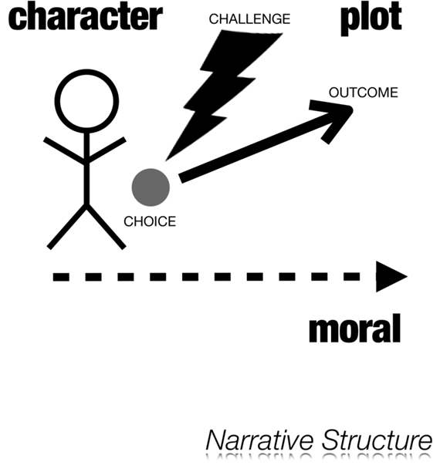
Advocacy Training: Storytelling
What makes a good story?
There is a challenge What challenge did you face? Why was it a challenge?
There is a choice What choice did you make? Why did you make that choice? Where did you get the courage?
There is an outcome What was the result? How did it feel? What can it teach us?

Slide 26
Advocacy Training: Storytelling
How do you tell your story?
The story you tell must be true.
Is it your story to tell? If not, don’t! If the story you are telling is not your own, you must have permission to share it.
Make sure you are sharing a story that relates to the topic at hand.
What are the stakes? The story should have action and consequences. What was gained or lost in this moment? What was the outcome? How did it impact you?

Slide 27
Advocacy Training: Storytelling
How do you tell your story?
Timing: Try to tell the story in 3-5 minutes. The power comes from the words you are saying not how long you are talking.
Practice: Share with your group, your friends and yourself before your meeting.

Slide 28
Advocacy Training: Storytelling
When telling your story, don’t:
Don’t explain a culture or community that is not your own. (Resource: Making an Inclusive Case for Ending Global Poverty)
Don’t overcomplicate it. Keep it simple yet powerful.
Don’t just retell it, relive it. Make your audience understand the importance.
Don’t forget to breathe. A pause before the plot twist or point of your story can amplify the impact.
Notes:
https://results.org/wp-content/uploads/Making-an-Inclusive-Case-for-Ending-Global-Poverty_.pdf

Slide 29
Advocacy Training: Storytelling
Homework: Draft and practice your story
What challenge did you face?
What choices did you have to make as a result of those challenges?
What was the outcome? How did it feel? How did it transform how you feel about your power to change the world?

Slide 30
Lobby meeting update:
Who has met with their member of Congress so far?
Notes:
Karyne
Who has met with members of Congress so far? If you haven’t lobbied before, what has prevented you from doing so? What might make you nervous about meeting with an MOC? - Margaret & Susan: share on their experience and tips:
(thanking your member of Congress,
acknowledging that they have a lot on their plate - showing appreciation for longstanding support as well as immediate support,
being a resource of information);
don’t be a stalker! Polite PUPO behavior, what does that look like??
Meeting staff is just as important! Don’t downplay it (they’re the gatekeeper!), if the staffer is convinced in supporting an issue, they will bring it to the MOC
Understanding the power of constituency, re-emphasize this point with attendees, the amount of support from a district can make a big difference (sharing the CMF slide with the power of hearing from a constituent)

Slide 31
Step One:
Get the meeting!
Request to meet with your member of Congress:
a) Use Legislator Lookup, find the scheduler
b) Use sample meeting request letter, copy staff (Follow up on the request!)
Request times that work with the people you want to join you if possible
Still out of your comfort zone - try joining a meeting held by your local RESULTS group!
Notes:
Karyne
https://youtube.com/shorts/OZ1QTIKddBQ?si=iwiwjTOYdxTprt4a
1 min video featuring Ken Patterson
Do put the meeting request along with the topic in the FIRST line of yoru email
Do send your meeting request early, at least 2 to 4 week before you want to have the meeting
Email the scheduler and cc the key aides that you want to work with - if the DC
Don’t give up! Follow up on the request -

Slide 32
Step Two:
Plan for the meeting!
Create an agenda and assign roles using the RESULTS Lobby Planning Form
Practice talking points (EPIC)
Reconfirm your meeting the day before
Notes:
Karyne
Create an agenda and assign roles using the RESULTS Lobby Planning Form
Practice talking points (EPIC)
Reconfirm your meeting the day before

Slide 33
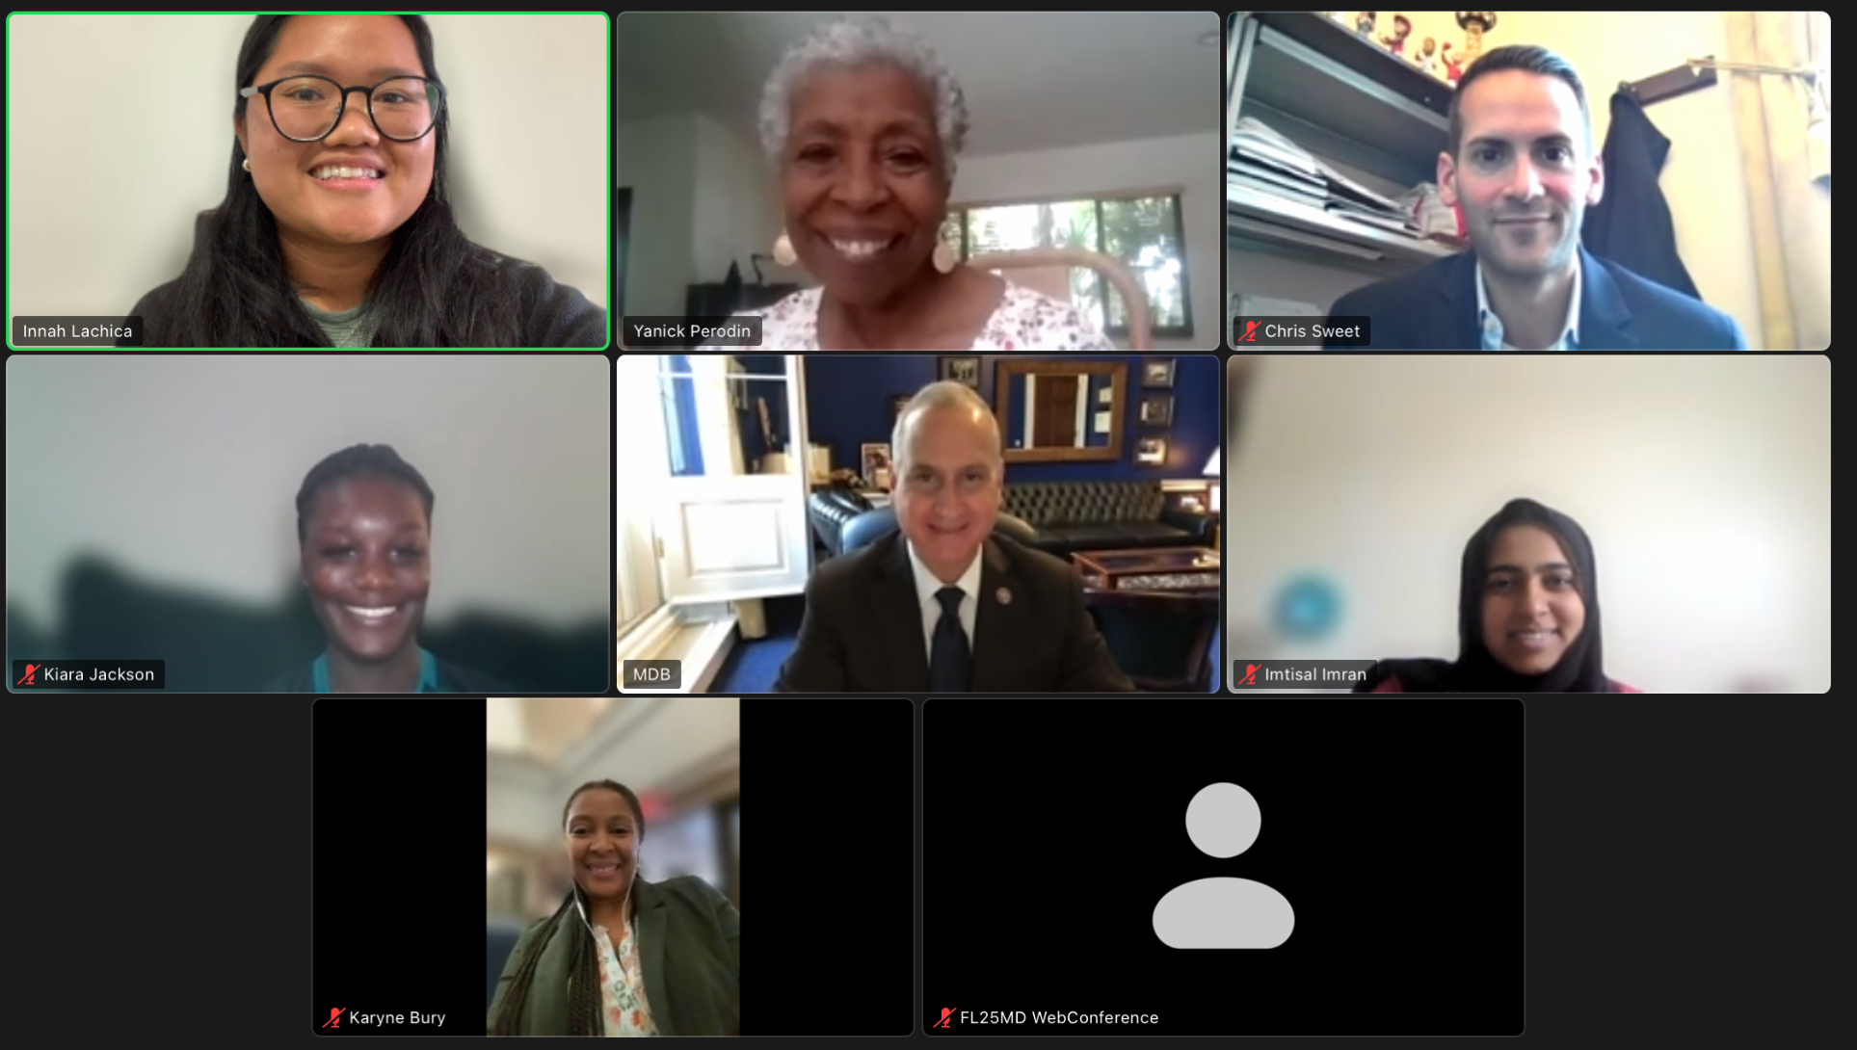
Step Three: Thank you’s and Follow Up
Send a thank you note and summary of asks
Report your meeting to your Rise Advocacy Chapter Coach
Continue to follow up on requests
Notes:
Karyne
Send a thank you note and summary of asks
Report your meeting to your Rise Advocacy Chapter Coach
Continue to follow up on requests

Slide 34
- Together Women Rise Grantees - Join the virtual national chapter meeting with a speaker from the grantee each month on the first Thursday of the month at 8 PM ET: Thursday, April 4 https://togetherwomenrise.org/upcoming-events/ - RESULTS April National Webinar Saturday, April 6 at 1:00 PM ET Speaker: RESULTS Founder, Sam Daley-Harris - Together Women Rise Advocacy Chapter Monthly Webinar Tuesday, April 16 at 8:30 PM ET
Join us!
Notes:
Margaret
RESULTS Global Policy Forum Thursday, February 22 - 9:00 PM ET Learn more about the appropriations process
Together Women Rise Orientation Webinar Tuesday, March 19 at 8:30 PM ET
Together Women Rise Grantees - Join the virtual national chapter meeting with a speaker from the grantee each month on the first Thursday of the month at 8 PM ET: https://togetherwomenrise.org/upcoming-events/

Slide 35
Invite others to join us in
changing the world together!
Sign up here: http://tinyurl.com/JoinRiseAdvocacyChapter

