Slide 1
Rise Advocacy Chapter Monthly Webinar
July 16, 2024

Slide 2
Welcome
Please let us know in the chat where you are joining us from!
Notes:
Susan (also introduce myself, Karyne, Margaret and Leslye and all coaches who are there)
8:30-8:35 PM: Welcome/Introductions (Leslye)
Susan & Karyne can check for new names
Welcome new folks, Please let us know in the chat where you are based. Introduce yourself since first time you are doing this.
Be sure to introduce people, Introduce Ken and Karyne and the rest of the Advocacy team of mentors and committee –Anne Child, Sarah Leone, Joanna Distefano, Susan Wright, Leslye Heilig, Margaret Moodian
Invite new folks to introduce themselves in the chat and share about their interest in advocacy
This is a non-partisan space where we learn how to build relationships with our members of Congress to influence policy. We center ourselves around mutual respect and inclusion.
Intro to vision and values of both organizations, provide the links to full statements
Invite Rise members to learn more about RESULTS by exploring their website, and RESULTS members to do the same with Together Women Rise. Review mission/vision/anti-oppression (only feel need to read full statement if there is time, but share links in any case)

Slide 3
Mission & Vision
Together Women Rise’s Mission
Together Women Rise cultivates the collective power of community to achieve global gender equality.
OUR VISION
Together Women Rise envisions a world where every person has the same opportunities to thrive regardless of their gender or where they live.
Notes:
Susan
Together Women Rise:
Vision
Together Women Rise envisions a world where every person has the same opportunities to thrive regardless of their gender or where they live.
Gender Equality Beliefs
Together Women Rise champions gender equality because women’s rights are human rights. When women and girls are treated equally, the world is healthier, safer, more peaceful, inclusive, and economically just for everyone.
https://togetherwomenrise.org/our-anti-oppression-commitment/

Slide 4
Our Values & Resources
​At RESULTS we pledge to create space for all voices, including those of us who are currently experiencing poverty. We will address oppressive behavior in our interactions, families, communities, work, and world. Our strength is rooted in our diversity of experiences, not in our assumptions.
With unearned privilege comes the responsibility to act so the burden to educate and change doesn’t fall solely on those experiencing oppression. When we miss the mark on our values, we will acknowledge our mistake, seek forgiveness, learn, and work together as a community to pursue equity.
Read our full anti-oppression values statement here at results.org/values.
Find these resources and more at results.org/volunteers/anti-oppression:
Resource Guides from our Diversity & Inclusion trainings, including:
Interrupting Microaggressions
Creating Space for Critical Conversations
Information on how RESULTS responds to oppressive incidents
Notes:
Susan
RESULTS Anti-Oppression Statement: https://results.org/volunteers/anti-oppression

Slide 5
Notes:
Karyne

Slide 6
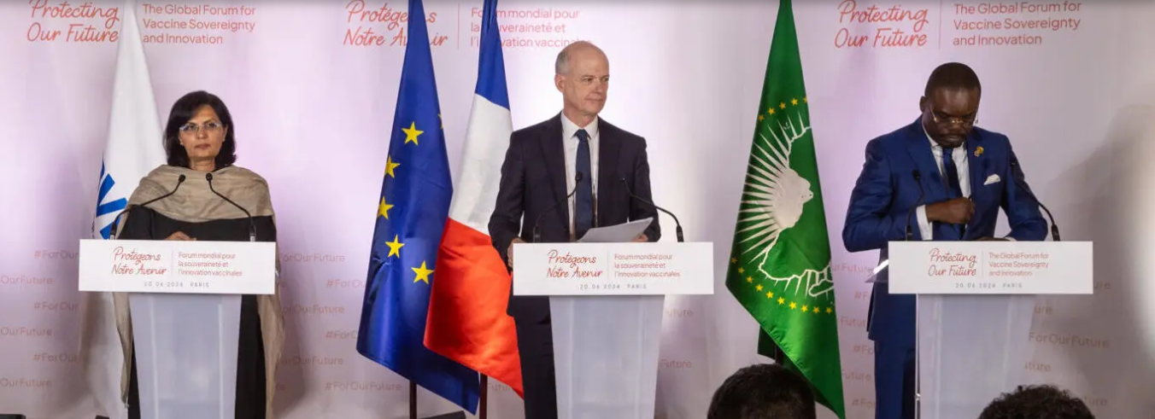
A historic step for global child survival
Karyne
Gavi Pre-Replenishment Conference and Investment Opportunity, Paris June 20, 2024
Notes:
Karyne

Slide 7
Recap of Gavi Global Forum in Paris
At June 20 conference, Gavi officially introduced a new 5-year strategy and aims to protect 500 million children save more than 8 million lives between 2026-2030.
60 % by 2040 - Launch of the African Vaccine Manufacturing Accelerator (AVMA), African Union has a goal to produce 60% of the continents’ vaccines by 2040.
The Biden Administration’s figure of at least $1.58 billion over 5 years sets us up for historic success.
U.S. pledge with ample bipartisan support was never a “given” – this is a result of your advocacy efforts!
Now we’ll need Congress to deliver that funding — and push the amount even higher.
Notes:
https://www.gavi.org/news/media-room/protecting-more-children-gavi-vaccine-alliance-plans-next-5-year-period

Slide 8
gavi by the numbers
1 billion children immunized
17 million future deaths prevented
50% of the world’s children vaccinated by Gavi
$54 returned for every $1 invested
19 countries transitioned out of support

Slide 9
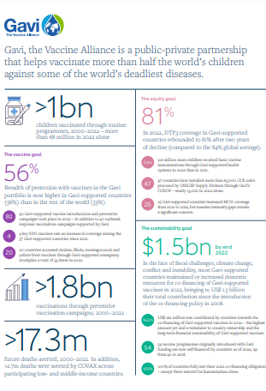
Learn more about Gavi’s amazing results here!
Notes:
https://digital.sciencehistory.org/works/wp988j884

Slide 10
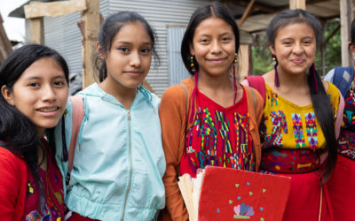
Grantee Spotlight
Limitless Horizons Ixil
Notes:
Susan

Slide 11
Advocacy Training
How to engage with offices not (yet) supportive on Gavi
Roleplay: Daiana Surkova, RESULTS North FL
Notes:
Karyne & Daiana

Slide 12
Advocacy Training
What did you observe? Can this work with your member at a future meeting?
Follow up from past meetings
Sent information ahead
Attitude of gratitude
One person/group representative of a number of constituents (or potentially partners!)
Firm, but not adversarial
Offers new information and solutions, and when you don’t know the answer, ok to say that!
Anything else?...
Notes:
Karyne & Daiana

Slide 13
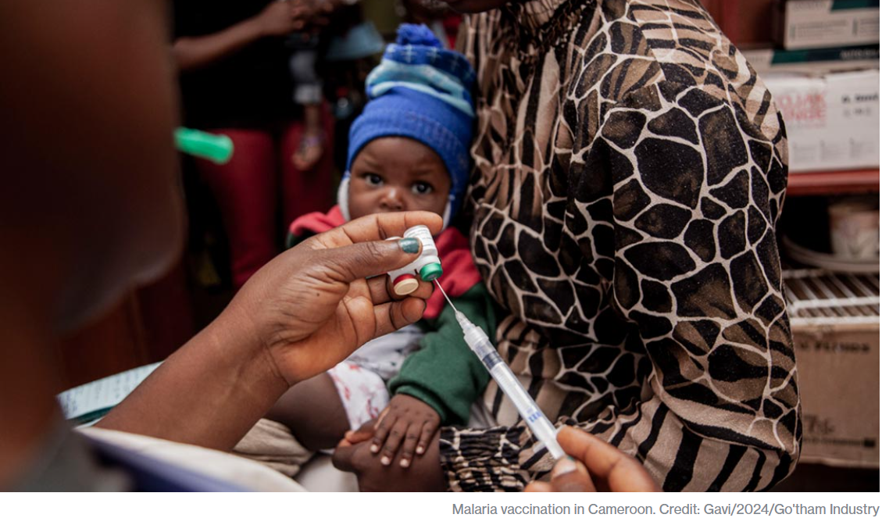
Notes:
Karyne

Slide 14
Gavi Resolutions – H.Res. 1286/ S. Res. 684
Senate Lead Sponsors: Sens. Wicker (R-MI) and Cardin (D-MD) House Lead Sponsors: Representatives Kean (R-NJ), Amo (D-RI), Salazar (R-FL), and Jacobs (D-CA).
Calls for United States to have supporting role in saving children’s lives of children and protecting people’s health through Gavi, the Vaccine Alliance.
Gavi has been a major contributor in reducing the number of childhood deaths in lower-income countries due to vaccine-preventable disease by 70 percent since 2000.
Country ownership and sustainability are at the core of the Gavi model.
Notes:
Gavi will launch their investment case to fund their next strategic period from 2026-2030.
https://www.gavi.org/our-alliance/strategy/phase-6-2026-2030

Slide 15
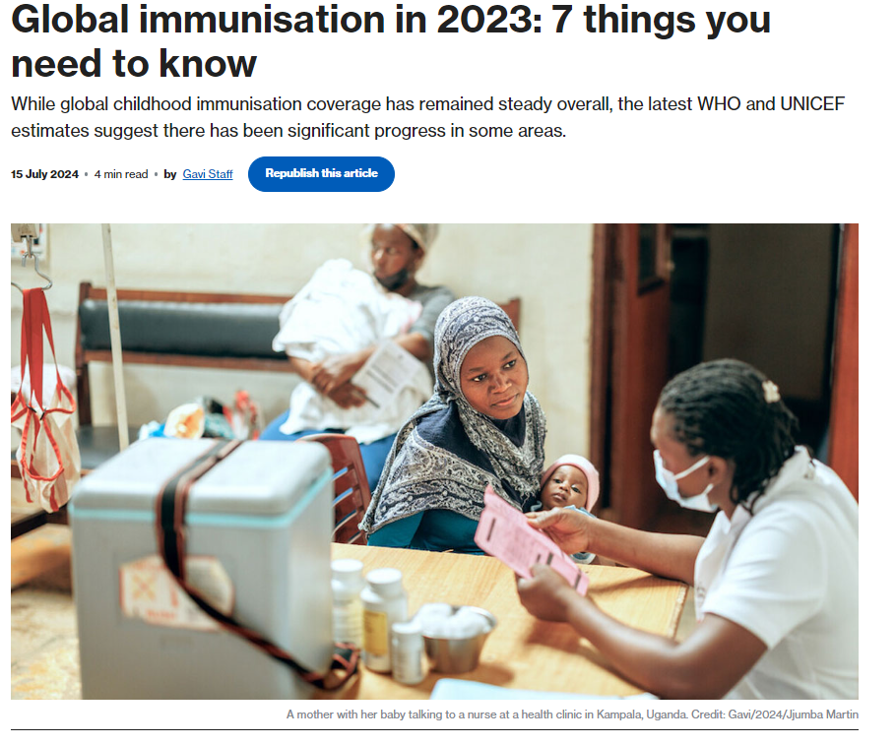
A mother with her baby talking to a nurse at a health clinic in Kampala, Uganda. Credit: Gavi/2024/Jjumba Martin
Notes:
Karyne
https://www.gavi.org/vaccineswork/global-immunisation-2023-7-things-you-need-know

Slide 16
1) More children are being immunised than ever before
2) Yet immunisation coverage has remained steady overall
3) Countries in Africa are bucking global trends
4) Breadth of protection against disease is increasing
5) More girls are being protected against cervical cancer than ever before
6) Too many children still aren’t receiving any routine immunisations
7) Measles outbreaks are an ongoing threat
Notes:
Karyne
https://www.gavi.org/vaccineswork/global-immunisation-2023-7-things-you-need-know

Slide 17
gavi by the numbers
1 billion children immunized
17 million future deaths prevented
50% of the world’s children vaccinated by Gavi
$54 returned for every $1 invested
19 countries transitioned out of support
Notes:
Karyne

Slide 18
Take Action on Gavi!
Check this scorecard see if your Representative or Senator has signed on to the Gavi Resolution (H. Res. 1286/ S. Res. 684).
Use Legislator Lookup (if you are unsure of who to reach out to, please don’t hesitate to reach out to us for support).
Email conventions: Senate: FirstName_LastName@SenatorsLastName.senate.gov House: FirstName.LastName@mail.house.gov
Personalize this sample email requesting your members of Congress co-sponsor H. Res. 1286 or S. Res. 684.
Follow up! If you’ve taken one action, take the other action tomorrow!
Notes:
Karyne

Slide 19
Take Action on Gavi!
Call the Capitol Switchboard at (202) 224-3121 and ask for the office.
Hello! My name is Name. I am a constituent living in city or zip code and a volunteer with Together Women Rise. I am calling to share my support for Gavi, The Vaccine Alliance and House Resolution 1286/ Senate Resolution 684.
Last year almost 5 million children worldwide died before their fifth birthday. The leading cause of death is a lack of access to basic health services like vaccines. 14 million kids missed out on the most basic vaccines and this is the most cost-effective way to save lives. Since 2000, Gavi, the Vaccine Alliance, has helped improve access and introduce new vaccines to fight killers like pneumonia, diarrhea, and now malaria. Gavi is preparing to support over 20 African countries to introduce the new malaria vaccine and help others vaccinate low- and no-dose children for these insidious diseases. Representative/Senator Name, will you co-sponsor the bipartisan Gavi resolutions (S.Res. 684/H.Res. 1286)? It will send a message to the rest of the world that we need to act now. Thank you!
Notes:
Karyne

Slide 20
Together Women Rise August Webinar Thursday, August 1 at 8 PM ET Register here
Featured Grantee: Flying Kites and Impact Network Guest Speakers:
Morgan Cormier, Manager of Institutional Partnerships, Flying Kites
Reshma Patel, Executive Director, Impact Network
Rise Advocacy Chapter August Webinar Tuesday, August 20 at 8:30 PM ET Guest speaker, Ken Patterson , Director RESULTS Grassroots Impact Team
Upcoming Events

Slide 21
Invite fellow Rise members to change the world together! Together Women Rise Advocacy Chapter Maximize Your Impact for Change Tuesday, September 24 at 8:30 PM ET
As Together Women Rise members, you have demonstrated your power, influence, and impact in making the world a better place for women and girls worldwide. Join us on Tuesday, September 24 to learn how you can continue to make change and maximize your impact through advocacy. You will hear from invited guest speakers including current members of the Together Women Rise Advocacy Chapter, Rise grantees, and even from the office of a member of Congress. Advocacy changes things, and our action is critical to creating the environment through which our Rise grantees can thrive.
Register here
Save the Date!

Slide 22
Invite others to join us in
changing the world together!
Sign up here: http://tinyurl.com/JoinRiseAdvocacyChapter

