Slide 1


Rise Advocacy Chapter
Global Allies Program
Joint Webinar
June 17, 2025
Notes:
Susan

Slide 2

Welcome
Please let us know in the chat where you are joining us from! Is this your first time to advocate for foreign aid?
Notes:
12:30 - 12:35 PM: Welcome/Introductions (total 5 mins)
(Susan/Wendy Frattolin)
Hit record!
Spotlight Susan
Susan
Welcome folks to our May Together Women Rise Advocacy Chapter webinar..
Add brief comments about Rise Advocacy Chapter for those who are new…
Encourage folks to introduce themselves in the chat!
Introduction to Beverley or Wendy
Wendy Frattolin welcome to give remarks (3 to 4 mins)
Spotlight Wendy
New to the Together Women Rise Advocacy Chapter? Let us know where you are joining from! If it’s been a while, welcome back!
Together Women Rise Mission & Vision Statement: https://togetherwomenrise.org/about-us/

Slide 3
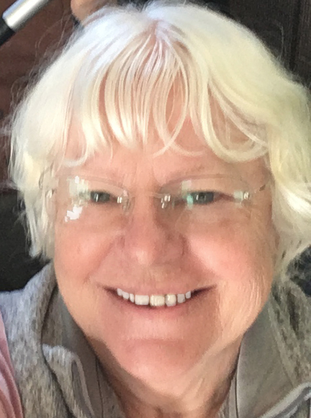
Susan Wright
Chair
Together Women Rise Advocacy Chapter
Notes:
12:30 - 12:35 PM: Welcome/Introductions (total 5 mins)
(Susan/Wendy Frattolin)
Hit record!
Spotlight Susan
Susan
Welcome folks to our May Together Women Rise Advocacy Chapter webinar..
Add brief comments about Rise Advocacy Chapter for those who are new…
Encourage folks to introduce themselves in the chat!
Introduction to Beverley or Wendy
Wendy Frattolin welcome to give remarks (3 to 4 mins)
Spotlight Wendy
New to the Together Women Rise Advocacy Chapter? Let us know where you are joining from! If it’s been a while, welcome back!
Together Women Rise Mission & Vision Statement: https://togetherwomenrise.org/about-us/

Slide 4
Mission & Vision
Together Women Rise’s Mission
Together Women Rise cultivates the collective power of community to achieve global gender equality.
OUR VISION
Together Women Rise envisions a world where every person
has the same opportunities to thrive
regardless of their gender or where they live.
Rise Anti Oppression Commitment:
At Together Women Rise, we come together as a community dedicated to equality and justice for women and girls everywhere. Read full statement here.
Notes:
12:30 - 12:35 PM: Welcome/Introductions (total 5 mins)
(Susan/Wendy Frattolin)
Hit record!
Spotlight Susan
Susan
Welcome folks to our May Together Women Rise Advocacy Chapter webinar..
Add brief comments about Rise Advocacy Chapter for those who are new…
Encourage folks to introduce themselves in the chat!
Introduction to Beverley or Wendy
Wendy Frattolin welcome to give remarks (3 to 4 mins)
Spotlight Wendy
New to the Together Women Rise Advocacy Chapter? Let us know where you are joining from! If it’s been a while, welcome back!
Together Women Rise Mission & Vision Statement: https://togetherwomenrise.org/about-us/

Slide 5
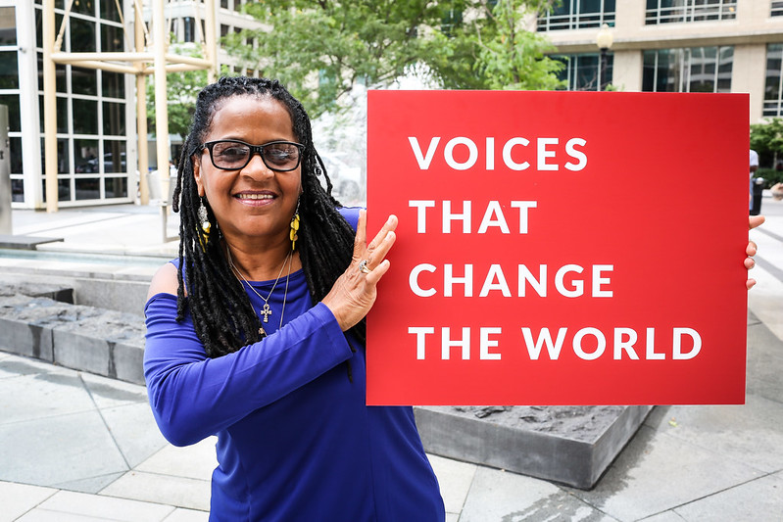
RESULTS is a movement of passionate, committed, everyday people. Together, we use our voices to influence political decisions that will bring an end to poverty.
Notes:
Karyne

Slide 6
Our Values & Resources
​At RESULTS we pledge to create space for all voices, including those of us who are currently experiencing poverty. We will address oppressive behavior in our interactions, families, communities, work, and world. Our strength is rooted in our diversity of experiences, not in our assumptions.
With unearned privilege comes the responsibility to act so the burden to educate and change doesn’t fall solely on those experiencing oppression. When we miss the mark on our values, we will acknowledge our mistake, seek forgiveness, learn, and work together as a community to pursue equity.
Read our full anti-oppression values statement here at results.org/values.

Slide 7
Welcome to our
Returned Peace Corps Volunteers!
Notes:
Karyne

Slide 8
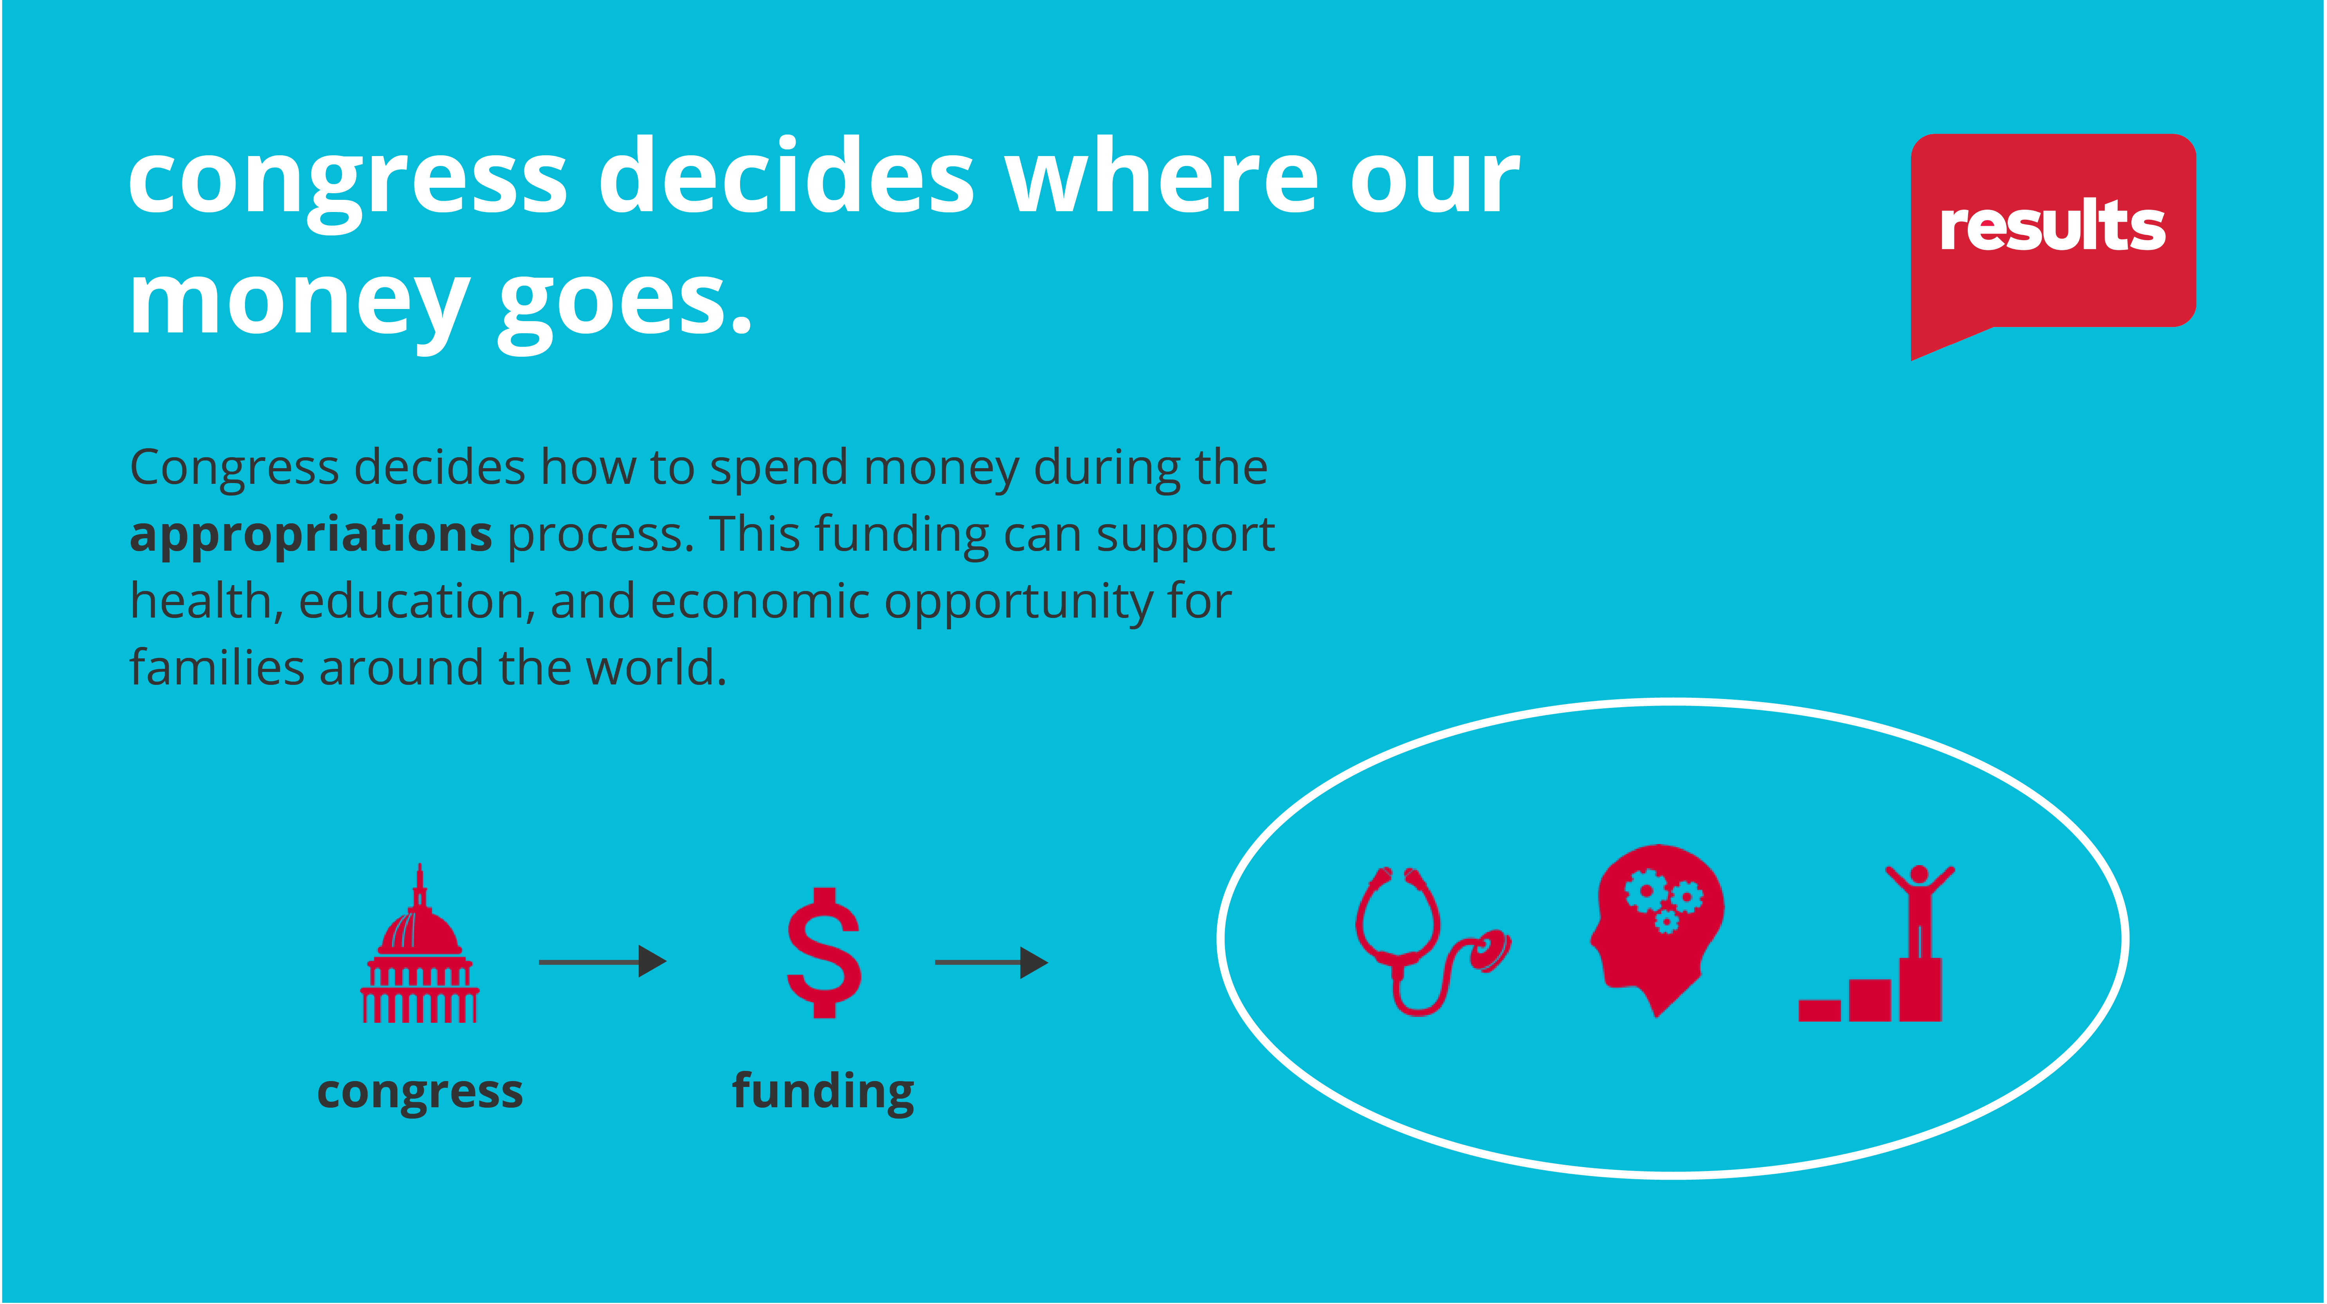
Notes:
Karyne

Slide 9
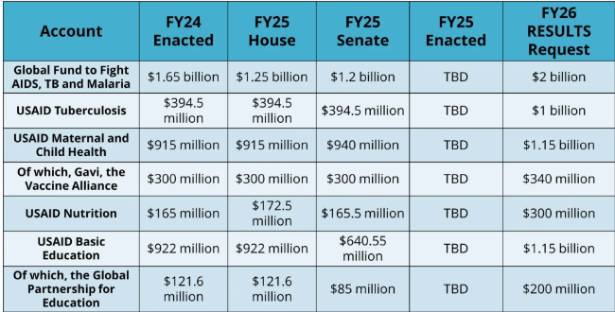
FY26 Appropriations
Notes:
Fiscal year 2026 appropriation memos: https://results.org/resources/fy26-global-appropriations-memos
Appropriations FY26 (Karyne)
https://results.org/resources/fy26-global-appropriations-memos
Every year, Congress decides how to spend the money in the U.S. federal budget. Our role is to urge lawmakers to fully fund global health and education accounts that can end poverty.
You can find the RESULTS asks and resources for Fiscal Year 2026 (FY26)
$2 Billion for the Global Fund to Fight AIDS TB and Malaria
$1 Billion to USAID Tuberculosis
$1.15 Billion to Maternal and Child Health of which $340 million to Gavi, the Vaccine Alliance
$300 Million to USAID Nutrition
And we are making adjustment to amount we’re asking for for Global Education and GPE because we original asked for $1.15 Billion but are adjusting to $970 Million to match the education Dear Colleague Letter, which is still an increase from FY25 enacted amount of $121.6 million
MCH Dear Colleague letter will be out soon take action on it
oon we expect there to be a dear colleague letter on Maternal and Child Health and Nutrition circulating Congress, your coaches will share this action with you once the letter is out: FY26 Sample Letter to Foreign Policy Aide: Rise Advocacy Action: FY26 Dear Colleague Letter Requests
Dear Colleague Letters are out now for Basic Education and Tuberculosis

Slide 10
House Letters Dear Colleague Letters
FY26 House Maternal and Child Health, Gavi, and Nutrition Dear Colleague Letter - 128 signers (FY25 119 signers)
FY26 House Global Fund Dear Colleague Letter – Closed with 160 signers (FY25 138 signers)
FY26 House Tuberculosis Dear Colleague Letter – Closed 136 signers (FY25 112 signers)
FY26 House Basic Education and GPE Dear Colleague Letter – Closed with 111 signers (FY 25 101 signers)
Notes:
Karyne
Appropriations FY26 (Karyne)
https://results.org/resources/fy26-global-appropriations-memos

Slide 11
Senate Letters Dear Colleague Letters
FY26 Maternal and Child Health, Gavi, and Nutrition Dear Colleague Letter - Closed with 28 signers (FY25 31 signers)
FY26 Global Fund Dear Colleague Letter – Closed with 35 signers (FY25
FY26 Tuberculosis Dear Colleague Letter – Closed with 35 signers (FY25 24 signers)
FY26 Basic Education and GPE Dear Colleague Letter – Closed with 29 signers (FY25 28 signers)
Check the Dear Colleague Letter scorecard to see if your member signed on!
Notes:
Karyne
Appropriations FY26 (Karyne)
https://results.org/resources/fy26-global-appropriations-memos

Slide 12
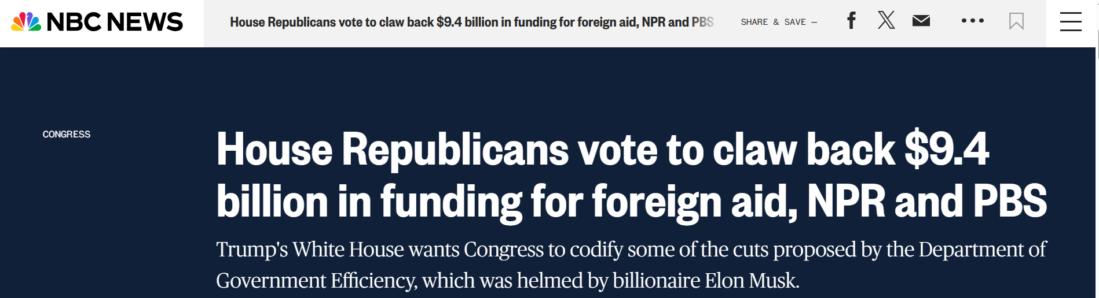
Recissions Package &
the “Big Beautiful Bill”
Notes:
Karyne

Slide 13
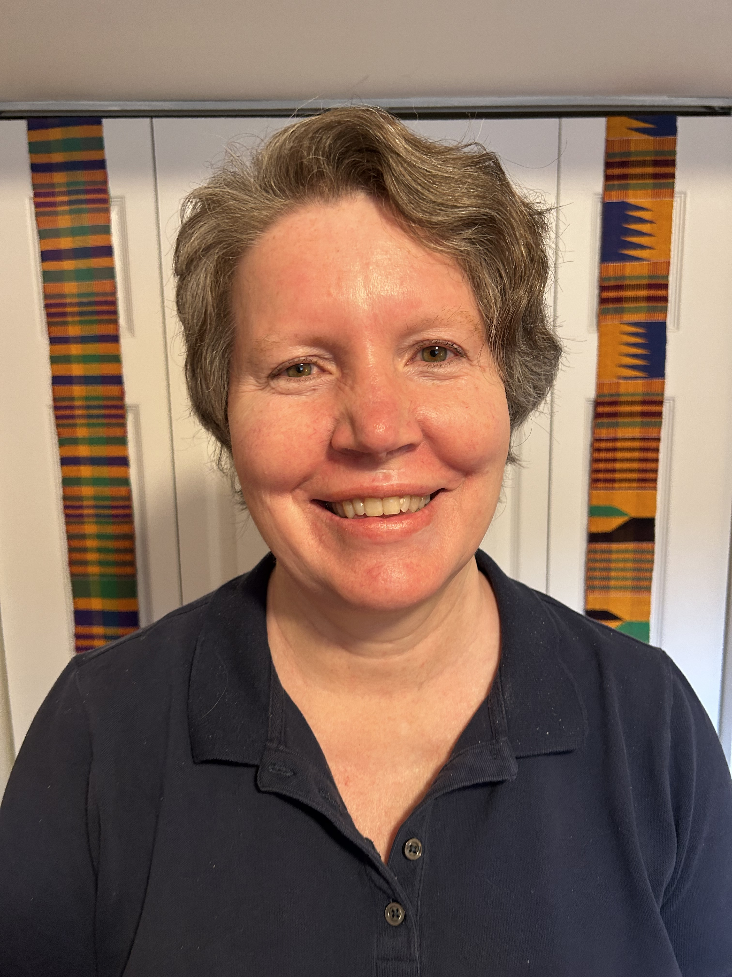
Tonight’s guest speaker:
Laurel Fain
Former Country Health Officer
USAID
Notes:
Susan

Slide 14

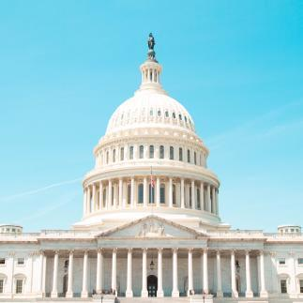

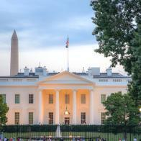
Championing the Global Fund
Notes:
Karyne

Slide 15
What happened last time?
White House proposal:
lowered rate of the match requirement on U.S. support of the Global Fund
Response from Congress:
rejected (and the 1:2 match continued)
Notes:
Karyne

Slide 16


What happened last time?
White House proposal:
29% cut
Final word from Congress:
16% boost
Notes:
Karyne

Slide 17
Tuesday, July 15 at 8:30 PM ET
July Meetings
Global Allies Program Webinar
Thursday, July 10 at 8:30 PM ET
Rise Advocacy Chapter
Notes:
Susan

Slide 18
Invite others to join us in
changing the world together!
Sign up here:
http://tinyurl.com/JoinRiseAdvocacyChapter
Notes:
Susan

Slide 19
Advocacy in 2025
Research & reach out to members of Congress – keep engaging!
Continue to write and submit media – raise awareness to your MOC & community!
Engage with your community – support fellow Rise chapter members to take action!
Notes:
Susan

