Slide 1
Racial Wealth & INCOME Gap:
A discussion of how our collective history informs our present
Tralonne Shorter & Laura Peralta
Senior Government Relation Advocates
tshorter@networklobby.org & lperalta@networklobby.org
820 First Street NE, Suite 350, Washington, DC 20002 | 202-347-9797 | info@networklobby.org | www.networklobby.org | www.networkadvocates.org
NETWORKLobby NETWORKLobby

Slide 2
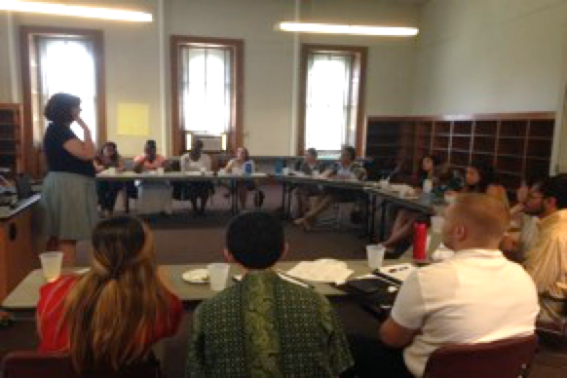
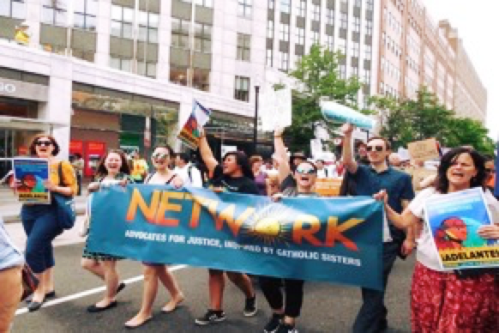
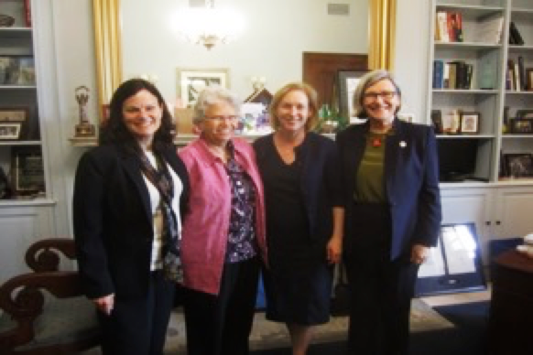
What Is NETWORK?
NETWORK educates, organizes, and lobbies for economic and social transformation

Slide 3
Purpose
Discuss basic information on income, wealth inequality, and the racial wealth gap
Understand the creation and perpetuation of the racial wealth and income gap

Slide 4
NETWORK’s Racial Justice Shared Agreements
Speak up/make space
We are each experts on our own experiences
Respect confidentiality/continue the conversation
Whether or not it has been named, the personal manifestations of power are present
Practice self-care
Embrace and express discomfort
Resolution will not happen today
Make space for evaluation of progress and tension

Slide 5
Wealth vs. Income
BASIS FOR COMPARISION | INCOME | WEALTH
Meaning | Money received or earned on a continuous basis, as a return for work or investments. | Money or valuable possession accumulated by a person during the course of his life.
What is it? | Flow of money | Stock of assets
Acquisition | Income is generated immediately. | Wealth is created over time.
Examples | Wages/salaries from jobs, interest from savings, etc. | Stocks, bonds, ownership of property, fine art
Income is a stream that helps in the creation of wealth
Wealth is what you have minus what you owe

Slide 6
Racial Wealth and Income Gap Activity
Instructions:
Each group should have 4 participants. Each group receives an envelope and each member selects a race card. Two people will receive “white participant” cards and two people will receive “Black participant” cards.
There are three action cards (“money”, “land”, and “lost opportunity”). Each participant takes turns picking up a policy card, reading the card to the group, and then reading the action corresponding to that card. Each round will result in participants gaining or losing one or all three of these cards. During the action step, the reader should pause to allow each player to gain or put down corresponding cards.
At the end of the activity, count how many of money, land, and lost opportunity cards each participant has. If your group finishes early, you may use begin with the discussion questions.

Slide 7
NETWORK’s Racial Justice Shared Agreements
Speak up/make space
We are each experts on our own experiences
Respect confidentiality/continue the conversation
Whether or not it has been named, the personal manifestations of power are present
Practice self-care
Embrace and express discomfort
Resolution will not happen today
Make space for evaluation of progress and tension

Slide 8
Disparities in Net Wealth

Slide 9
Cyclical Nature
Initial Inequalities
Lower Income, Lower Assets, Lower Quality of Education
Low Capital Formation
Lower Capacity to Generate Income
Unequal Taxes
Debt and Further Loss of Income and Wealth
Economic Inequality - the vicious cycle

Slide 10
Labor Discrimination
The National Labor Relations Act or the Wagner Act established protections for workers and allowed them to unionize for higher wages
Predominantly Black and brown jobs, such as railroad, domestic, and farmworkers, were excluded from this act
#ADDHASHTAG | @ADDHANDLE

Slide 11
Quiz
Test yourself:
What is the single largest driver of the racial wealth gap?
A. Inequities in education
B. Inequities in homeownership
C. Inequities in income

Slide 12
Driving Factors of Racial Wealth Gap
What’s Driving the Increasing Racial Wealth Gap
Source: IASP, 2013

Slide 13
History of the Suburbs

Slide 14
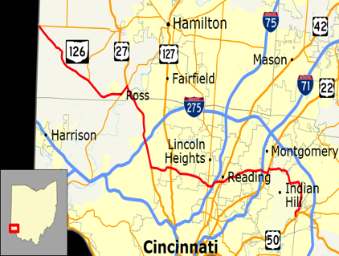
Interstate Highways Act
The building of federal interstate highways encourage “white flight” to the suburbs, where families could buy homes with yards.
Often times Black urban neighborhoods were gutted to make way for the new highways, which led to further loss of property values and to the development of the “inner city.”
#ADDHASHTAG | @ADDHANDLE

Slide 15
Housing Discrimination
Owning a home isn’t necessarily as easy as purchasing a home or going to the bank to get a mortgage.
Socially acceptable racism through the 1960s allowed homeowners associations to discriminate against families of color to preserve ‘white-only’ communities = REDLINING
#ADDHASHTAG | @ADDHANDLE

Slide 16
1938 Brooklyn Community Zoning Map
Brownsville, BedStuy, Bushwick
Prospect Park, Midwood, Sheepshead Bay

Slide 17
Lasting Impact of Redlining and Discriminatory Housing

Slide 18
Influence of Redlining on the Housing Landscape
Intentionally Segregated Neighborhoods
Underfunded Schools
Lack of Access to Quality Healthcare and Nutrition
Inadequate Public Transportation
Limited Economic Opportunities
Non-Traditional Sources of Income
Rampant Gentrification

Slide 19
Homeownership by Race

Slide 20
Our 2020 Vision: Mend the Gaps!
Wealth and Income Gap
Tax Justice
Living Wages
Family-Friendly Workplaces
Access Gaps
Democracy
Healthcare
Citizenship
Housing

Slide 21
Get Updates from NETWORK
Text
“Welcome”
to 877877

Slide 22
Recap
We learned:
Basic information on income, wealth inequality, and the racial wealth gap
The creation and perpetuation of the racial wealth gap

Slide 23
Sources
Institute on Assets and Social Policy - https://heller.brandeis.edu/iasp/pdfs/racial-wealth-equity/racial-wealth-gap/racial-wealth-gap-why-policy-matters.pdf
The Effects of the 1930s HOLC “Redlining” Maps - http://www.eh.net/eha/wp-content/uploads/2017/08/Aaronson.pdf
Brownstoner - https://www.brownstoner.com/history/redlining-racism-brooklyn-neighborhoods-bed-stuy-williamsburg-2/
Urban Institute - http://apps.urban.org/features/wealth-inequality-charts/

Slide 24
Thank you!
For questions email:
Catherine Gillette
Grassroots Mobilization Coordinator
cgillette@networklobby.org
820 First Street NE, Suite 350, Washington, DC 20002 | 202-347-9797 info@networklobby.org | www.networklobby.org | www.networkadvocates.org
NETWORKLobby NETWORKLobby

