Slide 1
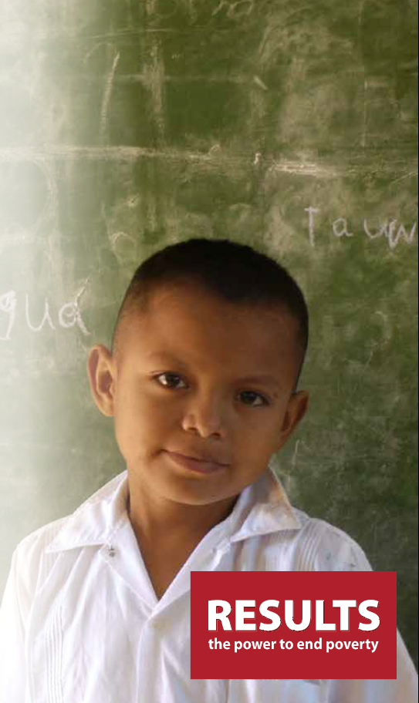



Monitoring the right to education worldwide: From Research to Action
24 July 2017
RIGHT TO
EDUCATION INDEX
2017 Partners Meeting
Tony Baker, Associate Director, Global Education
Ally Krupar, Senior Associate, RTEI
Mili Lechleiter, Global Education Associate
Right to Education Index
RESULTS International Conference
July 24, 2017
Dar es Salaam, Tanzania
RTEI Partners Meeting
22-25 February 2016

Slide 2
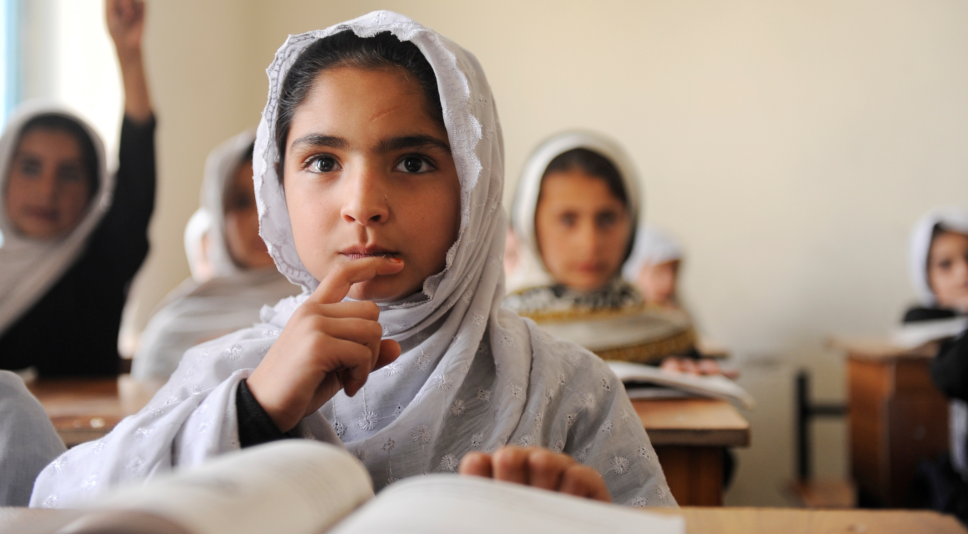
WHAT
IS
RTEI?
A global accountability initiative that aims to ensure that all people, no matter where they live, can enjoy their right to a quality education.
Built from the international right to education framework to monitor national progress towards its fulfillment.
Seeks to:
  Strengthen the expertise and capacity of civil society and education advocates.
  Increase public and political support for realizing the right to education.
  Hold governments and institutions accountable for their commitments to the right to education.
  And finally, uphold the right to education for every child and adult everywhere.
GPE/Jawad Jalali
Right to Education Index
RESULTS International Conference
July 24, 2017
Dar es Salaam, Tanzania
RTEI Partners Meeting
22-25 February 2016

Slide 3
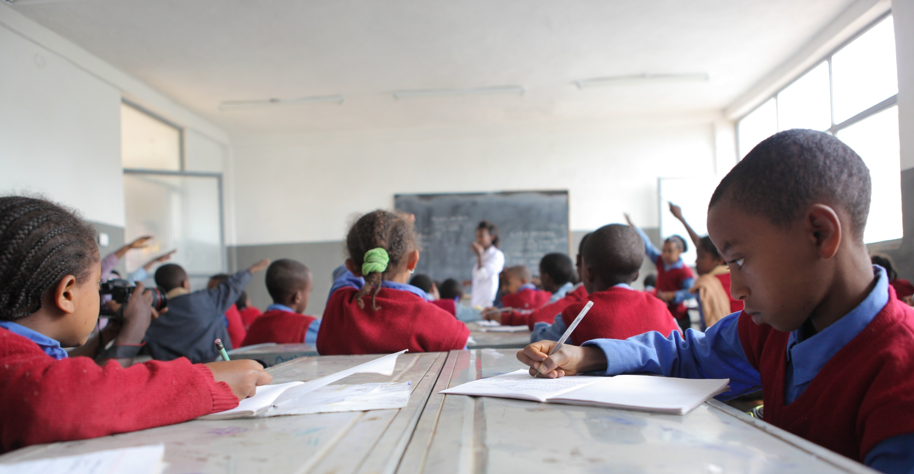










What
is
RTEI?
GPE/Midastouch
Right to Education Index
RESULTS International Conference
July 24, 2017
Dar es Salaam, Tanzania
RTEI Partners Meeting
22-25 February 2016

Slide 4
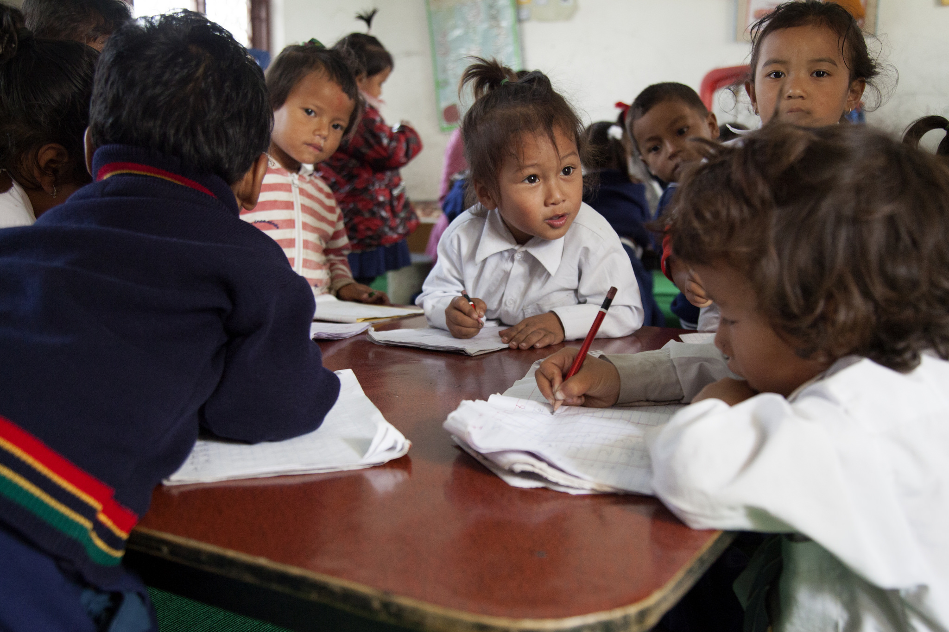















RTEI 2016
Australia: RESULTS International Australia
Canada: RESULTS Canada
Chile: Foro por el Derecho a la Educación (Foro)
DRC: Coalition Nationale de l’éducation Pour Tous (CONEPT)
Ethiopia: Basic Education Network Ethiopia (BEN-E)
Honduras: Foro Dakar
Indonesia: Network for Education Watch (NEW)
Nigeria: Civil Society Action Coalition on Education for All (CSACEFA)
Palestine: Teacher Creativity Center (TCC)
Philippines: Civil Society Network for Education Reforms (E-Net)
South Korea: RESULTS Korea
Tanzania: HakiElimu
United Kingdom: RESULTS UK
United States: Global Campaign for Education-US (GCE-US)
Zimbabwe: Education Coalition of Zimbabwe (ECOZI)
GPE/NayanTara Gurung Kakshapati
Right to Education Index
RESULTS International Conference
July 24, 2017
Dar es Salaam, Tanzania
RTEI Partners Meeting
22-25 February 2016

Slide 5
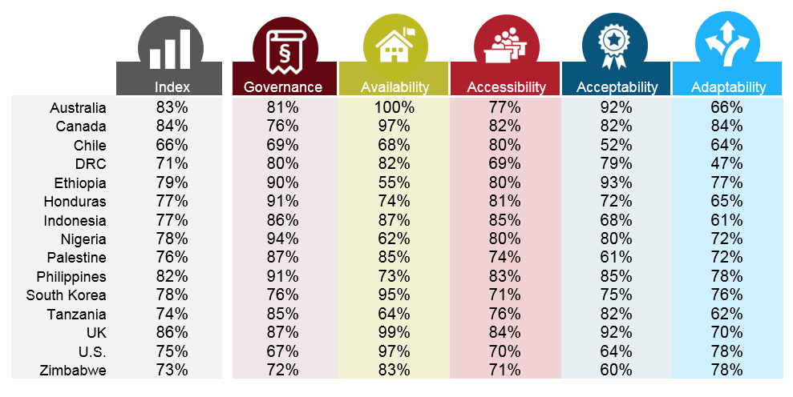
Overall Findings
GPE/Livia Barton
Right to Education Index
RESULTS International Conference
July 24, 2017
Dar es Salaam, Tanzania
RTEI Partners Meeting
22-25 February 2016

Slide 6
Findings
GPE/Kelly Lynch
Right to Education Index
RESULTS International Conference
July 24, 2017
Dar es Salaam, Tanzania
RTEI Partners Meeting
22-25 February 2016

Slide 7
Findings
GPE/Kelly Lynch
Right to Education Index
RESULTS International Conference
July 24, 2017
Dar es Salaam, Tanzania
RTEI Partners Meeting
22-25 February 2016

Slide 8
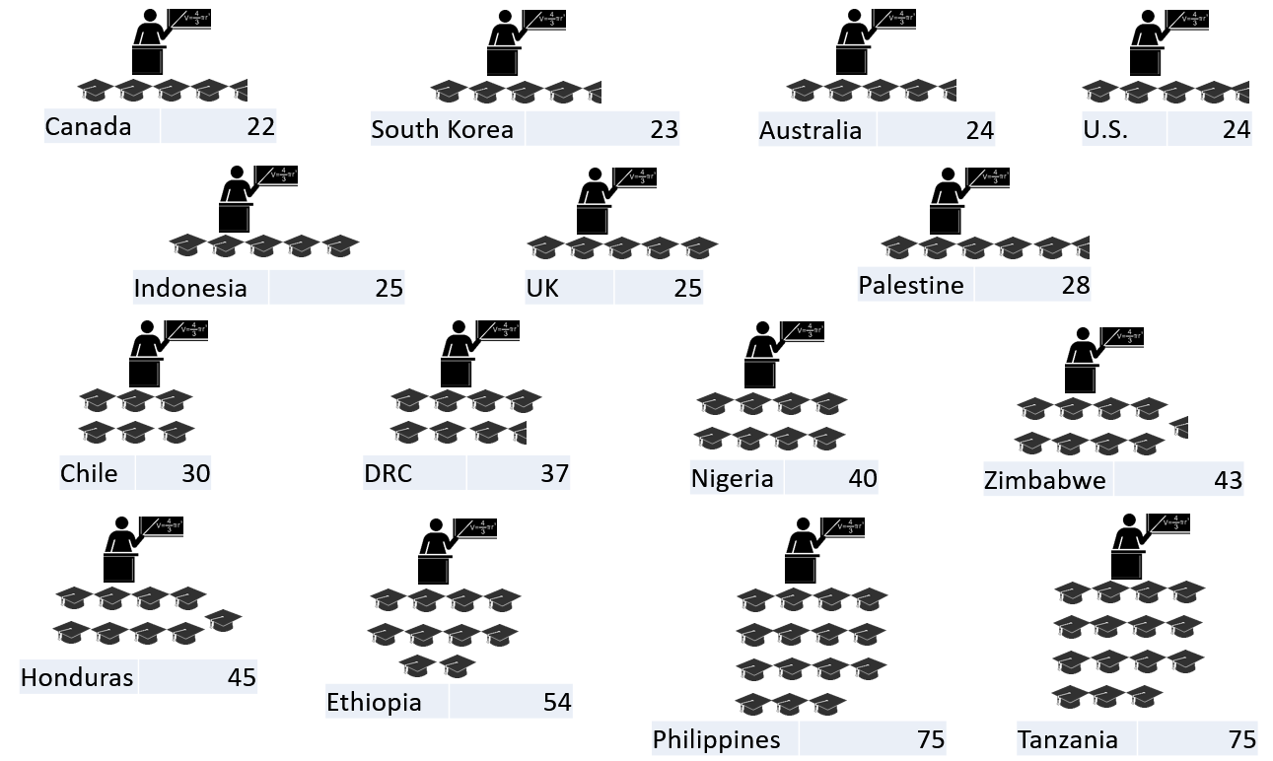
Availability Highlights
Primary school pupil-per-trained teacher ratios
GPE/Kelly Lynch
Right to Education Index
RESULTS International Conference
July 24, 2017
Dar es Salaam, Tanzania
RTEI Partners Meeting
22-25 February 2016

Slide 9
Accessibility Highlights
GPE/Kelly Lynch
Favors Female Favors Male
Right to Education Index
RESULTS International Conference
July 24, 2017
Dar es Salaam, Tanzania
RTEI Partners Meeting
22-25 February 2016

Slide 10
Adaptability Highlights
GPE/Kelly Lynch
Right to Education Index
RESULTS International Conference
July 24, 2017
Dar es Salaam, Tanzania
RTEI Partners Meeting
22-25 February 2016

Slide 11
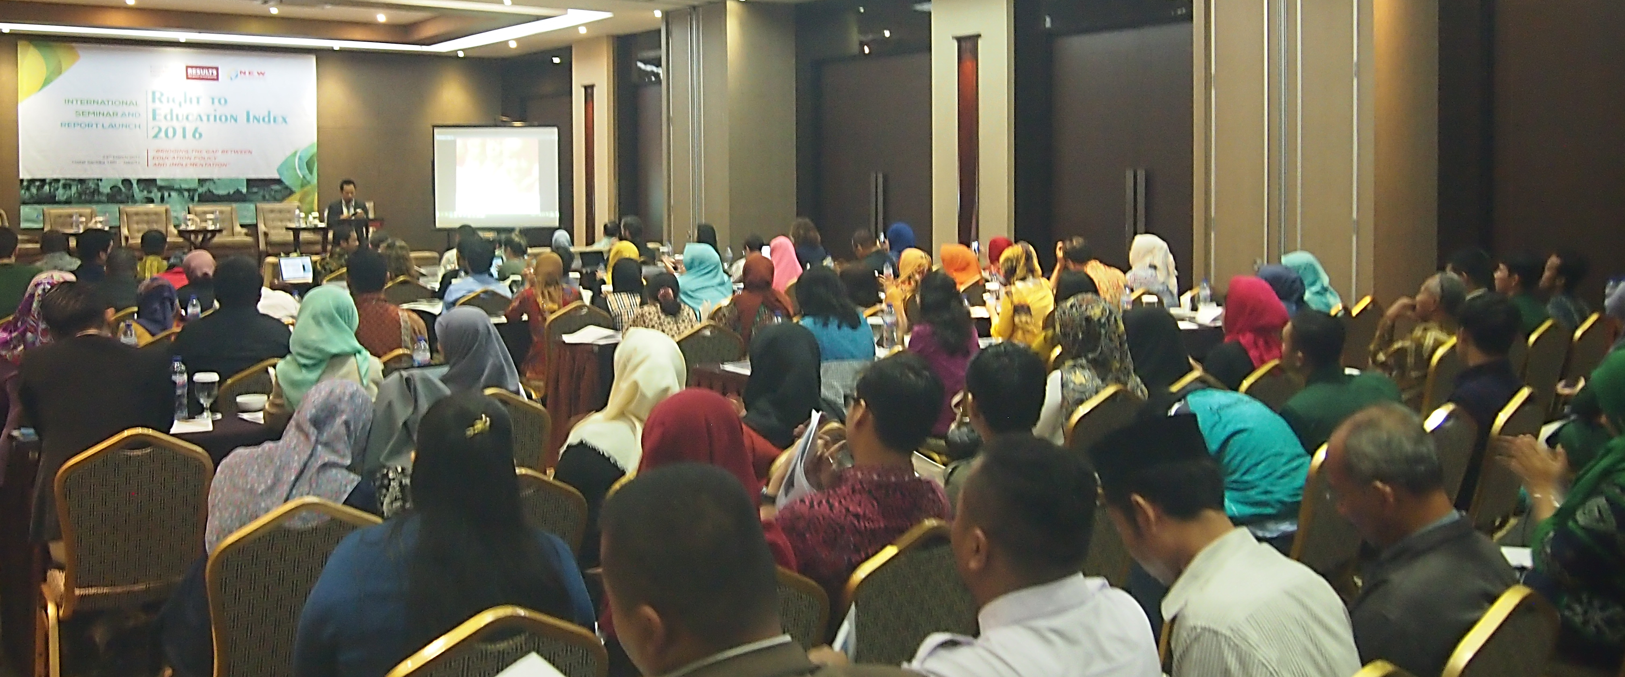
Research to Action
Partners’ meeting
Advocacy Strategies
Evidence-base
26 days
503 days
1 day
GPE/Kelly Lynch
262 days
51 days
Right to Education Index
RESULTS International Conference
July 24, 2017
Dar es Salaam, Tanzania
RTEI Partners Meeting
22-25 February 2016
43 days
47 days
44 days
176 days
67 days

Slide 12
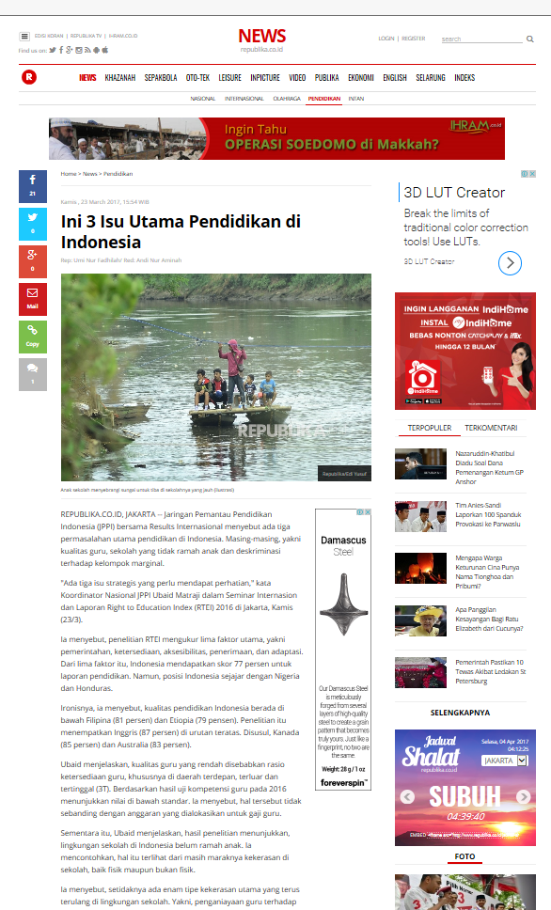
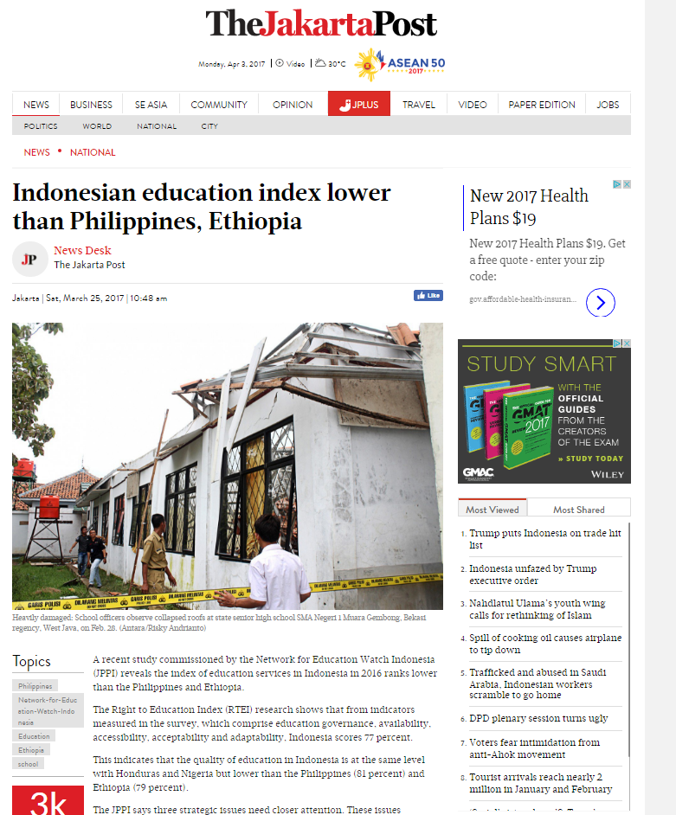
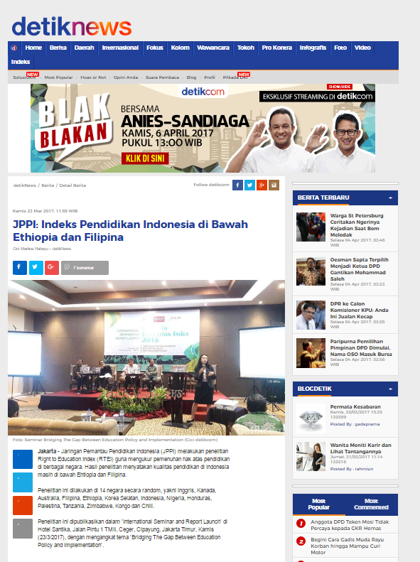
Indonesia Highlight
GPE/Kelly Lynch
Right to Education Index
RESULTS International Conference
July 24, 2017
Dar es Salaam, Tanzania
RTEI Partners Meeting
22-25 February 2016

Slide 13
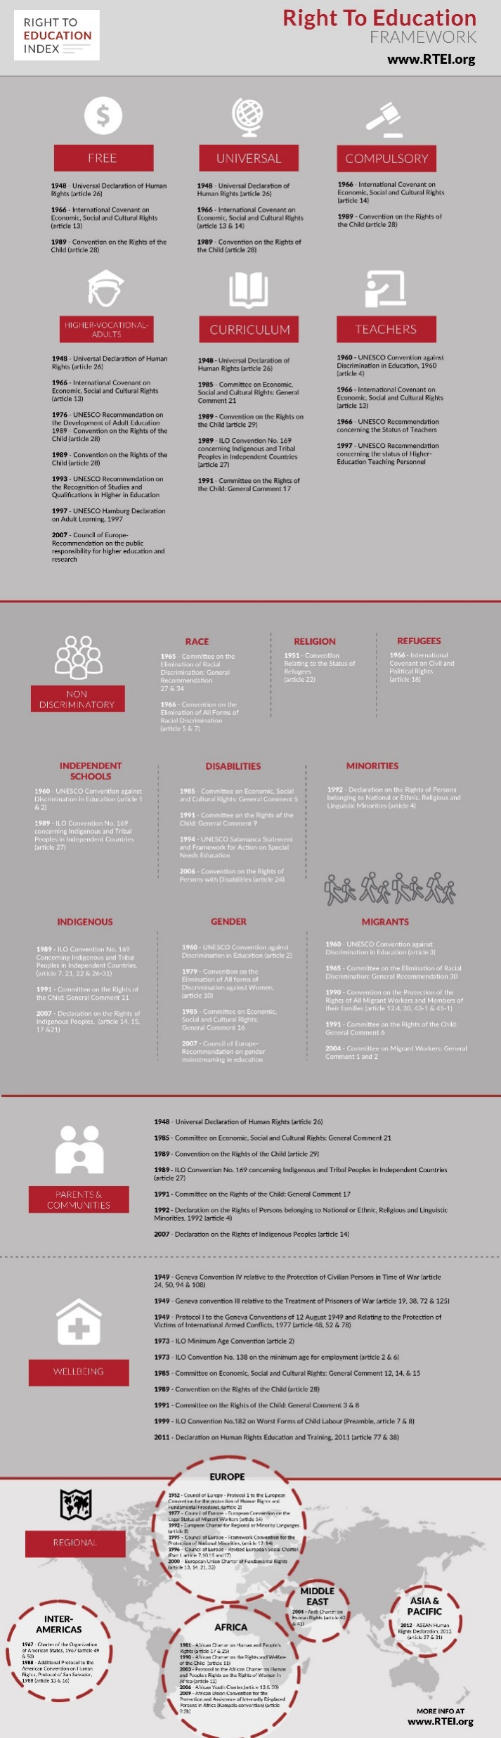
2017 Advocacy Strategies
Honduras
Indonesia
Palestine
Tanzania
Zimbabwe
26 days
503 days
1 day
GPE/Kelly Lynch
262 days
51 days
Right to Education Index
RESULTS International Conference
July 24, 2017
Dar es Salaam, Tanzania
RTEI Partners Meeting
22-25 February 2016
43 days
47 days
44 days
176 days
67 days

Slide 14

Examples
SDG monitoring and shadow reporting
Education sector planning
Local Education Groups
Universal Periodic Reviews
Parliamentary engagement
Using Media
GPE/Livia Barton
Right to Education Index
RESULTS International Conference
July 24, 2017
Dar es Salaam, Tanzania
RTEI Partners Meeting
22-25 February 2016

Slide 15
Global roadmap of education strategies
Local advocacy
National advocacy
National network building
National judicial system engagement
Parliamentary engagement
Education sector planning
International advocacy
Voluntary national review
SDG Monitoring
Universal Periodic Review
International advocacy network building
Right to Education Index
RESULTS International Conference
July 24, 2017
Dar es Salaam, Tanzania
RTEI Partners Meeting
22-25 February 2016

Slide 16
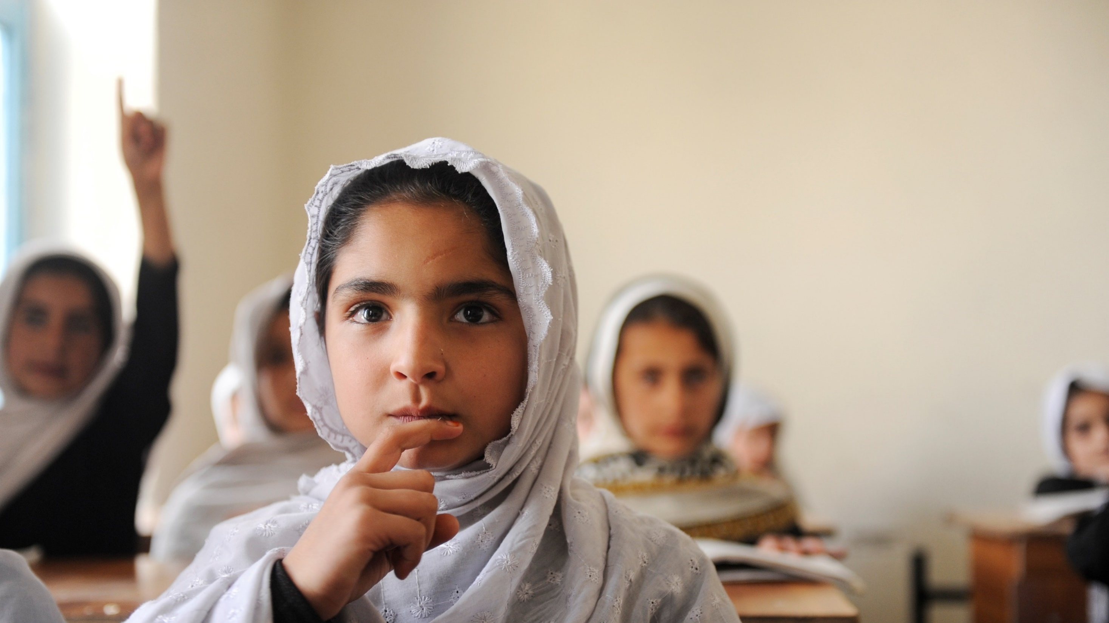
Discussion
How to engage RESULTS grassroots and other activists and advocates using RTEI?
U.S. implications of RTEI?
Other ideas to connect RESULTS grassroots movement with RTEI?
Right to Education Index
RESULTS International Conference
July 24, 2017
Dar es Salaam, Tanzania
RTEI Partners Meeting
22-25 February 2016

Slide 17
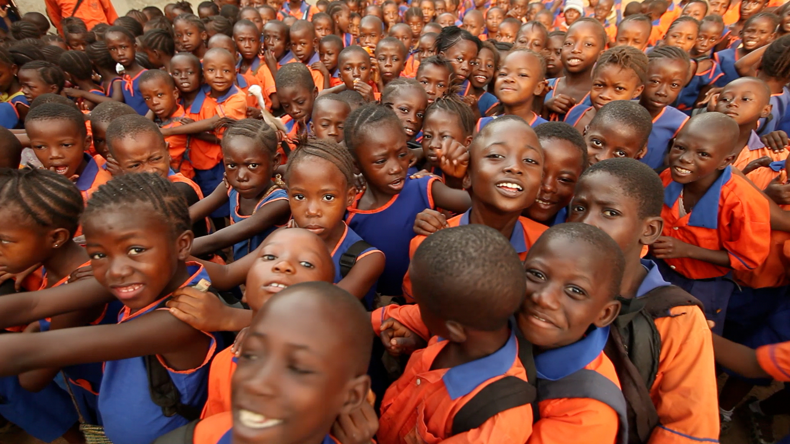
Thank you from the RTEI team!
Tony Baker
tbaker@results.org
Ally Krupar
Akrupar@results.org
Milagros Lechleiter
mlechleiter@results.org
Questions? Comments? Suggestions?
Right to Education Index
RESULTS International Conference
July 24, 2017
Dar es Salaam, Tanzania
RTEI Partners Meeting
22-25 February 2016

Slide 18

Theme
Governance
Availability
Accessibility
Acceptability
Adaptability
International Framework
-5 Questions
-32 data points
National law
-4 Questions
-7 data points
Classrooms
-2 Questions
-6 data points
Sanitation
-4 Questions
-12 data points
Free education
-6 Questions
-7 data points
Aims of education
-6 Questions
-20 data points
Children with disabilities
-3 Questions
-5 data points
Children of minorities
-3 Questions
-4 data points
Subtheme
Plan of action
-3 Questions
-3 data points
Monitoring & reporting
-4 Questions
-4 data points
Teachers
-4 Questions
-9 data points
Textbooks
-2 Questions
-4 data points
Discrimination
-4 Questions
-19 data points
Learning environment
-4 Questions
-4 data points
Out of school education
-4 Questions
-4 data points
Out of school children
-7 Questions
-7 data points
Financing
-7 Questions
-12 data points
Participation
-3 Questions
-10 data points
Learning outcomes
-4 Questions
-96 data points
0 to 1 scale (0 = right to education is lacking, 1 = right to education is satisfied)
National and international benchmarks where denominators for ratios (ie. pupil:classroom ratio)
1-x (where No = 1 and Yes = 0)
Progressively realized rights: 1 - (1 - x) (national logGDP per capita PPP/world µlogGDP per capita PPP)
Capped at 1
Calculations
Overall Index Score
Girls’ education
Children with Disabilities
Regional Disparities
Indigenous and Minority Populations
Private Education
Teachers
Income Inequality
Content of Education
Monitoring and Accountability
National Normative Framework
Opportunity and Indirect Costs
Alignment of Education Aims
Sustainable Development Goal (SDG) 4
Cross cutting
Notes:
Using the most recent data, preferring government sources, followed by international governmental sources like UIS, and then non-governmental sources, RTEI compares national level indicators.
Because most recent data was preferred, some partners submitted data from different years for various questions, depending on national data collection processes.
Scores are on a scale from 0 (right to education absent) to 100 (right to education respected, protected, and fulfilled).
The Index score is an average of each theme (Governance, Availability, Accessibility, Acceptability, and Adaptability). Each theme score is an average of its related subtheme scores. Subtheme scores are the average of individual question scores in their respective areas.
Progressively realized right indicators are weighted to account for national resource availability, using a log of the Gross Domestic Product (GDP) per capita purchasing power parity (PPP) model .
Data Availability is treated as a subtheme of Governance and is calculated as an average of all missing data by question, multiplied by the ratio of questions from national and international governmental sources.
For progressively realized indicators, coded responses were multiplied by the national logGDP per capita PPP divided by the 2016 global mean of the logGDP per capita PPP. The data was then subtracted from 1 for the adjusted score using the following formula: 1 - (1 - x) (national logGDP per capita/world logµGDP per capita), where x = question response
Subtheme averages
Every subtheme was an average of each data point
Data availability subtheme was calculated as a subtheme of Governance.
We coded responses by data source (government, NGO, Media, etc.)
Not applicable questions excluded.
We divided the number of questions supported by government data by the total number of applicable questions
1.6 Data availability subtheme was calculated as an average of all missing data per question multiplied by the ratio of questions from government sources.
Theme
Each theme was an averages of subthemes
Cross-cutting themes
Each cross cutting theme was an average of applicable data points.

