Slide 1
RESULTS September Global Poverty National Webinar
Education and Conflict
http://fuze.me/30204806, or dial (201) 479-4595, meeting ID 30204806.
Closed captioning: http://west.typewell.com/faelapgb

Slide 2
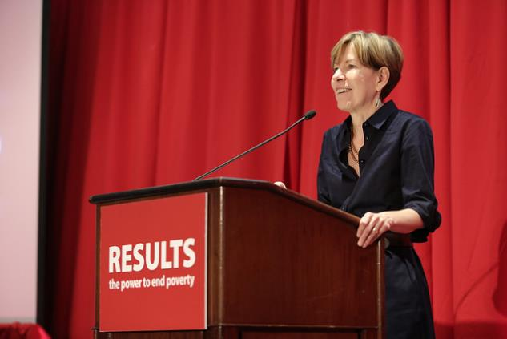
Welcome from Joanne Carter Executive Director, RESULTS
RESULTS National Webinar

Slide 3
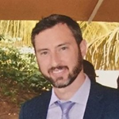
Tony Baker
Associate Director, Global Education
tbaker@results.org
Phone: (202) 783-7100
RESULTS National Webinar

Slide 4
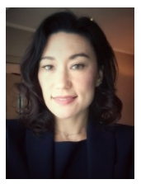
Lisa Bender, Education in Emergencies Lead at UNICEF
Lisa has a background in humanitarian response, post-crisis transition and social programming for children and youth.
At UNICEF’s global headquarters, she provides technical and policy advice in the education sector with a focus on complex
emergencies and fragile states.
Prior to UNICEF, Lisa worked with other UN agencies and international NGOs in direct programming, needs assessments, and evaluations in countries such as Yemen, the Democratic Republic of the Congo, and Bangladesh.
RESULTS National Webinar

Slide 5
Want to Ask a Question?
Unmute your line on your computer by clicking in Fuze
Press *1 on your phone
Type your question in the Chat Window in Fuze
If you are not sharing, please stay muted
RESULTS National Webinar

Slide 6
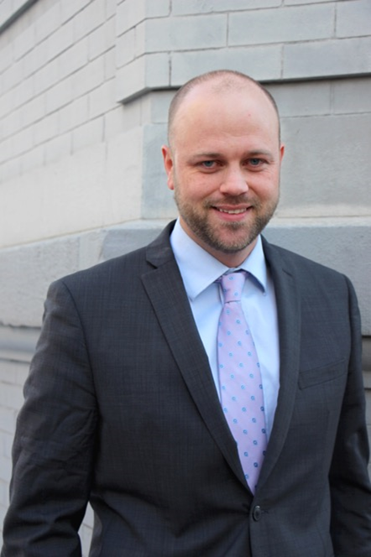
John Fawcett
Director, Global Policy and Advocacy
jfawcett@results.org
Phone: (202) 783-7100
RESULTS National Webinar

Slide 7
Legislative Update
READ Act
Global Partnership for Education resolution
FY 2018 Appropriations Update

Slide 8
READ Act

Slide 9
Global Partnership for Education
House GPE Resolution (H.Res.466)
23 cosponsors (6 Republicans, 17 Democrats)
Goal: 150 cosponsors; At least 50 Republicans
Senate GPE Resolution

Slide 10
FY18 Appropriations Update
Account | FY17 Enacted | FY18 RESULTS’ Request | FY18 President’s Request | FY18 House | FY18 Senate
Maternal and Child Health | $814.5 million | $900 million | $749.6 million | $814.5 million | $829 million
of which Gavi | $275 million | $290 million | $290 million | $290 million | $290 million
Nutrition | $125 million | $250 million | $78.5 million | $125 million | $125 million
Global Fund | $1.35 billion | $1.475 billion | $1.125 billion | $1.35 billion | $1.35 billion
Tuberculosis | $241 million | $450 million | $178.4 million | $241 million | $261 million
Basic Education | $800 million | $925 million | $378 million | $800 million | $500 million
of which GPE | $75 million | $125 million | unknown | $87.5 million | $75 million

Slide 11
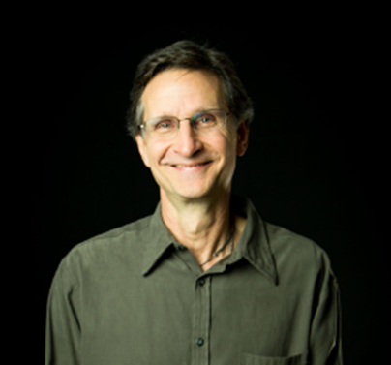
Grassroots Café
Ken Patterson
Director of Global Poverty Advocacy
Email: kpatterson@results.org
Phone: (828) 398-4562
RESULTS National Webinar

Slide 12
Great Advocacy so far, let’s keep it up!
Through July . . .
143 face-to-face meetings with representatives, 45 face-to-face meetings with senators, and 595 congressional meetings overall
273 pieces of media
RESULTS National Webinar

Slide 13
Outreach: The 500 Challenge is On!
Through July . . .
247 outreach activities with 55% of groups participating
Can we get to 500 events and 100% of groups this year?
RESULTS National Webinar

Slide 14
Fall Priorities for Global Group Strengthening
Supporting 100% of groups to do powerful community engagement
Supporting groups to build the Action Network in your communities
RESULTS National Webinar

Slide 15
Outreach Opportunities
Mid-October – Mid-November GPE media and outreach tour
October or November National Webinar
Master Advocacy Skills Trainer support
3-hour advocacy skills training curriculum
Fall training webinars supporting outreach
RCs are there to support you
RESULTS National Webinar

Slide 16
Build Your Action Network
We want to support you in building your local action network:
Ask people if they are willing to take 2 actions per month—tell them that’s what you need to be effective in persuading your members of Congress
Send us contact information for your Action Network member and we’ll help you engage them with regular actions.
RESULTS National Webinar

Slide 17
Announcements: Training
September 13, 9 pm ET. Webinar: The Global Partnership for Education: What Is It, and Why Do We Care?
September 13, 9 pm ET. RESULTS Introductory Call.
September 18, 1 pm ET and 8 pm ET. RESULTS Global Free Agents Webinars
September 21 at 8:30 pm ET. Using VolunteerMatch to Grow Your Group.
September 27 at 8:30 pm ET. Mapping Your Community for Outreach and Engagement.
October 14, 2 pm ET. National Webinar/Conference Call for Grassroots. Focus: GPE
RESULTS National Webinar

Slide 18
Announcements: Congress & Media
Congress
September 18-22: House Recess
September 21-22: Senate Recess
Media & Outreach
Mid-October through Mid-November: GPE Media and Outreach Tour with Selamawit Bekele
RESULTS National Webinar

Slide 19
10 people have stepped forward with gifts of $10,000 each in 2017 to create a $100,000 matching pool that launched at the International Conference.
The next step? Donate by December 31to help us meet the match!
Donate today!

Slide 20
RESULTS National Webinar

Slide 21
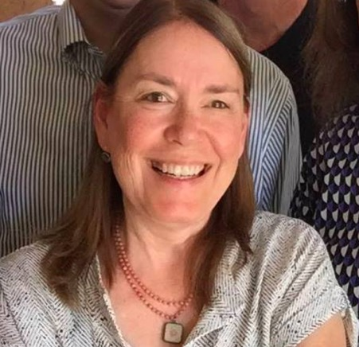
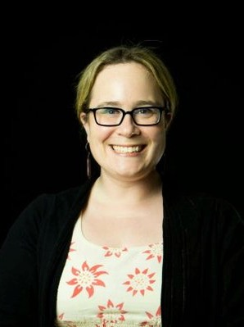
Laser Talk
GPE Resolution
Lisa Marchal
Senior Global Grassroots Associate
lmarchal@results.org
Phone: (317) 529-5182
Lori Saltveit
Regional Coordinator
RESULTS National Webinar

Slide 22
___________________
Report Just an Outreach Activity:
http://tinyurl.com/2017GlobalOutreach
Report Just a Lobby Meeting:
http://www.tinyurl.com/RESLRF
Report Just a Media Piece:
http://tinyurl.com/2017GlobalMedia
___________________
RESULTS National Webinar

Slide 23
How many people from your group
joined in today’s webinar?
Let us know your numbers directly -
send to Lisa Marchal
Senior Associate, Global Grassroots
lmarchal@results.org
RESULTS National Webinar

Slide 24
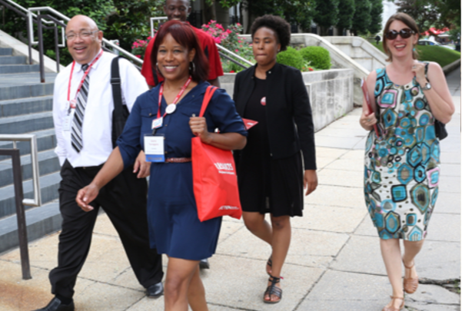
You Are the Fire and Fuel
That is Making Change Happen!

