Slide 1
RESULTS October Global Poverty National Webinar
Mobilizing Media on the Global Partnership for Education
http://fuze.me/30204806, or dial (201) 479-4595, meeting ID 30204806.
Closed captioning: http://west.typewell.com/faelapgb

Slide 2
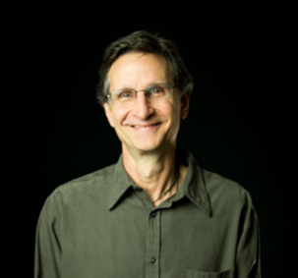
Welcome!
Ken Patterson
Director of Global Poverty Advocacy
Email: kpatterson@results.org
Phone: (828) 398-4562
RESULTS National Webinar

Slide 3
Invite Your Community on Nov. 11
Our Guest: Julia Gillard
Chair of the Board Directors for the Global Partnership for Education (GPE)
Former Prime Minister of Australia
We’ve invite RESULTS Canada, UK, and Australia to join us.
RESULTS National Webinar

Slide 4
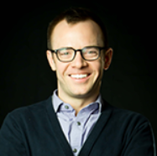
Colin Smith
Communications Director
csmith@results.org
Phone: (202) 783-7100
RESULTS National Webinar

Slide 5
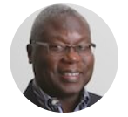
Jerry Large, Columnist, Seattle Times
2017 RESULTS Cameron Duncan Media Award Winner
I try to write about the intersections of everyday life and big issues. I like to invite readers to think a little differently. The topics I choose represent the things in which I take an interest, and I try to deal with them the way most folks would, sometimes seriously, sometimes with a sense of humor.
RESULTS National Webinar

Slide 6
Want to Ask a Question?
Unmute your line on your computer by clicking in Fuze
Press *1 on your phone
Type your question in the Chat Window in Fuze
If you are not sharing, please stay muted.
RESULTS National Webinar

Slide 7
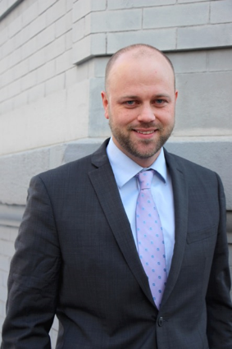
John Fawcett
Director, Global Policy and Advocacy
jfawcett@results.org
Phone: (202) 783-7100
RESULTS National Webinar

Slide 8
Legislative Update
Global Partnership Resolutions
H.Res. 466
S.Res. 286
Reach Act in the House

Slide 9
Global Partnership for Education
House GPE Resolution (H.Res.466)
36 cosponsors (11 Republicans, 25 Democrats – as of October 11)
Goal: 150 cosponsors; at least 50 Republicans
Senate GPE Resolution
Just introduced October 5, World Teacher Day
Co-led by Sens. Rubio and Booker

Slide 10
Grassroots Café
Ken Patterson
Director of Global Poverty Advocacy
Email: kpatterson@results.org
Phone: (828) 398-4562
RESULTS National Webinar

Slide 11
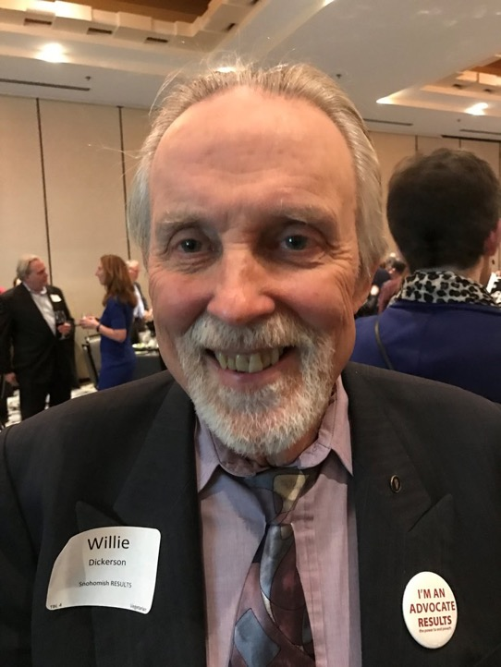
Grassroots Media Guru:
Willie Dickerson
RESULTS National Webinar

Slide 12
Great Advocacy Strides
with Congress and the Media
Let’s Make the Most of the Final Quarter
Data Reported Through September:
150 F-to-F Rep. meetings (58% group participation)
50 F-to-F Senate meetings (30% group participation)
252 House Staff meetings (75% group participation)
172 Senate Staff meetings (60% group participation)
624 meetings, 91% group participation!!
Note: House Recess now through October 22
RESULTS National Webinar

Slide 13
Great Advocacy Strides
with Congress and the Media
Let’s Make the Most of the Final Quarter
Data Reported Through September:
23 Opeds, 17% group participation
7 Editorials, 2% group participation
252 LTEs, 62% group participation
46 “Other” media, 23% group participation
328 pieces of media, 68% group participation
RESULTS National Webinar

Slide 14
Outreach:
Climbing Toward the 500 Goal
Through September:
262 Outreach Activities
58% group participation!
Can we get to 500 events and 100% group participation this year?
RESULTS National Webinar

Slide 15
Outreach Resources
November 11 National Webinar
Master Advocacy Skills Trainer support
3-hour advocacy skills training curriculum
Webinar series on outreach topics
Your Regional Coordinator
RESULTS National Webinar

Slide 16
Build Your Action Network
We want to support you in building your local action network:
Ask people if they are willing to take 2 actions per month—tell them that’s what you need to be effective in persuading your members of Congress
Send us contact information for your Action Network member and we’ll help you engage them with regular actions.
RESULTS National Webinar

Slide 17
Announcements: Training
This Week:
Monday, October 16, 1 pm ET and 8 pm ET. RESULTS Global Free Agents Webinars (Ken Patterson)
Wednesday, October 18, 9 pm ET. Building Your Action Network (Mark Campbell)
Coming Up:
October 27, 1 pm ET. RESULTS Introductory Call
October 30, 8 pm ET. Proven Tools for Bringing Out Leadership in Others
November 11, 2 pm ET. Global National with Julia Gillard of GPE as guest
RESULTS National Webinar

Slide 18
Virtual Thanksgiving Feast Friends & Family Campaign
What is it? Online, peer-to-peer fundraising campaign.
When? November 13-28 - Final grassroots fundraising opportunity for 2017
Why fundraise?
Help raise needed funds for RESULTS so we can continue to build on this year’s extraordinary organizing momentum, while protecting the gains we’ve made against poverty.
Spread the word about the great work your RESULTS group is doing
Grow your network of advocates and supporters
Resources available?
Campaign guide with sample talking points, emails to send to your networks, and social media posts
Personal fundraising website
One-on-one support from Development Team

Slide 19
Virtual Thanksgiving Feast Friends & Family Campaign
Next Steps?
Discuss with your group during next planning meeting to schedule in the Friends and Family Campaign.
Have questions? Contact Ben McGarry at bmcgarry@results.org or development@results.org.
Planning to participate? Let Ben or your Regional Coordinator know.
Look for more information including the Campaign Guide and instructions to set up your online fundraising page in early November.
THANK YOU IN ADVANCE FOR FUNDRAISING FOR RESULTS!

Slide 20
10 people have stepped forward with gifts of $10,000 each in 2017 to create a $100,000 matching pool that launched at the International Conference.
The next step? Donate by December 31to help us meet the match!
Donate today!

Slide 21
RESULTS National Webinar

Slide 22
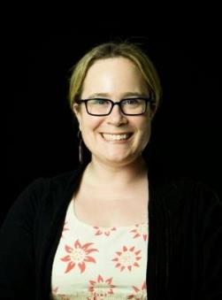
Laser Talk
Lisa Marchal
Senior Associate
Global Grassroots
lmarchal@results.org
Phone: (317) 529-5182
RESULTS National Webinar

Slide 23
Request for Senator to Cosponsor the GPE Resolution
Engage the Audience: Hello! And thank you for taking my call. I'm calling to let you know about the brand new Senate resolution supporting the Global Partnership for Education (S.Res. 286).
State the Problem: 263 million children and youth around the globe who should be in school are not. This is a crisis the puts us all in jeopardy, for we all pay for a world in which we don't prepare our children for success.
Inform on a Solution: The S.Res. 286, led by Senators Rubio (R-FL) and Booker (S-NJ), pairs with the current House Resolution to support the Global Partnership for Education, or GPE. GPE is plans to get over 25 million additional kids in the classroom for the first time by 2020 as well as and improve the quality of learning and the school experience for millions of others.
Call to Action: We know that ________________ understands the power of education, and we would love to add the senator's name to this bipartisan resolution. Would you be able to see if the Senator would cosponsor the resolution?
RESULTS National Webinar

Slide 24
___________________
Report Just an Outreach Activity:
http://tinyurl.com/2017GlobalOutreach
Report Just a Lobby Meeting:
http://www.tinyurl.com/RESLRF
Report Just a Media Piece:
http://tinyurl.com/2017GlobalMedia
___________________
RESULTS National Webinar

Slide 25
How many people from your group
joined in today’s webinar?
Let us know your numbers directly -
send to Lisa Marchal
Senior Associate, Global Grassroots
lmarchal@results.org
RESULTS National Webinar

Slide 26
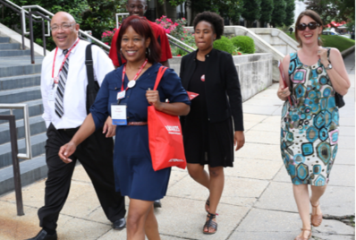
Thanks for Making the Most of the Fall. We’re Making it Happen!

