Slide 1
RESULTS November 2018 Global National Webinar
Post-election Recap and Engagement
Join at https://results.zoom.us/j/510407386. Or by phone at (669) 900-6833 or (929) 436-2866, meeting ID 510-407-386
Closed captioning: http://west.typewell.com/faelapgb

Slide 2
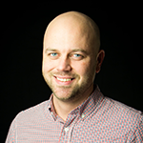
Welcome!
John Fawcett
Director, Global Policy and Advocacy
jfawcett@results.org
RESULTS Global Poverty Campaigns National Webinar

Slide 3
You Voted. What’s Next?
RESULTS Global Poverty Campaigns National Webinar
Notes:
Contact people who previously expressed interest

Slide 4
Jonathan Stivers The Sheridan Group
Jon Stivers has over two decades of high-level policy experience in the Executive and Legislative Branches specializing in foreign policy, international development, global health, appropriations, trade, export financing, democracy promotion, and human rights.
In the U.S. Congress, Jon served as Senior Advisor to the Speaker of the House of Representatives and Democratic Leader Nancy Pelosi. He played a leadership role on many ground-breaking legislative initiatives including the PEPFAR reauthorization bill and subsequent appropriations that doubled U.S. funding levels for global health in four years.

Slide 5
Q & A
On the webinar? Unmute by clicking the microphone.
On by phone? Unmute by hitting *6.
If you are not speaking, please stay muted.
RESULTS Global Poverty Campaigns National Webinar

Slide 6
The State of Our Campaign Work
John Fawcett
Director, Global Policy and Advocacy
jfawcett@results.org
RESULTS Global Poverty Campaigns National Webinar

Slide 7
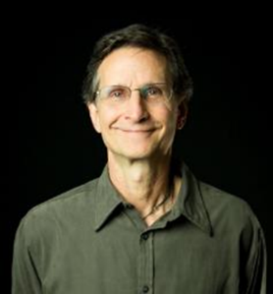
Grassroots Cafe
Ken Patterson
Director of Global Grassroots Advocacy
kpatterson@results.org
RESULTS Global Poverty Campaigns National Webinar

Slide 8
The 2018 Vision
Engage Communities - #LettersGetLOUD
International Conference
Election Engagement
Post-Election Engagement
RESULTS Global Poverty Campaigns National Webinar

Slide 9
VolunteerMatch Observations
There is a renewed sense of civic duty around elections—so a good time to engage people.
November is one of the best months of the year to recruit and engage people.
Best days to recruit are Monday – Thursday
Now is a good time to contact people who previously expressed interest
RESULTS Global Poverty Campaigns National Webinar
Notes:
Contact people who previously expressed interest

Slide 10
Post-Election Opportunities
Our video and messaging. Use our “What’s Next” video to engage your Action Network and social media contacts.
Broadcast media. Pitch your RESULTS group to local TV and radios stations. Find a sample pitch here, and a how-to video here.
VolunteerMatch ad blitz. We’ve posted 250 VolunteerMatch ads. Be ready to field inquires. See this two-page document for details and tips.
Virtual Thanksgiving Feast. Give people an opportunity to support our work financially as well. Start here.
RESULTS Global Poverty Campaigns National Webinar

Slide 11
Nov. 6 Was Just the Beginning
Engage: The election is over. Now the real work begins.
Problem: Here’s the thing: change doesn’t happen just because we vote. It doesn’t happen just because there are new faces in Washington.
It happens because we tell our members of Congress what we care about and what they can do about it. It happens because we make calls, write letters, and meet with them in person. It happens because we demand it to happen.
Inform: It’s up to us as constituents to hold our new members of Congress accountable. It’s up to us to fight for the country and world we want to live in. I learned this with RESULTS.
Call to Action: That’s what you’d do as a RESULTS advocate. Do you want to give it a try?
RESULTS Global Poverty Campaigns National Webinar
Notes:
Contact people who previously expressed interest

Slide 12
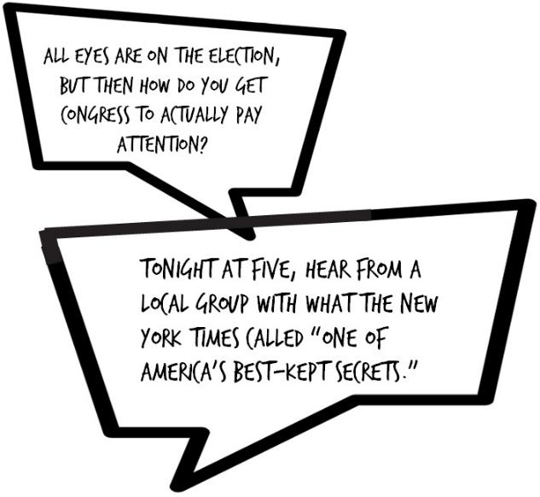
Broadcast Media
RESULTS Global Poverty Campaigns National Webinar

Slide 13
Broadcast Media
SUBJECT: Story idea – Will Congress listen to people here in Asheville after the election?
Dear News Director:
Thanks for all your thoughtful election coverage. I know many people are wondering if Congress even listens to everyday constituents. What happens after the elections? Is there a way to break through the political noise and make an impact?
A group of Asheville advocates focused on poverty have shown me the answer is yes. The group is called RESULTS. Last year a piece in the New York Times said:
RESULTS Global Poverty Campaigns National Webinar
Notes:
Contact people who previously expressed interest

Slide 14
Broadcast Media
“If you’re looking to bolster participatory democracy in the United States today, you’d be hard pressed to find better guidance than RESULTS volunteers.”
One thing we don’t study in school is our role in influencing the policies coming out of Washington. I’ve learned how to build relationships with our members of Congress, and how to follow-up with them (by phone, letters, and in-person) year-round. And to do it in a bipartisan way.
Would you be interested in showing viewers how to get past the front desk with Congress? There are local advocates you could interview. I think viewers would be hungry to learn this after election season. Would you be interested? Thanks for considering it.
RESULTS Global Poverty Campaigns National Webinar
Notes:
Contact people who previously expressed interest

Slide 15
Volunteer Match Blitz
RESULTS staff will place the ads, field the inquiries, educate new people about RESULTS, and have the initial conversation. We then send them to you!
Your group welcomes them, builds a relationship with them, assesses their needs, and supports them to have breakthrough experiences in our democracy. Are you ready?
RESULTS Global Poverty Campaigns National Webinar
Notes:
According to our expansion team, VolunteerMatch is our best source of new leads.
Invite Katie Brooks tell us about his experience finding RESULTS via VolunteerMatch.

Slide 16
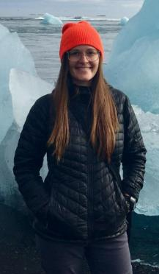
I found RESULTS through VolunteerMatch.
Katie Brooks of Boulder, Colorado
RESULTS Global Poverty Campaigns National Webinar
Notes:
According to our expansion team, VolunteerMatch is our best source of new leads.
Invite Katie Brooks tell us about his experience finding RESULTS via VolunteerMatch.

Slide 17
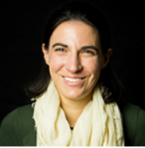
Virtual Thanksgiving Feast
Mea Geizhals
Grassroots Fundraising Manager
mgeizhals@results.org
RESULTS Global Poverty Campaigns National Webinar

Slide 18
https://results.salsalabs.org/virtualthanksgivingfeast/index.html

Slide 19
Join the 2018 Fall Peer-to-Peer Fundraiser to raise critical resources to end poverty
New for the 2018 Virtual Thanksgiving Feast:
Fundraising prizes – Notebooks! T-shirts!
Updated resources – Videos! Graphics!
Special announcements – Badges!
More than 30% of groups are fundraising for RESULTS in 2018. Join the fun!
Check it out at: results.salsalabs.org/virtualthanksgivingfeast/index.html
Contact Mea Geizhals with questions or if you plan to join at mgeizhals@results.org or 202-783-4800 x131

Slide 20
Grassroots Fundraising Share: Marty White
Marty White with Professor Muhammad Yunus at RESULTS fundraising event in 2017
Dallas Global group

Slide 21
Post-Election Engagement
How will you or your group take advantage of post-election interest?
Take 6 minutes to make plans with your group. What is your group most excited about taking on? If you are alone, do some thinking as well.
We’ll take 5 minutes to hear what you are excited about doing to make the most of this critical post-election period.
RESULTS Global Poverty Campaigns National Webinar

Slide 22
Post-Election Engagement Sharing
Share your plans for Post-Election Engagement and Virtual Thanksgiving Feast in the chat window, or unmute your line and share
On the webinar? Unmute by clicking the microphone.
On by phone? Unmute by hitting *6.
If you are not speaking, please stay muted.
RESULTS Global Poverty Campaigns National Webinar

Slide 23
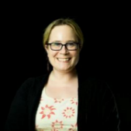
Would You Like Some Coaching Resources on 1:1 Conversations?
The Personal Narrative: Your Story of Self, Us, and Now
Utilizing the RESULTS Laser Talk
Creating your own EPIC (Engage, Problem, Inform, Call to Action) Laser Talk
Contact Lisa Marchal, Global Grassroots Manager, at lmarchal@results.org for a 30-minute coaching conversation.
RESULTS Global Poverty Campaigns National Webinar

Slide 24
Meetings with Congress
Through October 2018
Face-to-face with Representatives - 121
With House aides – 218
Total in House = 339
Face-to-face with Senators - 45
With Senate aides - 123
Total in Senate - 168
RESULTS Global Poverty Campaigns National Webinar

Slide 25
Outreach
Through October 2018
Outreach Events - 131
#LettersGetLoud Letters - 1196
New partners/advocates - 74
New Action Network members - 166
RESULTS Global Poverty Campaigns National Webinar

Slide 26
Media
Through October 2018
Op-eds - 20
Editorials - 15
Letters to the Editor - 258
Other media – 14
RESULTS Global Poverty Campaigns National Webinar

Slide 27
For Your Calendar See Your Weekly Update for all the information on how to join.
November. Virtual Thanksgiving Feast Fundraising Campaign
November 8 and 14. New Advocate Orientation, 8:30 pm ET
November 19. Global Campaigns Free Agents Webinars, 1 pm ET and 8 pm ET
RESULTS Global Poverty Campaigns National Webinar

Slide 28
For Your Calendar See your Weekly Update for all the information on how to join.
Week of Nov. 19. Congressional Recess
November 22-23. RESULTS Office Closed for Thanksgiving
December 5. Action Network Community of Practice,
8 pm ET.
RESULTS Global Poverty Campaigns National Webinar

Slide 29
Mark Your Calendars!
July 13-16, 2019
RESULTS International Conference
Do you have a great speaker idea?
Submit your idea here: https://tinyurl.com/2018ICSpeakers

Slide 30
How many people from your group
joined in today’s webinar?
Let us know your numbers directly in the chat box or send to Lisa Marchal,
Global Grassroots Manager
lmarchal@results.org
RESULTS Global Poverty Campaigns National Webinar

Slide 31
November 6 was just the beginning …

