Slide 1
RESULTS March 2018 Global National Webinar
Tuberculosis: 2018 Is An Opportunity for Real Progress
http://fuze.me/30204806, or dial (201) 479-4595, meeting ID 30204806.
Closed captioning: http://west.typewell.com/faelapgb

Slide 2
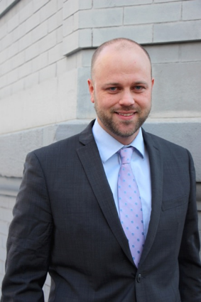
Welcome from John Fawcett, Director of Global Policy and Advocacy
RESULTS National Webinar

Slide 3
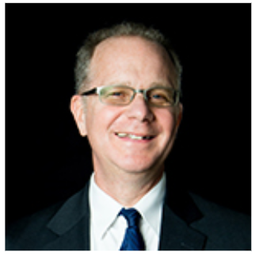
Introduction of Today’s Guest
By RESULTS TB Advocacy Office
David Bryden
RESULTS National Webinar

Slide 4
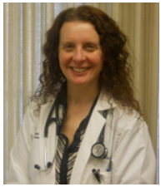
Today’s Guest: Dr. Jennifer Furin
Dr. Furin is an infectious diseases clinician and a medical anthropologist who has spent the last 22 years working in the field of TB. She specializes in community-based management of Drug-Resistant-TB, especially among vulnerable populations--including children, people living with HIV, people in prison, and those in resource-poor settings. She is currently a lecturer at Harvard Medical School in the Department of Global Health and Social Medicine and has served as a consultant for the World Health Organizations, multiple National TB Programs and for MSF projects in Khayeltisha and Eshowe (South Africa) and Tajikistan.
RESULTS National Webinar

Slide 5
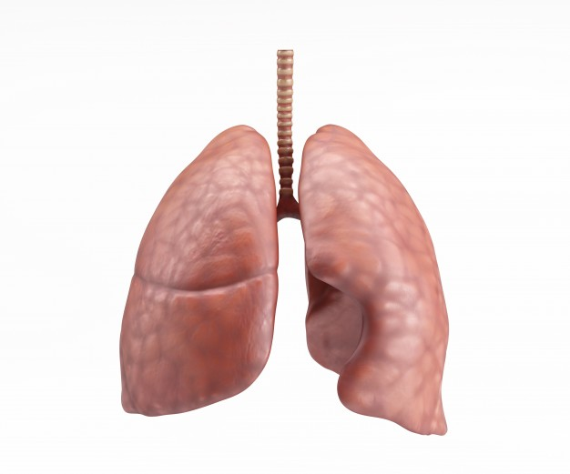
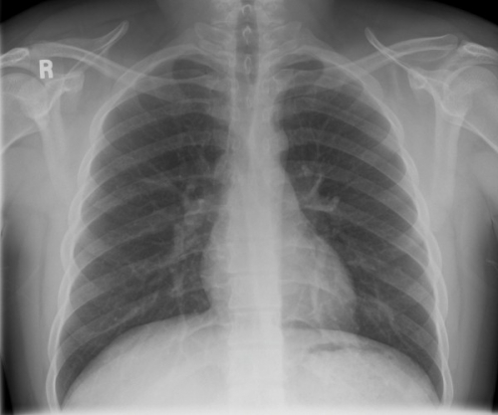
Demand Funding for Tuberculosis because EVERYBODY BREATHES!

Slide 6
Summary Points
10.4 million new cases each year
4000 people die of TB every day, making it the leading global infectious killer
Drug-resistant forms of TB will be responsible for 25% of deaths due to antimicrobial resistance
New York City outbreak in the 1990s cautionary tale of TB funding cuts
Family disease in which children are especially vulnerable—20 million children exposed to TB each year, with almost none being offered interventions.
Impact of TB on the world will not be diminished without significant investment in research to develop new tools.

Slide 7
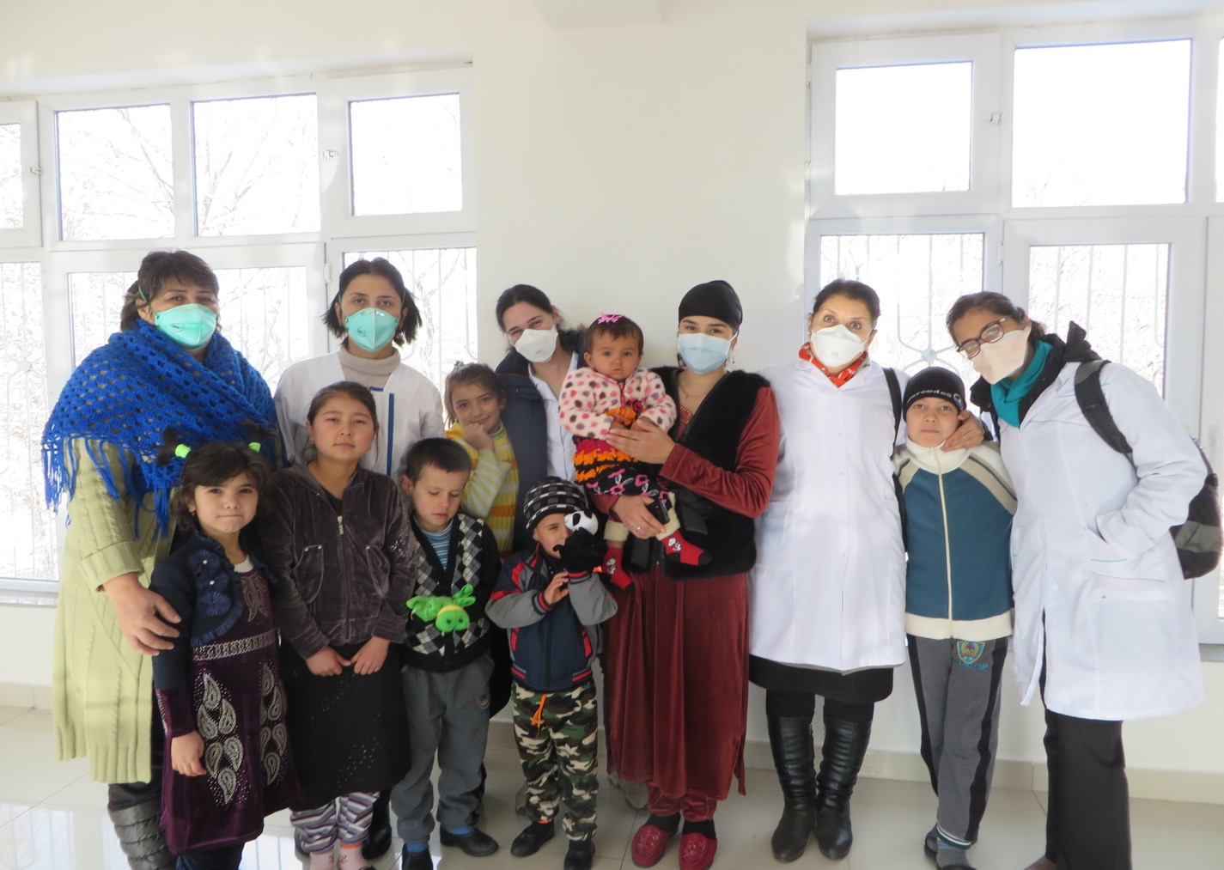

Slide 8
Breathing with Ease: Advocacy Messages
Opportunity of HLM at UN
Do not cut funding to domestic programs.
Increase funding for global fight.
Expand research capacity and resources.
Involve survivors in every step to ensure human rights-based approach.

Slide 9
Want to Ask a Question or Share a Comment?
Unmute your line on your computer by clicking in Fuze
Press *1 on your phone
Type your question in the Chat Window in Fuze
If you are not sharing, please stay muted.
RESULTS National Webinar

Slide 10
John Fawcett
Director, Global Policy and Advocacy
Email: jfawcett@results.org
RESULTS National Webinar

Slide 11
FY19 Appropriations Letters
Issue | Leads | Signers | Deadline
Basic Education and GPE | Reichert (R-WA), Quigley (D-IL) | 58 | March 9 March 12
Maternal and Child Health, Gavi, and Nutrition | Reichert (R-WA), McCollum (D-MN), Lee (D-CA), McCaul (R-TX), Ross (R-FL), Donovan (R-NY), Bera (D-CA) | 100 | March 12
Global Fund and PEPFAR | Lee (D-CA), Ros-Lehtinen (R-FL) | 98 | March 12
Global TB | Engel (D-NY), Young (R-AK), Green (D-TX) | 54 | March 9 March 12

Slide 12
FY19 Appropriations Resources
Action Sheet and Outreach Guide
Latest signers
Appropriations 101 Webinar Recording
FY 2019 Appropriations Request Sheets
New: Laser Talk on following up
http://www.results.org/issues/appropriations

Slide 13
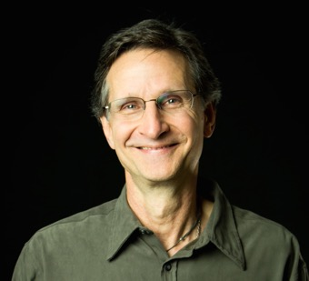
Grassroots Café
Ken Patterson
Director of Global Poverty Advocacy
Email: kpatterson@results.org
RESULTS National Webinar

Slide 14
Building Our Movement in 2018
Thousands of individualized letters
in first half of 2018
International Conference in July
Election Engagement second half of 2018
RESULTS National Webinar

Slide 15
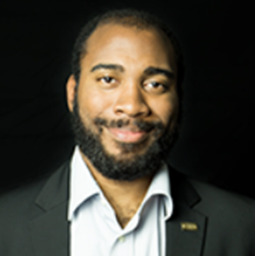
17
2018 RESULTS #LettersGetLoud Campaign Overview

Slide 16
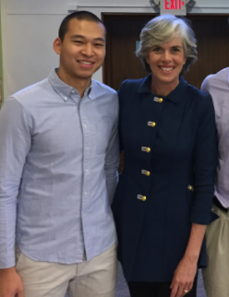
A #LettersGetLOUD Story!
Vincent Lin,
REAL Change Fellow
with Rep. Katherine Clark (D-MA-5)
2018 RESULTS #LettersGetLoud Campaign Overview

Slide 17
Need a sample meeting agenda for #lettersgetLOUD?
Or perhaps an inviting/outreach laser talk?
Perhaps some snappy RESULTS tabling gear?
Go to http://www.results.org/lettersgetloud!
2018 RESULTS #LettersGetLoud Campaign Overview

Slide 18
Building Our Movement in 2018
Thousands of individualized letters
in first half of 2018
International Conference in July
Election Engagement second half of 2018
RESULTS National Webinar

Slide 19
RESULTS National Webinar

Slide 20
Can we have every group represented in DC and have every group bring at least one who has never attended before?
RESULTS National Webinar

Slide 21
Gap Funding for U.S.-based Global Poverty Advocates:
https://tinyurl.com/GapFunding
REAL Change info and application:
http://www.results.org/realchange
RESULTS National Webinar

Slide 22
Reporting Your Advocacy
So far in 2018 (through February) . . .
Outreach Events:
19 Outreach Activities
10 new Partners
34 new Action Network members
117 Letters
23% of Groups participating in outreach so far
RESULTS National Webinar

Slide 23
Reporting Your Advocacy
So far in 2018 (through February) . . .
Meetings with Members of Congress & staff:
13 Face-to-Face meetings with Reps.
9 Face-to-Face meetings with Senators
3 meetings with House aides
8 meetings with Senate aides
Total: 33 Congressional meetings overall
28% of Groups have met with MoC or Staff member
RESULTS National Webinar

Slide 24
Reporting Your Advocacy
So far in 2018 (through February) . . .
Media:
1 oped
45 Letters to the Editor
3 Other types of media
20% of groups have generated media so far
RESULTS National Webinar

Slide 25
Group Plans Turned In So Far
Indianapolis
Bloomington
Missoula
Cheyenne
Oakland
Sierra Nevada
Portland
Silicon Valley
Northern VA
Honolulu
Seattle
Tacoma
Tri-Cities
South Kitsap
Fort Worth
Houston
Dallas
New Orleans
Austin
St. Louis
Detroit
Madison
Miami
Orlando
Asheville
Los Angeles
Orange County
Inland Empire
28 of 80 Group Plans Turned = 35%
RESULTS National Webinar

Slide 26
For Your Calendars
March 19, 1 pm ET and 8 pm ET. RESULTS Global Free Agents Webinars (choose one).
Login: http://fuze.me/35703902. Or to join by phone only, dial (201) 479-4595, meeting ID 35703902.
March 22, 8:30 pm ET. RESULTS Introductory Call. Dial (712) 775-8972, passcode 761262.
March 24. World TB Day.
March 26-April 6. Senate and House Recess.
RESULTS National Webinar

Slide 27
April 14: National Webinar Focused on our Anti-Oppression Efforts
RESULTS National Webinar

Slide 28
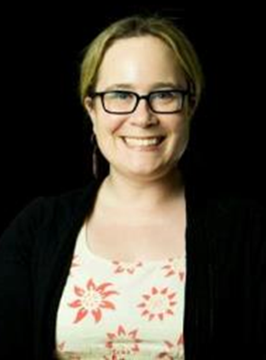
FY19 Sign-on Letters Laser Talk
Mark Campbell
Global Health Associate
Email: mcampbell@results.org
Lisa Marchal
Global Grassroots Manager
Email: lmarchal@results.org
RESULTS National Webinar

Slide 29
FY19 Sign-on Letters Laser Talk
Engage: Hi my name is _______, and I'm a constituent from _______________, and I’m calling for two things. The first is to thank the you and the Rep. for his/her past support for __________ issue through ____ action. The second is to request action on an important issue.
Problem: As you know, this is a critical time for FY19 spending, and the President has proposed extreme cuts to international development programs that support families, save lives, and build US partnerships around the world.
Inform: Congress was critical in protecting global health and education programs for FY18, and can do the same for FY19, but the timeframe for that, as you know, is limited.
Call to action: There are two Dear Colleague letters closing today, March 12: one which supports the Global Fund to Fight AIDS, Tuberculosis and Malaria, and one which supports maternal and child health. Will the representative sign them today? Also, can we count on the representative to send specific funding requests on the Global Fund and maternal/child health to the State and Foreign Operations Subcommittee on Appropriations by March 16? I can provide whatever information you need on the letters as well as the funding requests.
RESULTS National Webinar

Slide 30
How many people from your group
joined in today’s webinar?
Let us know your numbers directly -
send to Lisa Marchal
Global Grassroots Manager
lmarchal@results.org
RESULTS National Webinar

