Slide 1
RESULTS March Global Poverty National Webinar
FY18 Appropriations and Budget
https://www.fuzemeeting.com/fuze/f2988286/30204806, or dial (201) 479-4595, meeting ID 30204806.
Closed captioning: http://west.typewell.com/faelapgb

Slide 2
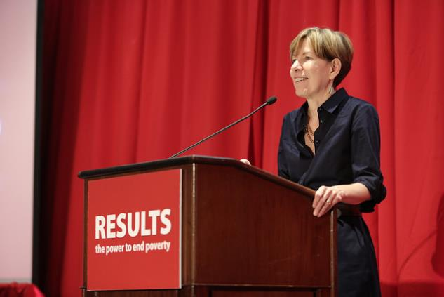
Welcome from Joanne Carter Executive Director, RESULTS
RESULTS National Webinar

Slide 3
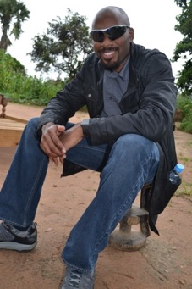
Mark Campbell Global Health Associate
RESULTS 2017
Zambia Grassroots Learning
And Sharing Tour Recap
E-mail: mcampbell@results.org
Phone: (202) 783-4800
RESULTS National Webinar

Slide 4
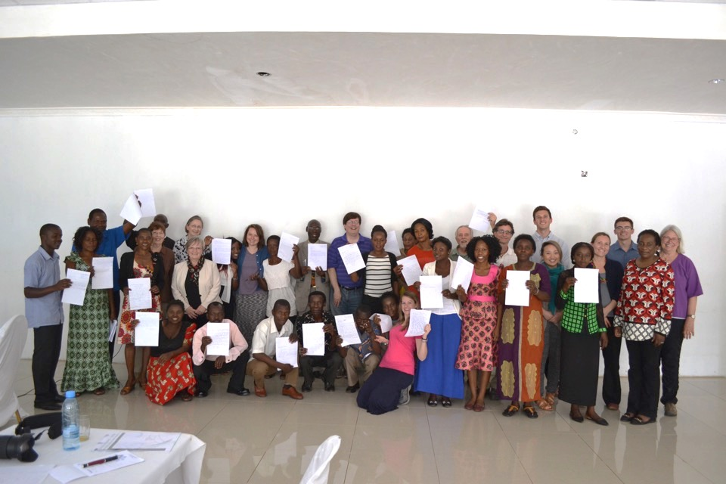
RESULTS National Webinar

Slide 5
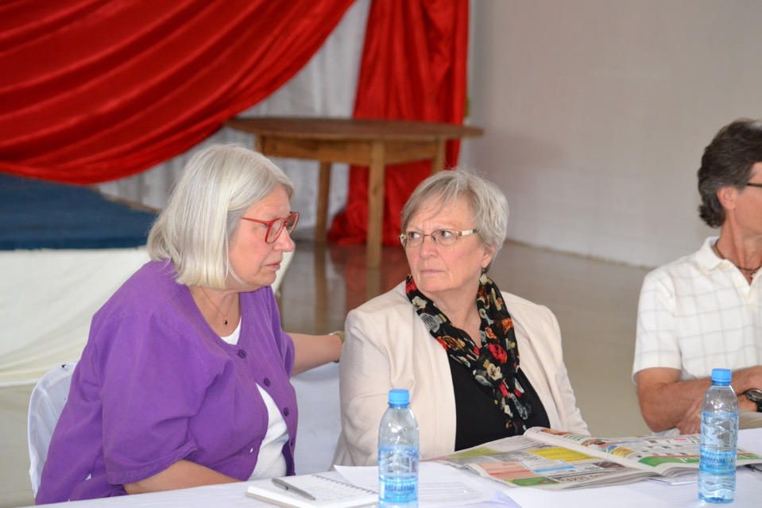
RESULTS National Webinar

Slide 6
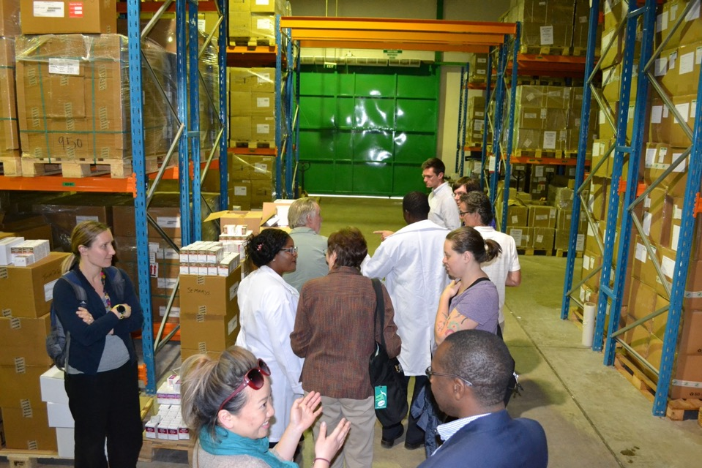
RESULTS National Webinar

Slide 7
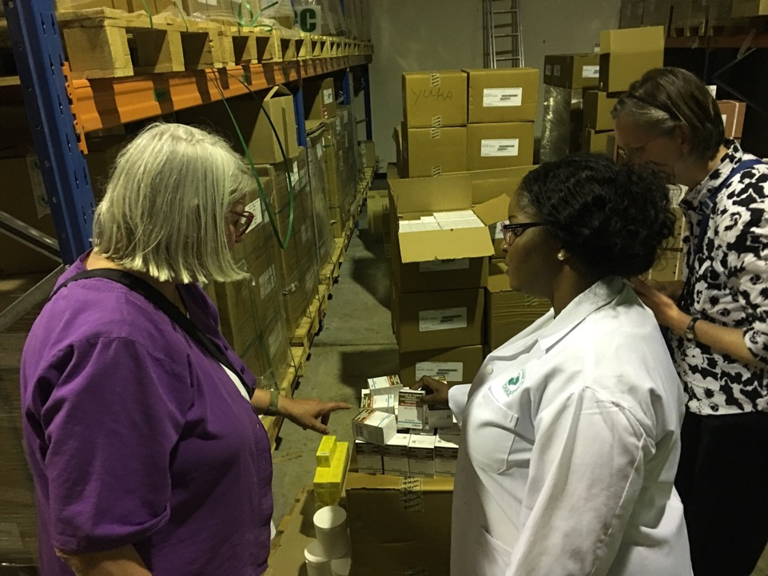
RESULTS National Webinar

Slide 8
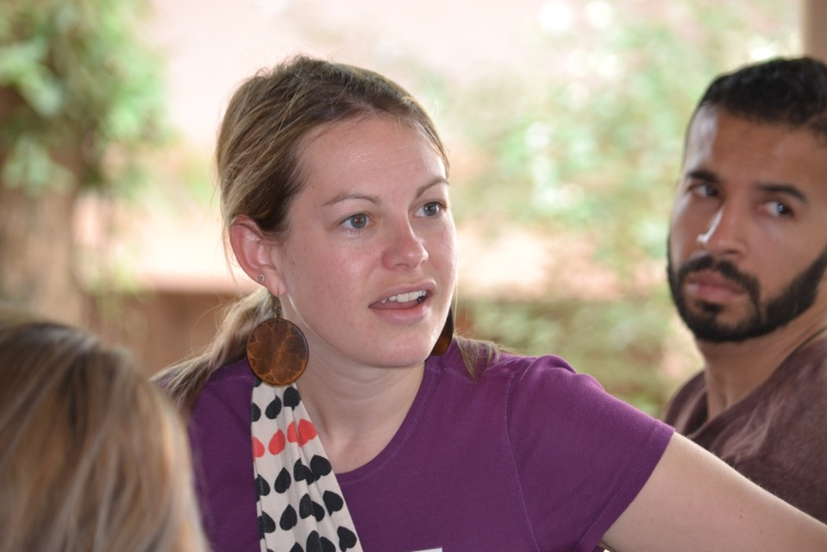
RESULTS National Webinar

Slide 9
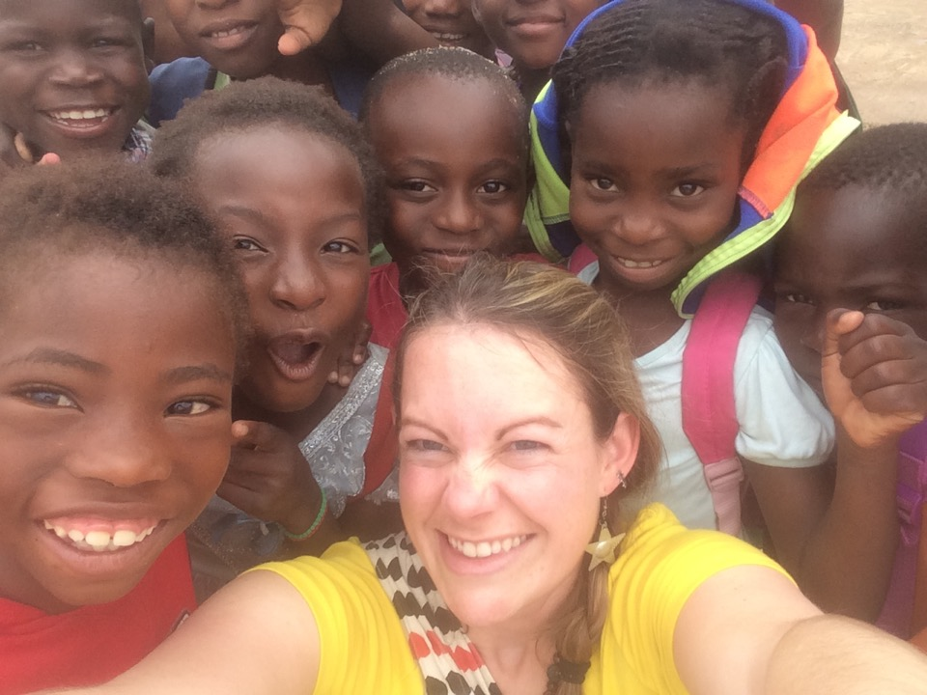
RESULTS National Webinar

Slide 10
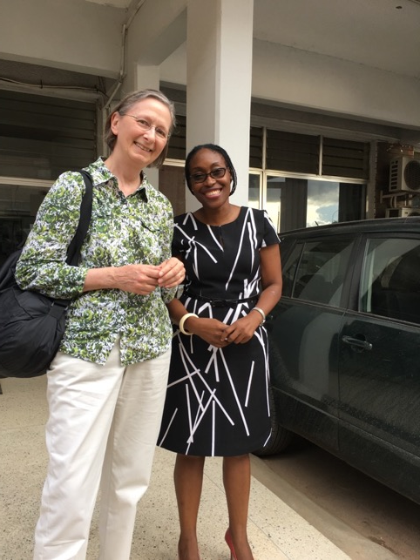
RESULTS National Webinar

Slide 11
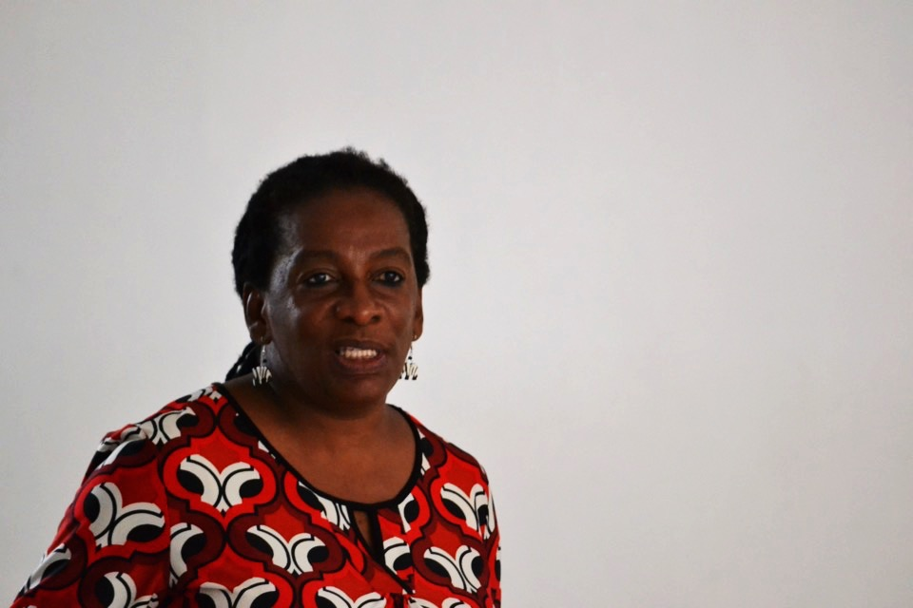
RESULTS National Webinar

Slide 12
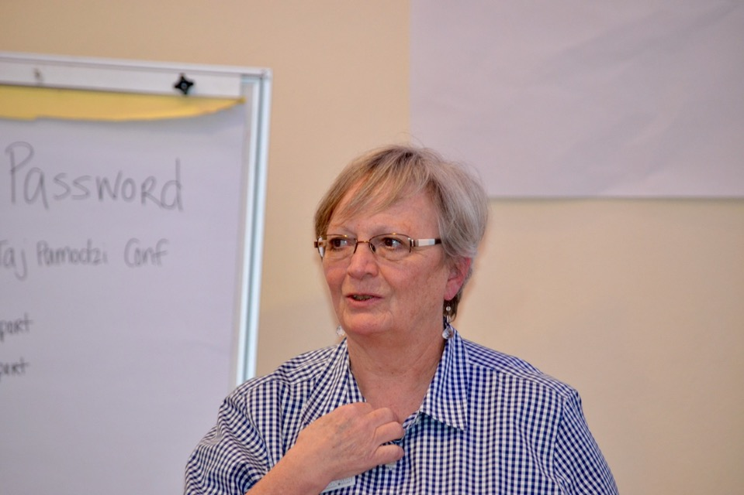
RESULTS National Webinar

Slide 13
RESULTS National Webinar

Slide 14
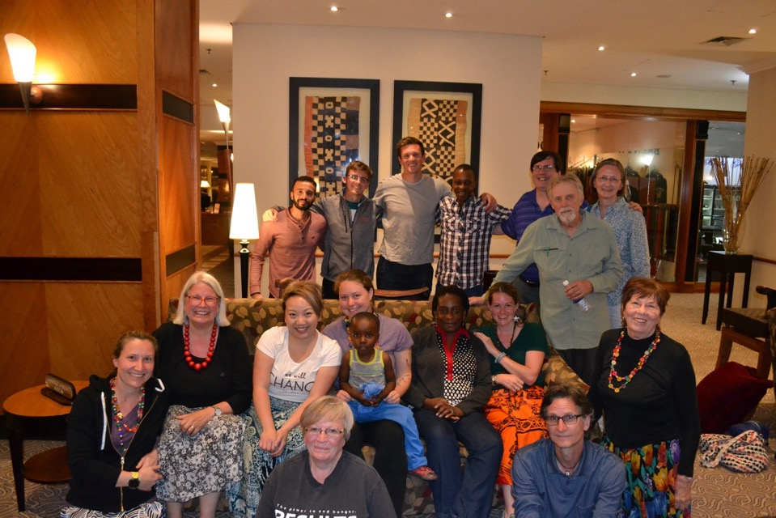
RESULTS National Webinar

Slide 15
Questions
When prompted, unmute your line on your computer (click in Fuze) or press *1 on your phone to share.
If you are not sharing, please keep your line muted.
RESULTS National Webinar

Slide 16
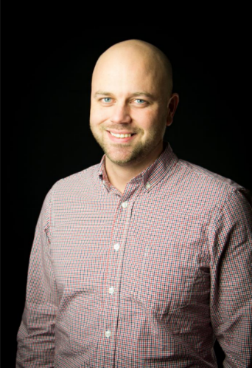
John Fawcett Director, Global Policy and Advocacy
E-mail: jfawcett@results.org
Phone: (202) 783-7100
RESULTS National Webinar

Slide 17
Appropriations
5
Member Requests
House Deadline: March 30
Senate Deadline: Not set
Sign-on Letters
Four bipartisan House sign-on letters
One bipartisan Senate sign-on letter (so far)

Slide 18
Appropriations
5
Maternal and Child Health, Gavi, and Nutrition
Bipartisan letter led by Reps. Reichert (R-WA), Lee (D-CA), McCaul (R-TX), Ross (R-FL), and Bera (D-CA).
Asks appropriators for robust funding for Maternal and Child Health Account – including Gavi, and Robust funding for the Nutrition Account in Global Health at USAID.
Deadline for signers is March 28

Slide 19
Appropriations
5
Global Fund to Fight AIDS, TB & Malaria; & PEPFAR
Bipartisan letter led by Rep. Barbara Lee (D-CA) and Rep. Ileana Ros-Lehtinen (R-FL)
Asks for robust funding for the Global Fund and PEPFAR
Deadline for signers is March 24

Slide 20
Appropriations
5
Global Tuberculosis
Bipartisan letter led by Reps. Engel (D-NY), Don Young (R-AK), Gene Green (D-TX)
Asks appropriators for $450 million for the bilateral tuberculosis program at USAID
Deadline for signers is March 23

Slide 21
Appropriations
5
Basic Education and Global Partnership for Education (GPE)
Bipartisan letter led by Reps. Reichert (R-WA) and Quigley (D-IL)
Asks appropriators for robust funding for Basic Education and the Global Partnership for Education
Deadline for signers is March 27

Slide 22
Appropriations
5
Maternal and Child Health, Gavi, and Nutrition
Bipartisan letter led by Sen. Coons (D-DE) and Sen. Collins (R-ME)
Asks appropriators for robust funding for maternal and child health, Gavi, and nutrition to support ending preventable maternal and child deaths
Deadline for signers is April 5

Slide 23
Appropriations
5
Bookmark this: http://bit.ly/FY18RESULTS
Up to the minute updates!
Tools: http://www.results.org/issues/appropriations
Appropriations Action Sheet and Outreach Guide
Laser Talk
Background 2-page request on each issue
Sample emails for each request
September 2016 RESULTS National Conference Call/Webinar Slides

Slide 24
Appropriations
5
Remember…
Appropriations Committee needs to hear support for these programs
Every letter is bipartisan
Get a yes? Use the Champion Scale!

Slide 25
Ken Patterson Director of Global Grassroots Advocacy
Grassroots Café
E-mail: kpatterson@results.org
Phone: (828) 398-4562
RESULTS National Webinar

Slide 26
The Good News
Our successes are bipartisan
Research backs up our approach
People are hungry to get engaged
RESULTS National Webinar

Slide 27
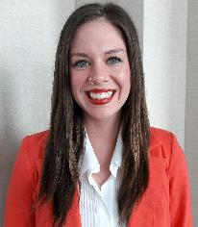
Leading with Action
Organizing for Impact
Grassroots Shares
Cecilia van Wijk – Indianapolis, IN
RESULTS National Webinar

Slide 28
Tools at Your Disposal
International Conference
Monthly Action Sheet with Guide
Joint Action Sheet with Guide
Advocacy Workshop Guide (coming)
Webinars on Advocacy Skill Training
Master Trainer program April 28-30
Laser Talk on Offering Engagement
RESULTS National Webinar

Slide 29
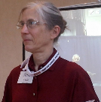
EPIC Laser Talk:
Sharing Your Expertise to Grow Your Group
Led by Anne Child, Regional Coordinator
Engage: I’ve been noticing that a lot of people are hungry to use their voices to make a difference. Are you noticing the same thing?
Problem: I’m also hearing from people that they don’t know what to do.
Inform: I feel lucky that I found RESULTS. RESULTS has trained me in the most effect tactics for having my voice heard on issues of poverty. Recent research from the Congressional Management Foundation confirms these tactics.
Call to Action: I’m interested in growing our RESULTS chapter, but I’d also like to share our knowhow with others in the community. Would your group be interesting in having me lead a hands-on advocacy skills workshop to help your people channel their passions?
RESULTS National Webinar

Slide 30
RESULTS 100 Days Campaign
Strategy: Meet face-to-face with your members of Congress or with local congressional staff
Goal: 100 percent participation of RESULTS groups and Free Agent advocates
Game On: track and celebrate your progress with our interactive game board
#First100days
#RESULTS100
RESULTS National Webinar

Slide 31
First 100 Days Successes So Far
What’s been reported as of March 7?
90 meetings with members of Congress or their Staff
37/80 Groups participated so far or 46% of Global groups
http://tinyurl.com/MakeThatLobbyReport
RESULTS National Webinar

Slide 32
First 100 Days Successes So Far
What’s been reported as of March 7?
41 Outreach Activities reported
17/80 Groups participating, or 21% of Global Groups
http://tinyurl.com/MakeThatOutreachReport
RESULTS National Webinar

Slide 33
First 100 Days Successes So Far
What’s been reported as of March 7?
35/80 First 100 Day plans turned in, or 44% of Global group plans.
RESULTS National Webinar

Slide 34
Announcements
First 100 Days Webinar - Creating Bi-Partisan Support for our Issues in our Communities: A Learning and Sharing Lab. March 15, 9 pm ET. Login online: http://fuze.me/34116938; or via phone (201) 479-4595 and enter meeting ID 34116938.
Are you interested in exploring the critical relationship between advocacy and anti-oppression? Please join RESULTS for a virtual opportunity on Thursday, March 16 at 8:00 pm ET for a conversation around the forward and the first chapter of the book The New Jim Crow: Mass Incarceration In the Age of Colorblindness by Michelle Alexander. To participate, log in at http://fuze.me/34326078 or dial in by phone (201) 479-4595, meeting ID 34326078. Dates for continuation of book club: March 30, April 13, April 27.
Next RESULTS Introductory Call is Friday, March 24 at 1 pm ET. Register for an upcoming Intro Call on the RESULTS website.
Next RESULTS National Webinar for Global Campaigns: Saturday, April 8, 2 pm ET.
Registration for the RESULTS International Conference is open! July 22-25, 2017 in Washington, DC.
Buy Reclaiming Our Democracy—the e-version version for $2.99 on Amazon, iBooks, and Barnes and Noble. Today only!!
RESULTS National Webinar

Slide 35
First 100 Days
2017 Global Grassroots Planning Calendar: http://tinyurl.com/GRPlanningCalendar
Use our First 100 Days support materials: http://results.org/issues/first_100_days
________________________
As you continue your member of Congress meetings . . .
When you get a congressional meeting or town hall scheduled, please enter it into our First 100 Days Meeting Tracker: http://tinyurl.com/100daysmeetings
After you meeting, please tell us what happened in the RESULTS Lobby Report Form: www.tinyurl.com/RESLRF
________________________
See a reporting error? No problem! Contact Lisa Marchal (lmarchal@results.org) and we’ll get it fixed.
RESULTS National Webinar

Slide 36
How many people from your group
joined in today’s webinar?
Let us know your numbers directly
at lmarchal@results.org!
RESULTS National Webinar

Slide 37
Thank you for being on today’s webinar!
March Global Health Leadership Training, Indianapolis
Leaders in Action!

