Slide 1
Lobby 101 Training

Slide 2
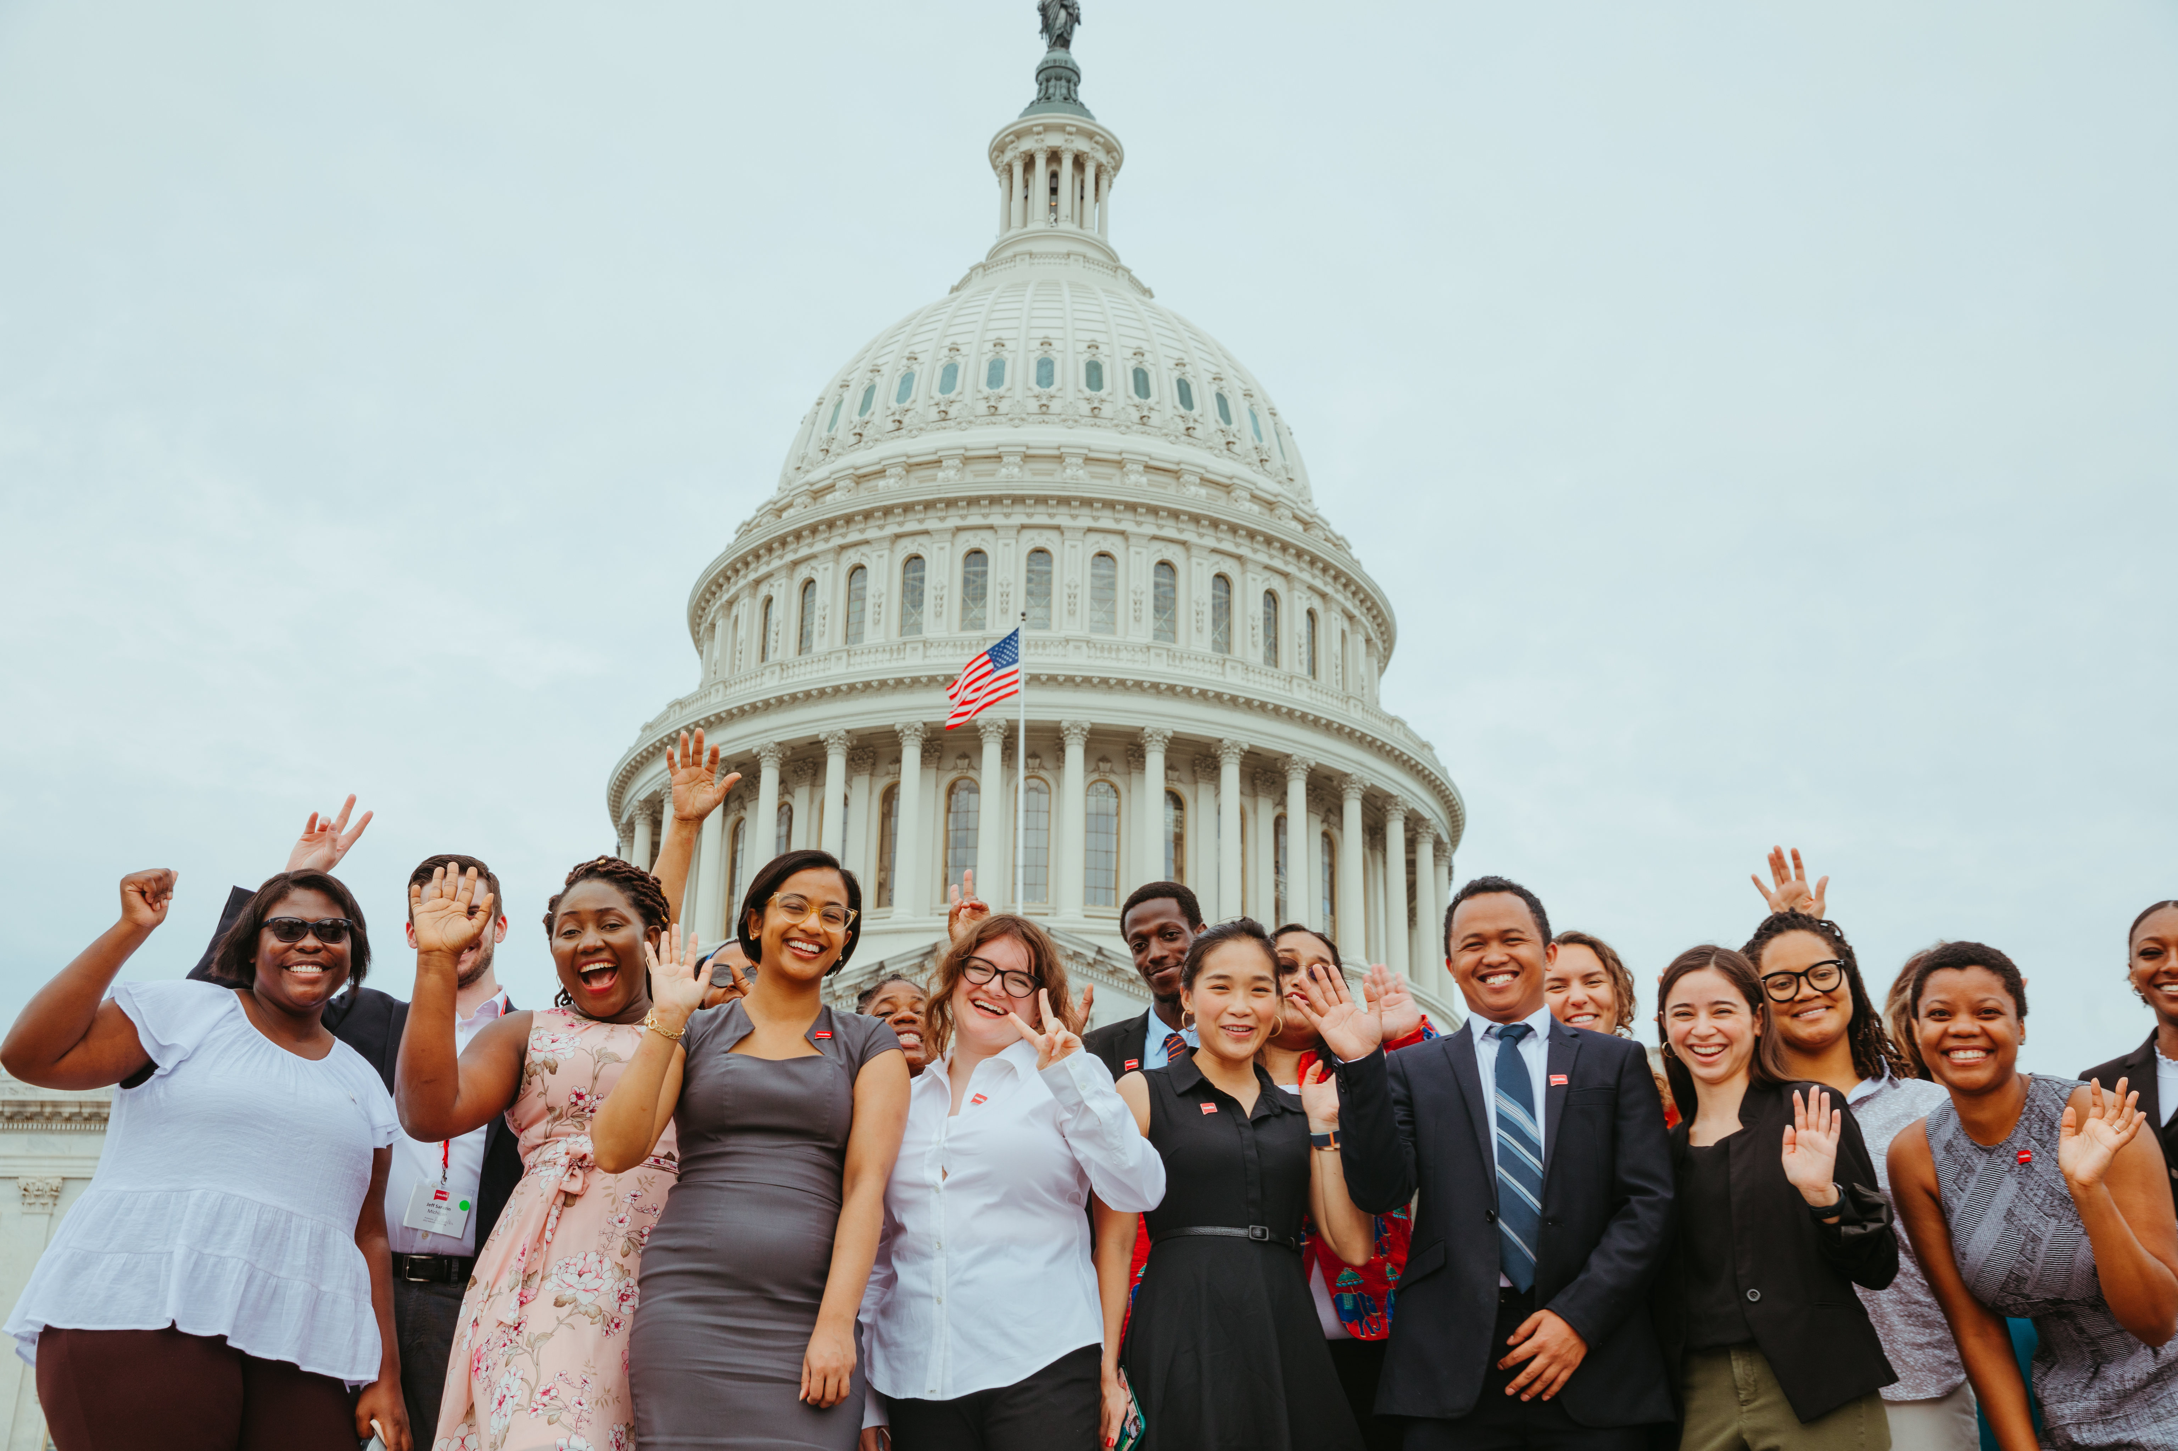
Welcome!
Use the chat to introduce yourself
Name & pronoun
City
One word that describes why you’re joining

Slide 3
poll

Slide 4
Keep in mind…
Stay on mute
Private chat us if you have tech issues
Live transcript available
Want to rename yourself? Right click on your
Zoom square & select “rename”
Zoom tip

Slide 5
The basics
Notes:
The question is how is the battle going?

Slide 6
What is a lobby meeting?
Notes:
Another way to approach this engaging statement is that you can catch the attention of policymakers because it is unusual to have such powerful evidence that policies can make such an impact. The CTC is effective in lifting out children of poverty – in fact, Columbia University researchers found that after the monthly payments started in July 2021, nearly 4 million children were kept from poverty each month.
CTC and EITC have allowed more people to move out of poverty than any other program besides Social Security (5.3 million people in 2020)

Slide 7
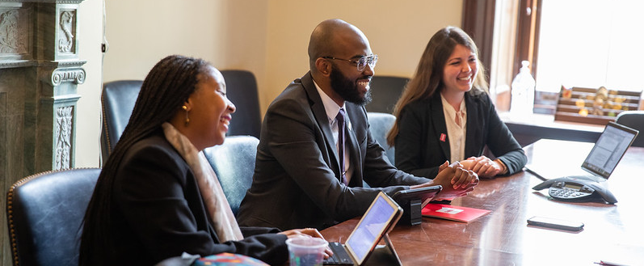
A meeting with our elected officials or their staff, to influence them to take action around an issue.
Notes:
Another way to approach this engaging statement is that you can catch the attention of policymakers because it is unusual to have such powerful evidence that policies can make such an impact. The CTC is effective in lifting out children of poverty – in fact, Columbia University researchers found that after the monthly payments started in July 2021, nearly 4 million children were kept from poverty each month.
CTC and EITC have allowed more people to move out of poverty than any other program besides Social Security (5.3 million people in 2020)

Slide 8
Goals of lobby meeting
Build relationship
Introduce group as resource
Prove community cares
Educate on issues
Gather intel
Get commitment
Notes:
Joining a group in your community
these are not ALL of the roles – sample size

Slide 9
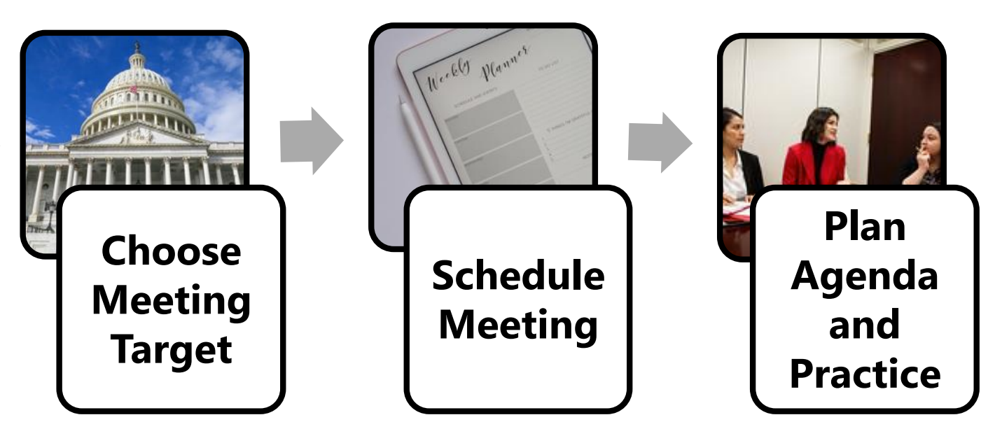
Steps to a successful meeting

Slide 10
Set up the meeting
Notes:
The question is how is the battle going?

Slide 11
Identify your target
Which member of Congress?
What issue(s) will you cover?
Face to face or with staff?
In district? Virtual?

Slide 12
Champion Scale
Leader
+3
Opponent
-1
Neutral
0
Supporter
+1
Advocate
+2
Champion
+4
Champion Scale Worksheet

Slide 13
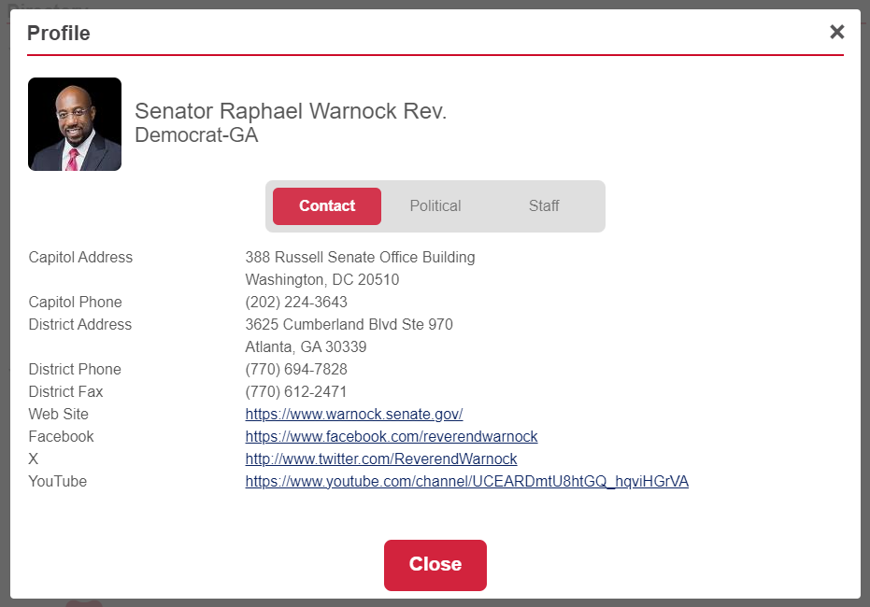
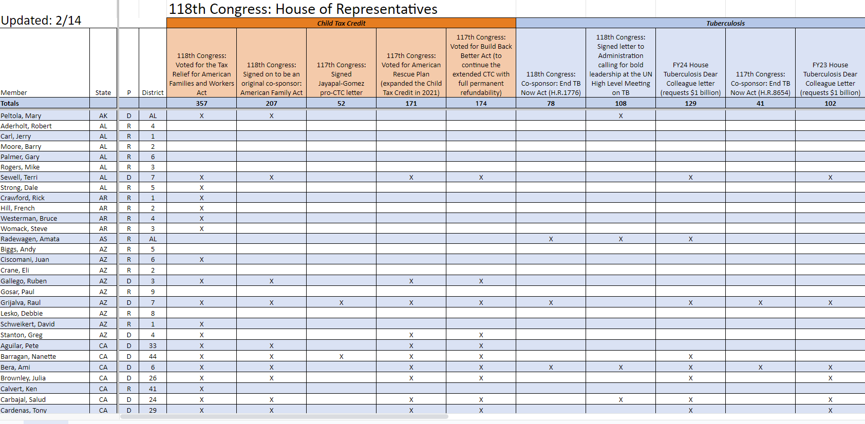
Research your target
Legislator Look-up
Congressional Scorecard
results.org/volunteers/lobbying

Slide 14
Send the meeting request
Type of Meeting | How to Schedule
Face to face with member of Congress | Send an email to the scheduler in DC office Call the DC office and ask to speak to the scheduler It does not hurt to do both!
Meeting with DC office staff | Email the staffer directly Email the scheduler with your request and issues you'd like to discuss
Meeting with in-district staff | Email the local office with your request and issues you'd like to discuss Call the local office and schedule directly with an aide

Slide 15
Send the meeting request
Dear ________ (scheduler/staff name):
My name is ______ and I am a constituent of Sen./Rep. _________ from_______ and a volunteer with RESULTS.
On behalf of ________ (RESULTS chapter name), we are requesting the opportunity to meet with the (Representative or Senator) to discuss domestic and global poverty issues, including child nutrition (SNAP) and global malnutrition that constituents care about deeply.
We’d like to meet in person in the (state/district) with additional constituents and RESULTS members joining virtually. We’d also be willing to meet virtually. Will you please get back to us with possible dates in the coming month or two? Thanks in advance!
Identify the staff using Legislator Look-up
Derive email using formula
Send request with topic of meeting and suggested dates
SENATE
firstname_lastname@senatorlastname.senate.gov ​
HOUSE
firstname.lastname@mail.house.gov
Find meeting request templates at results.org/lobbying

Slide 16
Lobby prep
Notes:
The question is how is the battle going?

Slide 17
1) Introductions
2) Personal Story
3) Overview of the issue(s)
4) Call to action: “Will you support __________?”
Sample Meeting Agenda
2) Thank you

Slide 18
What does this look like?
What motivates you? What are you passionate about?
How did you get into public service?
Has the Congressmen supported global nutrition efforts in the past?
What is the Congressperson's position on fighting malnutrition through USAID?
Is there additional information we can provide to your office?

Slide 19
Meeting Roles
Attendee
Notetaker
Facilitator
Issue overview
Personal share
Timekeeper
Notes:
Joining a group in your community
these are not ALL of the roles – sample size

Slide 20
Attend and follow-up
Notes:
The question is how is the battle going?

Slide 21
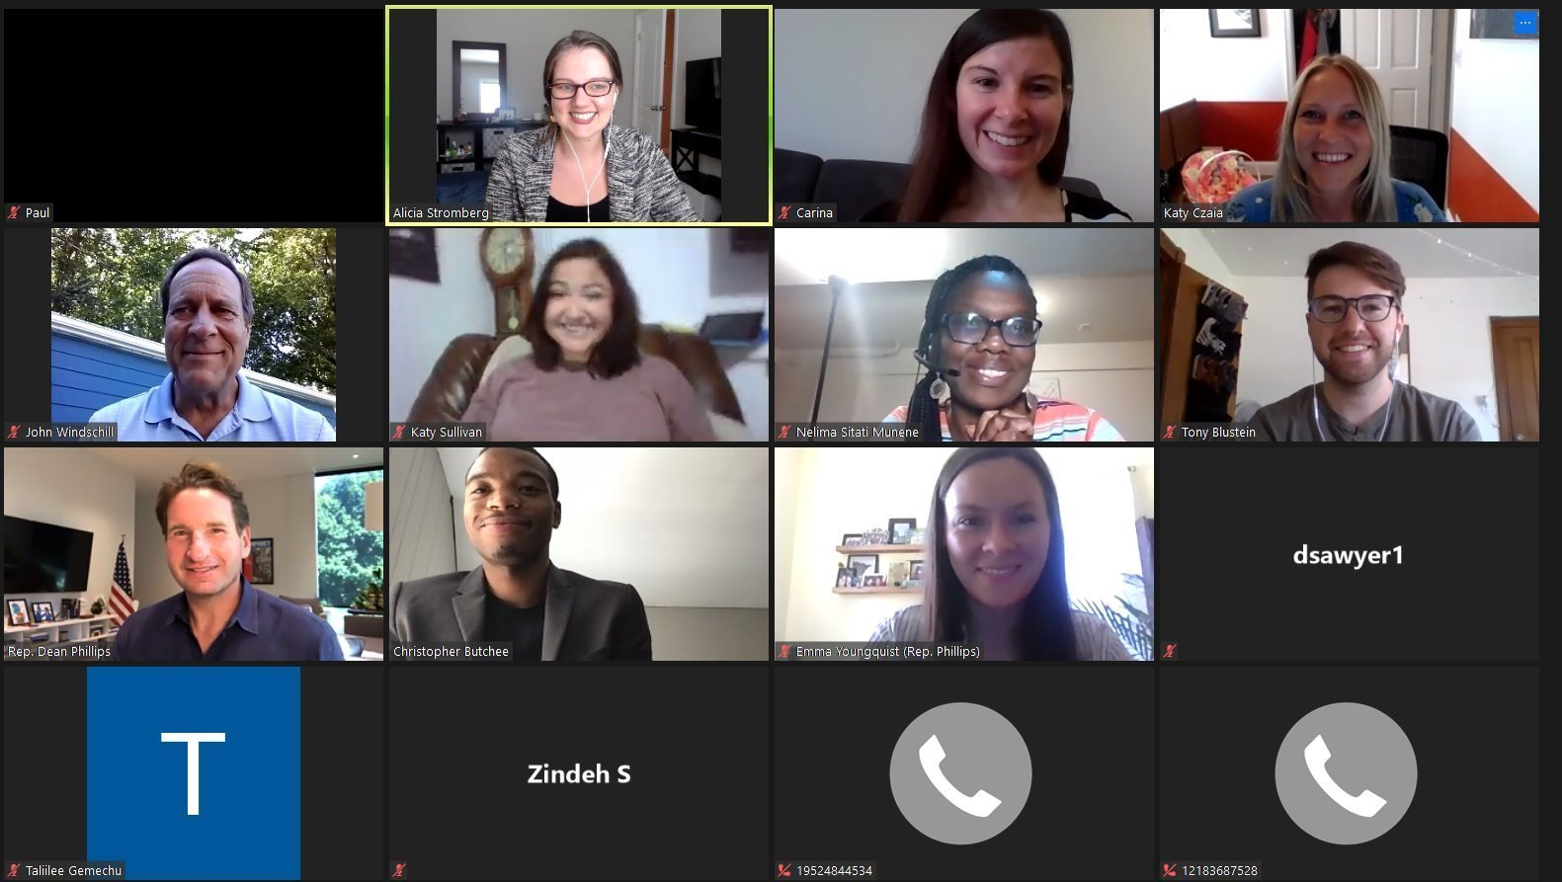
Tips when attending
Be yourself
Nerves are normal
Power in attending
Confirm logistics
Take a picture
RESULTS MN meeting virtually with Rep. Dean Phillips, 2020

Slide 22
“Do not underestimate your impact… One meeting may not feel like you are changing the world. Your advocacy really does make a difference!”
Anna Dieterich
former staff for Senator Murkowski (AK, R)

Slide 23
Follow-up
Send an email to the office and reiterate your request
Include:
Lobby leave-behinds
Address questions from meeting
Photo
Where the relationship begins!

Slide 24
Powerful speaking
Notes:
The question is how is the battle going?

Slide 25
"EPIC" Laser Talk Model
E – Engage
P – Problem
I – Inform
C – Call to action

Slide 26
E - Engage
Capture your listener’s attention with a dramatic fact, short statement, or personal story.
In the case of a lobby meeting, we would be talking to the staffer or even the member of Congress.

Slide 27
P - Problem
Present causes of the problem you introduced in the first section.
How widespread or serious is the problem? How has the problem impacted you or your community?

Slide 28
I - Inform
Inform the listener about a solution to the problem you presented.
You might cite a recent study or tell a first-person account of how the solution has impacted you or others you know

Slide 29
C – Call to action
Call to Action answers the question “so what do you want me to do about it?”
Make the action something specific you can follow up on. Frame it as a yes or no question.

Slide 30
Example
Engage | Personal Story We know how to keep moms and babies healthy and thriving. Yet still: 300,000 women and girls die every year from lack of basic healthcare for pregnancy and birth. And 2.3 million newborns die in their first months of life.
Problem | The problem isn’t a need for a new medical intervention that doesn’t exist yet. It’s ensuring that all people, no matter where they live, have access to lifesaving healthcare and basic nutrition. Things like routine healthcare for women and babies, access to emergency hospital care, training for health workers, access to lifesaving vaccines, and nutrition supplementation have all proven to save millions of lives every year.
Inform on Solution | USAID, the primary federal agency that administers foreign aid and development assistance, has a strong record of supporting maternal and child health programs that make a difference. In 2021 alone, USAID helped increase access to essential care for more than 59 million women and children.
Call to Action | We have the resources right now to ensure all children, no matter where they live, can access their rights to health and nutrition. We’re asking you to help us make that possibility a reality. Will you support lifesaving maternal and child health programs by including $1.15 billion for USAID Maternal and Child Health programs in your FY25 budget request?

Slide 31
Raise your voice – right now
Notes:
The question is how is the battle going?

Slide 32
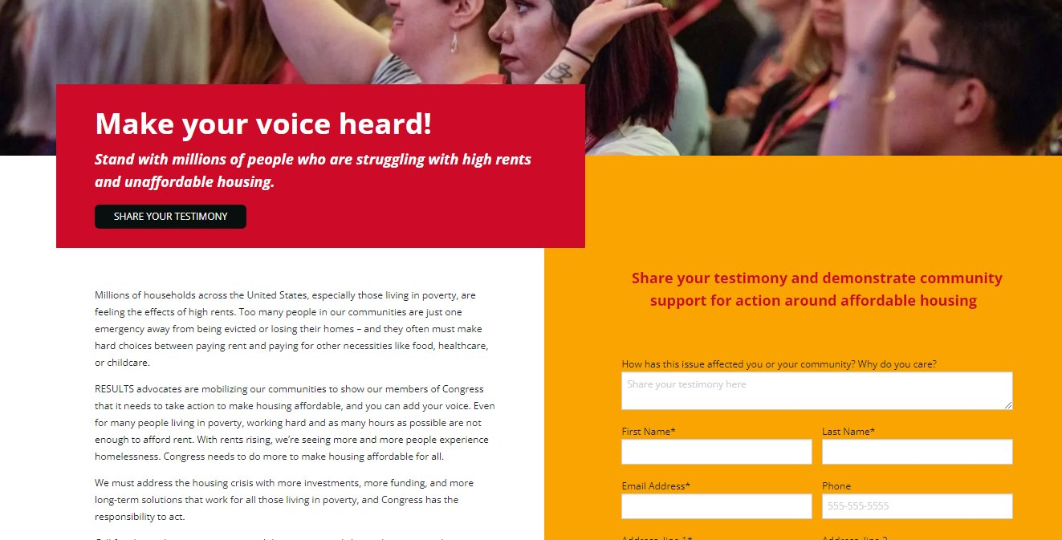
RESULTS Solidarity Action
follow along!
results.org/raise-your-voice-us | results.org/raise-your-voice-global

Slide 33
Lobby with RESULTS
Notes:
The question is how is the battle going?

Slide 34
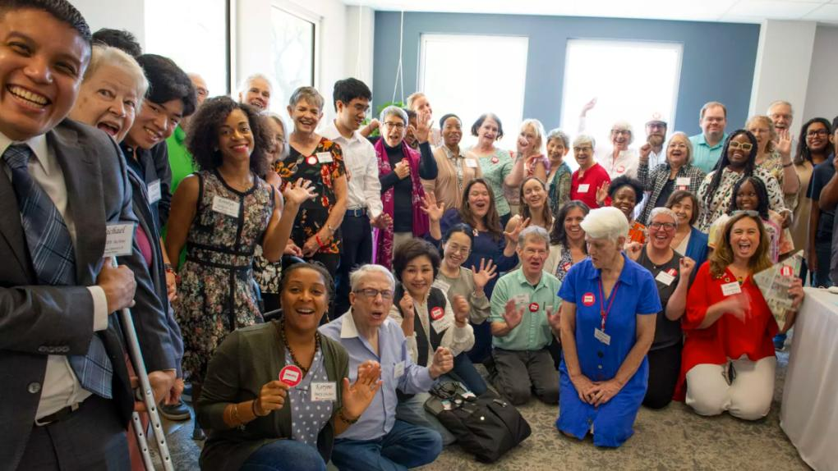
Community of Change

Slide 35
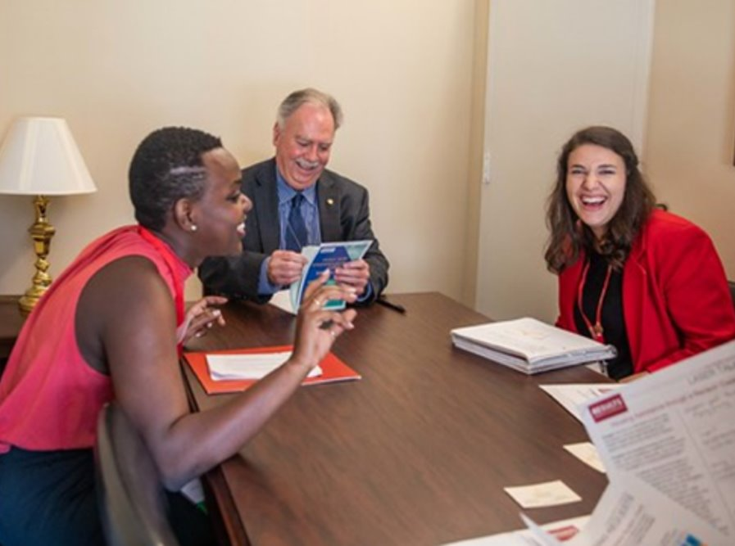
What to expect when lobbying with RESULTS?
Connect to your lobby team (based on city/state)
Be included on plans to lobby your members of Congress
Participate in lobby prep
Attend lobby meetings
3-6 hours/month
February – May

Slide 36
How to get involved
Step 1
Questions? Email Alicia @ astromberg@results.org
Step 2
Step 3
Fill out the lobby interest form
Receive an email with follow-up resources
We will introduce you via email to your lobby team
Schedule a 1:1 if you still have questions
If you are already in a RESULTS group, no need to fill out the form

Slide 37
Resources
Lobbying
Guide - Meet with Congress
Lobby Resource Hub
Legislator Look-up
Congressional Scorecard
Champion Scale
Powerful Speaking​
Guide - EPIC Laser Talk ​
Current Laser Talks​
EPIC Worksheet ​
Amplify your meeting
Solidarity Action – US
Solidarity Action - Global
​

