Slide 1
RESULTS June 2018 Global National Webinar
The International Conference: Power in DC and Power Back Home
http://fuze.me/30204806, or dial (201) 479-4595, meeting ID 30204806.
Closed captioning: http://west.typewell.com/faelapgb

Slide 2
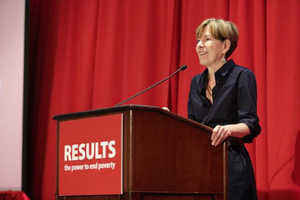
Welcome from
Executive Director
Dr. Joanne Carter
RESULTS Global Poverty Campaigns National Webinar

Slide 3
What Does the International Conference Mean For Us?
RESULTS Global Poverty Campaigns National Webinar

Slide 4
Spring Friends & Family Fundraising Campaign
Support Moms, Champion Kids
Extended Through June
https://results.salsalabs.org/momsandkids
Questions?
Mea Geizhals, Grassroots Fundraising Manager
(202) 783-4800 x131 or mgeizhals@results.org
RESULTS Global Poverty Campaigns National Webinar

Slide 5
Big Goal!
$40,000 fundraising goal
Joanne’s Challenge: 100% Group participation in grassroots fundraising in 2018
Tip: Don’t wait to fundraise! Fundraise this spring to avoid competing with mid-term elections fundraising in the fall.
RESULTS Global Poverty Campaigns National Webinar

Slide 6
Want to Share Your Ideas/Thoughts?
Unmute your line on your computer by clicking in Fuze
Press *1 on your phone
Type in the Chat Window in Fuze
If you are not speaking, please stay muted.
RESULTS Global Poverty Campaigns National Webinar

Slide 7
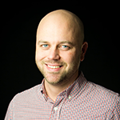
IC Learning Tracks and Advocacy Day
John Fawcett
Director, Global Policy and Advocacy
jfawcett@results.org
RESULTS Global Poverty Campaigns National Webinar

Slide 8
IC Learning Tracks and Advocacy Day
Important elements of the IC to keep in mind
Contacting Susan Fleurant (sfleurant@results.org) for lobby prep call scheduling
Advocacy Day prep materials
#LettersGetLOUD and getting media published in June
RESULTS Global Poverty Campaigns National Webinar

Slide 9
Want to Share Your Ideas/Thoughts?
Unmute your line on your computer by clicking in Fuze
Press *1 on your phone
Type in the Chat Window in Fuze
If you are not speaking, please stay muted.
RESULTS Global Poverty Campaigns National Webinar

Slide 10
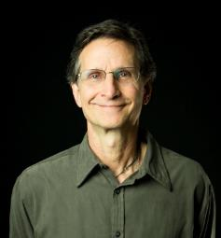
Grassroots Cafe
Ken Patterson
Director of Global Grassroots Advocacy
kpatterson@results.org
RESULTS Global Poverty Campaigns National Webinar

Slide 11
The 2018 Vision
Engage Communities
#LettersGetLOUD
International Conference
Election Engagement
Engaging Our Communities
Write letters to hand-carry to local meetings & DC
Get people to join local meetings with you
Have them make calls before, during, after the IC.
Invite them to the IC!!
If the can’t come, have them join DC meetings remotely.
RESULTS Global Poverty Campaigns National Webinar

Slide 12
Let’s Hear from You
1. Let’s hear first from those going to the IC the first time or who have been 1 to 3 times (then others chime in):
Why is the International Conference important to you and fellow advocates?
Take 2-3 minutes to talk in the room about #2
2. Let’s hear ideas from everyone:
How can we include people who are home in our efforts in Washington at the IC?
RESULTS Global Poverty Campaigns National Webinar

Slide 13
Want to Share Your Ideas/Thoughts?
Unmute your line on your computer by clicking in Fuze
Press *1 on your phone
Type in the Chat Window in Fuze
If you are not speaking, please stay muted.
RESULTS Global Poverty Campaigns National Webinar

Slide 14
Ideas for People Not in DC
Get them to write letters, generate media
Get them to join by phone or video
Ask them to make calls while you are in DC
Have them post LGL letters on social media
Have them join the streaming plenaries
Have them set up a meeting in the district or in state
RESULTS Global Poverty Campaigns National Webinar

Slide 15
IC Related
1. It is not to late to decide to come or invite other people—5 weeks!
2. Make nominations for the Bob Dickerson Award. Nomination form in Weekly Update!
3. We are offering two intensive workshops:
7/14 at 9 am: Running for Office
7/18 at 9 am: Running a Great Advocacy Skills Workshop in Your Community
See the Weekly Update!
RESULTS Global Poverty Campaigns National Webinar

Slide 16
Congress Meetings Reported
Through May 2018
Face-to-face with Reps = 39 with 34% of groups
With House aides = 59 with 41% of groups
Total in House = 98 with 58% of groups
Face-to-face with Senators = 15 with 15% of groups
With Senate aides = 58 with 46% of groups
Total in Senate = 73 with 53% of groups
Total Meetings = 164, 70% group participation
RESULTS Global Poverty Campaigns National Webinar

Slide 17
Outreach Reported
Through May 2018
Outreach Events: 90 with 36% of groups
#LettersGetLoud Letters: 858 with 15% of groups
New partners/advocates: 47 with 16% of groups
New Action Network members: 78 with 12% of Groups
RESULTS Global Poverty Campaigns National Webinar

Slide 18
Media Reported
Through May 2018
Op-eds = 11 with 4% of groups
Editorials = 2 with 2% of groups
Letters to the Editor = 113 with 38% of groups
Other media = 3 with 4% of groups
Total Media = 129 with 45% group participation
RESULTS Global Poverty Campaigns National Webinar

Slide 19
Grassroots Fundraising
So far this year
17 Global Groups have participated
in fundraising in 2018
This is 21% of Global Groups
These groups have raised an incredible $86,000!
Congratulations and Thank You!
Let’s get 100% participation this year.
RESULTS Global Poverty Campaigns National Webinar

Slide 20
Grassroot Reporting
Please catch up on reporting
Congress, Media, Outreach!
Let’s get good numbers through June
Find out what you’ve reported here: https://tinyurl.com/RESULTSGlobalReporting
Please do it today with your group!
THANK YOU!
RESULTS Global Poverty Campaigns National Webinar

Slide 21
Grassroot Board Statements
Stephan Blobaum (Des Moines, IA)
Bob Cosgrove (Salt Lake City, UT)
Gerry Fairbrother (Santa Fe, NM)
Joyce James (Louisiana)
Qiana Torregano (Louisiana)
See more on the candidates here: http://www.results.org/blog/results_2018_grassroots_board_nominations
Vote Here: https://www.surveymonkey.com/r/GRBM2018
RESULTS Global Poverty Campaigns National Webinar

Slide 22
For Your Calendar
June 14. New Advocate Orientation, 8:30 pm ET
June 18. Global Free Agents, 1 & 8 pm ET
June 20. New Advocate Orientation, 8:30 pm ET
June 22. New Advocate Orientation, 1 pm ET
June 29-July 9. House Recess, July 2-6. Senate
June 30. End of Friends and Family Fundraising
July: NO GLOBAL WEBINAR
July 14-17. RESULTS 2018 IC
RESULTS Global Poverty Campaigns National Webinar

Slide 23
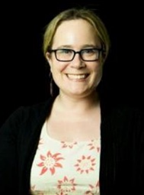
How many people from your group
joined in today’s webinar?
Let us know your numbers directly in the chat box or send to Lisa Marchal,
Global Grassroots Manager
lmarchal@results.org
RESULTS Global Poverty Campaigns National Webinar

