Slide 1
RESULTS International Conference – July 22, 2017
Background: Healthcare
Meredith Dodson
Director of U.S. Poverty Campaigns
Notes:
Sources:
https://www.cbpp.org/blog/cbo-32-million-people-would-lose-health-coverage-under-aca-repeal
https://www.washingtonpost.com/news/monkey-cage/wp/2017/07/19/why-cant-the-senate-repeal-obamacare-because-its-actual-policies-are-popular/?utm_term=.6e3706fc351a
http://www.politico.com/story/2017/07/18/republican-budget-tax-plan-240659
https://www.americanprogress.org/issues/economy/news/2017/07/18/435981/8-ways-house-republicans-budget-will-harm-working-families-pay-millionaire-tax-cuts/
https://www.cbpp.org/blog/house-budget-would-cut-non-defense-programs-to-historic-lows

Slide 2
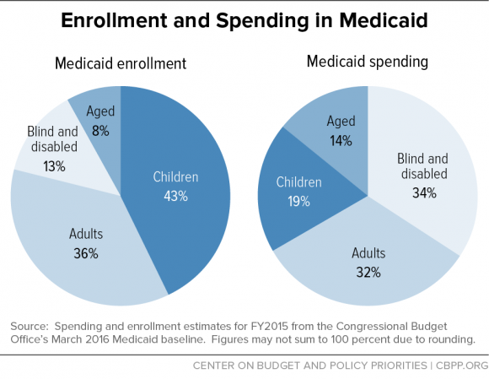
Medicaid
Largest health program in the U.S.
  doctor visits
  hospital care
  prescription drugs
  nursing home costs
Largest population covered are
children
Medicaid used to be restricted to
mandatory populations
Medicaid expansion opened program to all low-income adults below 138 percent of federal poverty line
Source: http://www.cbpp.org/research/health/policy-basics-introduction-to-medicaid

Slide 3
Source: Center on Budget and Policy Priorities

Slide 4
Affordable Care Act (ACA)
The Affordable Care Act (ACA), has three primary goals:
Make affordable health insurance available to more people.
Expand the Medicaid program to cover all adults with income below 138% of the federal poverty level.
Support innovative medical care delivery methods designed to lower the costs of health care generally^{[1]}
Notes:
Bullet 2 is more relevant for us—highlighting the effects of the Medicaid expansion

Slide 5
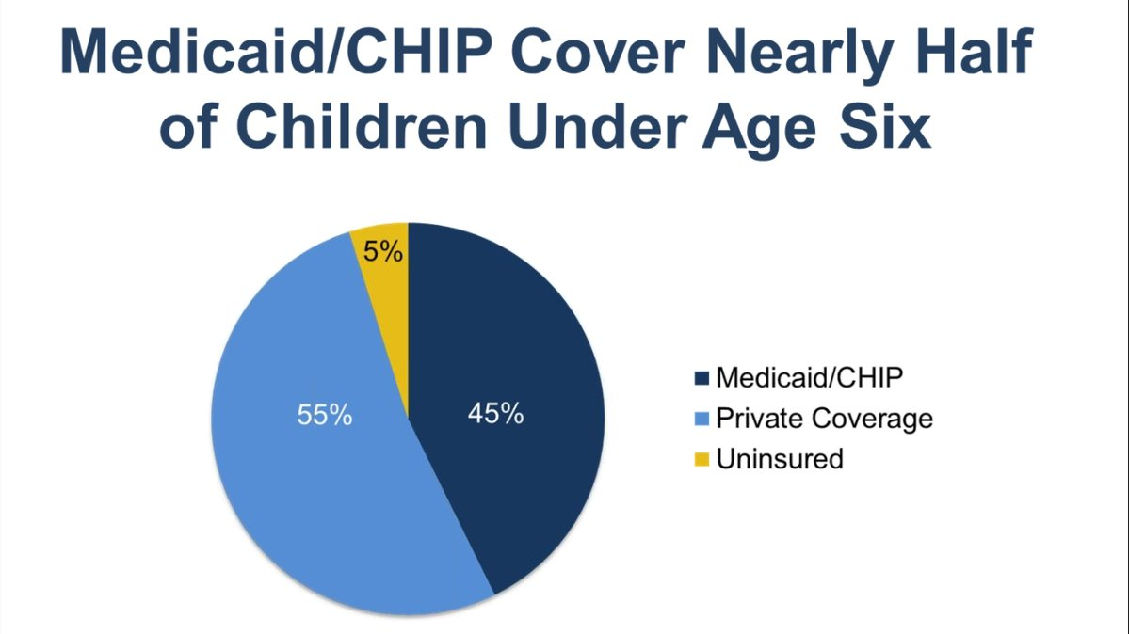
Source: https://ccf.georgetown.edu/wp-content/uploads/2017/02/MedicaidYoungChildren.pdf
Notes:
the important of the ACA & Medicaid for children

Slide 6
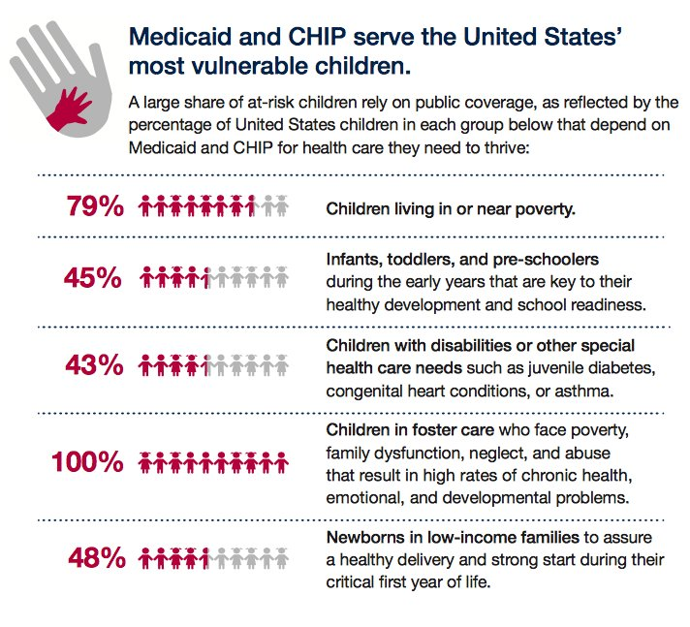
Notes:
Medicaid is Key – Especially for Low-Income Children
Medicaid plays a crucial role in providing health care for millions of children in low-income families, seniors, people with disabilities, and others.
Medicaid covers 35.7 million children – here is a breakdown of the critical role Medicaid and CHIP (the Children’s Health Insurance Program) play in the lives of millions of children from Georgetown’s Center for Children and Families.

Slide 7
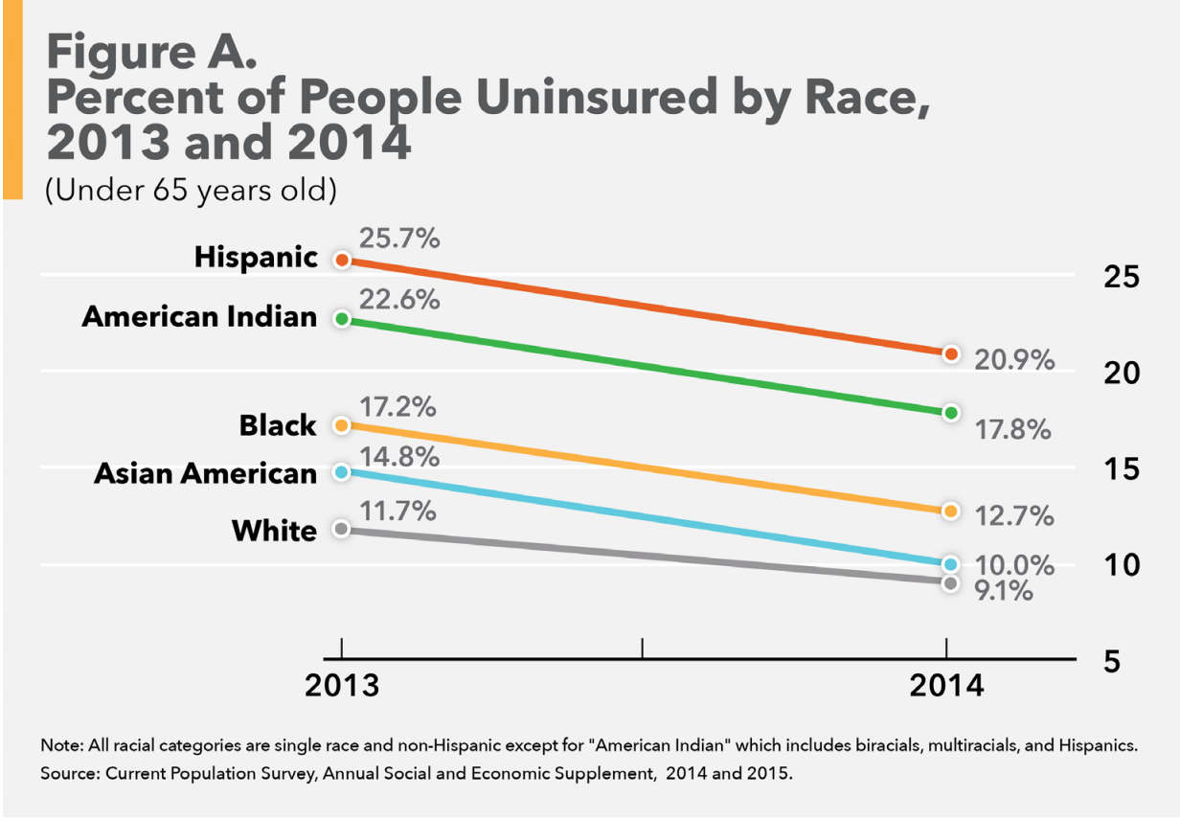
First Attack: ACA and Medicaid Expansion
Obamacare Reduces Racial Disparities in Health Coverage: http://bit.ly/ACAandRace
Notes:
Whites have a net-worth 15 times that of Blacks ($111,740 vs $7,113) and over 13 times that of Latinos ($111,740 vs $8,113).

Slide 8
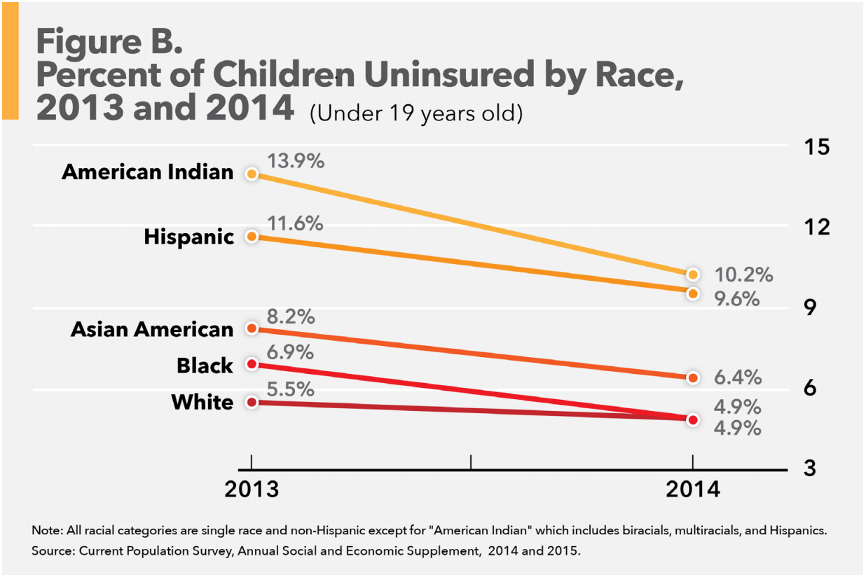
Despite the Impact of ACA on Closing the Gaps
Notes:
Whites have a net-worth 15 times that of Blacks ($111,740 vs $7,113) and over 13 times that of Latinos ($111,740 vs $8,113).

Slide 9
Medicaid Under Attack
RESULTS strongly opposes efforts to enact structural changes (including caps or “block grants”), changes in financing, or repeal of the Affordable Care Act’s Medicaid expansion.
Notes:
---
Dismantling Obamacare means higher premiums, deductibles and cost-sharing for the 57 million senior citizens and disabled Americans enrolled in the program. It would also bring back the “donut hole” in Medicare’s prescription drug coverage
According to the Congressional Budget Office (CBO), repealing Obamacare would increase Medicare spending by $802 billion over 10 years
After the elimination of the ACA’s expansion of Medicaid eligibility and of subsidies for insurance purchased through the ACA marketplaces, that number would increase to 27 million, and then to 32 million in 2026.

Slide 10
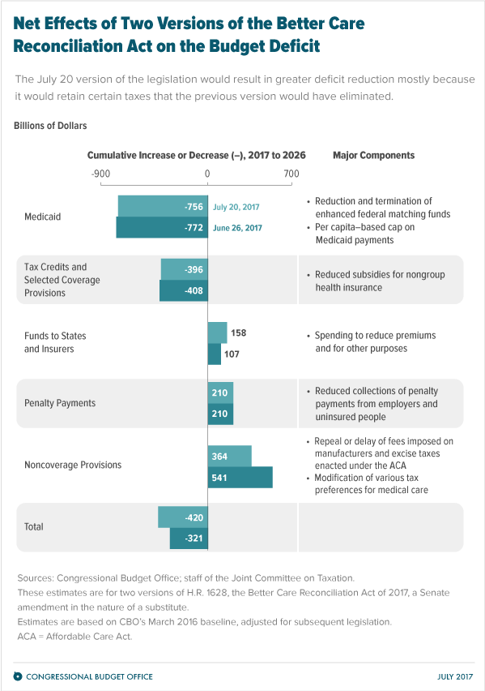
Senate Option 1: BCRA
Expected vote on Better Care Reconciliation Act (BCRA) this past week
Key points:
  Ending Medicaid
  Capping and cutting federal funding
  Increasing premiums and deductibles
  Weakening protections for older people and people with pre-existing conditions​
Updated version is no different from the original – this bill cannot be fixed
Source: https://www.cbo.gov/publication/52941

Slide 11
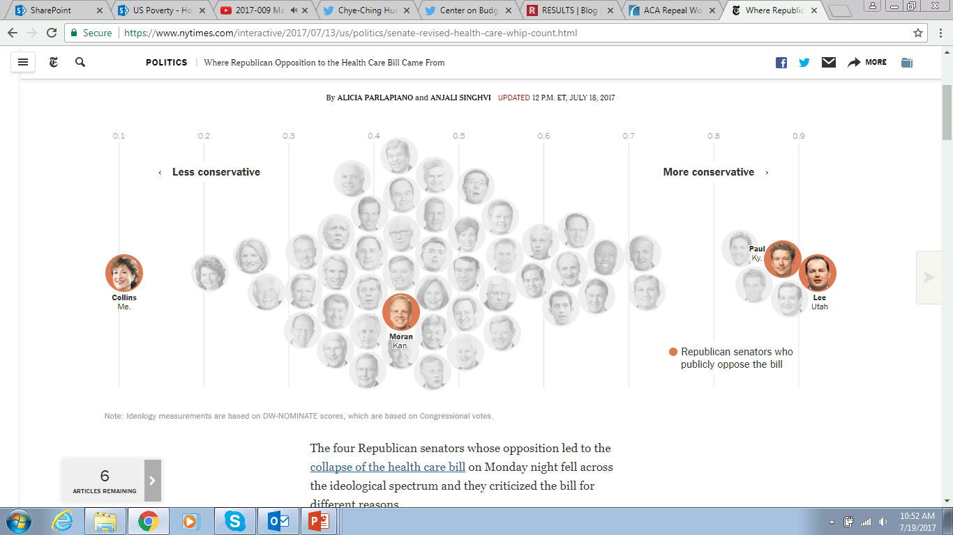
Who opposed the motion the proceed on BCRA?
Source: https://www.nytimes.com/interactive/2017/07/13/us/politics/senate-revised-health-care-whip-count.html

Slide 12
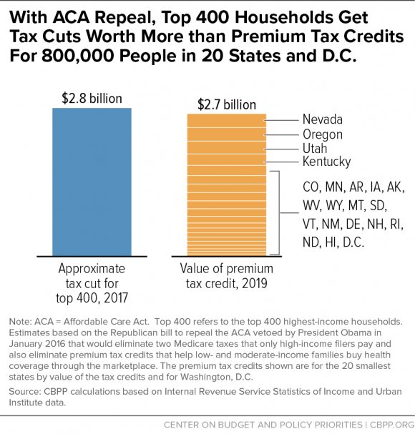
Senate Option 2: “Repeal and Delay”
Trump: “Let Obamacare fail” and repeal and replace
McConnell announced plans to vote next week on a repeal of the law with a two-year delay
Repeal would leave 32 million people without coverage by 2026
Country’s richest get tax cuts

Slide 13
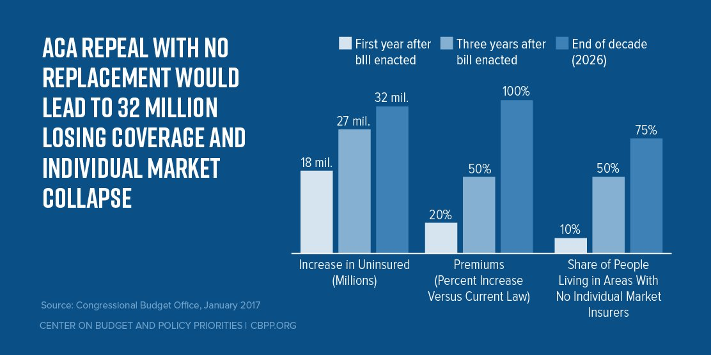
ACA Repeal = Tax Cuts for the Wealthy

Slide 14
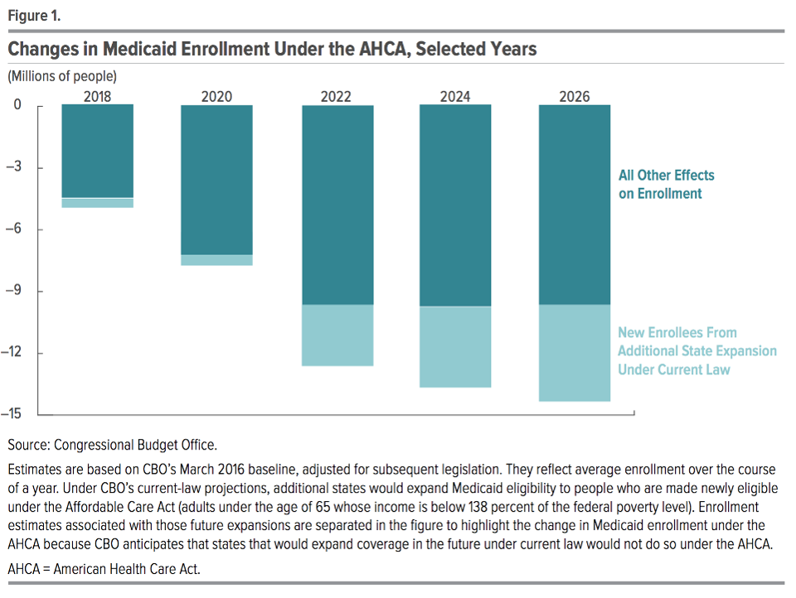
House Budget Proposal
Take up legislation that "fast tracks" at least $20 billion in cuts to Medicaid
The House budget would cut funding for Medicaid and other health care programs by $1.5 trillion over 10 years

Slide 15
Next: Bipartisan Group
Senator Joe Manchin (D-WV) piecing together bipartisan working group
Wants to start new round of health care reform discussions after failure of BCRA
Manchin reached out to fellow former governors turned U.S. senators
Senators:
  Lamar Alexander (R-TN)
  Mike Rounds (R-SD)
  James Risch (R-ID)
  John Hoeven (R-ND)
  Mark Warner (D-VA)
  Tim Kaine (D-VA)
  Tom Carper (D-DE)
  Jeanne Shaheen (D-NH)
  Angus King (I-ME)
Children’s Health Insurance Program up for renewal this fall
  Conservatives may make demands to cut Medicaid or the ACA as the price for renewal of CHIP
Source: http://www.thedailybeast.com/manchin-attempting-to-form-bipartisan-group-on-health-care

Slide 16
Isn’t Medicaid spending out of control?
The Argument:
  Per capita caps needed to rein in the growing costs to the federal government
  Gives states more “flexibility” to innovate, find efficiencies, and cut waste
But all that is false. Medicaid spending is not out of control.
The Truth
  Medicaid’s costs per beneficiary are substantially lower than for private insurance
  Shifting millions of dollars in costs to states is just going to lead to cuts in services and eligibility

Slide 17
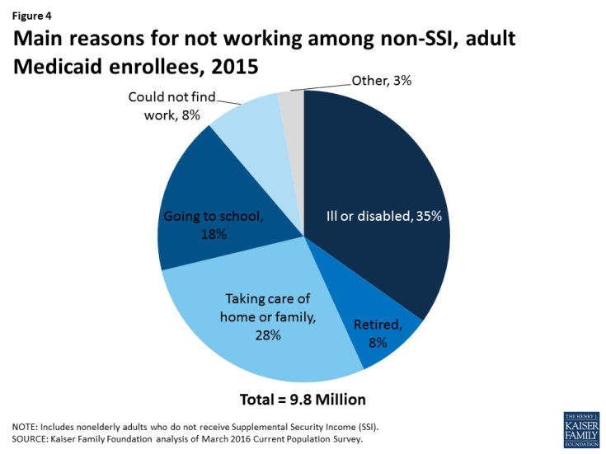
Why is imposing work requirements on Medicaid recipients counterproductive?
Some people turn to Medicaid in tough economic times or during a pregnancy
  May not be able to find work or work consistently
Seniors and people with disabilities rely on Medicaid for long-term services
  May face barriers to work due to impairments
No provisions for job training, child care, or work supports
Unsuccessful in increasing long-term employment
Source: http://www.kff.org/medicaid/issue-brief/understanding-the-intersection-of-medicaid-and-work/

Slide 18

Questions?

