Slide 1
Motivational Interviewing
RESULTS Webinar Session 4
Presented 1-26-2022
By David Christian, Ph.D.

Slide 2
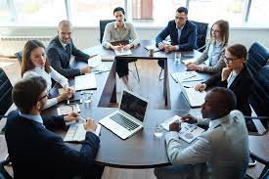
Session 5: Dealing With Resistance Part 2 Six More Methods
Review
Define
Demo
Do
Discuss

Slide 3
Ruler Method: 1-10, how much do you support X? Why not one number lower?
Acknowledge any truth in what they are saying, even if it is small.
Reflect: Show interest and understanding of their perspective and values.
Ask them to explain their view, revealing their own knowledge gaps.
Affirm the values underlying their resistance, which you share.
Amplified Reflection- encourages them to moderate their view.
Review

Slide 4
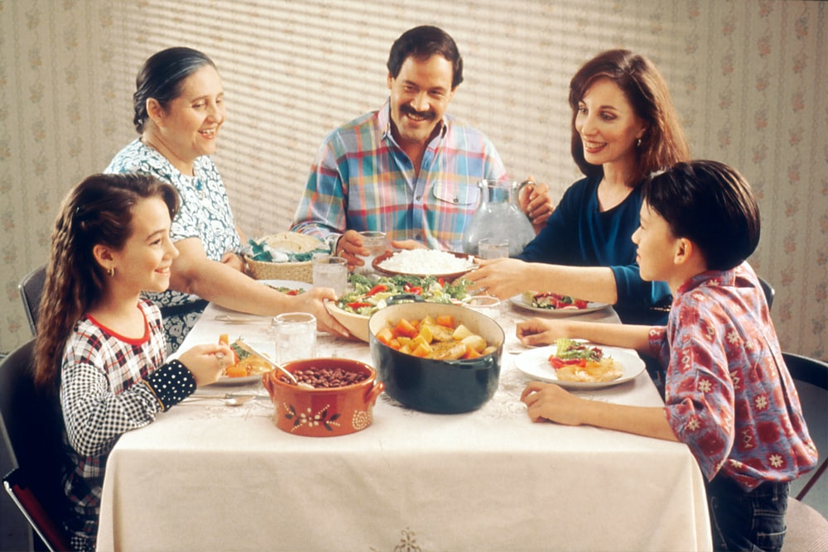
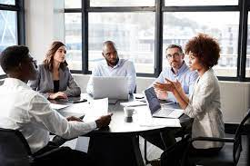
How’s Your Practice Going?

Slide 5
Stages of Change:
1-2 Use Darn
3-5 Use CAT
5. Maintenance
Consistent, Zealous
4. Action
Moving, Engaged, Acting.
3. Preparation
Open, Looking, Interested
2. Contemplation
Maybe, Ambivalent
1. Precontemplation
Angry, In Denial, Defensive

Slide 6
Resistance is sustain talk- It indicates resistance to change

Slide 7
Tonight’s Role Play
Global Vaccine Funding
Problem: Covid has killed tens of thousands and suppressed our economy.
Ask: Include $17 billion in supplemental funding for global vaccine access in the fiscal year 2022 spending bill (by Feb 18).
Objectives:
Reverse the pandemic.
Suppress new variants.
Save tens of thousands of lives.
Protect our economy.
Utilize bipartisan support.

Slide 8
Two-Handed Reflection
Reflect their objection, then say “and on the other hand” …evoke change talk from them (DARN CAT).

Slide 9
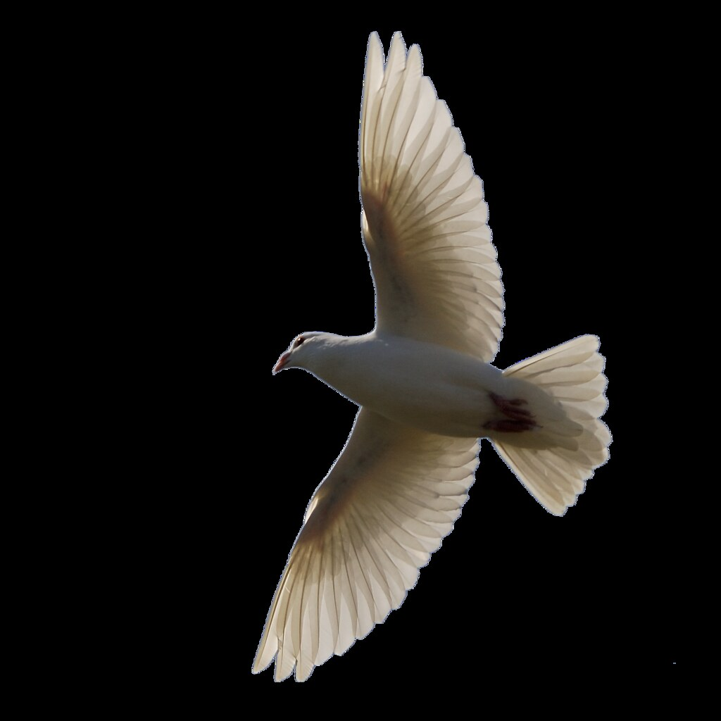
Emphasize their Autonomy
Remind them that they are free to do as they please, but doing X will produce desired outcome Y.

Slide 10
Reframe
Look for a positive implication in the problem they’ve raised. See how the negative can be a positive.

Slide 11
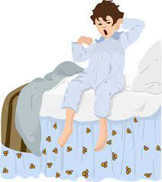
Solicit Their Advice
Ask for their suggestions about the objections they’ve raised.
The Blanky Story

Slide 12
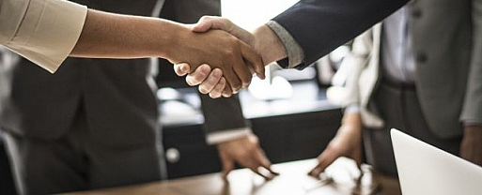
Find the Win/Win
See if there’s a way for both your opinion and theirs to coexist without judgment or conflict.

Slide 13
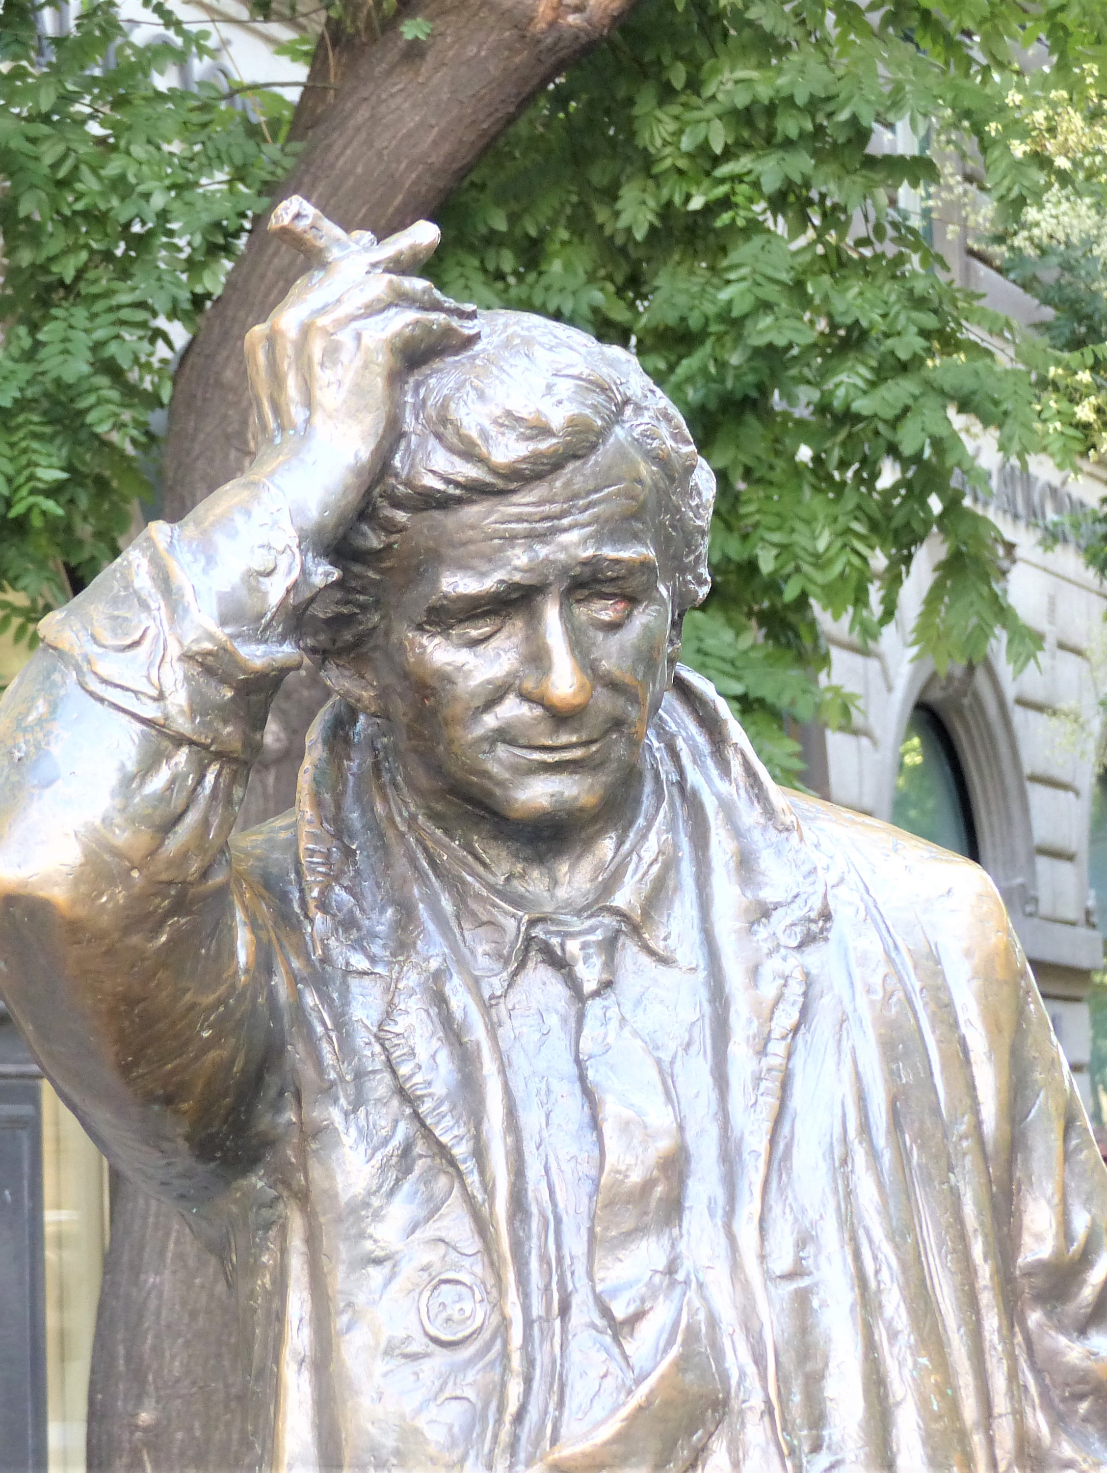
The Columbo Method
Express your confusion: 1) Reflect their view, 2) the discrepant facts as you know them, then 3) ask for their help resolving the confusion.

Slide 14
Demo Role Play with MOC

Slide 15
Global Vaccine Funding: - $17B - Lives Saved - Economy - Prevention - Bipartisan
Two-Handed Reflection- Reflect their objection “and on the other hand” …evoke change talk from them.
Emphasize their autonomy- “Of course, you can do as you wish, however, doing X will produce desired outcome Y.”
Reframe- Look for a positive implication in the problem they’ve raised.
Solicit their advice- Ask for their suggestions about the issue they raised.
Find the win/win- See if there’s a way for both your opinion and theirs to coexist without judgment or conflict.
Colombo Method- Express your confusion: 1) Reflect their view, 2) the discrepant facts as you know them, 3) ask for their help resolving the confusion.

Slide 16
Discuss
What did you notice?

Slide 17
Global Vaccine Funding: - $17B - Lives Saved - Economy - Prevention - Bipartisan
Two-Handed Reflection- Reflect their objection “and on the other hand” …evoke change talk from them.
Emphasize their autonomy- “Of course, you can do as you wish, however, doing X will produce desired outcome Y.”
Reframe- Look for a positive implication in the problem they’ve raised.
Solicit their advice- Ask for their suggestions about the issue they raised.
Find the win/win- See if there’s a way for both your opinion and theirs to coexist without judgment or conflict.
Colombo Method- Express your confusion: 1) Reflect their view, 2) the discrepant facts as you know them, 3) ask for their help resolving the confusion.

Slide 18
Discuss
Advocates-
MOCs-
Observers-
Everyone-
Observations
Questions

Slide 19
Practice with-
Fellow Advocates
Friends
Family
Coworkers
Next Session-
Feb 16

