Slide 1
Motivational Interviewing
RESULTS Webinar Session 2
Presented 10-27-2021
By David Christian, Ph.D.

Slide 2
Review of Session 1
Spirit of MI
Partnership
Acceptance
Compassion
Evocation
Four Processes
Engage
Focus
Evoke
Plan

Slide 3
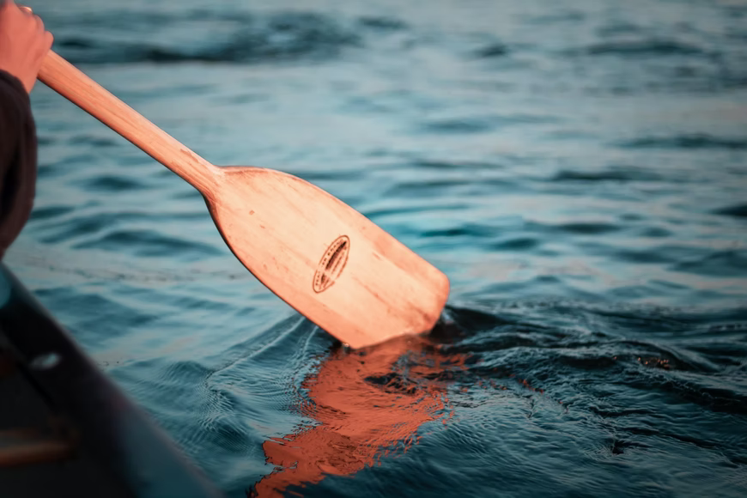
Core Skills: OARS Creating Collaborative Relationship
Open Questions
Affirmations
Reflections
Summaries

Slide 4
Session Overview
Define and Illustrate Oars
Demo: Role Play
Breakout Triads- practice OARS
Group Discussion
Practice suggestions

Slide 5
Open the Dialogue with Open Questions
Closed: Would you support our proposal?
Open: How much do you know about our proposal?
Try the 6 W’s: Who, What, When, Where, Why, and How
Try it: with your MOC

Slide 6
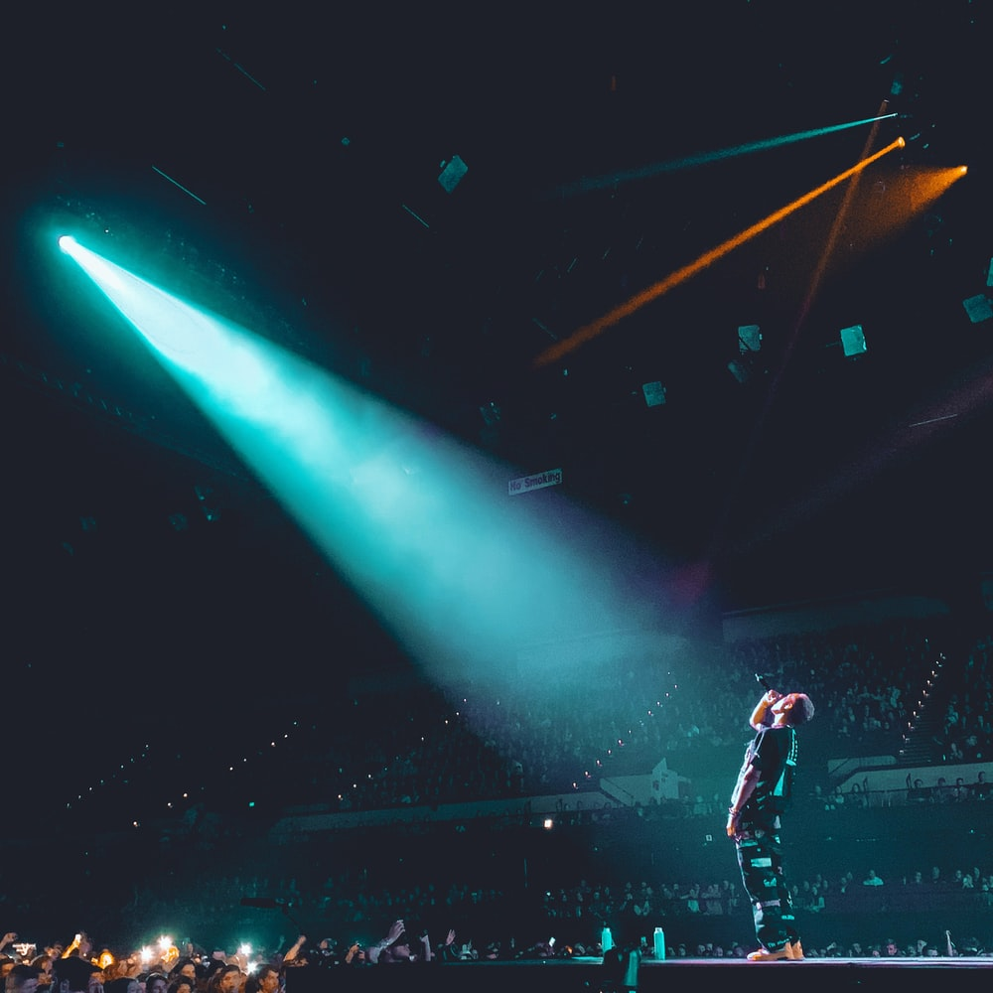
Affirm Them
Spotlight:
Strengths
Efforts
Values
Intentions

Slide 7
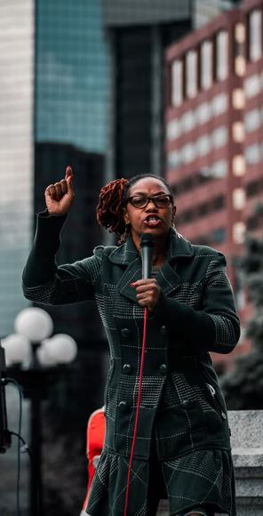
Sources For Affirmations
Their website
Newspapers from their area
Our own notes
Others?
One for your MOC.

Slide 8
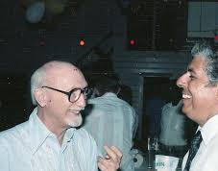
Reflectively Listen
(check your understanding)
Show nonjudgmental understanding of their:
Thoughts
Feelings
Values
Both stated (surface) and implied (deep)

Slide 9
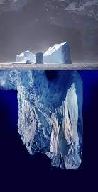
Reflection Guidelines
Simple reflection shows the exposed iceberg.
Deep reflection adds meaning, feeling or emphasis, showing the submerged iceberg (what’s implied).
Make your best guess about what the person means.
“Continue the paragraph” to encourage them to go deeper.
Reflection stops dead horse beatings.
Keep reflections brief.

Slide 10
Demo: What are your thoughts about climate change?

Slide 11
Summarize (The Big View)
Summary Options
The situation as they see it.
Options discussed and agreements.
Why this is important.
The next steps or plan.

Slide 12
Role Plays
Simulator- safe, low risk, supportive.
Playful- opportunity to try things.
Feedback- what worked, and a few suggestions.
Empathy- understand the “other side”

Slide 13
MI moves them through the
Stages of Change
Maintenance
Consistent, Zealous
4. Action
Moving, Engaged, Acting.
3. Preparation
Open, Looking, Interested
2. Contemplation
Maybe, Ambivalent
1. Precontemplation
Angry, In Denial, Defensive

Slide 14
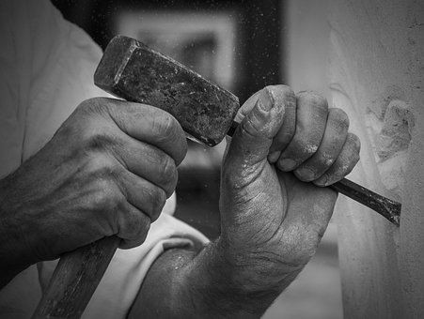
With MI, we think like a gardener, not a sculptor.

Slide 15
Pre-Meeting Checklist
Our Agenda
Follow Up
Focus
Affirmation
Ask
Them
Stage of Change
Interests and Values
Obstacles

Slide 16
You can do any “what” if you have the right “why.” -Nietzsche
Conservative
Values
Individual liberty
Economic security
Business/Job growth
National Security
Market-based solutions
Individual responsibility
Fairness based on effort
Treating people equally
Respect for innocent life
Patriotism
Nationalism
Deference to tradition
Avoiding radical changes
Eliminating subsidies
American ingenuity
Improving infrastructure
Privatization
Reduced regulations
Sustainability
Supporting families
Protect taxpayers
Revenue neutrality
Reducing spending
Conservative leadership
Avoid big spending
Smaller government

Slide 17
Demo Role Play with MOC

Slide 18
Triad Role Play
MOC: Play the role Sarah played
Advocate: Use OARS like Dave
Observer: Count OARS
Chat 5, Feedback 1, Switch
Make mistakes!

Slide 19
OARS Observer Tasks
OARS Count
What worked?
Suggestions?

Slide 20
Discuss
Advocates- Your experience?
MOC’s- Your experience?
Everyone-
Observations
Questions
What if’s
Thanks!

Slide 21
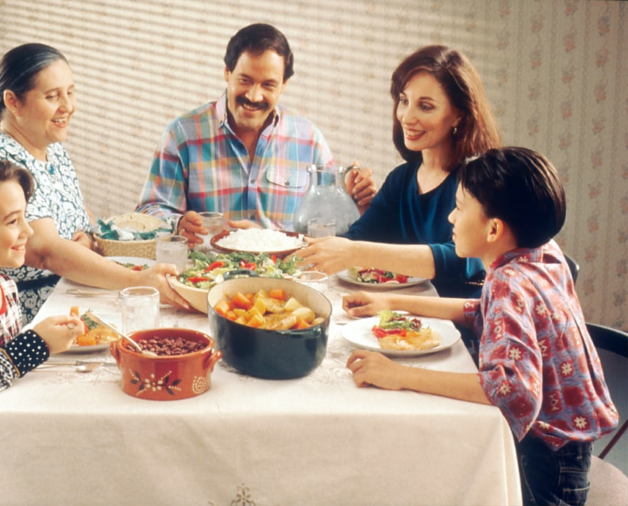
Practice OARS with-
advocates
coworkers
family
friends
Next Session, Nov. 16
Evoking Change Talk

