Slide 1
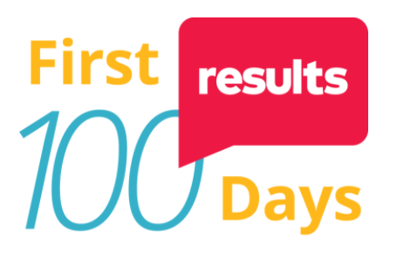
An Introduction to CPSP
Poverty & Policy Amidst COVID-19
Megan Curran, PhD
Megan Curran, Postdoctoral Research Scientist

Slide 2
About the Center on Poverty & Social Policy
Mission: The Center on Poverty and Social Policy (CPSP) at the Columbia School of Social Work produces cutting-edge research to advance our understanding of poverty and the role of social policy in the United States and in New York City.
(OPM)
(SPM)
For images & more information, see US Census Bureau

Slide 3
3 Ways CPSP Is Measuring Poverty During COVID-19
Traditional SPM poverty analysis
Use annual data available on a one-year lag (e.g. 2019 data available to use in 2020)
Assess impact of policy on poverty within a one-year window
Forecasting ‘real-time’ monthly SPM poverty estimates
Use combination of monthly data (e.g. income surveys, unemployment rates, unemployment benefits receipt, etc)
Assess changes in family income & poverty rates by month
Monthly SPM poverty threshold = annual SPM income threshold (e.g. approx. $28,000) divided by 12
Forecasting ‘real-time’ annual SPM poverty estimates
Use combination of data, including unemployment rates
Project family income & poverty rates for the current year (e.g. what might 2021 poverty look like?)

Slide 4
Monthly Poverty During COVID-19
For more, visit:
https://www.povertycenter.columbia.edu/forecasting-monthly-poverty

Slide 5
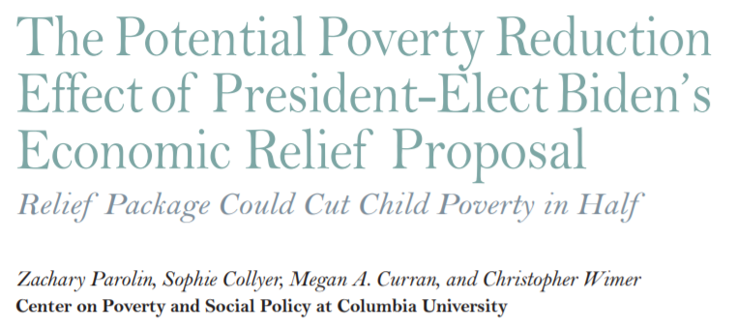
Assessing the American Relief Plan

Slide 6
Child Tax Credit: Who’s Currently Left Out?
One-third of all children are in families who earn too little to receive the full Child Tax Credit
1/3 of kids left out

Slide 7
Improving the Child Tax Credit: American Family Act (AFA) Analysis
Proposed changes:
increase benefit value for all children, with extra bump for young children under age 6
make it fully available to children in families with the lowest incomes
pay it out monthly
Analysis led by CPSP Research Director: Sophie Collyer

Slide 8
CPSP Child Tax Credit Resources
CPSP policy briefs explaining:
The national profile of the children currently left out of the Child Tax Credit HERE & HERE
How many children are left out (i.e. would benefit from Child Tax Credit reform) by state & Congressional district HERE
CPSP fact sheets: HERE
A breakdown of the anti-poverty impact of a reform like the American Family Act by:
Children’s race and ethnicity; family structure and size (# of parents & # of children); immigration status; whether or not someone in the household has a disability (national numbers)
The % and number of families who would be moved out of poverty (below 100% SPM), deep poverty (below 50% SPM), and near-poverty (between 100-200%SPM) (state numbers)

Slide 9
Expanding Access to Housing Assistance: Section 8
Cuts Black poverty in half
Cuts Hispanic poverty by two-thirds
& helps reduce the racial poverty gap

Slide 10
Impact of Housing Assistance on Children: Section 8
Combining a Child Tax Credit expansion with Section 8 housing voucher expansion cuts child poverty for all children & helps narrow the racial child poverty gap

Slide 11
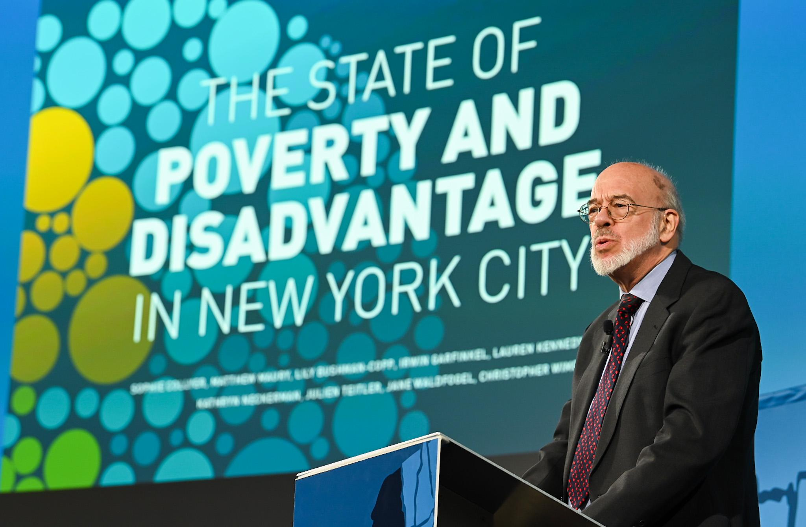
NY: Poverty Tracker & Early Childhood Poverty Tracker
If you’re in NY, follow our state & local work:
In partnership with

Slide 12
Keep in touch!
povertycenter.columbia.edu
cpsp@columbia.edu
@cpsppoverty
Join our emailing list for policy analysis updates and information about upcoming policy seminars.

