Slide 1
Welcome to RESULTS!

Slide 2
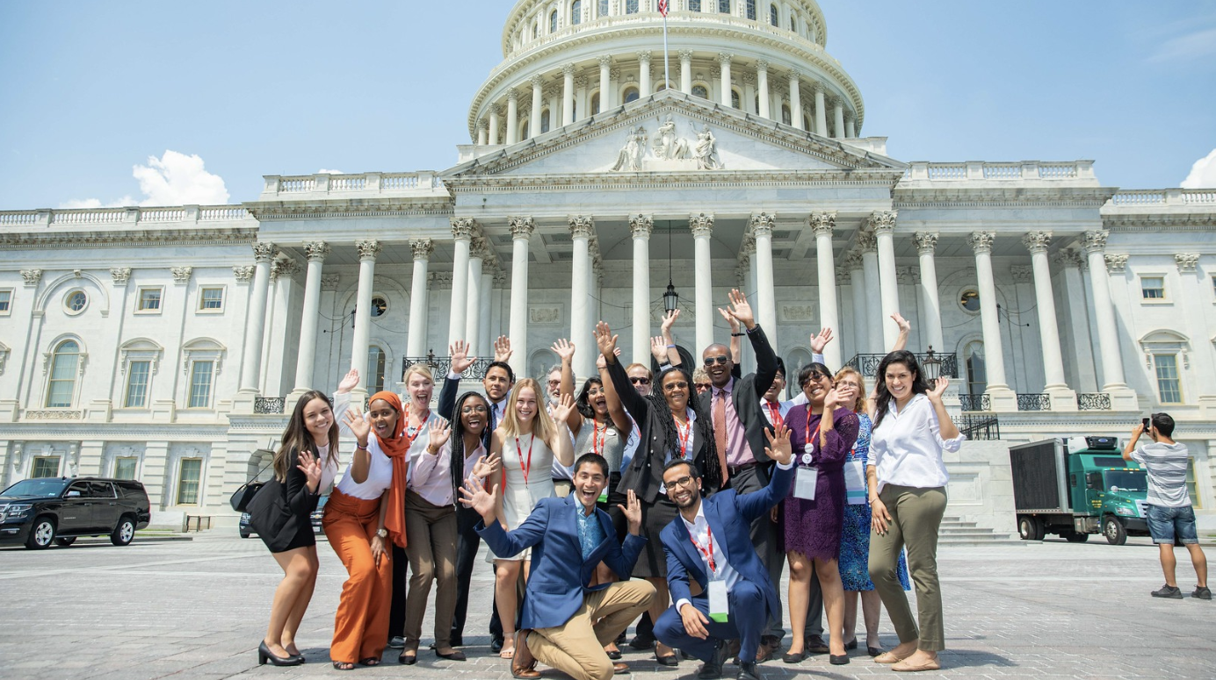
RESULTS is a movement of passionate, committed, everyday people. Together, we use our voices to influence political decisions that will bring an end to poverty.

Slide 4
RESULTS New Advocate Orientation
RESULTS: Who We Are & Why We Advocate
Strategy: Actions that Make a Difference
2020 Issues & RESULTS COVID-19 Response
Basic Advocacy Skills & Other Support
Connecting in your Community

Slide 5
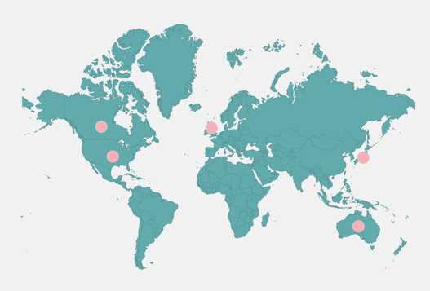
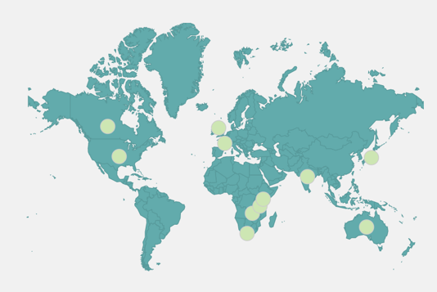
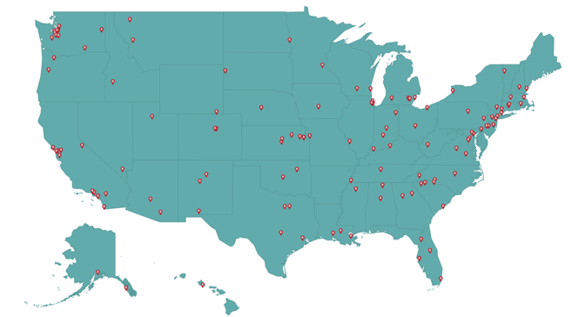
RESULTS International
ACTION Global Health Partners
RESULTS
U.S. Chapters

Slide 6
RESULTS Believes…
The end of poverty is possible and achievable. Political will is lacking.
Poverty is driven by oppression. RESULTS opposes all forms of oppression.
Government has an important role to play in ending poverty. Elected officials work for us. We need to supervise them.
Poverty is not partisan.
Nobody should be denied their basic rights to healthcare, education, or economic opportunity.
We must take action now.

Slide 7
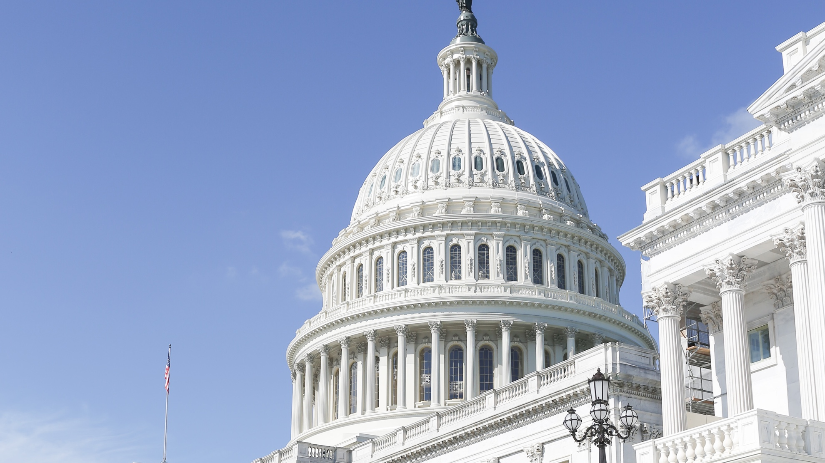
RESULTS Advocates Influence Congress
They won’t listen to me?
I don’t even know where to start.
Who am I???
Government is CORRUPT.
I won’t make a difference
I can’t make a difference
I’ll sound / look stupid …
They don’t care about me.
I’m very busy.. This sounds like ... A lot …
Members of Congress make decisions EVERY. SINGLE. DAY. that impact the lives of millions of people here in the US and across the world.

Slide 8
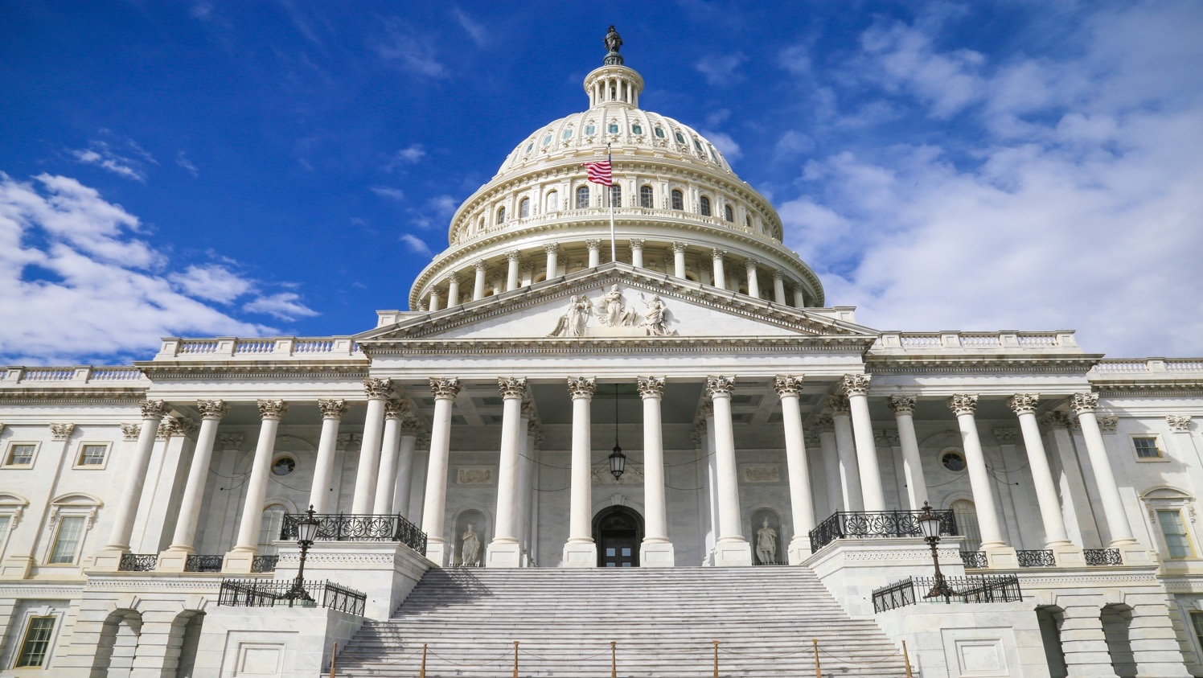
RESULTS Advocates Influence Congress
Members of Congress make decisions EVERY. SINGLE. DAY. that impact the lives of millions of people here in the US and across the world.

Slide 9
RESULTS U.S. Poverty Advocates were essential in securing
$1.27 Billion increase in Housing assistance
to address the affordable housing crisis, building momentum for a bigger housing push in 2020

Slide 10
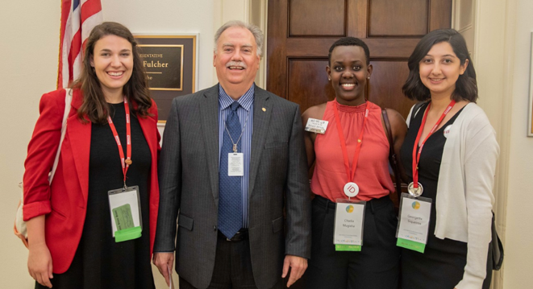
Our Advocacy Strategy
Influence
Trust
Relationships

Slide 11
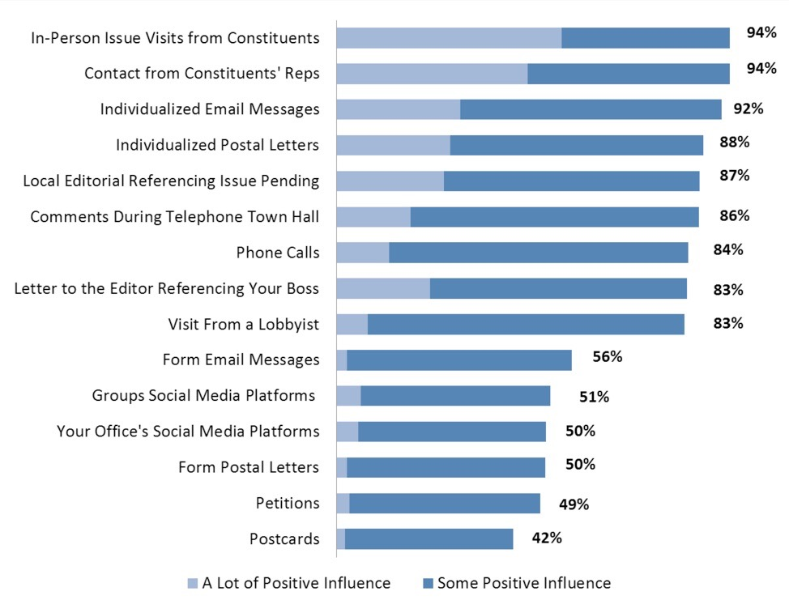
Actions that
Make a Difference
Congressional Management Foundation

Slide 12
RESULTS Campaigns

Slide 13
Current Campaigns Addressing Coronavirus in U.S. and Globally
U.S.
40+ million Americans have filed for unemployment
Unemployment projected to stay at 10% through 2021
1 in 3 Americans worried about keeping roof over head during a recession
Global
Acute food insecurity could double by end of year (from 135 million to 265 million)
People living with HIV/AIDS, TB, and other conditions risk not having access to life-saving care
95+% of world’s children affected by school closures

Slide 14
RESULTS Policy Response
US PRIORITY:
Address needs of renters in the short and long term, prevent homelessness
Ensure people can put food on the table & address hunger (SNAP)
Expand the EITC and CTC
GLOBAL PRIORITY:
Step up fight against infectious diseases, specifically AIDS, TB, and malaria
Ensure access to immunization for all
Fight famine and malnutrition

Slide 15
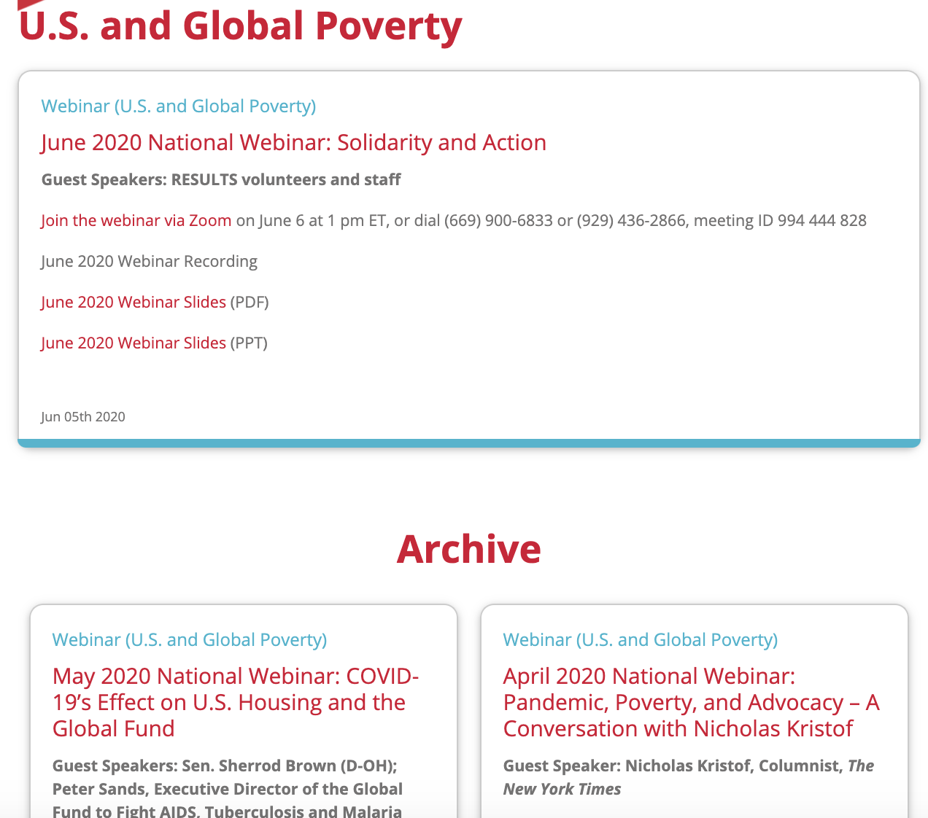
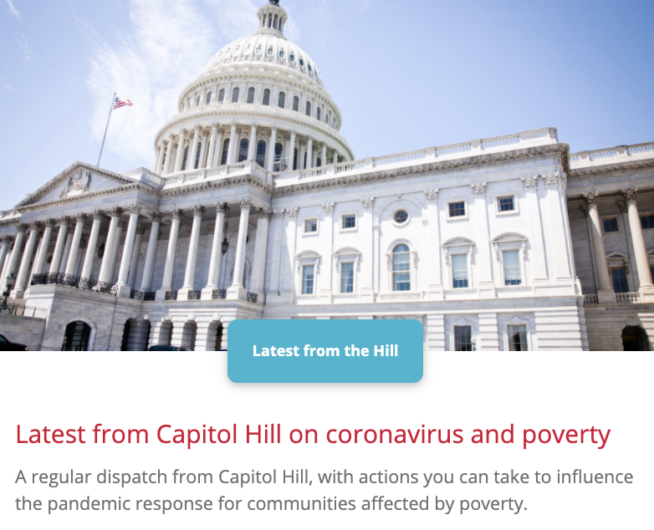
Questions on our Campaigns?
Listen to the RESULTS National Webinar
results.org/volunteers/national-webinars/
Read the RESULTS Blog

Slide 17
Advocacy Skills

Slide 18
Advocacy Skill: Know Your MoC
Who represents you?
Where do they stand on issues of poverty?
Legislator
Look Up
Congressional Scorecard

Slide 19
Advocacy Skill: Personal Stories
Why do YOU care about…
…housing & hunger in America
…the health & well-being of people across the world
…ending poverty
What inspires you to act?

Slide 20
Advocacy Skill: EPIC Messages
ENGAGE
Get the listener’s attention. Identify yourself. Invoke a value. Find a ‘thank you.’ Tell them WHY you care.
PROBLEM
Identify the problem you want them to solve, clearly. If you have a personal story, share your experience.
INFORM ON SOLUTION
Lead them to the solution. Add details. Paint a picture. Show them how your solution addresses the problem. If you have a personal story, share it.
CALL TO ACTION
Answers the question “So what do you want me to do about it?” Be specific. Include bill number, $ amount. Frame as YES or NO. Be confident.

Slide 21
Advocacy Skill: EPIC Messages
ENGAGE
We have an affordable housing crisis – that is now acute in the current pandemic – which is hitting families in our community hard.
PROBLEM
Right now, millions of American families are struggling to pay rent and put food on the table as layoffs skyrocket. Many of these families were struggling even before the impact of coronavirus. According to Harvard researchers, since 1960 renters’ median earnings have gone up 5 percent while cost of rent went up 61 percent.
INFORM ON SOLUTION
Congress has moved legislation to help address the immediate crisis – including resources for people experiencing homelessness, but given the scale more needs to be done. We need a national moratorium on evictions and $100 billion in emergency rental assistance.
CALL TO ACTION
Will you tell leadership to include an eviction moratorium and $100 billion in emergency rental assistance for families facing evictions in upcoming economic recovery legislation?

Slide 22
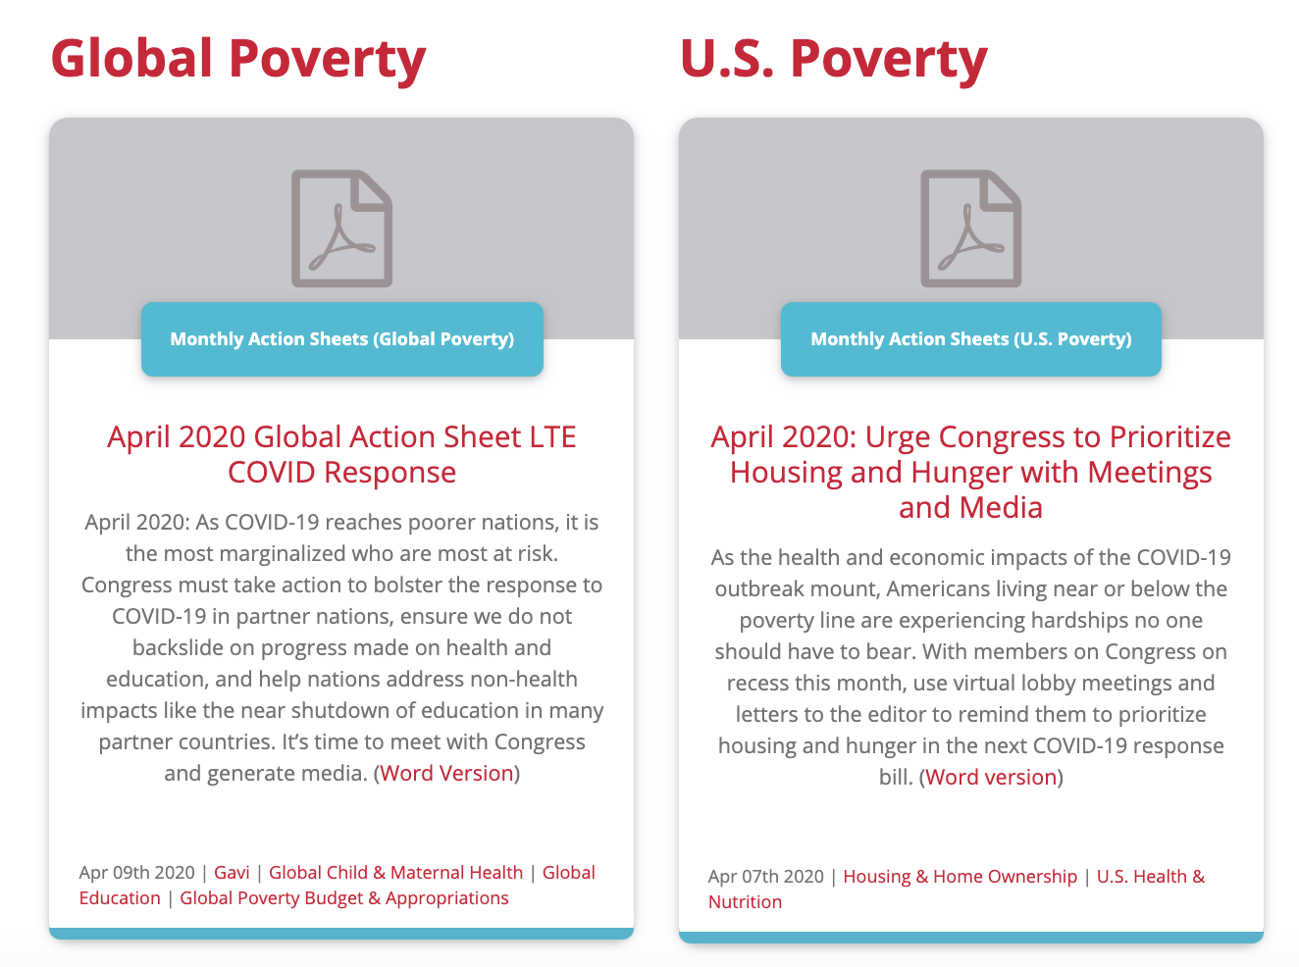
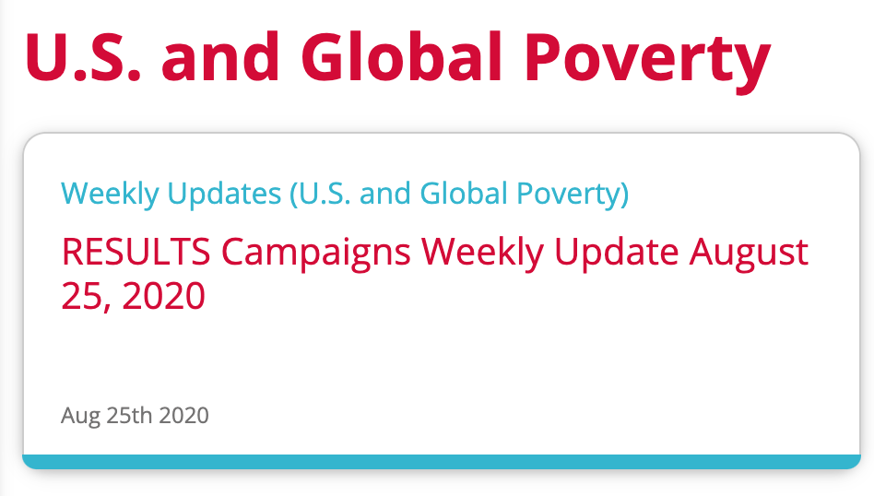
RESULTS Support Tools
National Campaigns Webinar
1st Saturday @ 1pm ET Monthly
Monthly Action Sheet
Weekly Update:
Every Tuesday

Slide 23
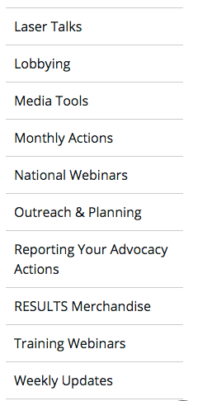
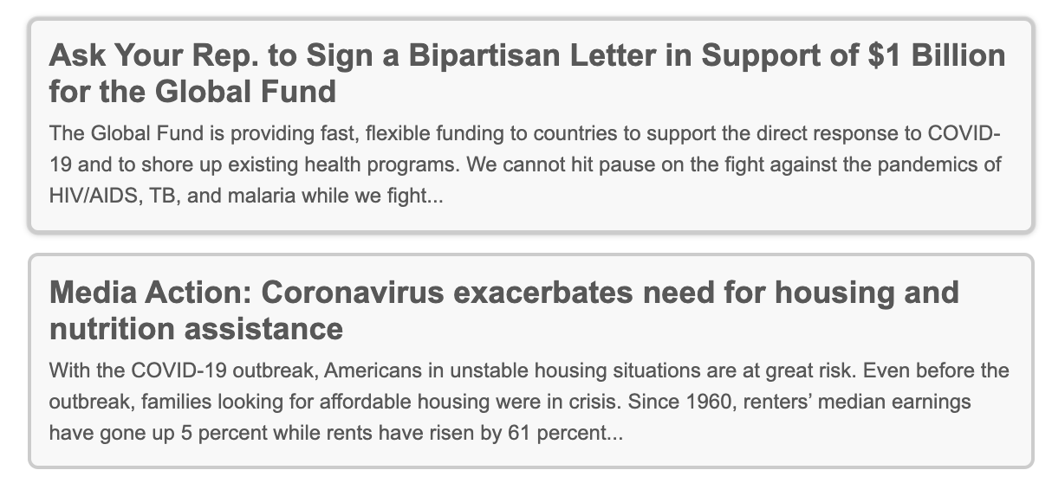
RESULTS Support Tools

Slide 24
RESULTS Support Tools

Slide 25
You Don’t Have to Do This Alone
Get Connected

Slide 26
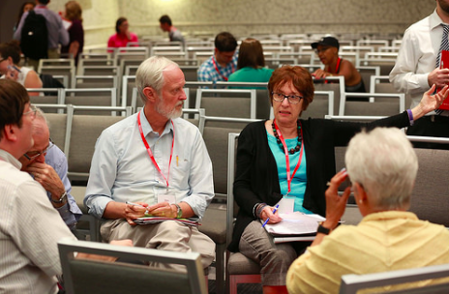
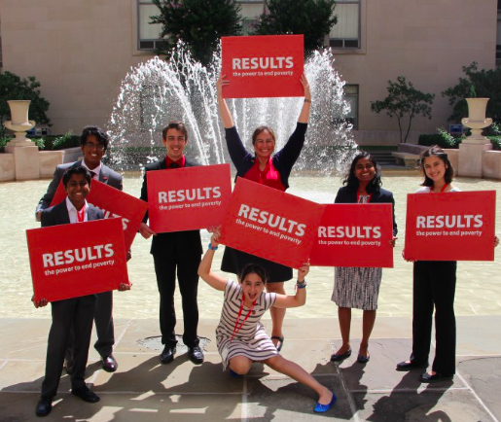
Connect in your Community
Join a RESULTS Group
Meet regularly
Learn about issues
Take action
Share leadership
*RESULTS groups are meeting virtually until it is safe to be together in person
Time Commitment: 3-6 hours / month
Leadership positions available

Slide 27
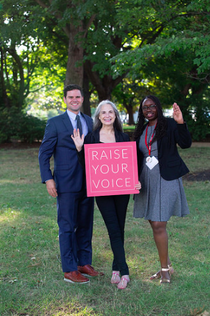
Connect in your Community
Start a RESULTS Group
Recruit a Core Team (3-4 people)
Learn advocacy skills & take action
Host a kick-off meeting
Confirm local leadership
Time commitment: 4-10 hours / month depending on how much leadership you want to take on!

Slide 28
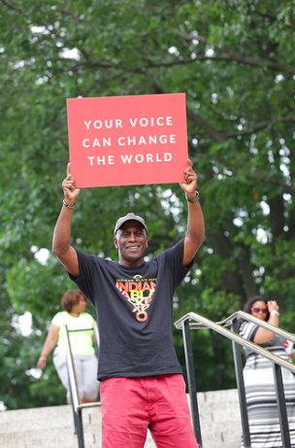
No Group? No Problem.
Be a Free Agent
Virtual Group
Monthly online meeting with staff & other Free Agents
Take action on your own
Time commitment: 2-4 hours / month

Slide 29
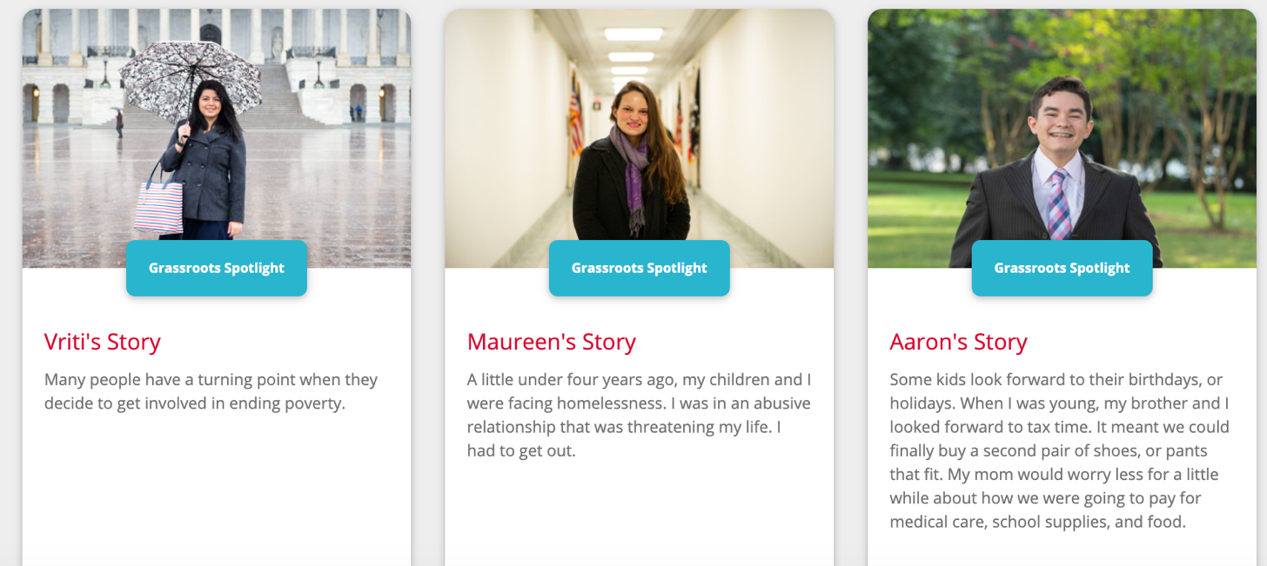
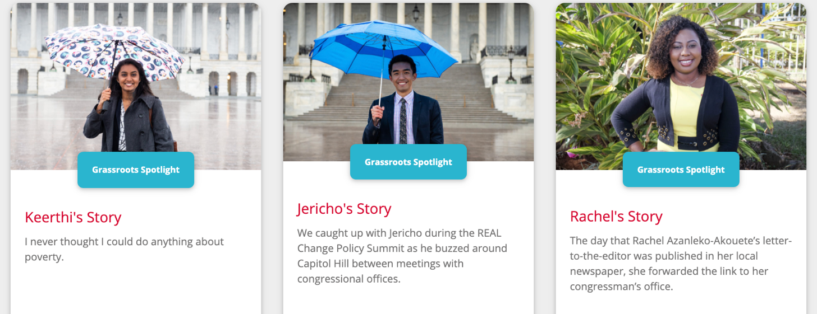
RESULTS Fellowship
Info at results.org/fellowship
Age: 20-30
1 Year Commitment
Organize & Advocate in Local Community
Opportunity to learn and advocate in Washington D.C.*
Current class is full – apply next year!

Slide 30
RESULTS Volunteer Commitments
Help make the RESULTS movement a respectful, inclusive place
Connect with RESULTS
Join a local group or become a Free Agent (or start a group!)
Choose to be a U.S. (domestic) or Global Advocate
Take one RESULTS advocacy action each month
Listen to the Monthly Campaigns Webinar (live or recorded)
Read the Weekly Update

Slide 31
Next Steps to Get Involved
Say Yes! I want to be an advocate
Use chat box or email results@results.org
First name
City, State
US or Global Focus
Want more time to think? No problem.
We’ll email everyone tomorrow.
Reply when you’re ready.

Slide 32
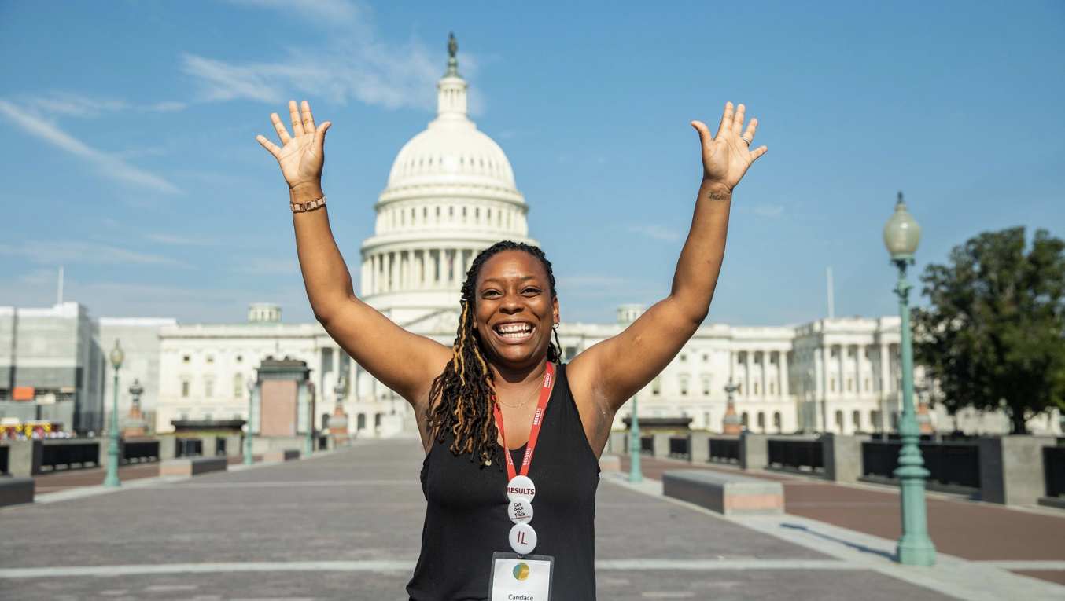
Be an advocate

