Slide 1
Motivational Interviewing
RESULTS Webinar Session 5
Presented 1-25-2025
By David Christian, Ph.D.

Slide 2
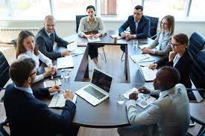
Session 5: Dealing With Resistance Part 2 Five More Methods
Review
Define
Demo
Do
Discuss

Slide 3
Ruler Method: 1-10, how much do you support X? Why not one number lower?
Acknowledge Truth in what they are saying, even if it is small.
Kind Curiosity: Ask them to explain their view, revealing their knowledge gaps.
Reflect and Affirm values underlying their resistance, which you share.
Amplified Reflection- encourages them to moderate their view.
Review

Slide 4
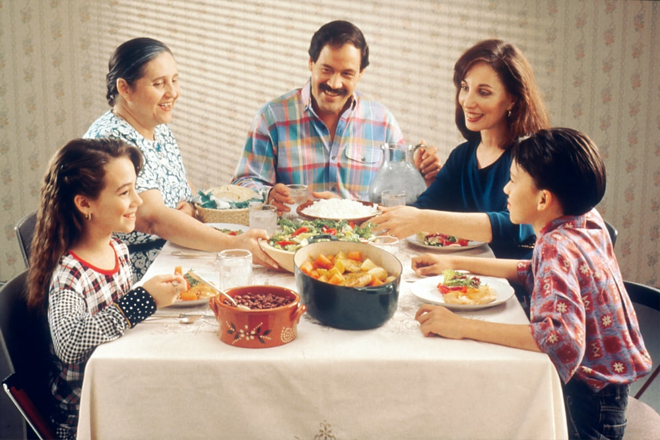
How’s Your Practice Going?

Slide 5
Move them through
The Stages of Change:
5. Maintenance
Consistent, Zealous
4. Action
Moving, Engaged, Acting.
3. Preparation
Open, Looking, Interested
2. Contemplation
Maybe, Ambivalent
1. Precontemplation
Angry, In Denial, Defensive

Slide 6
Resistance is sustain talk- It indicates resistance to change

Slide 7
Tonight’s Role Play
Global Vaccine Funding
Problem: Covid has killed tens of thousands and suppressed our economy.
Ask: Include $17 billion in supplemental funding for global vaccine access in the fiscal year 2022 spending bill (by Feb 18).
Objectives:
Reverse the pandemic.
Suppress new variants.
Save tens of thousands of lives.
Protect our economy.
Utilize bipartisan support.

Slide 8
Two-Handed Reflection
Reflect their objection, then say “and on the other hand” …evoke change talk from them (DARN CAT).

Slide 9
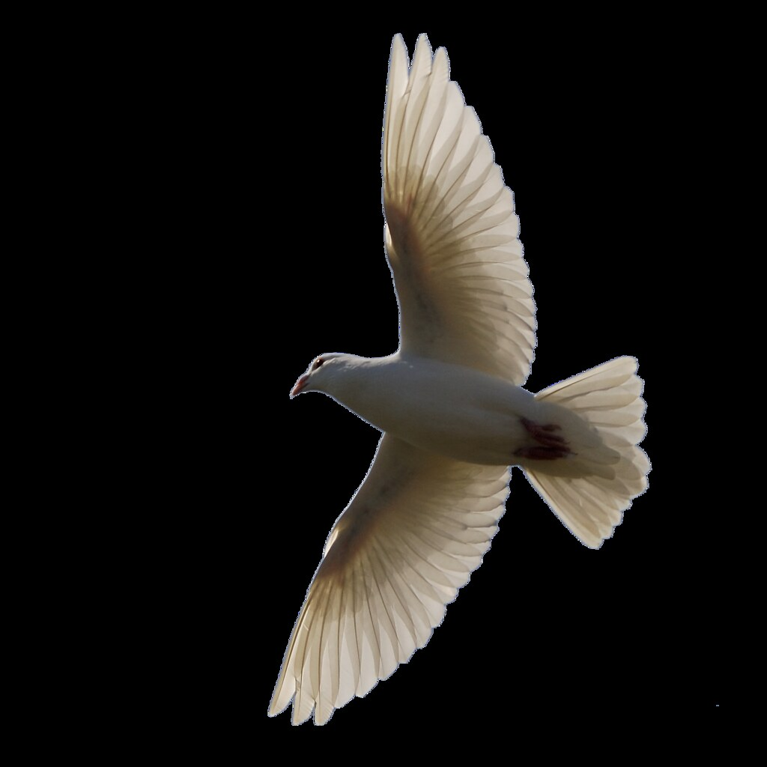
Emphasize their Autonomy
Remind them that they are free to do as they please, but doing X will produce desired outcome Y.

Slide 10
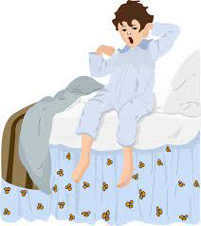
Solicit Their Advice
Ask for their suggestions about the objections they’ve raised.
The Blanky Story

Slide 11
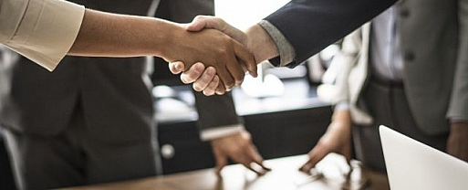
Find the Win/Win: Look for a way to serve their values and yours.

Slide 12
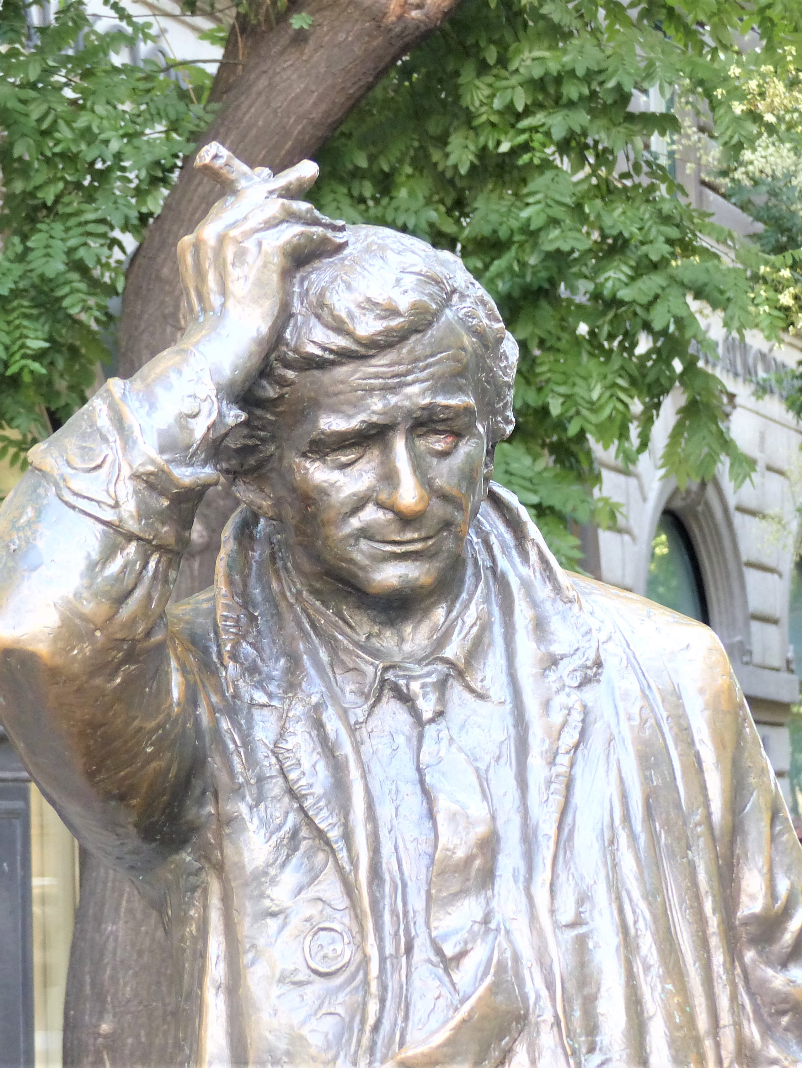
The Columbo Method
Express your confusion: 1) Reflect their view, 2) the discrepant facts as you know them, then 3) ask for their help resolving the confusion.

Slide 13
Demo Role Play with MOC

Slide 14
Conservative Values
Individual liberty
Energy freedom
Economic security
Business/Job growth
National Security
Market-based solutions
Individual responsibility
Fairness based on effort
Treating people equally
Respect for innocent life
Patriotism/Nationalism
Deference to tradition
Avoiding radical changes
Eliminating subsidies
American ingenuity
Improving infrastructure
Privatization
Reduced regulations
Sustainability
Supporting families
Protect taxpayers
Revenue neutrality
Reducing spending
Conservative leadership
Avoid big spending
Smaller government

Slide 15
Role Play: Promoting Global Fund: Fights AIDS, TB & Malaria through treatment, prevention, and care. 44 million lives saved.
Two-Handed Reflection- Reflect their objection “and on the other hand” …evoke change talk from them.
Emphasize their autonomy- “Of course, you can do as you wish, however, doing X will produce desired outcome Y.”
Solicit their advice- Ask for their suggestions about the issue they raised.
Find the win/win- Look for a way to serve their values and yours.
Colombo Method- Express your confusion: 1) Reflect their view, 2) the discrepant facts as you know them, 3) ask for their help resolving the confusion.
Conservative Values: security (economic, national), protecting innocent life, tradition

Slide 16
Discuss:
Observations
Questions

Slide 17
Role Play: Promoting Global Fund: Fights AIDS, TB & Malaria through treatment, prevention, and care. 44 million lives saved.
Two-Handed Reflection- Reflect their objection “and on the other hand” …evoke change talk from them.
Emphasize their autonomy- “Of course, you can do as you wish, however, doing X will produce desired outcome Y.”
Solicit their advice- Ask for their suggestions about the issue they raised.
Find the win/win- Look for a way to serve their values and yours.
Colombo Method- Express your confusion: 1) Reflect their view, 2) the discrepant facts as you know them, 3) ask for their help resolving the confusion.
Conservative Values: security (economic, national), protecting innocent life, tradition

Slide 18
Discuss:
Observations
Questions

Slide 19
Practice with-
Fellow Advocates
Friends
Family
Coworkers
Next Session:

