Slide 1
Motivational Interviewing
RESULTS Webinar Session 2
Presented 10-9-2024
By David Christian, Ph.D.

Slide 4
Review
Spirit of MI
Partnership
Acceptance
Compassion
Evocation
Four Processes
Engage
Focus
Evoke
Plan

Slide 5
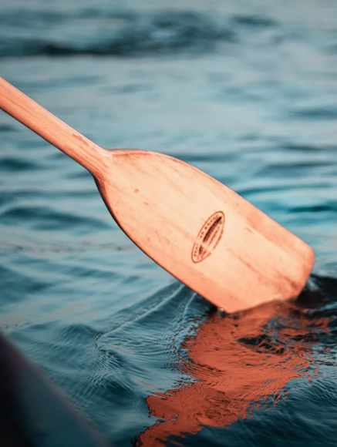
Core Skills: OARS Creating Collaborative Relationship
Open Questions
Affirmations
Reflections
Summaries

Slide 6
Session Overview
Define and Illustrate Oars
Demo: Role Play
Breakout Triads- practice OARS
Group Discussion
Practice suggestions

Slide 7
Open the Dialogue with Open Questions
Closed: Would you support our proposal?
Open: How much do you know about our proposal?
Try the 6 W’s: Who, What, When, Where, Why, and How
Why open vs. closed?
Open toward action.

Slide 8
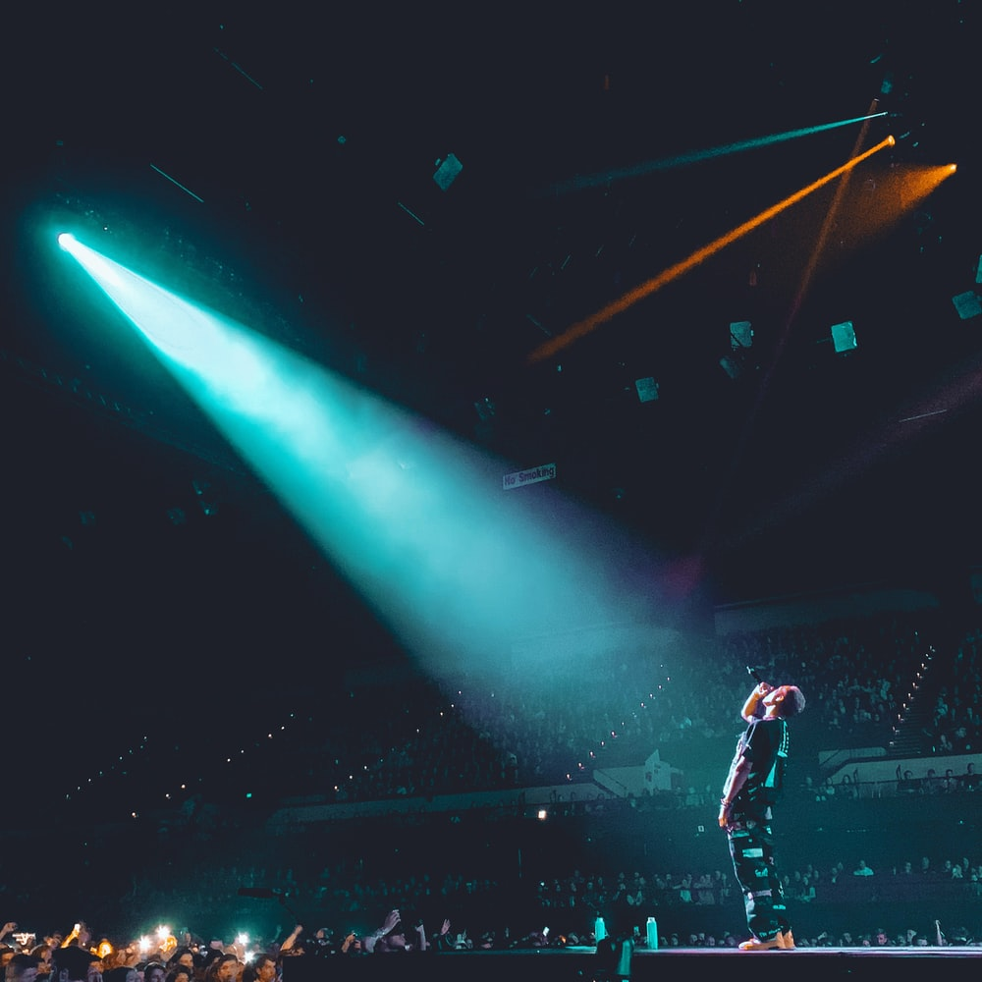
Affirm Them
Spotlight:
Strengths
Efforts
Values
Intentions

Slide 9
Where to Get Affirmation Ideas?
Newspaper articles
Their website
Team notes from previous visits
Web-based information about them.
Their statements in the current meeting.

Slide 10
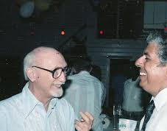
Reflectively Listen
(check your understanding)
Show nonjudgmental understanding of their:
Thoughts
Feelings
Values
Reasons
Both stated (surface) and implied (deep)

Slide 11
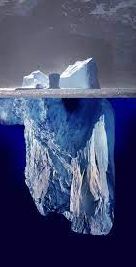
Reflection Guidelines
Simple reflection shows the exposed iceberg (what they said).
Deep reflection adds meaning, feeling or emphasis, showing the submerged iceberg (what they are implying).
Make your best guess about what the person means by “Continuing the paragraph” to encourage them to go deeper.
Reflection stops dead horse beatings.
Keep reflections brief.

Slide 12
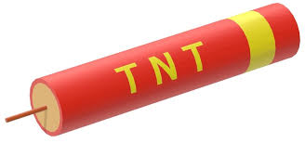
Summarize Strategically (The Big View)
Summary Options
The situation as they see it.
Options discussed and agreements.
Why this is important.
The next steps or plan.
TNT: The Next Thing

Slide 13
Demo With Sarah
Sarah will be playing House Speaker Johnson
Goal: pass the End TB Now bill.
Specific goal: move him forward (stages of change)
Other background from Sarah

Slide 14
Triad Role Play
MOC: Play Speaker Johnson
Advocate: Use OARS
Observer: Count OARS, keep time
Chat 5 mins, Feedback 2 mins
Make mistakes!

Slide 15
Discuss
Advocates- Your experience?
MOC’s- Your experience?
Observers- what did you notice?
Everyone-
Observations
Questions
What if’s
Sarah- final business items.

