Slide 1
Motivational Interviewing
RESULTS Webinar Session 1
Presented by
David Christian, Ph.D.

Slide 2
Ph.D. Utah State University
1992- Psychology Faculty, University of Idaho
1998- Clinical Practice, Logan, UT
MI Trainings since 1992
Leader, CCL’s Effective Communication Team

Slide 3
MI is a set of communication skills that foster collaboration.
What’s your level of experience with MI?

Slide 4
Lobbyists
Financial Counselors
Nurses
Physicians
Dieticians
CIO’s
Social Workers
Psychologists
Business Leaders

Slide 5
Never doubt that a small group of thoughtful, committed citizens can change the world; indeed, it's the only thing that ever has. - Margaret Mead

Slide 6
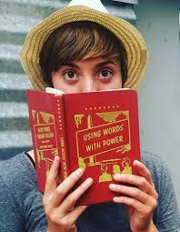
2017

Slide 7
2016: The Problem
In 2010 the Utah State Legislature passed a joint resolution denying climate change and asking the EPA to cease its climate change regulations and policies.

Slide 8
The Goal
Have the Utah State Legislature pass a joint resolution recognizing climate change and allowing it to inform state-related decision making.
(The Utah legislature is 86% Republican.)

Slide 9
MI: Collaboration vs. Confrontation
Traditional (Confrontational)
Collaborative
Provide reasons to change.
Focus on their failings.
Challenge their values.
Warn of bad consequences.
Problem is personalized.
Educate, lecture, instruct.
Evoke their reasons to change.
Affirm their abilities.
Utilize their values.
Focus on desired outcomes.
Problem is externalized.
Inquire, listen, invite.

Slide 10
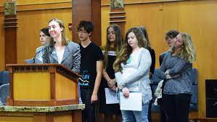
2017

Slide 11
2017 Utah Legislature:
Failed to pass.
(86% Republican)

Slide 12
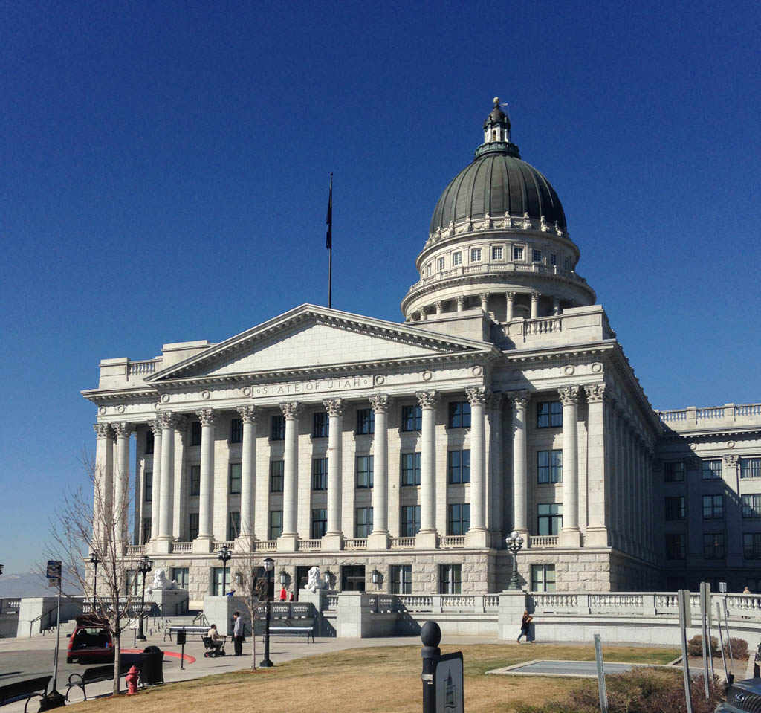
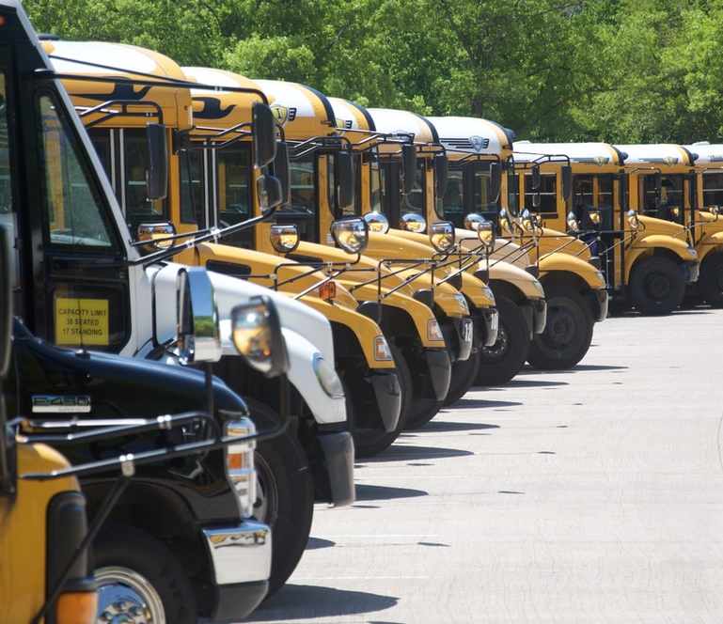
2018: An Expanded Approach

Slide 13
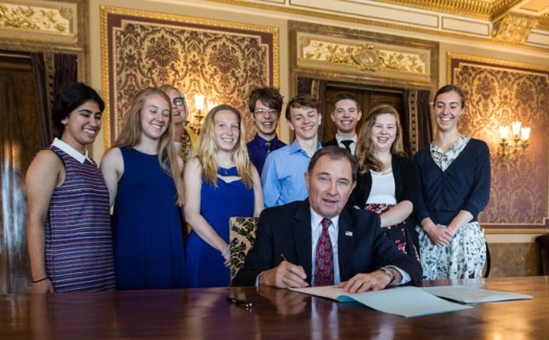
PRESS RELEASE: Utah’s Legislature is First in Conservative State to Officially Recognize Climate Change Governor leads ceremonial signing of resolution

Slide 14
“How a Group of teenagers
convinced the Utah legislature to recognize
climate
change”
By Isabella Gomez and
Saeed Ahmed, CNN Updated 7:36 PM ET,
Tue May 22, 2018

Slide 15
The 4 D’s:
Describe
Demo
Do
Discuss

Slide 16
As RESULTS staff and volunteers, what kind of collaboration problems are you facing?

Slide 17
Agenda: Session 1
Definition, History
Spirit of MI
Four Processes

Slide 18
MI’s Origin: Bill Miller
1983: The Milwaukee Problem

Slide 19
Over 1400 published MI studies.

Slide 20
Demo: Recruiting My Ambivalent Neighbor to Join Citizens Climate Lobby
Using traditional methods.
Using MI.
Notes:
To demonstrate how this ambivalence can play out in our interactions with others we are going to do an exercise.
[Exercise: Instruct participants to:
Find a partner.
Each of you write down something you are interested in doing but have mixed feelings about (e.g., buying a new car, quitting smoking, exercising, etc.).
Select who will speak first.
The speaker presents what it is that you would like to do (but haven’t done yet).
The listener then argues strongly in favor of one of the options or sides.
Speaker, your job is to listen and note what you are thinking and feeling.
Switch roles.]

Slide 21
MI moves them through the
Stages of Change
Maintenance
Consistent, Zealous
4. Action
Moving, Engaged, Acting.
3. Preparation
Open, Looking, Interested
2. Contemplation
Maybe, Ambivalent
1. Precontemplation
Angry, In Denial, Defensive

Slide 22
Two Approaches
Traditional (Confrontational)
Collaborative (MI)
Provide reasons to change.
Focus on their failings.
Challenge their values.
Warn of bad consequences.
Problem is personalized.
Educate, lecture, instruct.
Evoke their reasons to change.
Affirm their abilities.
Utilize their values.
Focus on desired outcomes.
Problem is externalized.
Inquire, listen, invite.

Slide 23
Let’s Discuss
What did you notice?

Slide 24
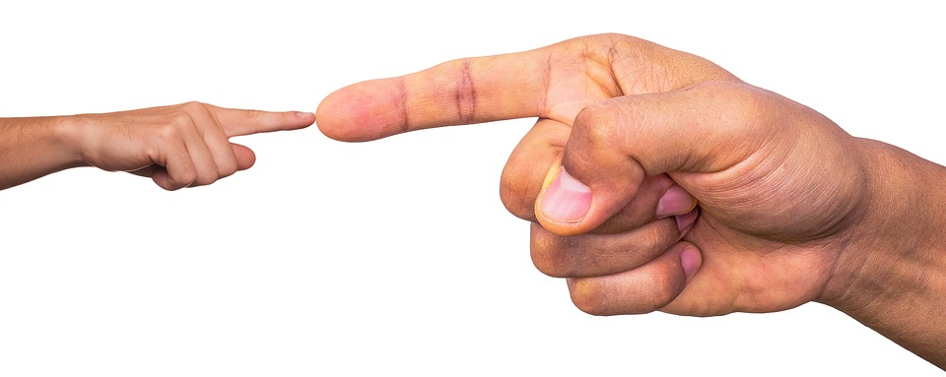
The Backfire Effect:
Well reasoned arguments can cause push back.

Slide 25
Don’t Personalize the Problem
They are the problem.
Us
Do Externalize the Problem
The Issue is the Problem
Us

Slide 26
The Spirit of MI: PACE Partnership Acceptance Compassion Evocation

Slide 27
Partnership
Collaborative vs. adversarial.
Partnering vs. personalizing.

Slide 28
Acceptance
Show unconditional caring.
Be empathic.
Understand vs. agree.
Respect their autonomy.
Affirm the good in them.
The appreciator

Slide 29
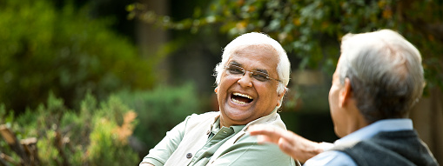
Show respectful understanding of their:
Thoughts
Feelings
Values
Circumstances
Compassion

Slide 30
Evocation
Draw out their ideas.
Help them find their reasons to cooperate.
Help them see how it serves their values.

Slide 31
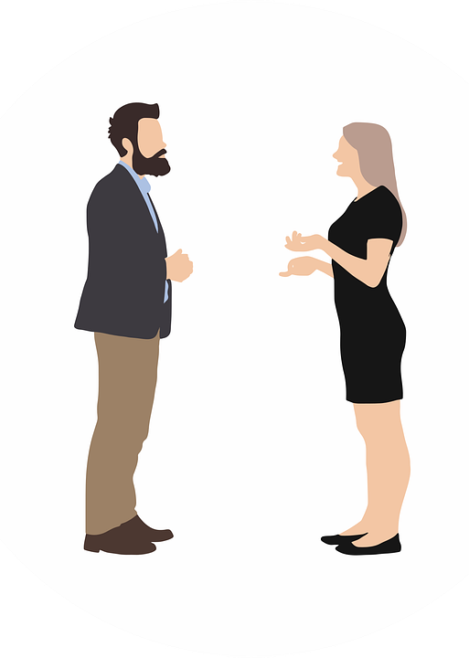
Evocation
People are more persuaded by the ideas you draw from them than ones offered directly.

Slide 32
Let’s Practice The Spirit of MI: PACE
Identify someone you’d like to influence .
Write any negative attitudes of them.
Write a more compassionate view:
Affirm something about them.
Identify values you share.
Empathize with their perspective.

Slide 33
Let’s Discuss
Person (relationship)
Your negative attitude.
Affirmation, Shared Values, Empathize with their Perspective

Slide 34
The Four Processes: 1. Engage 2. Focus 3. Evoke 4. Plan

Slide 35
Engage
Mine
Ours
Theirs
Find common goals and values.

Slide 36
Conservative Values
Individual liberty
Energy freedom
Economic security
Business/Job growth
National Security
Market-based solutions
Individual responsibility
Fairness based on effort
Treating people equally
Respect for innocent life
Patriotism/Nationalism
Deference to tradition
Avoiding radical changes
Eliminating subsidies
American ingenuity
Improving infrastructure
Privatization
Reduced regulations
Sustainability
Supporting families
Protect taxpayers
Revenue neutrality
Reducing spending
Conservative leadership
Avoid big spending
Smaller government

Slide 37
Let’s Practice
Identify one or more ways you can promote RESULTS’ agenda using conservative values.

Slide 38
Individual liberty
Energy freedom
Economic security
Business/Job growth
National Security
Market-based solutions
Individual responsibility
Fairness based on effort
Treating people equally
Respect for innocent life
Patriotism/Nationalism
Deference to tradition
Avoiding radical changes
Eliminating subsidies
American ingenuity
Improving infrastructure
Privatization
Reduced regulations
Sustainability
Supporting families
Protect taxpayers
Revenue neutrality
Reducing spending
Conservative leadership
Avoid big spending
Smaller government

Slide 39
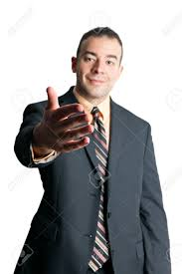
FOCUS
If they’re hostile- explore their values.
If they’re supportive- plan your action.
If they’re ambivalent- foster change talk.

Slide 40
Evoke Change Talk: DARN CAT
Desires
Abilities
Reasons
Needs
Commitment
Activation
Taking Steps

Slide 41
Plan
Link every interaction to the next.
Make strategic summaries.

Slide 42
Questions, Thoughts

Slide 43
Practice Suggestions
Identify a relationship to improve.
Identify values important to them.
Consider how you can use PACE to collaborate:
Partnership
Acceptance
Compassion
Evocation

Slide 44
Next Session: Oct. 9
The Core Skills: OARS
Open Questions
Affirmations
Reflective Listening
Summaries

