Slide 1
RESULTS Qtr. New Advocate Mentor Call!
January 31st, 2024
Welcome!

Slide 2
Welcome! Please put your name, pronouns, where you’re joining from, and if this is your first time attending a mentor webinar in the chat!

Slide 3
2024 strategy
Notes:
The question is how is the battle going?

Slide 4
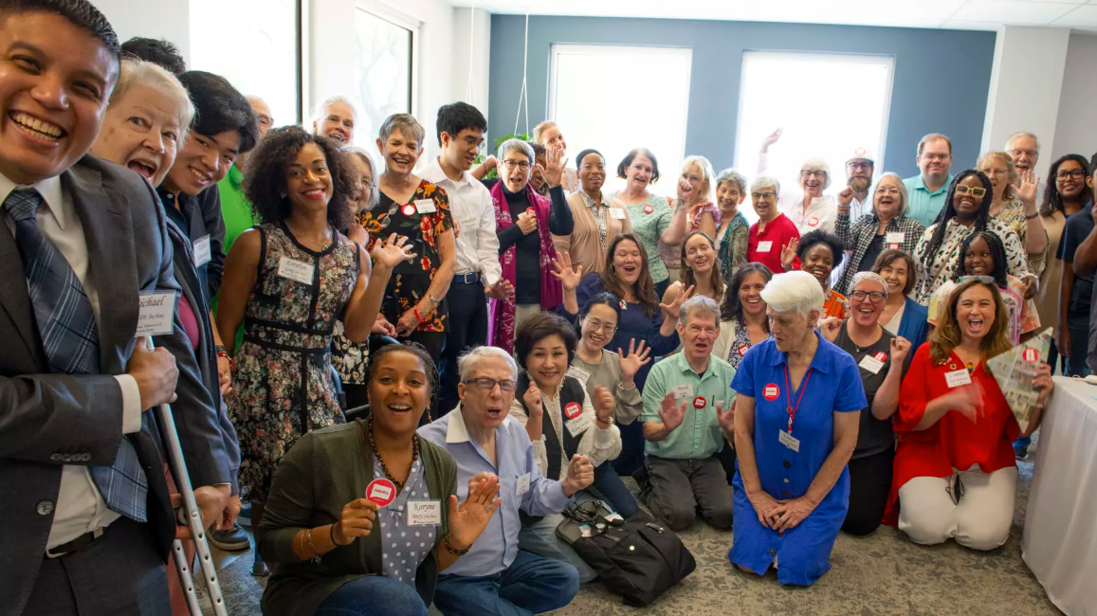
Community of Change

Slide 5
5
Build the Base
CREATE A FOLLOWING
Build community connection & awareness.
Mobilize for Action
ENGAGE YOUR FOLLOWING
Support community to act.
Organize for Power
BUILD POWER
Connect community for long-term advocacy.
Nurture new relationships. Enlist new advocates. Develop new leaders.
Notes:
Goals for recruitment have been to get people to join groups, make longer term commitments, more people take meaningful actions – but it can feel like an uphill climb to find those people and see meaningful growth – people don't turnout to events – people don’t have anyone to invite that they haven't already worn out – takes an enormous amount of effort to do turnout and most groups have fallen away from outreach
Previous recruitment and staff led campaigns were focused on connecting with people who want to volunteer
--that list is what's built our warm leads list – or base of people that RESULTS groups have been reaching out to
--missing a big portion of people – people who care about issues, who share values, who want to see change happen, but aren't actively on volunteermatch or necessarily looking for opportunities to volunteer
Add – why people turn out
Goal:
Extra emphasis on building the base – creating the base of people for local groups to connect with
--lower bar for people to connect, right now it’s “volunteer, join a group”. We want to build the community of people who care and connect with issues – maybe not jumping to full on volunteer yet (maybe they are)
--this will make our elevated outreach ideals more effective – when we need people to show up, we have the people to invite
--extension of the warm leads engagement, but warm leads 5.0
Build a broader base of people that care about RESULTS issues
Connect with large number of people on a personal level using RESULTS issues that are resonating in their own lives and communities
Lower the bar to connect with people (in the past – be a volunteer – built warm leads list. Now – show solidarity with issue you care about. Lower commitment.
Give grassroots groups tools with messaging that they can use in community and relational organizing and outreach

Slide 6
Ladder of Engagement
Group member
Attend lobby meeting
Attend Orientation
Added to Action Network
RESULTS emails & Action Alerts
Takes Solidarity Action

Slide 7
Menu of recruitment options
Warm leads + new from 2023
Outreach & Partnerships Coordinator
Solidarity Action
May convening action
VolunteerMatch

Slide 8
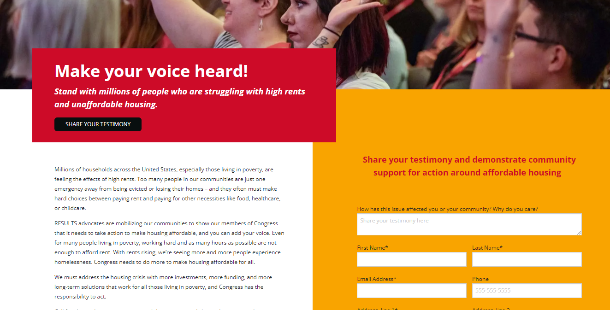
Solidarity Action
https://results.org/raise-your-voice-us

Slide 9
Group Discussion
What are your recruitment & growth goals for the year?
Which of these options sounds like a good strategy for your group?
What questions do you have?

Slide 10
Self Care in 2024: How do mentors prevent burn out?

Slide 11
Best Practices in 2024
Make sure your new advocate knows your name, the best way to contact you, and that they know when the next group meeting/webinar is!
Check in twice a month via an email, text message, or phone call, not only to see how the advocates journey but to do a personal check-in, ask how they truly are!
Make sure you do everything you can to encourage them to join their first meeting with a member of congress --- it's an experience they can't pass up!

Slide 12
Quick Review:
New Advocate Mentor
Supports new group members to get started
Organize 1:1 with new volunteers as they get started
Check to make sure they're on communication list-servs
Reminder & follow-up texts for first group meeting
Ensures new members are up to speed on RESULTS and local group activities
Offers mentorship
Gets new advocates engaged at a level they are comfortable with
Checks in periodically and acts as a resource
Fosters sense of community and belonging
Ensures the group maintains a welcoming atmosphere
Make space in group meetings for questions
Stewards anti-oppression practices in the group

Slide 13
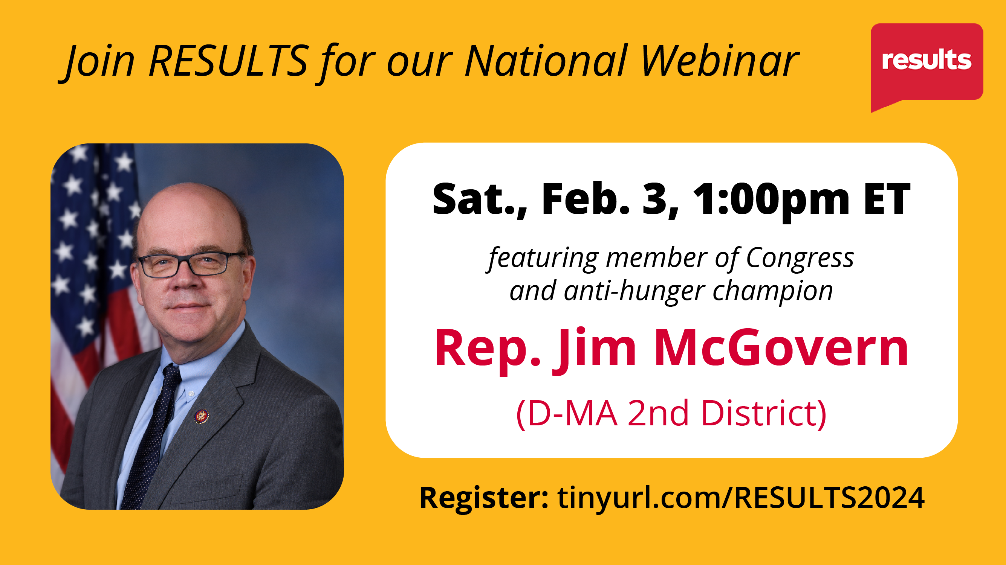
Guest Speaker

Slide 14
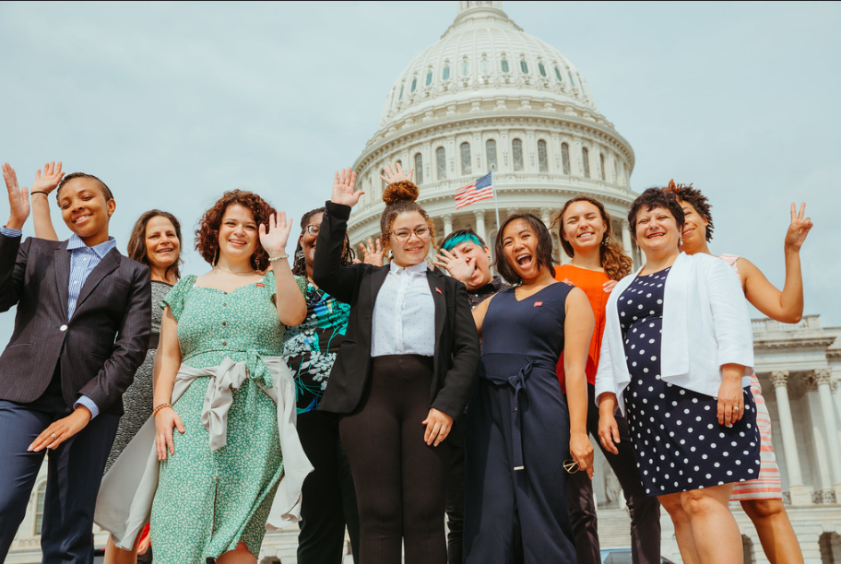
thank you!
For questions contact sleone@results.org or astromberg@results.org

