Slide 1
Organizing for the Future

Slide 2
Welcome!
Use the chat to introduce yourself
Name
Pronoun
ONE WORD that describes why you're joining today

Slide 3
Keep in mind…
This webinar is recorded
Private chat us if you have tech issues
Live transcript available
Zoom tip
Want to rename yourself? Right click on your Zoom square and select “rename”

Slide 4
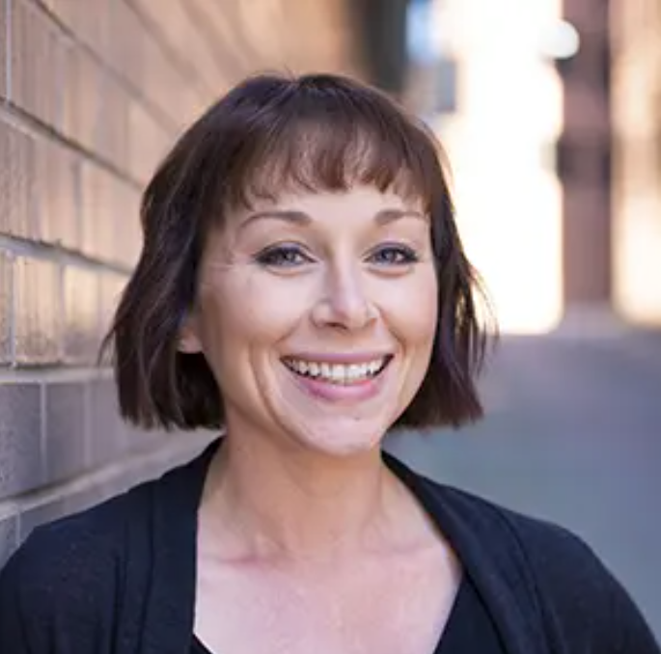
Let’s get started
Amanda Beals Associate Director,
Grassroots Expansion abeals@results.org

Slide 5
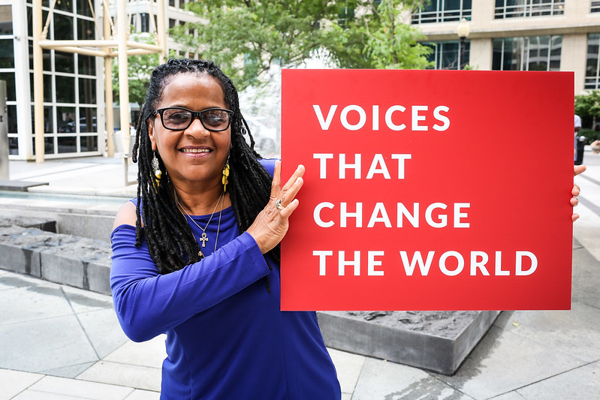
RESULTS is a movement of passionate, committed, everyday people. Together, we use our voices to influence political decisions that will bring an end to poverty.

Slide 6
Ground Rules
Inclusive & welcoming space
Use the chat to connect & ask questions
Share from your own experience & respect the experience of others
RESULTS is nonpartisan - stay focused on values, issues, people & community

Slide 7
Agenda
Connect with RESULTS Community
Get Grounded in Shared Values
Understand How Election Results Impact our Advocacy
Actions That Make a Difference Right Now
Looking Ahead: First 100 Days in 2025

Slide 8
RESULTS Values

Slide 9
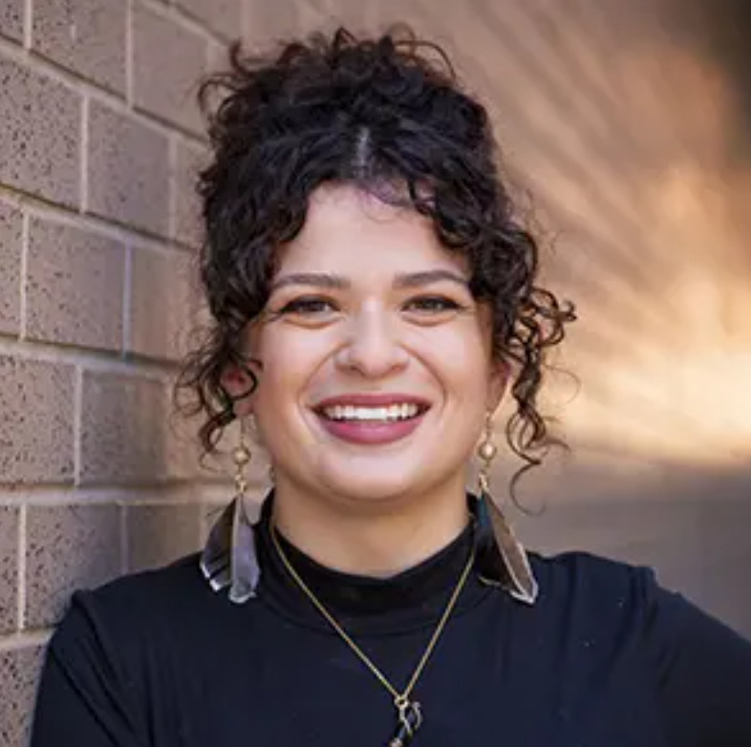
Community values
Sarah Leone Associate,
Grassroots Impact
sleone@results.org

Slide 10
RESULTS Values
We pledge to create space for all voices, including those of us who are currently experiencing poverty. We will address oppressive behavior in our interactions, families, communities, work, and world.
With unearned privilege comes the responsibility to act so the burden to educate and change doesn’t fall solely on those experiencing oppression. When we miss the mark on our values, we will acknowledge our mistake, seek forgiveness, learn, and work together as a community to pursue equity.
Read more at: results.org/values

Slide 11
The Power of the RESULTS Community

Slide 12
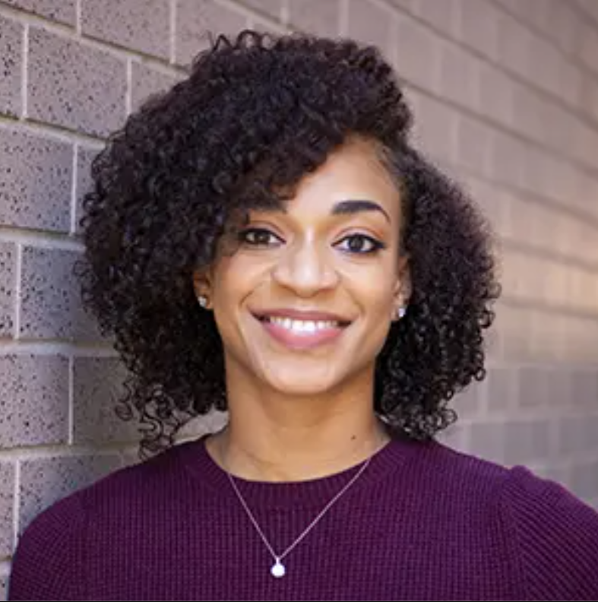
RESULTS Successes
Errolyn Gray Senior Associate,
Grassroots Expansion egray@results.org

Slide 13
What we have achieved
2002:
$1 million increase to international TB control funding
2005:
Suspension of the National Reporting System
2018:
Passage of bipartisan Farm Bill
263 signers in support of the Reach Act
2021:
Passage of the American Rescue Plan

Slide 14
2024 Elections: Impact on RESULTS Advocacy

Slide 15
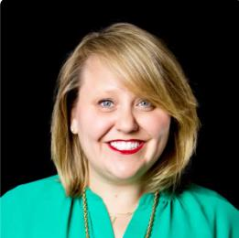
Election Outcomes
Crickett Nicovich Director of Policy and Government Affairs cnicovich@results.org

Slide 16
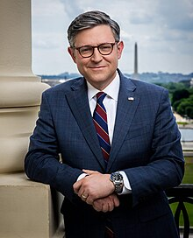
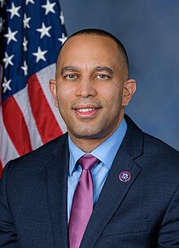
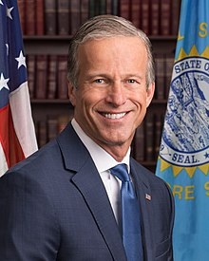
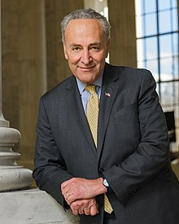
Congressional Leadership
Speaker of the House Mike Johnson (R-LA)
House Minority Leader Hakeem Jeffries (D-NY)
Senate Majority leader John Thune (R-SD)
Senate Minority Leader Chuck Schumer (D-NY)

Slide 17
Key U.S. Policy Committees
House Ways & Means
Chair Jason Smith (R-MO)
Ranking Member Richard Neal (D-MA)
Senate Finance
Chair Mike Crapo (R-ID)
Ranking Member Ron Wyden (D-OR)

Slide 18
Key U.S. Policy Committees
House Agriculture
Chair Glenn Thompson (R-PA)??
Ranking Member David Scott (D-GA)
Senate Agriculture
Chair John Boozman (R-AR)
Ranking Member Amy Klobuchar (D-MN)

Slide 19
Key Global Policy Committees
House Foreign Affairs
Chair Ann Wagner (R-MO) or Darrell Issa (R-CA)
Ranking Member Gregory Meeks (D-NY)
Senate Foreign Relations
Chair James Risch (R-ID)
Ranking Member Jeanne Shaheen (D-NH)

Slide 20
Key Appropriations Committees
House
Chair Tom Cole (R-OK); Ranking Member Rosa DeLauro (D-CT)
SFOPS Chair Mario Diaz-Balart (R-FL); Ranking Member Grace Meng (D-NY)
Senate
Chair Susan Collins (R-ME); Vice Chair Patty Murray (D-WA)
SFOPS Chair Lindsey Graham (R-SC); Ranking Member Chris Coons (D-DE)

Slide 21
US Poverty Policy Outlook
Opportunities
Major focus on federal tax policy in new Congress
Increasing the CTC has been championed by President-Elect Trump and Vice President-Elect Vance
Opportunities to educate on the need for housing & nutrition
New members of Congress to educate

Slide 22
US Poverty Policy Outlook
Challenges
Expect pushback from Trump Administration and Congress on some US Policy goals
Increased partisanship in 2025 and beyond
Changing leadership on key committees
Critical decisions on nutrition policy & SNAP are imminent

Slide 23
Global Poverty Policy Outlook
Challenges
Extremely likely that Trump Administration will propose changes to global poverty policy and deep cuts to funding for global poverty programs

Slide 24
Gloal Poverty Policy Outlook
Opportunities
Advocates can shape how Congress responds
Advance the fight against AIDS, TB, and Malaria
Global Fund to Fight AIDS, TB, and Malaria Replenishment
Build new champions and strong, bipartisan support across global issues during annual appropriations

Slide 25
What’s Most Important Right now

Slide 26
Sustain Yourself as an Advocate
Stay Connected to Community
Prioritize Self-Care
Set Boundaries
Focus on Values-Based Living & Tangible, Effective Action
RESULTS Tool for Building Resilience

Slide 27
Opportunities for Tangible, Effective Action

Slide 28
Actions to Take Right Now
Global Poverty
Pass the End TB Now Act in the House
Ask your Representative to cosponsor H.R. 1776
Elevate in the media
US Poverty
Protect SNAP in the next Farm Bill
Urge Senators & Representatives to support SNAP, educate on importance
Elevate in the media

Slide 29
RESULTS Plan for 2025
First 100 Days Lobby Campaign
January-April 2025
Support existing champions & enlist new allies in Congress
Meet with 100% of the Senate
Meet with key committee members in the House
Key Issues & Asks
Funding the fight against poverty: Appropriations
Justice in the tax code: CTC and EITC
Bold commitments to the Global Fund

Slide 30
Organizing for the Future: Recommit to Advocacy

Slide 31
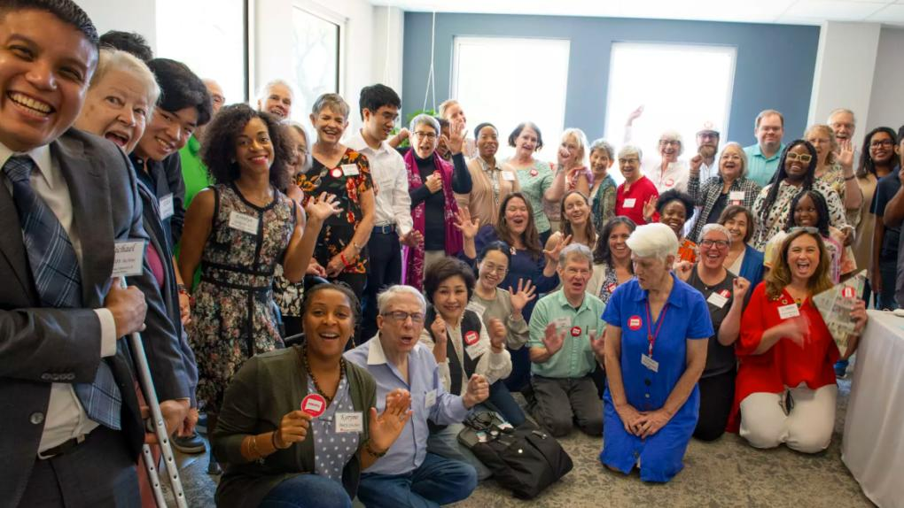
Find your role in the movement

Slide 32
Commit to take action
Step 1
Step 2
Step 3
Fill out the form and make a commitment to advocacy in 2025
You will receive a follow-up email with resources
We will share next steps as the campaign approaches
Questions? Email us at volunteer@results.org

Slide 34
Thank you

