Slide 1
September 2025 Outreach Quarterly Call
Belonging that Builds Power

Slide 2

Welcome
Let us know where you are joining from in the chat!
Photo Credit: Annie Nyle (Unsplash.com)

Slide 3

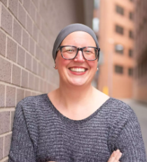
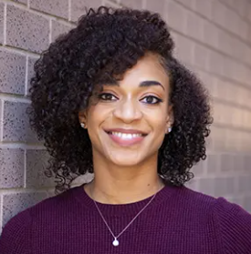
Introducing the team!
Karyne Bury
Grassroots Team
Joanna DiStefano
Grassroots Team
Errolyn Gray
New Advocate Engagement
Notes:
Intros - sharing our why statement, “”who do you want to be in the world?”

Slide 4
Tonight's Agenda
Discuss recent events and impact on outreach and gatherings
Recap session 1 and session 2
Discuss volunteer engagement and retention
Skills building: Public Narrative
Review resources and share next steps
Notes:
Joanna

Slide 5
Anti-Oppression Values
RESULTS is a movement of passionate, committed everyday people. Together we use our voices to influence political decisions that will bring an end to poverty. Poverty cannot end as long as oppression exists.
We commit to opposing all forms of oppression, including ableism, ageism, biphobia, classism, colonialism, homophobia, racism, religious discrimination, sexism, transphobia,
white saviorism, and xenophobia.
At RESULTS we pledge to create space for all voices, including those of us who are currently experiencing poverty. We will address oppressive behavior in our interactions, families, communities, work, and world. Our strength is rooted in our diversity of experiences, not in our assumptions.
With unearned privilege comes the responsibility to act so the burden to educate and change doesn’t fall solely on those experiencing oppression. When we miss the mark on our values, we will acknowledge our mistake, seek forgiveness, learn, and work together as a community to pursue equity.
There are no saviors — only partners, advocates, and allies. We agree to help make the RESULTS movement a respectful, inclusive space.
Notes:
Joanna

Slide 6
In-Person Event Safety
Lean into relational organizing strengths
Screen/register all event participants
Continue to schedule 1:1's with new volunteers and warm leads
Get creative with virtual event alternatives
Touch base with RCs and RESULTS staff
Notes:
Joanna

Slide 7


Session 1 (March):
Community & Partnership Mapping
Session 2 (June):
Effective one–on-one conversations
Notes:
Karyne

Slide 8
Discussion:
Volunteer Engagement & Retention
Notes:
Joanna
Review work on Community & Partnership Mapping Tool:
So as part of the resources available on our website under the “Community Outreach” tab, you will find the Community & Partnership mapping tool. This gives you a framework where you can, using one of our results issues, begin mapping out potential people to work with locally.

Slide 9
1. Introductions (share the group you’re in, how long you’ve been in RESULTS, etc.)
2. Share your affirmative truth - Why are you committed to advocacy? Why does it matter?
3. How does your group culture reflect your affirmative truth?
Breakout Questions
Notes:
Joanna
Review work on Community & Partnership Mapping Tool:
So as part of the resources available on our website under the “Community Outreach” tab, you will find the Community & Partnership mapping tool. This gives you a framework where you can, using one of our results issues, begin mapping out potential people to work with locally.

Slide 10

Time to breakout!
10 mins

Slide 11
Skills Building:
It starts with YOU!
What is your story?
Notes:
Karyne
Review work on Community & Partnership Mapping Tool:
So as part of the resources available on our website under the “Community Outreach” tab, you will find the Community & Partnership mapping tool. This gives you a framework where you can, using one of our results issues, begin mapping out potential people to work with locally.

Slide 12
Your Public Narrative
Notes:
Karyne
Review work on Community & Partnership Mapping Tool:
So as part of the resources available on our website under the “Community Outreach” tab, you will find the Community & Partnership mapping tool. This gives you a framework where you can, using one of our results issues, begin mapping out potential people to work with locally.

Slide 13
Values → Emotion → Action
Notes:
Karyne
Review work on Community & Partnership Mapping Tool:
So as part of the resources available on our website under the “Community Outreach” tab, you will find the Community & Partnership mapping tool. This gives you a framework where you can, using one of our results issues, begin mapping out potential people to work with locally.

Slide 14
Telling YOUR story to create change
- Why you joined RESULTS
- Why someone you know joined you and took action
- Why your group took action and how it made you feel
Notes:
Karyne
Review work on Community & Partnership Mapping Tool:
So as part of the resources available on our website under the “Community Outreach” tab, you will find the Community & Partnership mapping tool. This gives you a framework where you can, using one of our results issues, begin mapping out potential people to work with locally.

Slide 15
What makes a good story:
- Challenge
- Choice
- Outcome
Notes:
Karyne
Review work on Community & Partnership Mapping Tool:
So as part of the resources available on our website under the “Community Outreach” tab, you will find the Community & Partnership mapping tool. This gives you a framework where you can, using one of our results issues, begin mapping out potential people to work with locally.

Slide 16
Start drafting your story…
10 mins
Notes:
Karyne
Review work on Community & Partnership Mapping Tool:
So as part of the resources available on our website under the “Community Outreach” tab, you will find the Community & Partnership mapping tool. This gives you a framework where you can, using one of our results issues, begin mapping out potential people to work with locally.

Slide 17
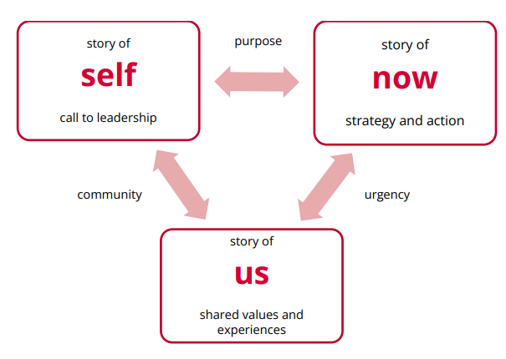
Format your story
Notes:
Karyne
Review work on Community & Partnership Mapping Tool:
So as part of the resources available on our website under the “Community Outreach” tab, you will find the Community & Partnership mapping tool. This gives you a framework where you can, using one of our results issues, begin mapping out potential people to work with locally.

Slide 18
Story of Us & Now →
Group Culture?
Notes:
Karyne
Review work on Community & Partnership Mapping Tool:
So as part of the resources available on our website under the “Community Outreach” tab, you will find the Community & Partnership mapping tool. This gives you a framework where you can, using one of our results issues, begin mapping out potential people to work with locally.

Slide 19
Next steps
Practice your public narrative.
Encourage your group members to work on theirs, support them with the worksheet and other resources.
Does your group have a mission statement that ties in “story of us” and “story of now”?
How does this impact the group culture?
Assess your group: What is the volunteer experience like? Are there issues to be addressed?
Notes:
Karyne

Slide 20
Tracking and Follow-up:
An Essential Next Step
Notes:
Joanna
Review work on Community & Partnership Mapping Tool:
So as part of the resources available on our website under the “Community Outreach” tab, you will find the Community & Partnership mapping tool. This gives you a framework where you can, using one of our results issues, begin mapping out potential people to work with locally.

Slide 21
Tips
Timing | Follow Up Method
24-48 hours after signing up | Touchpoint 1
2 weeks after initial touchpoint | Touchpoint 2
4 weeks after initial touchpoint | Touchpoint 3
6-8 weeks after initial touchpoint | Touchpoint 4
9 weeks | Final Email & Move to Cold Leads
Notes:
Errolyn

Slide 22
Resources
Community Mapping Tool: Helps you identify potential partners and advocates
Engagement Tracker: Helps you track engagement and build relationships with intentionality
Partner Email Template: Supports you to reach out to potential partners
One-on-One Conversations Guide: Helps you engage in impactful conversations with potential partners and advocates
Notes:
Errolyn

Slide 23
Need additional support outreach & community engagement?
Contact us!
Karyne Bury
Grassroots Team
kbury@results.org
Joanna DiStefano
Grassroots Team
jdistefano@results.org
Errolyn Gray
New Advocate Engagement
egray@results.org

Slide 24
Additional Outreach Resources:
EPIC Laser Talk: Invitation to RESULTS movement
Individual planning form
Supporting your leaders to welcome & engage new advocates
Outreach How To’s
Resource guide for planning in-person events (Updated March 2024)
Notes:
Errolyn

Slide 25
Final Outreach Gathering of 2025
December 11 @ 8pm ET
Register here

Slide 27
Closing
Notes:
Errolyn

