Slide 1
Building Power through Action Summer Action Matters Campaign

Slide 2

Welcome Let us know where you are joining from in the chat!
Photo Credit: Roberto Nickson (Unsplash.com)

Slide 3
Tonight's Agenda
Discuss the what and why of outreach (as advocacy!)
Review our work on community mapping
Identify next steps in community engagement (one-on-ones)
Start defining your groups actions for summer Action Matters Campaign

Slide 4
Community & Partnership Mapping Tool
Notes:
Karyne Review work on Community & Partnership Mapping Tool:
So as part of the resources available on our website under the “Community Outreach” tab, you will find the Community & Partnership mapping tool. This gives you a framework where you can, using one of our results issues, begin mapping out potential people to work with locally.

Slide 5
Who cares about the issue?
The Issue
How are we connected to those who care about the issue?
Notes:
Karyne – check in and share what folks have worked on
With the advocacy issue of focus in the center, the mapping two essentially has 3 areas where you think about:
The issue
Who cares about or is affected by the issue
How are we connected to those who care about or are affected by the issue?

Slide 6
What does the conversation sound like?
Notes:
8:30- 8:45pm – Now that we have the map, what does the conversation sound like
Most effective - Have a one-on-one conversation with someone from a potential partner organization! As you may have already experienced, in organizing, one on one convos are a key tool to building, establishing, maintaining, and growing relationships based on shared interests, values, and resources. But how do you have effective one on one conversation? Relationships building is one of the core practices of building power in organizing and developing partnerships. And as a core practice, it is sometimes hard to know if we are doing it right!

Slide 7

First 100 Days
January – May 2025
Summer Action Matters Campaign June 2025 – August 2025
Notes:
Errolyn

Slide 8
Level Up Your Advocacy
Relational Organizing & 1:1 Conversations
Warm Leads Lists
Retention Plan
Community Mapping & Partnerships

Slide 9
Take action. Connect with community. Build power.
Action Matters Campaign Guide
Notes:
Errolyn

Slide 10
How do you have effective one-on-one conversation?
Attention
Interest
Exploration
Exchange
Commitment
Notes:
A good model of how to start genuine yet structured 1:1’s has this kind of a structure:
Attention: What’s grabbed your attention about this individual or organization? What would make them a good potential partner to meet our groups advocacy goals?
Interest: You have made some assumptions about the person you are talking to, and the first meeting is where you will prove and dispel these assumptions
Exploration: Asking good, open, questions to learn more about them, like asking “Why?” Dig in deeper to understand what they value
Have an Exchange: Once we have established that we have some shared values we can continue our exchange, what can we offer that can set the basis of this relationship (insight, information, opportunities for a next meeting)
Commitment: Make a specific ask – this is where people sometimes are shy, but without the ask we won’t have the next step. Give a clear ask and opportunity for people to act with us, be specific and use plain language.

Slide 11
How do you have effective one-on-one conversation?
Attention – What has grabbed your attention about this individual or organization?
Interest - You have made some assumptions about the person, this is where you will prove and dispel these assumptions.
Exploration - Asking good, open, questions to learn more about them, dig in deeper to understand what they value
Notes:
A good model of how to start genuine yet structured 1:1’s has this kind of a structure:
Attention: What’s grabbed your attention about this individual or organization? What would make them a good potential partner to meet our groups advocacy goals?
Interest: You have made some assumptions about the person you are talking to, and the first meeting is where you will prove and dispel these assumptions
Exploration: Asking good, open, questions to learn more about them, like asking “Why?” Dig in deeper to understand what they value

Slide 12
How do you have effective one-on-one conversation?
Exchange - Once we have established shared values we can continue our exchange, what can we offer - insight, information, opportunities?
Commitment - Make an ask, and be specific!
Notes:
Have an Exchange: Once we have established that we have some shared values we can continue our exchange, what can we offer that can set the basis of this relationship (insight, information, opportunities for a next meeting)
Commitment: Make a specific ask – this is where people sometimes are shy, but without the ask we won’t have the next step. Give a clear ask and opportunity for people to act with us, be specific and use plain language.

Slide 13

Time to roleplay
Photo Credit: Mirko Fabian (Unsplash.com)

Slide 14
Practice your 1:1 Conversations
Roleplaying pairs: 1 RESULTS volunteer, and 1 community member, potential partner, new advocate, family member or friend.
Try to have your one-on-one conversation outlined with the 5 steps: Attention, Interest, Exploration, Exchange, & Commitment.
We will do 2 rounds, please keep to about 3 - 5 mins, then switch roles.
Don’t always say yes immediately, think about some responses you’ve received in prior one-on-one conversations.
Then take a few minutes to debrief and be ready to share with the group when we return to the main room!
Notes:
Now, with our balance of time we will break up into breakout rooms to practice these initial conversations.
Instructions:
We’re going to break out in pairs, and give enough time for a roleplay where we have 1 RESULTS volunteer, and 1 potential partner
Take note on the 5 steps we talked about earlier, keep to about 5 mins each round, then switch roles.
Don’t always say yes immediately, change it up (although who would say no to joining or partnering with RESULTS!), but the reality is there could be a variety of responses to an invitation – a “no” can be “not a good fit” or “not yet”
Take a few mins to debrief, highlight what went well, what maybe not so well, then we will return and read out to the full group – what was this like? What did you observe? Do you feel confident in having these conversations with members of your own community/future partners? Why or why not?

Slide 15

Time to breakout!
Practice your 1:1 conversations!

Slide 16
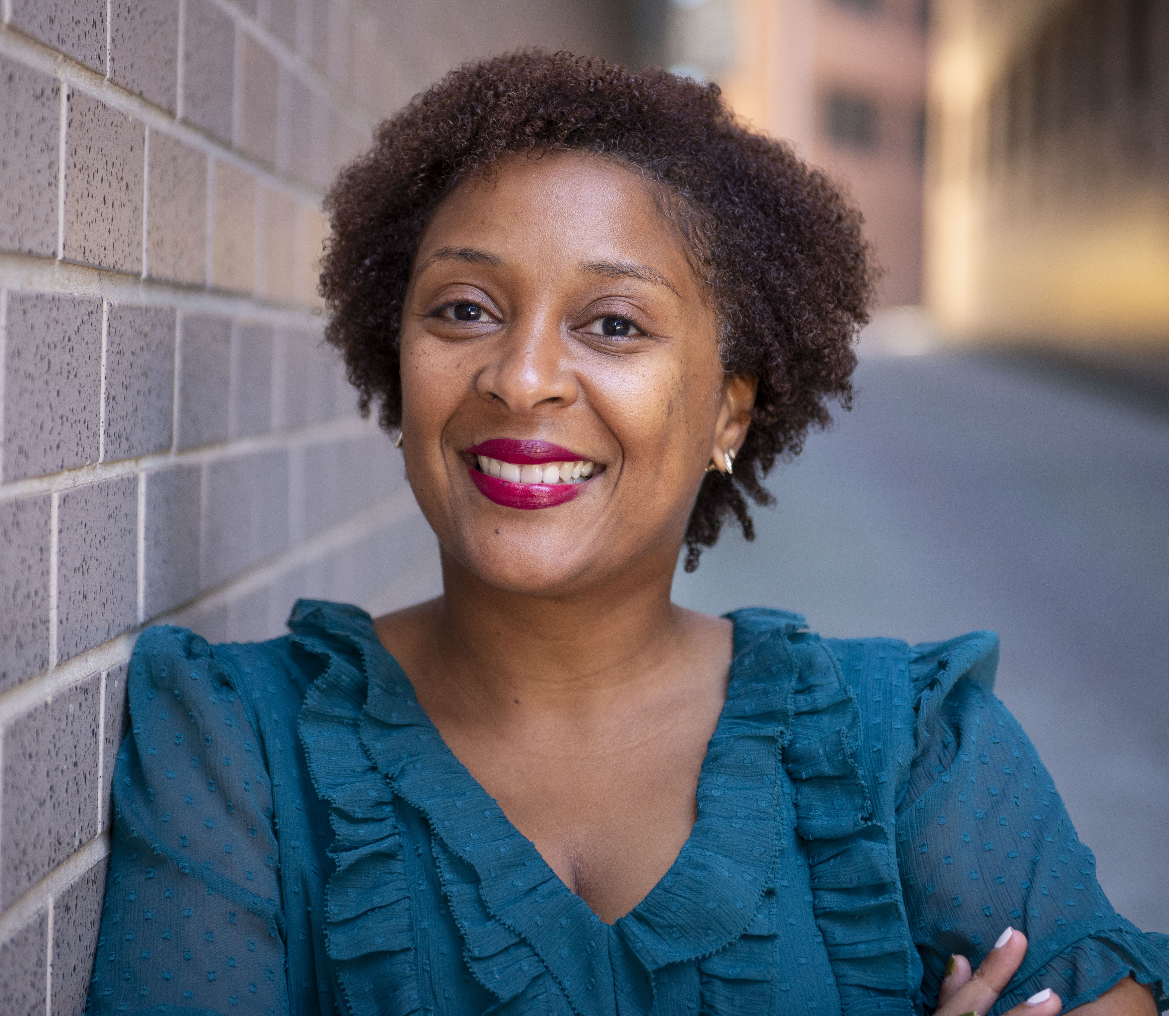
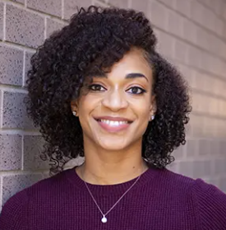
Need additional support outreach & community engagement? Contact us!
Karyne Bury RESULTS Grassroots Team
kbury@results.org
Errolyn Gray RESULTS Grassroots Team
egray@results.org

Slide 17
Summer Outreach Resources:
Summer Action Matters Campaign Guide
Summer 2025 Action Sheet: Action Matters
Community & Partnership Mapping Tool
One-on-one new advocate meeting
Warm leads communication templates
Guide: Support new advocates to lobby
Group guide to welcoming & supporting new advocates
Notes:
Errolyn

Slide 18
Additional Outreach Resources:
EPIC Laser Talk: Invitation to RESULTS movement
Individual planning form
Supporting your leaders to welcome & engage new advocates
Outreach How To’s
Resource guide for planning in-person events (Updated March 2024)
Notes:
Errolyn

Slide 19
Join our Q3 Outreach Gathering in September
In the meantime practice your one-on-one conversations!

Slide 21
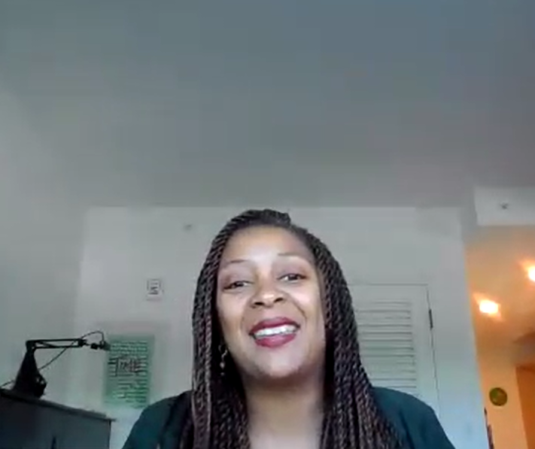
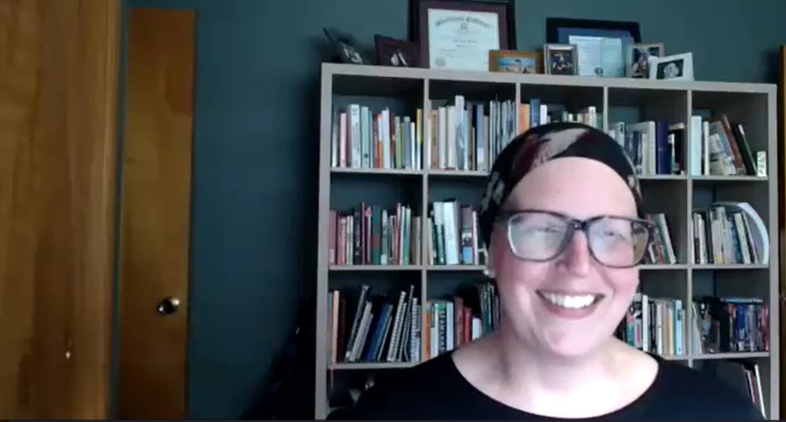
Examples of 1:1 Conversations
Link
Notes:
“Good” convo with a hard ask (8 mins): https://results.zoom.us/rec/share/2YKVPyAMiry9zMcEV7Pyw7wMzN1lody1hNPYcrCfK-oQX6hPbEjw_nRxcDOO_oBi.Y2A65UXWegD8WXja?startTime=1714763044000
What are your thoughts on this conversations?
Shared values and understand of what people are going through
Shared frustration with ppl in power not doing enough to help the people – so shared how RESULTS is the antidote to the frustration.
Very clear example of what our group does! Share opportunities to make an impact and how we do it. Share successes too!
Was not available to join the meeting, so be flexible, what other opportunities do you have to take this forward?

Slide 22
Examples of 1:1 Conversations
Version 1: “Bad” model, off topic and no ask
Notes:
“Bad” model 1: What not to do – complain and then go off topic, with no hard ask: https://results.zoom.us/rec/share/2YKVPyAMiry9zMcEV7Pyw7wMzN1lody1hNPYcrCfK-oQX6hPbEjw_nRxcDOO_oBi.Y2A65UXWegD8WXja?startTime=1714764483000
What are your thoughts on this conversations?
Count how many missed opportunities there were to veer the conversation back to an invitation to learn more about advocacy? Shared experiences and issues, interested in voting and democratic ideals, shared about other organizations, including her own, but then didn’t ask further questions.

Slide 23
Examples of 1:1 Conversations
Version 2: “Bad” model, closed the door!
Notes:
“Bad” Model 2: What not to do – if they can’t make the meeting, don’t close the door! (End video at 1:50) https://results.zoom.us/rec/share/2YKVPyAMiry9zMcEV7Pyw7wMzN1lody1hNPYcrCfK-oQX6hPbEjw_nRxcDOO_oBi.Y2A65UXWegD8WXja?startTime=1714763647000
What are your thoughts on this conversations?
Picking up from the invitation, sometimes the timing doesn’t work out! Don’t close the door if they can’t make the meeting, there may be another way to connect!

Slide 24
Next steps for you and your group!
Complete your community & partnership map. Work with your group, do further research, and explore local organizations whose issues intersect.
Practice. Continue practicing your one-on-one conversations.
Review resources. Check out the guides to help plan your June Community Actions and explore additional resources on the RESULTS website under “Engaging the Community.”
Notes:
Complete your community & partnership map. Work with your group, do further research, and explore local organizations whose issues intersect.
Practice. Continue practicing your one-on-one conversations.
Review resources. Check out the guides to help plan your June Community Actions and explore additional resources on the RESULTS website under “Engaging the Community.”

Slide 25
Why do we partner?

Slide 26

Why do we partner?
Issues > individual, group, organization
Helps to complete gaps in knowledge or resources.
Expands our impact!
Notes:
The issues we are trying to address – ending poverty – cannot be done alone, not by one individual, nor one organization. Partnership helps us expand our work and our impact to move our advocacy forward.

Slide 27
What does an effective partnership look like?
Shared values.
Good communication.
Not transactional, but transformational.
Notes:
Shared values – while we all may not agree with everything, or approach things the same way, good partners have some shared values.
Communication – even if it’s just to update what the other is doing
Not transactional – don’t just call up someone when you need something, like personal relationships, or relationships with MOCs, it’s important to have consistency in engaging with partners and avoid making the relationship transactional. Share upcoming news with them, or invites to events, new information, etc.

Slide 28



RESULTS Organizational Partners
Notes:
Two RESULTS organizational partners

Slide 29
Community & Partnership Mapping Tool
Notes:
Community & Partnership Mapping Tool:
So as part of the resources available on our website under the “Community Outreach” tab, you will find the Community & Partnership mapping tool. This gives you a framework where you can, using one of our results issues, begin mapping out potential people to work with locally.

Slide 30
Who cares about the issue?
The Issue
How are we connected to those who care about the issue?
Notes:
With the advocacy issue of focus in the center, the mapping two essentially has 3 areas where you think about:
The issue
Who cares about or is affected by the issue
How are we connected to those who care about or are affected by the issue?

Slide 31
the
Issue
Food Insecurity
Notes:
There the Mapping Tool has been completed on the issue of food insecurity
Who cares about or is affected by the issue of food insecurity as it affects children in your community? Do you know of a specific organization which provides support for children experiencing food insecurity? Or where there may be summer food programs? Name them!
Domestically
Child poverty organizations, service providers
Schools
Pediatric associations
United Way
Children’s Trust
Food Banks
Faith Groups
Rotary groups
Global
USGLC
UN Association
Care
ONE Campaign
Partners in Health
University Global Health Programs
Others? (brainstorm with audience)
Who has connections to these organizations within your group?
Current volunteers
Fellows
Former volunteers
Friends, family, colleagues?
Fellow members of your faith community?
Other places where you and other group members are volunteering?
Elections? Campaigns?
What are the ways that you can work together? Open to the group for shared brainstorm
Joint lobby meetings
Community events to build awareness – bringing in a guest speaker/expert to talk about the issue and educate
Letter writing/postcard writing to MOCs
Any other ideas folks want to share of how they can work with potential partners?
Perhaps phrase as "who cares about or is affected by issues of food insecurity as it affects children in your community. Coach people to be specific - instead of saying 'local elementary schools' name the school/s in their community that they would want to reach out to, name the specific organization, etc, The more specific people can get with their list building the better

Slide 32
Food Insecurity
Who covers it in the media?
Who studies it?
Who experiences it?
And how am I including them in working on the solution?
Who in your local
(or state) government works on this issue?
Businesses, non-profits, educational institutions, foundations?
Notes:
For example, food insecurity – think about how it affects your community?
Do you know of a specific organization which provides support for those experiencing food insecurity? Who are those most affected – children? The elderly? What organizations exist to support? If it’s children, where are there summer food programs? Try to name them and be specific!
Who is affected by it, and how are they included in solutions to resolve it?

Slide 33
Community Colleges/
Universities
Parents
Educators
Food Insecurity
Healthcare Providers
Child Services Agencies
Food Banks
Homeless Trust/
Housing Authority
Notes:
There the Mapping Tool has been completed on the issue of food insecurity
Who cares about or is affected by the issue of food insecurity as it affects children in your community? Do you know of a specific organization which provides support for children experiencing food insecurity? Or where there may be summer food programs? Name them!
Domestically
Child poverty organizations, service providers
Schools
Pediatric associations
United Way
Children’s Trust
Food Banks
Faith Groups
Rotary groups
Global
USGLC
UN Association
Care
ONE Campaign
Partners in Health
University Global Health Programs
Others? (brainstorm with audience)
Who has connections to these organizations within your group?
Current volunteers
Fellows
Former volunteers
Friends, family, colleagues?
Fellow members of your faith community?
Other places where you and other group members are volunteering?
Elections? Campaigns?
What are the ways that you can work together? Open to the group for shared brainstorm
Joint lobby meetings
Community events to build awareness – bringing in a guest speaker/expert to talk about the issue and educate
Letter writing/postcard writing to MOCs
Any other ideas folks want to share of how they can work with potential partners?
Perhaps phrase as "who cares about or is affected by issues of food insecurity as it affects children in your community. Coach people to be specific - instead of saying 'local elementary schools' name the school/s in their community that they would want to reach out to, name the specific organization, etc, The more specific people can get with their list building the better

Slide 34
Unitarian Universalist Church of Birmingham
Alabama Arise
Grace Klein Community
(Food Banks)
Food Insecurity
Jones Valley Teaching Farm
UAB
Hunger Free
Alabama
Voices for Alabama’s Children
Notes:
There the Mapping Tool has been completed on the issue of food insecurity
Who cares about or is affected by the issue of food insecurity as it affects children in your community? Do you know of a specific organization which provides support for children experiencing food insecurity? Or where there may be summer food programs? Name them, specifically!
Domestically
Child poverty organizations, service providers
Schools
Pediatric associations
United Way
Children’s Trust
Food Banks
Faith Groups
Rotary groups
Global
USGLC
UN Association
Care
ONE Campaign
Partners in Health
University Global Health Programs
Others? (brainstorm with audience)
Who has connections to these organizations within your group?
Current volunteers
Fellows
Former volunteers
Friends, family, colleagues?
Fellow members of your faith community?
Other places where you and other group members are volunteering?
Elections? Campaigns?
What are the ways that you can work together? Open to the group for shared brainstorm
Joint lobby meetings
Community events to build awareness – bringing in a guest speaker/expert to talk about the issue and educate
Letter writing/postcard writing to MOCs
Any other ideas folks want to share of how they can work with potential partners?
Perhaps phrase as "who cares about or is affected by issues of food insecurity as it affects children in your community. Coach people to be specific - instead of saying 'local elementary schools' name the school/s in their community that they would want to reach out to, name the specific organization, etc, The more specific people can get with their list building the better

Slide 35
Six Degrees of Separation: How are we connected….?
Work connections?
Neighborhood connections?
Connections in your faith community?
Other volunteer or social organizations?
Notes:
Who has connections to these organizations within your group?
Current volunteers
Fellows
Former volunteers
Friends, family, colleagues?
Fellow members of your faith community?
Other places where you and other group members are volunteering?
Elections? Campaigns?
What are the ways that you can work together? Open to the group for shared brainstorm
Joint lobby meetings
Community events to build awareness – bringing in a guest speaker/expert to talk about the issue and educate
Letter writing/postcard writing to MOCs
Any other ideas folks want to share of how they can work with potential partners?
Perhaps phrase as "who cares about or is affected by issues of food insecurity as it affects children in your community. Coach people to be specific - instead of saying 'local elementary schools' name the school/s in their community that they would want to reach out to, name the specific organization, etc, The more specific people can get with their list building the better

Slide 36
AL group member sings in the church choir
Group member has volunteered at this food bank
Unitarian Universalist Church of Birmingham
Group member
has a friend
who
works there
Alabama Arise
Grace Klein Community
(Food Bank)
Group members were professors, alumni or are current students.
Food Insecurity
Jones Valley Teaching Farm
UAB
Hunger Free
Alabama
Group member read about their work in an article
Voices for Alabama’s Children
Group member has a contact who shared info about these organizations.
Notes:
There the Mapping Tool has been completed on the issue of food insecurity
Who cares about or is affected by the issue of food insecurity as it affects children in your community? Do you know of a specific organization which provides support for children experiencing food insecurity? Or where there may be summer food programs? Name them, specifically!
Domestically
Child poverty organizations, service providers
Schools
Pediatric associations
United Way
Children’s Trust
Food Banks
Faith Groups
Rotary groups
Global
USGLC
UN Association
Care
ONE Campaign
Partners in Health
University Global Health Programs
Others? (brainstorm with audience)
Who has connections to these organizations within your group?
Current volunteers
Fellows
Former volunteers
Friends, family, colleagues?
Fellow members of your faith community?
Other places where you and other group members are volunteering?
Elections? Campaigns?
What are the ways that you can work together? Open to the group for shared brainstorm
Joint lobby meetings
Community events to build awareness – bringing in a guest speaker/expert to talk about the issue and educate
Letter writing/postcard writing to MOCs
Any other ideas folks want to share of how they can work with potential partners?
Perhaps phrase as "who cares about or is affected by issues of food insecurity as it affects children in your community. Coach people to be specific - instead of saying 'local elementary schools' name the school/s in their community that they would want to reach out to, name the specific organization, etc, The more specific people can get with their list building the better

Slide 37
Take a few minutes to start your map!
Notes:
I would like to give you all about a minute or two to get started take the initial step of the mapping tool. Once you’ve decided on an issue, name as many local people or organizations as you can think of, this is a great activity that you can complete with your group at your group meeting this month!

Slide 38
What’s next?
Be inspired! Think about connections you can make in your community. Complete the map at your next group meeting.
Share ideas on how to work with potential partnerships.
Outline what the first steps could look like:
6 Degrees of Separation – who knows who?
What are some activities they’re doing in the community? Where can we potentially explore work together?
Who can contact them for a 1:1 conversation? What could it sound like? See a link to sample convos here!

