Slide 1
Global Allies Presentation
October 13, 2022

Slide 2
Our Anti-Oppression Values
2
​RESULTS is a movement of passionate, committed everyday people. Together we use our voices to influence political decisions that will bring an end to poverty. Poverty cannot end as long as oppression exists. We commit to opposing all forms of oppression, including ableism, ageism, biphobia, classism, colonialism, homophobia, racism, religious discrimination, sexism, transphobia, white saviorism, and xenophobia.
At RESULTS we pledge to create space for all voices, including those of us who are currently experiencing poverty. We will address oppressive behavior in our interactions, families, communities, work, and world. Our strength is rooted in our diversity of experiences, not in our assumptions.
With unearned privilege comes the responsibility to act so the burden to educate and change doesn’t fall solely on those experiencing oppression. When we miss the mark on our values, we will acknowledge our mistake, seek forgiveness, learn, and work together as a community to pursue equity.
There are no saviors — only partners, advocates, and allies. We agree to help make the RESULTS movement a respectful, inclusive space.
Find all our anti-oppression resources at https://results.org/volunteers/anti-oppression/

Slide 3

Global Education

Slide 4

Dr. Meg P. Gardinier
Introduction
Former Fulbright Advisor @ Georgetown University
Graduate Education Faculty @ School for International Training (SIT), Florida International University, and Indiana Tech
Comparative and International Education Researcher with publications on Educational Reform in Post-Communist Albania
Worked with UNESCO and NGOs
Served as Global Peace Education Campaign Coordinator for Hague Appeal for Peace (2001-2003)
Global Education Policy Manager

Slide 5
Why Focus on Education?
Education has the power to end cycles of poverty by increasing future wages, preventing child marriages, and reducing infant mortality.
Achieving universal primary and secondary education would help lift more than 420 million out of poverty.
Girls, low-income children, and children with disabilities, and youth affected by conflict face the greatest barriers to education.
The COVID-19 pandemic has severely disrupted children's access to quality education around the world.
Education = HOPE for children and families, particularly those living in situations of conflict and crisis.

Slide 6
The Learning Crisis
More than 90% of the world’s children have had their education disrupted by the pandemic.
In 2021, 244 million children and young people were out of school.
Nearly 370 million children worldwide were deprived of in-school meals.
The longer vulnerable children are out of school, the less likely they are to return; the World Bank estimates that this generation of students will lose $10 trillion in lifetime earnings because of learning loss.
These factors have created a learning crisis.

Slide 7
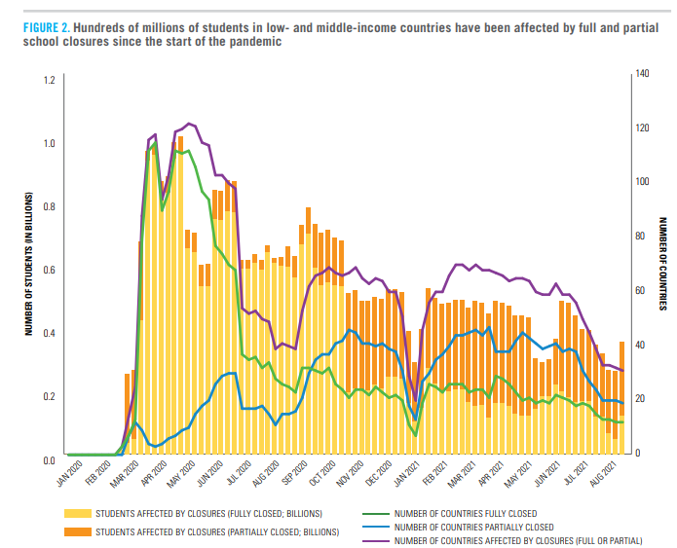
Global Impact
7
In low- and middle-income countries, up to 70% of 10-year-olds are unable to read a simple text (worse than pre-pandemic).
Around 200 million youth ages 12-17 are out of school, and 80% of children in low-income countries lack access to preschool.
Source: "The State of the Global Education Crisis" by UNESCO, UNICEF, and the World Bank
Notes:
Key for conversations: make it real, share how you have used the CTC, how your family or community has been impacted, and share some of the important data on the impact of the CTC.
Talking points:
1. The CTC is so effective helping families make ends meet – and we have studies show how families use their CTC – which includes housing. This CBPP analysis of U.S. Census Bureau’s Household Pulse Survey collected between July and September 2021 focuses specifically on how lower-income families used the CTC -- families used the CTC for housing, food, clothing, and utilities — and education.
https://www.cbpp.org/blog/rising-food-and-energy-prices-underscore-the-urgency-of-acting-on-the-child-tax-credit
Related: A new study from the Brookings Institution shows that the CTC monthly payments dramatically reduced child poverty, fostered healthier eating, and allowed parents to invest in their children’s education. Also, a steady supplement to their monthly income helped families avoid high-interest payday loans for financial help. As the study confirms, families spent their CTC payments on rent, food, and clothes for their kids.
2. At a time when federal rental assistance is not universally available to all those who need it and instead only reaches one in four eligible households, the CTC played a role for some families as another form of rental assistance – and this is a big deal to help families weather high costs due to inflation.
3. This loss of monthly CTC payments and full refundability comes at the worst possible time – when families are facing higher costs from inflation. Moody’s Analytics says the average household is spending an extra $327 per month due to inflation, with a steep rise in rents fueling it. The 2021 CTC monthly payments averaged $444 per month per household. The math is simple; if you want to help families with higher costs, extend the CTC.
4. Meanwhile it is important to note that the CTC does not cause inflation – and is a key tool for families feeling the pressure of rising costs. In April, more than 130 economists wrote that, “the expanded Child Tax Credit is one of the easiest, most effective, and direct tools currently at our disposal to help families deal with the impact of inflation on family budgets.” There is no evidence that the increased CTC in 2021 contributed to rising costs. As noted by CBPP, the expanded CTC would contribute “little or no inflationary pressure”, and two former Treasury Secretaries made a similar point in a May 2 New York Times op-ed. When a politician says that inflation is hurting families, the response should be, “Then why haven’t you extended the Child Tax Credit payments?”
5. Finally, we know that many of you have heard from policymakers that they would like an earnings requirement linked to the CTC. We urge you to share why you think investing in dramatic reductions in child poverty should be the goal, and that you are focused on reducing hardship for children regardless of their parents’ work history. You could share that 1.4 million CTC households have left their jobs since the payments stopped, primarily because they can no longer afford childcare. Now, as inflation bears down, families are facing greater obstacles to making ends meet.
INTERACTIVE: what is something you’ve shared about why you think the CTC is important in your media, outreach, or advocacy meetings? Or, what is something you plan to emphasize in your Advocacy Month meetings?

Slide 8
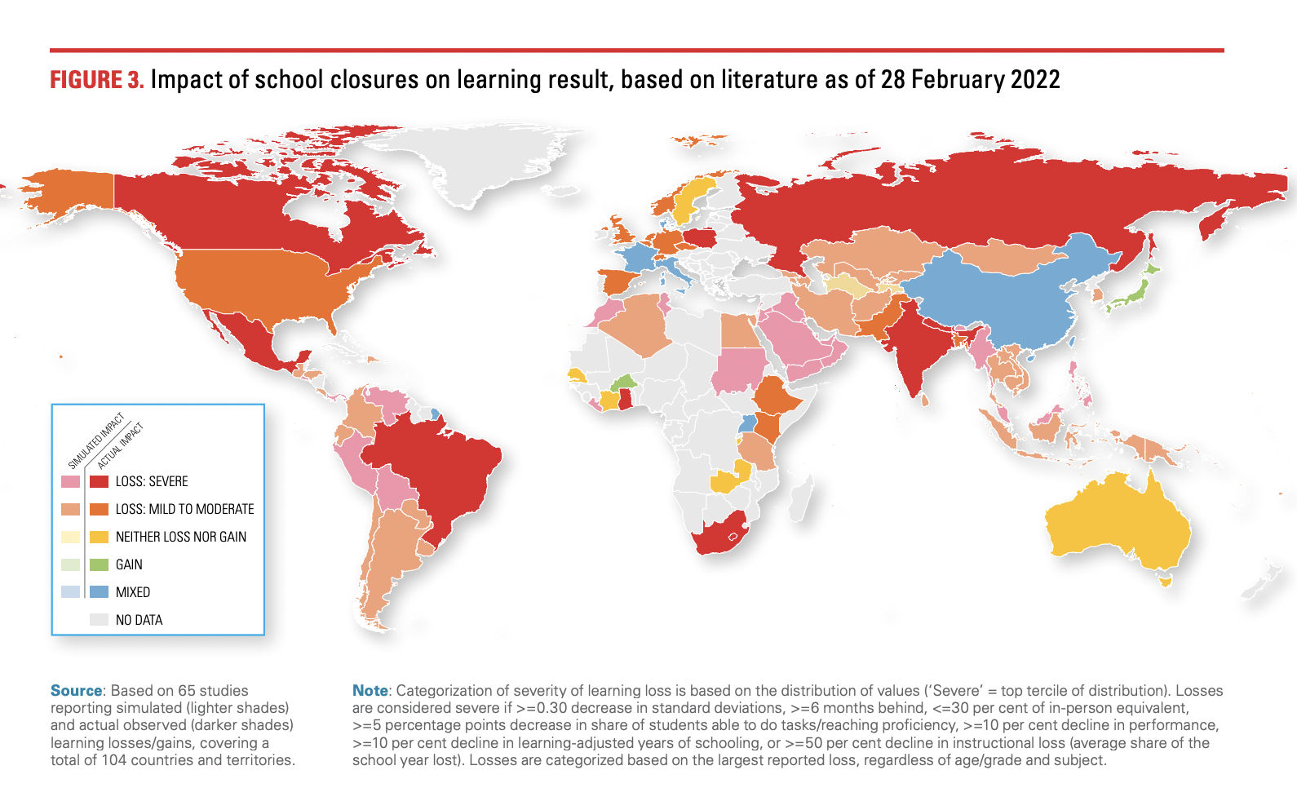
Global Impact
8
Source: “Where Are We in Education Recovery" by UNESCO, UNICEF, and the World Bank

Slide 9
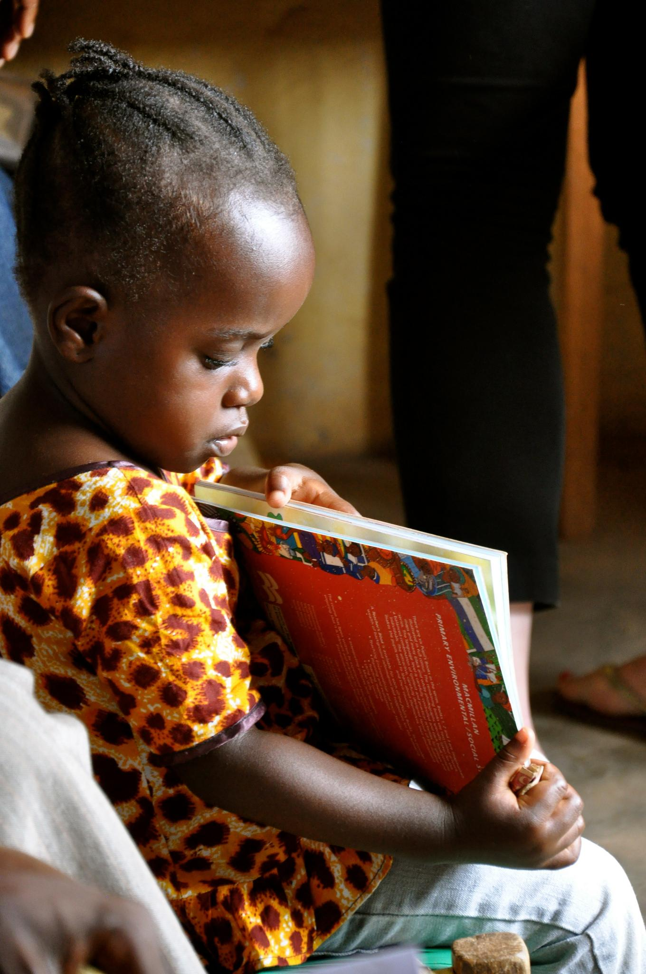
COVID’s impact on foundational skills
An estimated 70% of 10 year olds in lower and middle income contexts experience learning poverty. They are unable to understand a simple text.
Those marginalized by disability, poverty, race, gender and other factors were the least likely to access remote learning opportunities.
USAID is committed to addressing these gaps in foundational learning to ensure all students have opportunities to progress
Photo Credit: USAID LIberia

Slide 10
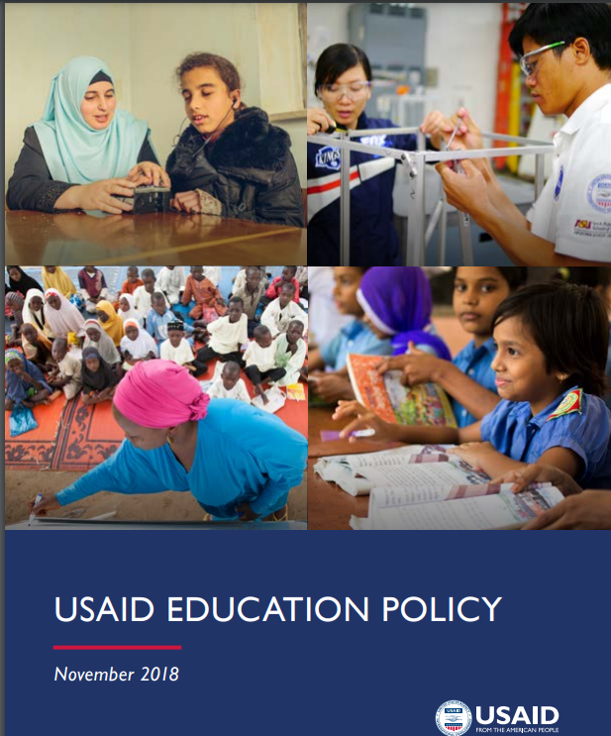
USAID’s Policy Goals
Improving Learning Outcomes
Expand access to quality basic education for all, particularly the most marginalized and vulnerable populations

Slide 11
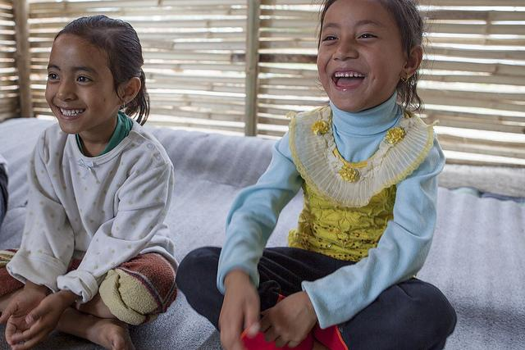
Addressing the challenges of learning loss
USAID, UNICEF, and other agencies recommend that governments implement the RAPID Framework
Assess learning losses and prioritize inclusive and differentiated instruction
Give greater attention to social and emotional skills and the wellbeing of teachers and students.
Photo credit: USAID Nepal

Slide 12
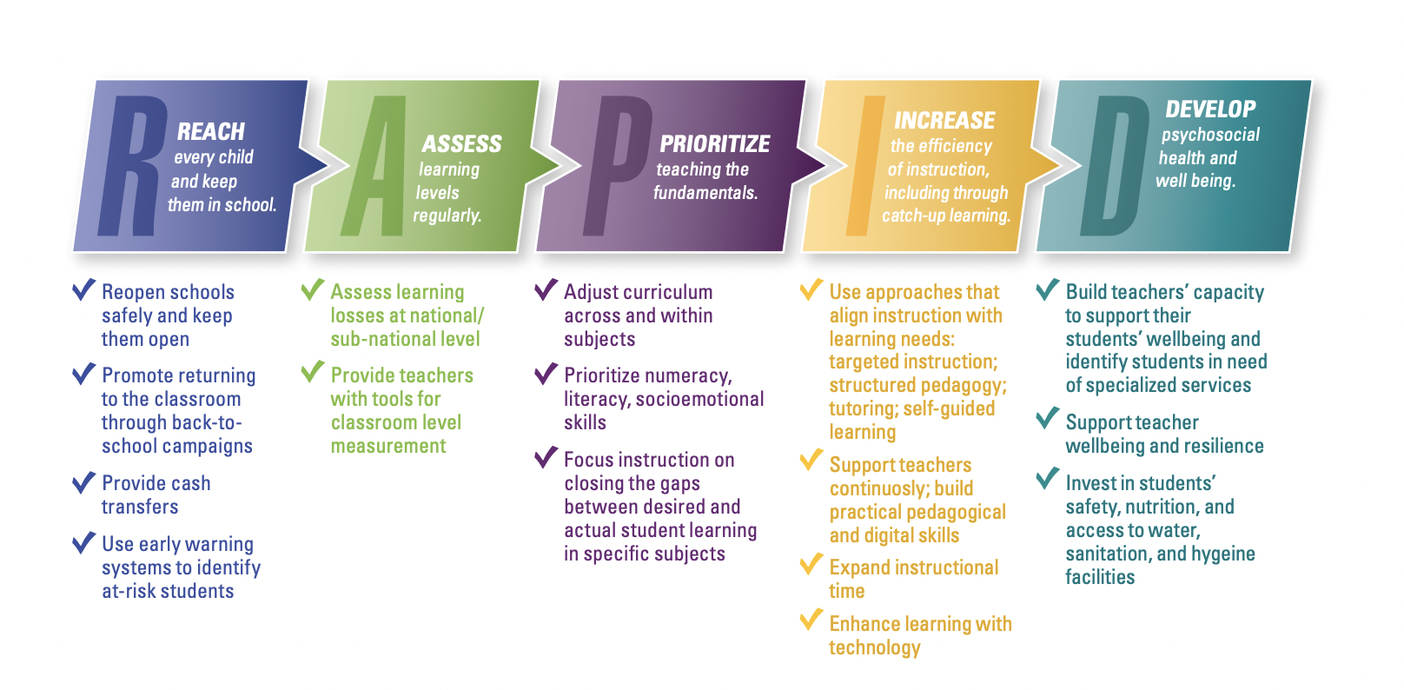
RAPID Framework
From learning recovery to education transformation - World Education Blog (world-education-blog.org)

Slide 13
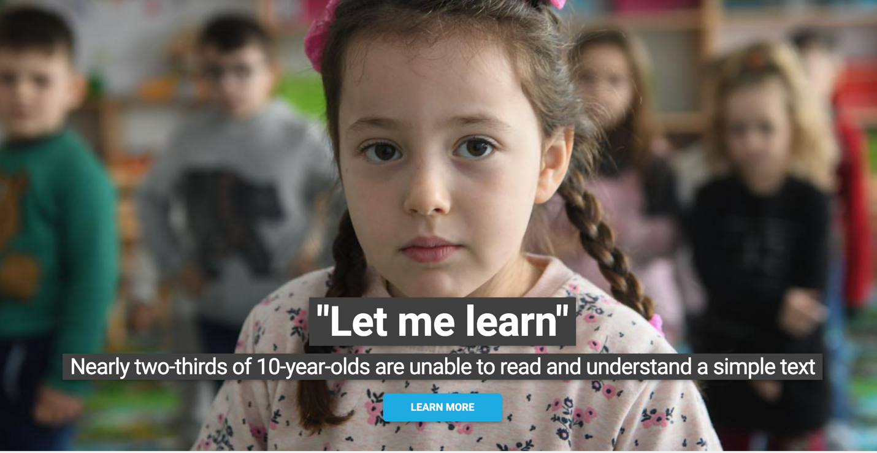
“LET ME LEARN” Campaign

Slide 14
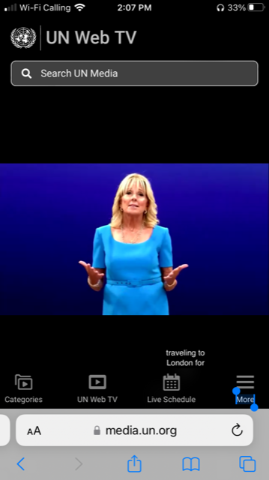
Dr. Jill Biden Addresses World Leaders at TES
14
The Commitment to Action (CtA) recognizes that foundational learning provides the essential building blocks for all other learning, knowledge and higher-order skills.
By endorsing the CtA, countries and organizations commit to taking urgent and decisive action to reduce by half the global share of children unable to read and understand a simple text by age ten, by 2030.
Commitment to Action on Foundational Learning | UNICEF

Slide 15
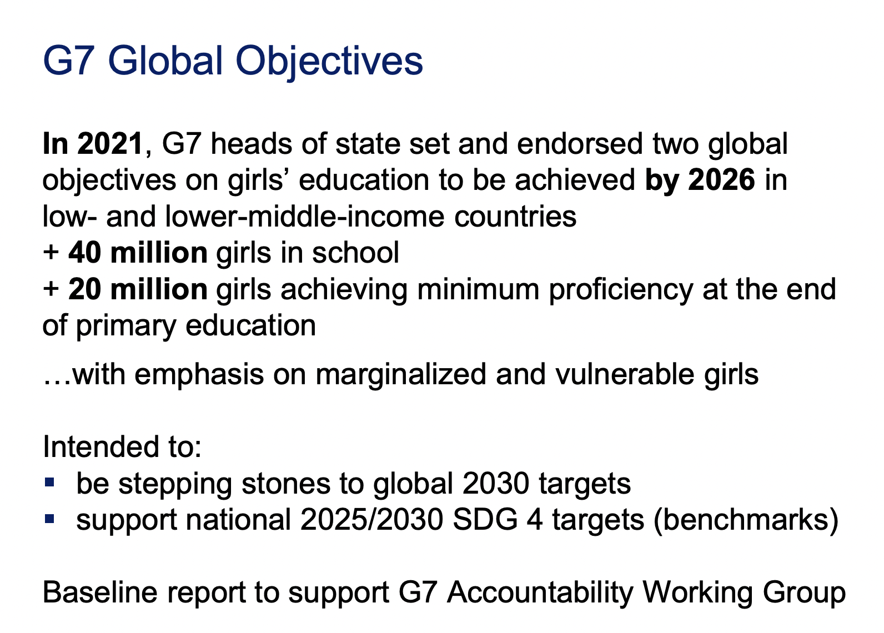
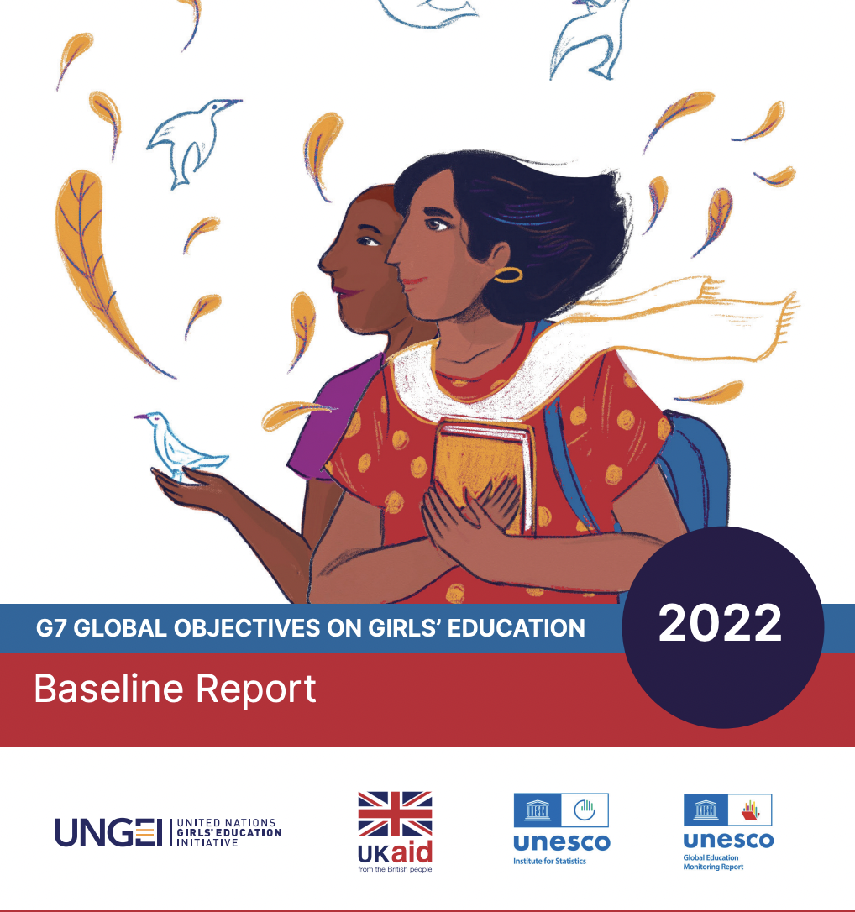
#GetGirlsLearning

Slide 16
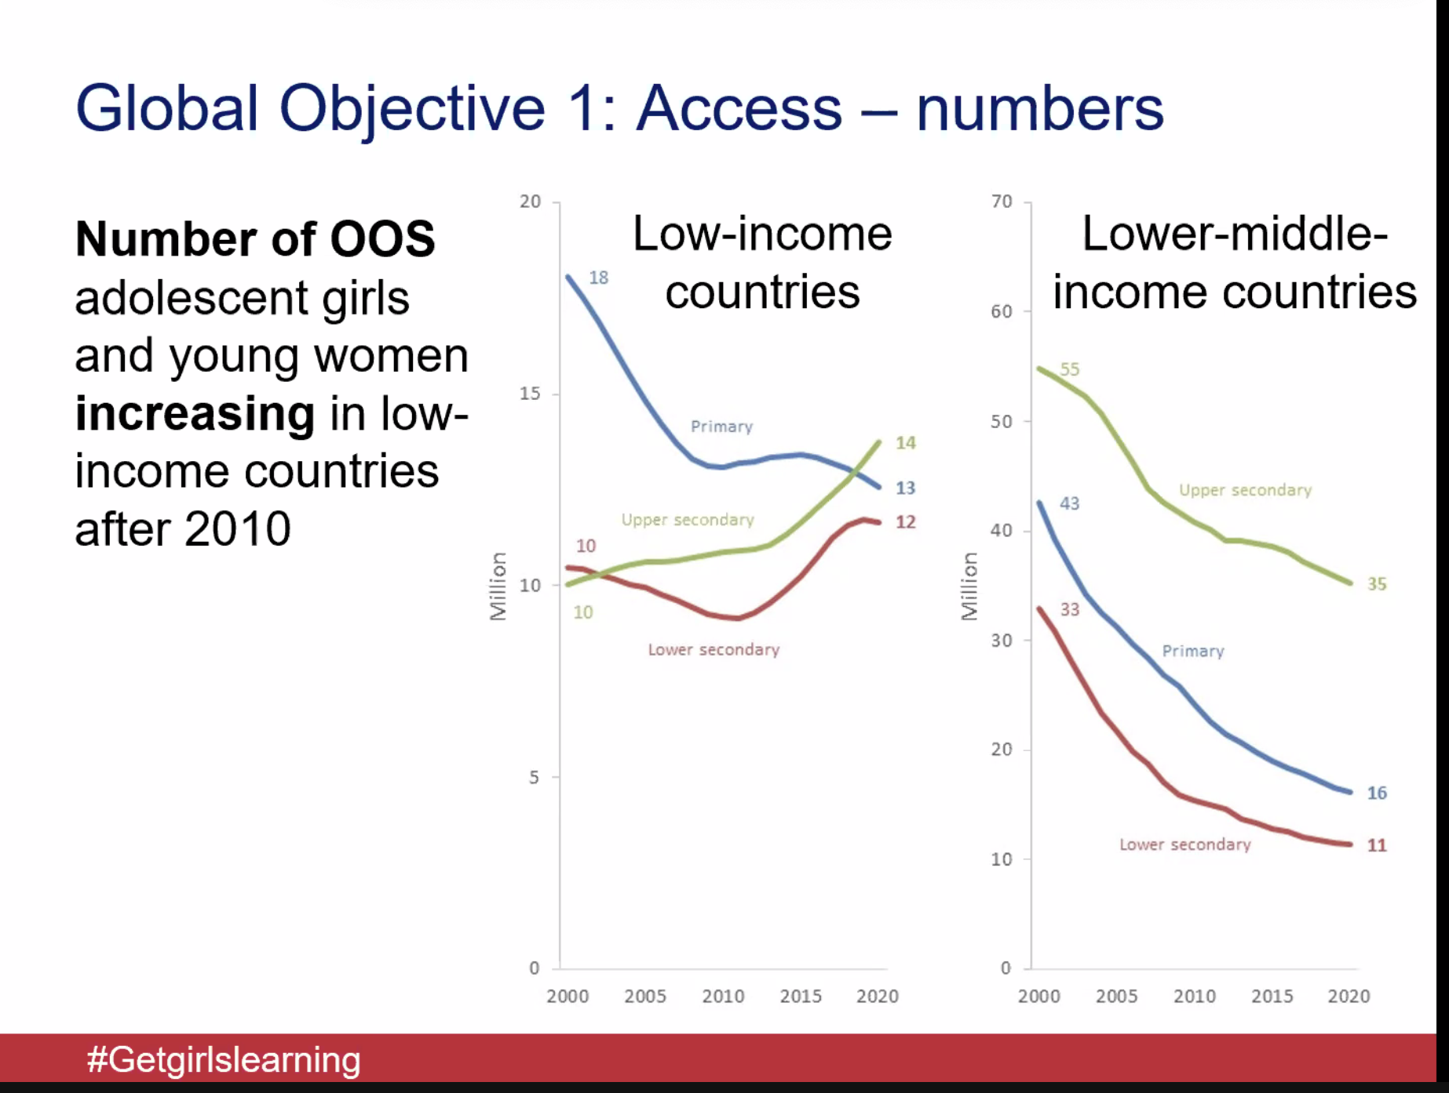
#GetGirlsLearning

Slide 17
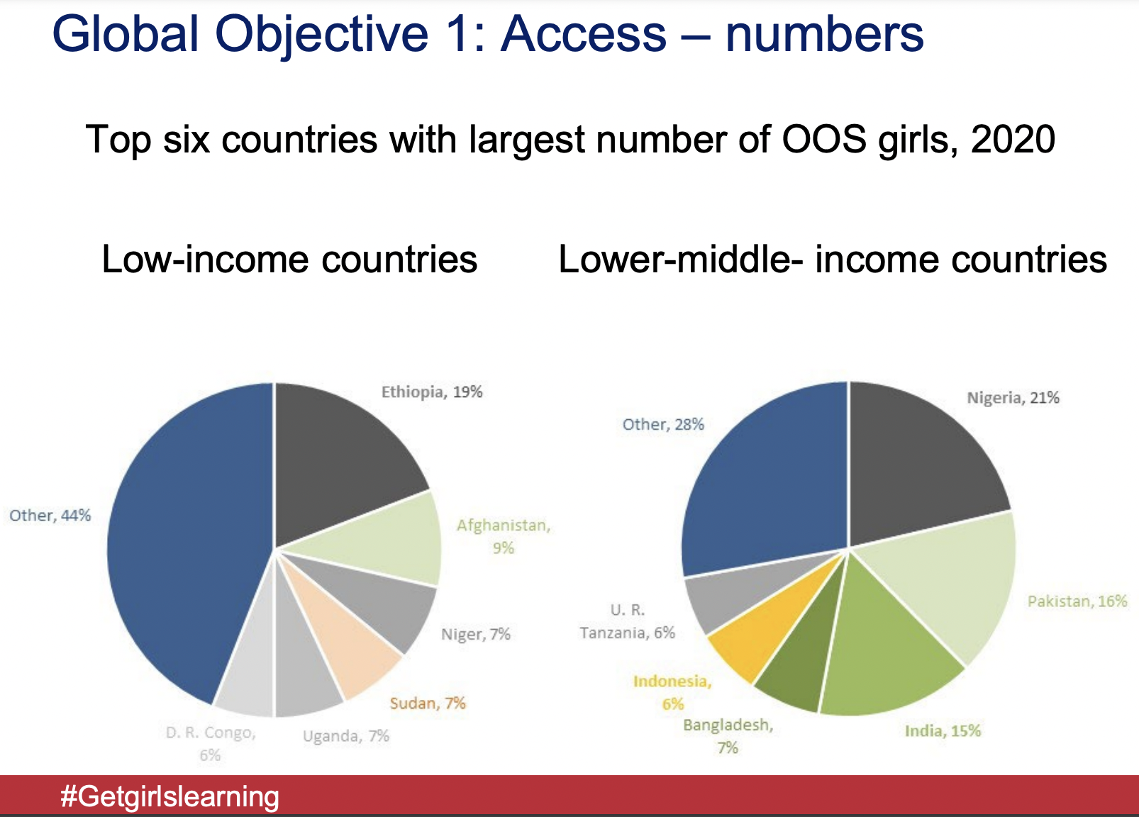
#GetGirlsLearning

Slide 18
Cultural Factors Impact Girls’ Recovery from Covid Learning Loss
Existing social norms in some countries and communities may create inequalities for girls in accessing and using digital devices. For example, fathers in Nigeria reported actively discouraging their daughters but not their sons from using the internet and were less likely to assist their daughters’ learning through technology during COVID-19.
In Kenya, 74 percent of adolescent girls reported household chores distracted them from remote learning.
In Peru, male students were less likely than female students to engage in distance learning.
In Ethiopia and Bangladesh, adolescent boys were more likely than adolescent girls to receive help from their family with their schoolwork.

Slide 19
READ Act Reauthorization Act (H.R.7240/S.3938)
Reauthorizes the 2017 READ Act for an additional 5 years.
Continues and updates the USG comprehensive strategy to promote basic education and support students, especially girls.
Ensures access to basic, quality education for children affected by conflict and other emergencies.
Improves coordination between U.S. agencies, partner countries, and civil society organizations like the Global Partnership for Education (GPE) & Education Cannot Wait (ECW).
Requires rigorous monitoring and evaluations and a yearly report to Congress.

Slide 20
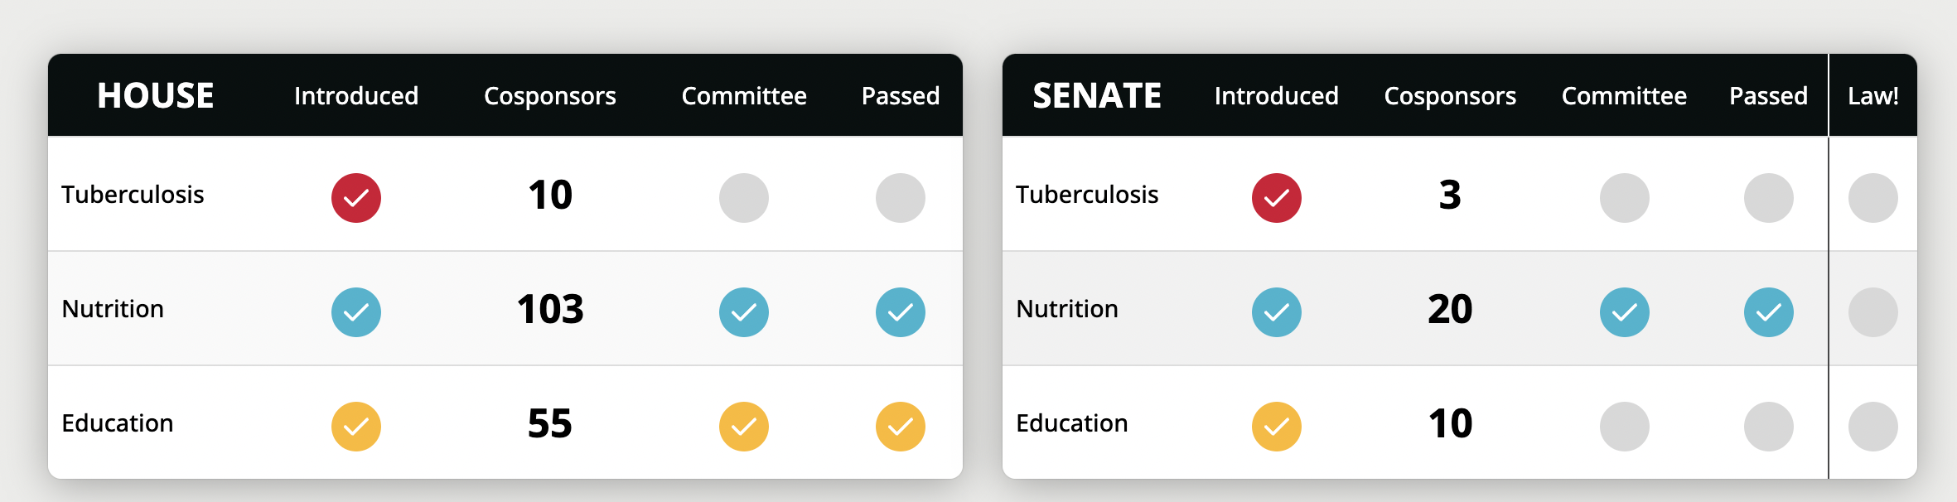
Current Status
Introduced by Sens. Durbin (D-IL) and Rubio (R-FL) in the Senate and Reps. Bass (D-CA) and Smith (R-NJ) in the House
Passed the House Foreign Affairs Committee already!
Recently passed the House!
Goal: Gain cosponsors in the Senate.

Slide 21
Q & A
What issues are the most important to you in the area of global education?
What actions can you take to ensure children’s right to inclusive quality education?

Slide 22
Looking Ahead
Overall goals: Improve the effectiveness, equity, and impact of U.S. programs for global health and education.
PASS THESE BILLS!
  Nutrition: Need full Senate vote
  Education: Gain cosponsors, bring to Senate floor
  Tuberculosis: Gain cosponsors, pass committees

Slide 23
23
Resources on Foundational Learning and Global Education
U.S. Government Strategy on International Basic Education, Fiscal Years 2019-2023
UNICEF, UNESCO and the World Bank. Where are we on Education Recovery?
UNESCO. Visualizing Indicators of Education for the World. Based on the Global Education Monitoring Report. Consulted 7 Sep 2022.
World Bank, UNICEF, FCDO, USAID, the Bill & Melinda Gates Foundation, and UNESCO, The State of Global Learning Poverty: 2022 Update
UNESCO, “Reimagining our futures together: a new social contract for education.”
https://www.ungei.org/publication/g7-global-objectives-girls-education
Notes:
Chat: https://results.org/event/117143/
https://us02web.zoom.us/j/89994576857?pwd=WUwyZ0NuNUFsVnh6TDR1MXF1Zy80dz09#success
https://results.zoom.us/meeting/register/tJ0pc-2spjkiY3WkF4QbtgAWikteQvMT2A

