Slide 1
Monthly Webinar October 10, 2024

Slide 2
Welcome everyone!
Let us know where you are joining us
from in the chat!
Share a greeting in another language if you know one.

Slide 3
Our Values & Resources
3
​At RESULTS we pledge to create space for all voices, including those of us who are currently experiencing poverty. We will address oppressive behavior in our interactions, families, communities, work, and world. Our strength is rooted in our diversity of experiences, not in our assumptions.
With unearned privilege comes the responsibility to act so the burden to educate and change doesn’t fall solely on those experiencing oppression. When we miss the mark on our values, we will acknowledge our mistake, seek forgiveness, learn, and work together as a community to pursue equity.
Read our full anti-oppression values statement here at results.org/values.
Check out the Anti-Oppression Workshop Schedule for training opportunities.
Find these resources and more at results.org/volunteers/anti-oppression:
Resource Guides from our Diversity & Inclusion trainings, including:
Interrupting Microaggressions
Creating Space for Critical Conversations
Information on how RESULTS responds to oppressive incidents

Slide 4
Tonight’s Agenda
Welcome & Introductions
Campaigns Updates: End TB Now Act (S.228/ H.R. 1776)
Training: Breaking through the Noise with Media
October Advocacy Actions
Closing Announcements

Slide 5
Campaigns Updates
Notes:
Karyne

Slide 6
End TB Now Act (S. 288) Passes the Senate!

Slide 7
End TB Now Act (S.288, H.R.1776)
Requires the U.S. to establish bold goals for reaching the most vulnerable populations
Strengthens U.S. bilateral coordination to develop comprehensive global TB response
Catalyzes support for TB research and development (R&D)
Improves TB capacity of high-burden countries & affected communities
Requires annual report to Congress on U.S. TB activities and impact
Evaluates the performance of TB programs that are supported by U.S.

Slide 8
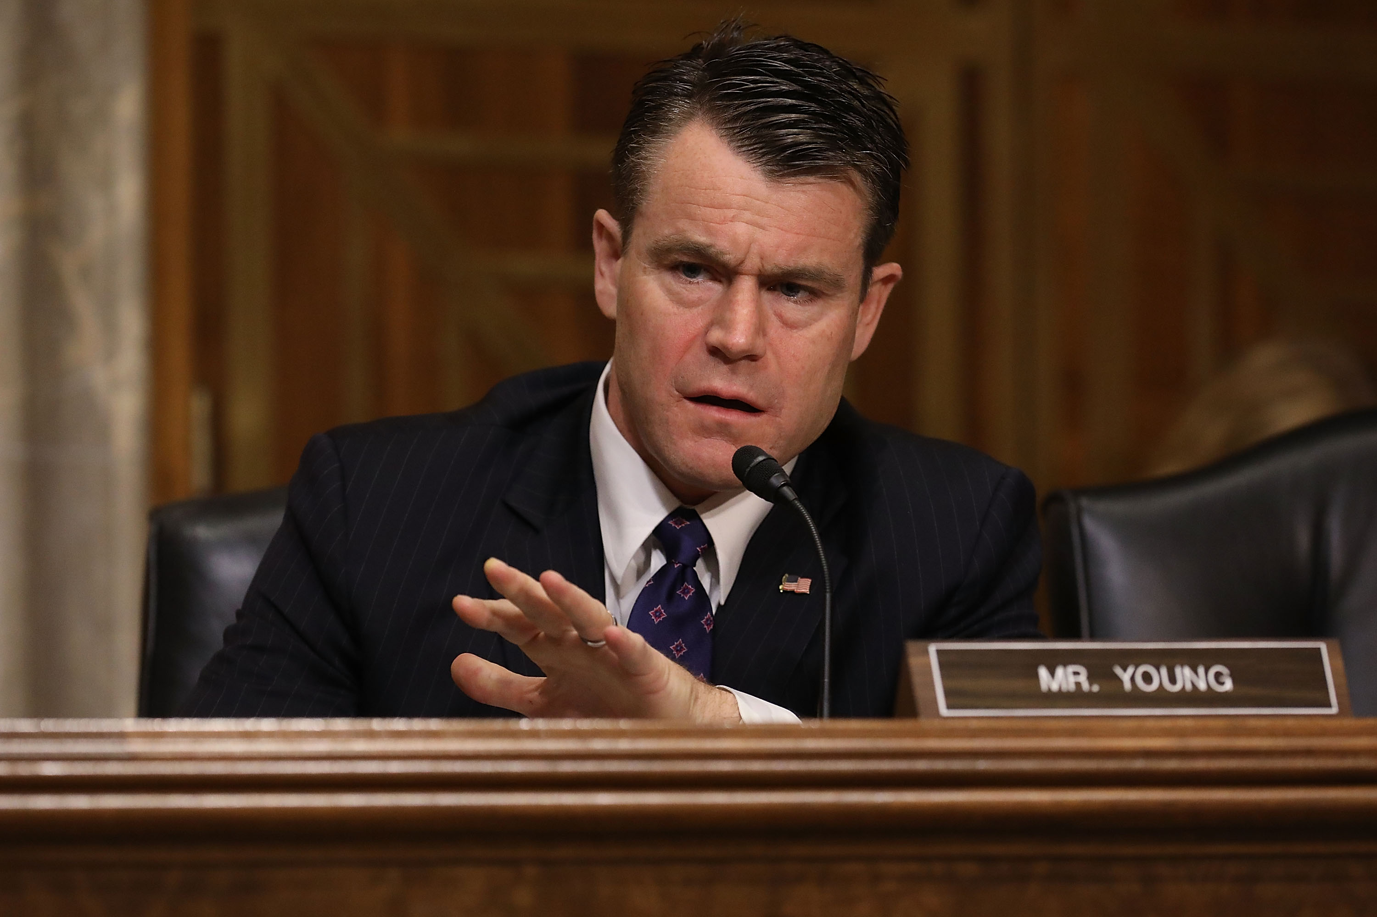
Young Praises Senate Passage of End Tuberculosis Now Act
Notes:
Add image of Todd Young in Senate

Slide 9
A look back at what made it happen…

Slide 10
UN High-Level Meeting on TB
September 22, 2023

Slide 11
Dear Colleague Letters on TB
Prioritizing the following five priorities:
a measurable goal to reach everyone sick with TB with quality testing and treatment;
specific, bold new financial commitments to close the global funding gap;
priority for a human rights and a person-centered approach to the pandemic;
faster development and broad access to new tools, including diagnostics, treatments, and vaccines; and
commitment to ongoing high-level accountability against the declaration’s

Slide 12
Dear Colleague Letters on TB
Senate TB Dear Colleague Letter closed with 34 Senators (just over 1/3 of the Senate)
House TB Dear Colleague Letter closed with 108 members signing on.
Continued follow up actions on these letters

Slide 13
More progress on End TB Now Act (S. 288/ H.R. 1776)
Passed House Foreign Affairs Committee & Senate Foreign Relations Committee!
More co-sponsors = more support to move bill to floor for a vote in both chambers
Current co-sponsors: congressional scorecard
Action: Reach out to your Rep. in the House, ask to bring H.R. 1776 to a floor vote before end of 118th Congress (December!).
Notes:
Karyne

Slide 14
Actions on TB Right Now
Ask your Representative in the House to speak to House about passing it ASAP.
Leverage your work on the House and Senate TB sign-on letters
Thank those who signed, cosponsored, signed FY25 appropriations for TB, or Global Fund
118th Congress Scorecard

Slide 15
Breaking through the noise with Media
Notes:
Ken

Slide 16
TB still in the Media?
8/28/23: NY Times: "We Thought We'd Beat These Three Diseases, But They Are Still Killing Us."
“ …the very winnable fights against three diseases with a long history of maiming, crippling and killing humans: tuberculosis, malaria and polio. The dark star of the three is tuberculosis.”
"The realities of modern travel mean that none of us is protected from a TB resurgence until we have protected people everywhere."
8/10/23: Food Supplements Are Transforming TB Survival in India
Among family members living with a person with active lung TB, improving nutrition resulted in a 40 to 50% reduction in new TB cases. (Forbes)

Slide 19
Why do we use media?
Making connections between the issues we advocate on and current events
Bringing awareness of these issues to our community (more constituents & voters)
Puts pressure on MOCs to act (they monitor what is being said about them in the media)
Notes:
Karyne

Slide 20
How to get started
Find a local hook
Articles in the paper? Make the connection to other global issues that intersect with education, nutrition, and health
Important statistic relevant to your district or state?
Respond to other published media
Thank you to your Rep. or Senator
Looking for relevant hooks? Check out this resource.
Notes:
Karyne – here are some ideas of hooks, any one?

Slide 21
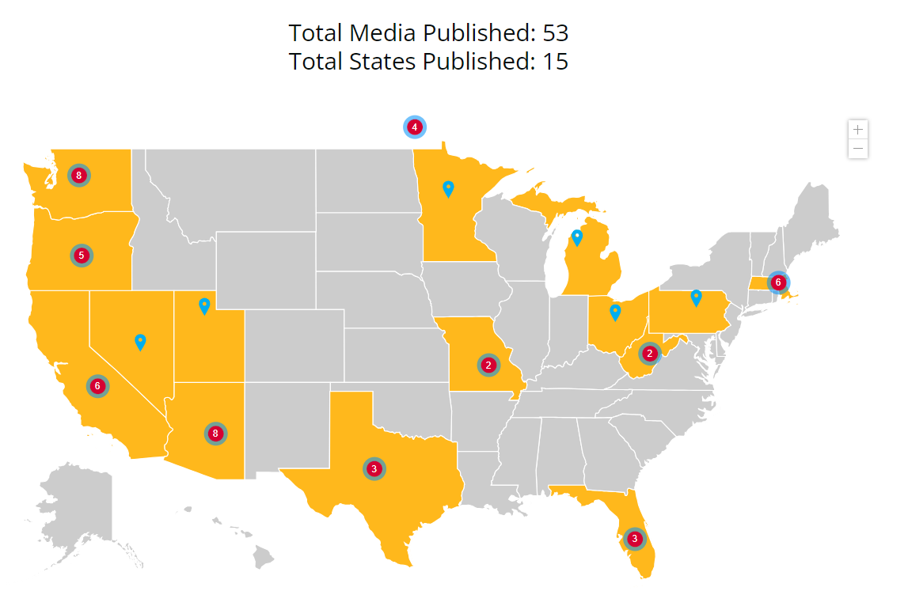
What has been published?
2024 RESULTS Global Media Packet
Published as of 10/10/2024
Notes:
Karyne – here are some ideas of hooks, any more?

Slide 22
How to get started
Use sample LTE template to get you started, personalize it. Why is this issue important to you? Why should it be important to our members of Congress & Candidates?
Tuberculosis: The House must pass the End TB Now Act
Education: Media: Every child deserves an education
Gavi, the Vaccine Alliance: Media: Congress should support Gavi's life-saving work
Nutrition & Nutrition for Growth: Media: The US must make a strong, early pledge to Nutrition for Growth
Notes:
Karyne – here are some ideas of hooks, any more?

Slide 23
Tips on writing LTEs
Remember your C’s
Be current – respond to recent article or current event
Construct your LTE in EPIC format
Keep it concise: Rule of thumb is 150 - 200 words or less (follow the paper’s guidelines on word count)
Connect the dots: How is this relevant to your community/district/state?
Notes:
Karyne – here are some ideas of hooks, any one?

Slide 24
Tips on writing LTEs
Remember your C’s
Be challenging - ask a question (but don’t make a personal attack), name your member of Congress
Have a call to action whether for Congress or from the reader
Be creative!
Be contagious: Submit to as many newspapers as possible
When you’re ready to submit
Don’t forget your contact information!
Notes:
Karyne – here are some ideas of hooks, any more?

Slide 25
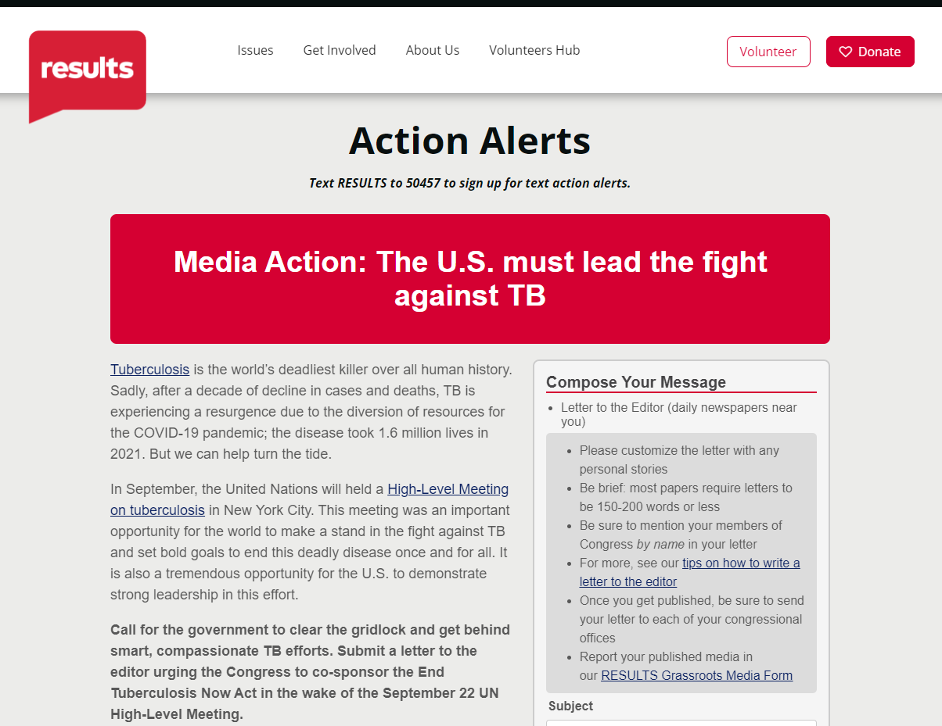
Submitting an LTE
https://results.org/volunteers/action-center/action-alerts?vvsrc=%2fcampaigns%2f63557%2frespond
Notes:
Karyne
Action Alert (direct link) - https://results.org/volunteers/action-center/action-alerts?vvsrc=%2fcampaigns%2f63557%2frespond

Slide 26
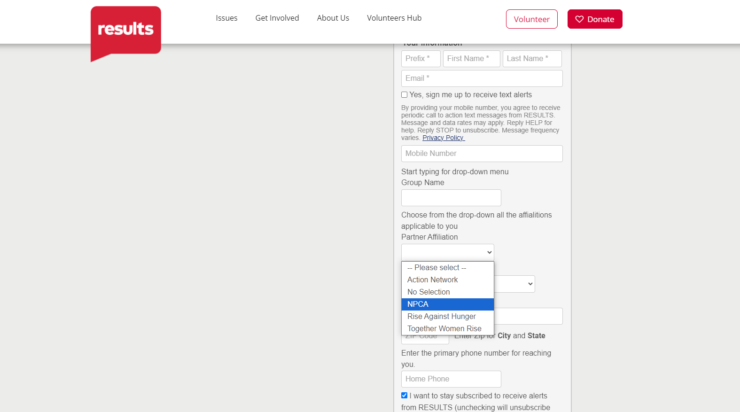

Slide 27
Q&A

Slide 28
Let’s keep writing and submitting!

Slide 29
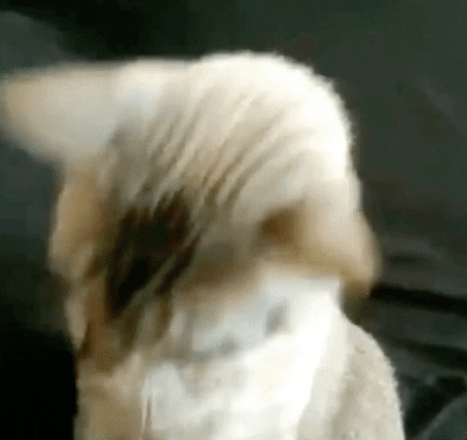
Let’s take action!
Notes:
Karyne

Slide 30
Next Steps: Choose your own adventure…
Send a follow up email or make a phone call to your House Rep. on the End TB Now Act
Write and submit a letter to the editor (LTE)
Inform other RPCVs in your network about the impact of TB in your country of service and how they can make a difference through advocacy
Notes:
Karyne

Slide 31
How to get started
Use sample LTE template to get you started, personalize it. Why is this issue important to you? Why should it be important to our members of Congress & Candidates?
Tuberculosis: The House must pass the End TB Now Act
Education: Media: Every child deserves an education
Gavi, the Vaccine Alliance: Media: Congress should support Gavi's life-saving work
Nutrition & Nutrition for Growth: Media: The US must make a strong, early pledge to Nutrition for Growth
Notes:
Karyne – here are some ideas of hooks, any more?

Slide 32
Gavi Resolutions – H.Res. 1286/ S. Res. 684
Senate Lead Sponsors: Sens. Wicker (R-MI) and Cardin (D-MD) House Lead Sponsors: Representatives Kean (R-NJ), Amo (D-RI), Salazar (R-FL), and Jacobs (D-CA).
Calls for United States to have supporting role in saving children’s lives of children and protecting people’s health through Gavi, the Vaccine Alliance.
Gavi has been a major contributor in reducing the number of childhood deaths in lower-income countries due to vaccine-preventable disease by 70 percent since 2000.
Country ownership and sustainability are at the core of the Gavi model.
Notes:
Gavi will launch their investment case to fund their next strategic period from 2026-2030.
https://www.gavi.org/our-alliance/strategy/phase-6-2026-2030

Slide 33
Continue Taking Action on Gavi!
Check this scorecard see if your Representative or Senator has signed on to the Gavi Resolution (H. Res. 1286/ S. Res. 684).
Use Legislator Lookup (if you are unsure of who to reach out to, please don’t hesitate to reach out to us for support).
Email convention: Senate - FirstName_LastName@SenatorsLastName.Senate.Gov (example: alex_moree@rubio.senate.gov) House – FirstName.LastName@mail.house.gov (example: Max.Price@mail.house.gov)
Personalize this sample email requesting your members of Congress co-sponsor H. Res. 1286 or S. Res. 684.
Follow up! If you’ve taken one action today, take the other action tomorrow.
Notes:
Karyne

Slide 34
Join us for a post-election webinar
Thursday, November 14 at 8:30 PM ET

Slide 35
Thank you for taking action with us tonight!

Slide 36
Making the Local Case for TB
TB cases in your state: check your state department of health and the CDC for data:
--https://www.cdc.gov/tb/default.htm
--https://www.cdc.gov/tb/statistics/default.htm
Does your states university system have involvement in global health? Research? Vaccines? It's worth sharing your state's connection to global health.
Notes:
Ken

