Slide 1
October 2019 Global Grassroots Webinar
What Happened at the Global Fund Replenishment?
Join at https://results.zoom.us/j/510407386. Or by phone at (669) 900-6833 or (929) 436-2866, meeting ID 510-407-386
Closed captioning: http://west.typewell.com/faelapgb

Slide 2
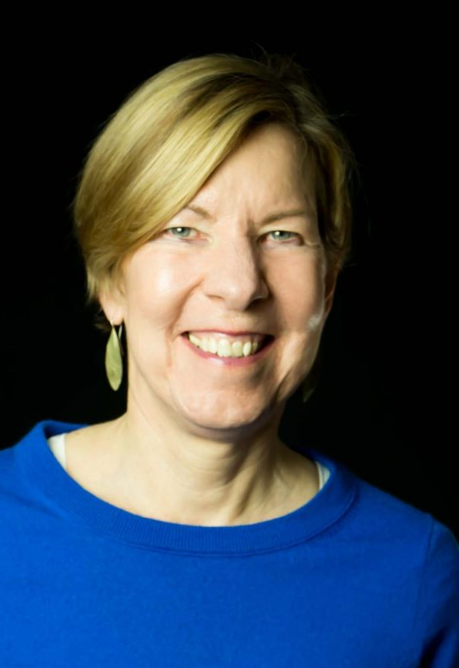
Executive Director
Joanne Carter

Slide 3
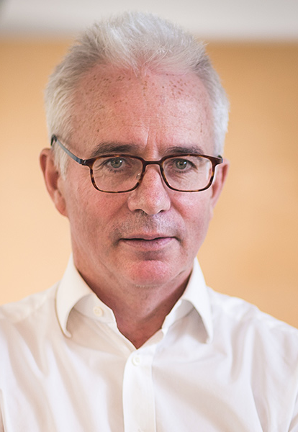
Today’s Guest
Peter Sands
Executive Director of the Global Fund to Fight AIDS, TB, and Malaria

Slide 4
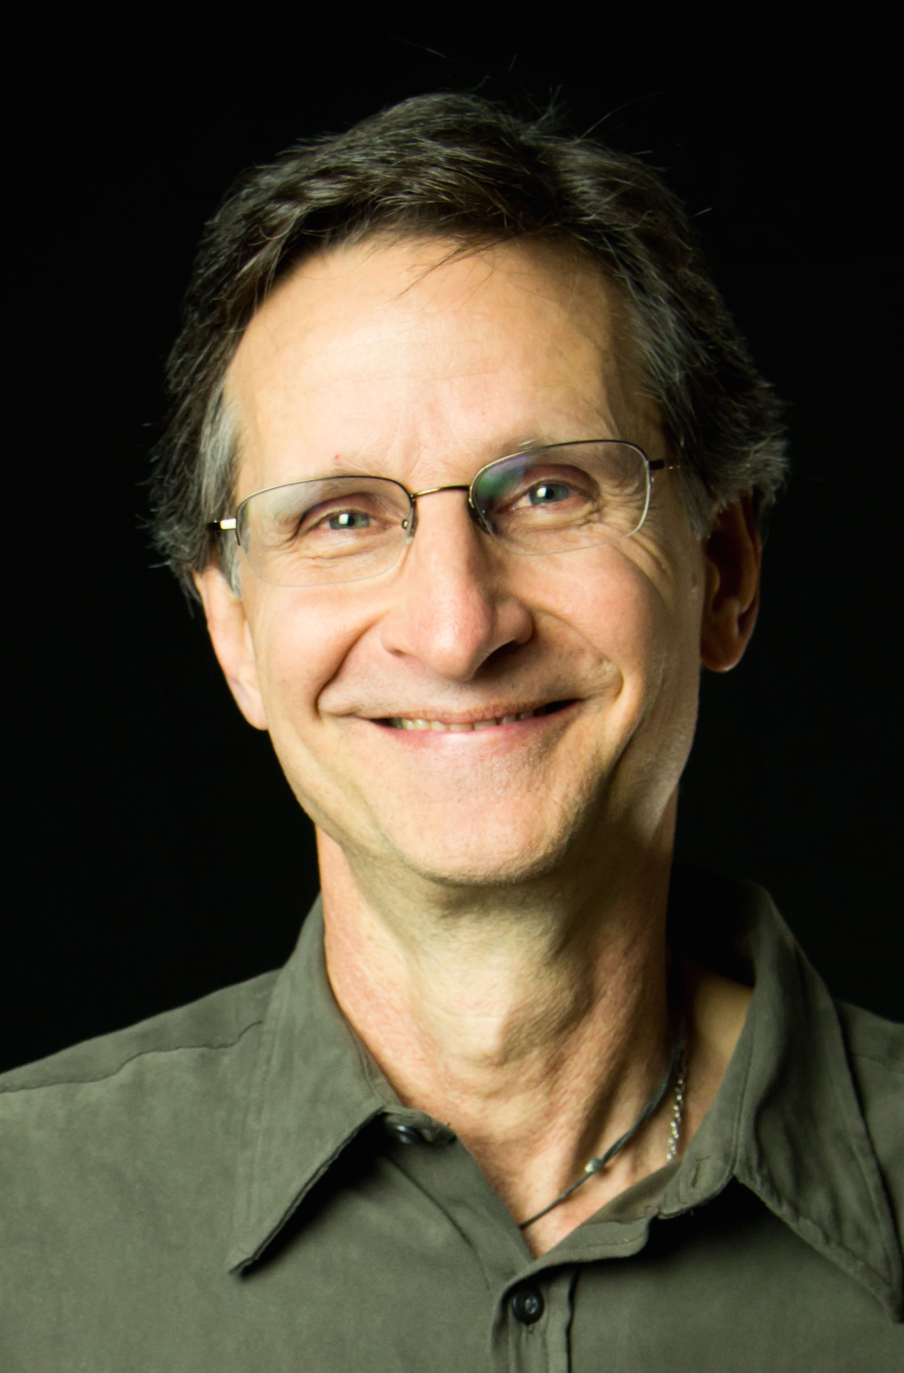
Grassroots Café
Celebrating You!
Ken Patterson
Director, Grassroots Impact

Slide 5
Global Fund Celebration and Debrief

Slide 6
Celebrating You
Notes:
It was no accident that Congress was put into a position of leadership on the Global Fund replenishment. Everything you’ve been doing for that past 18 months has been to address a major dilemma—what do we do when the Administration undermines the Global Fund?

Slide 7
Grassroots Stories from our Global Fund Work

Slide 8
S.Res.318 Cosponsors by State

Slide 9
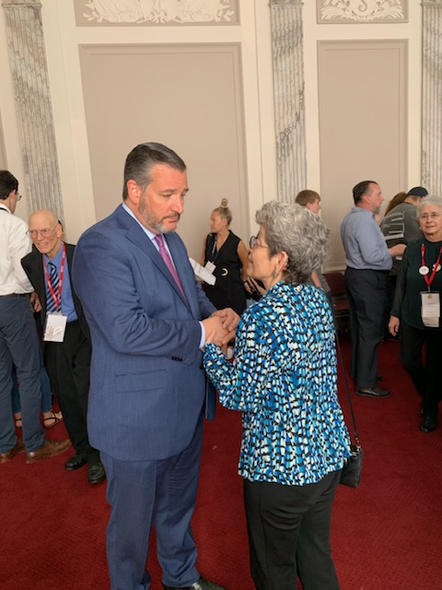
How Things Get Done
Great IC Moment with Margaret Smith
Great Follow Up by Yvette Medina and Grace Liu
Notes:
Well, we were at his coffee on Lobby Day. I had set up the meetings with the Senator’s staffs and we were the second largest group waiting for him when he arrived. I was trying to make sure our group was ready to go when the first group was finished, so I was hovering around them. As soon as they left I went up to him and as he shook my hand I grabbed him with both hands and made him listen to both a laser talk on the Global Fund and on nutrition. A number of folks later texted me pictures. Maybe it helped.
Yvette Medina, joined our group in 2018 after you introduced us to her (she moved to Dallas from NC), has been the point person for all of TX for Senator Cruz and has done a great job with his office both in Dallas and in DC. Yvette has been the one contacting his office about the GF Resolution along with Grace Liu.
As you will recall you also introduced us to Grace who moved from Memphis this year. Grace joined us in June and also attended the IC. All 8 of us from Dallas at the IC had one MoC or Senator to follow up with after the IC. Grace helped Yvette since July with Cruz office. In many cases I think having two folks asking was key to getting some on.
So who know why he did it but we were elated! Dallas was able to get 6 on the GF resolutions (3 R’s & 3 D’s)!

Slide 10
Celebrating You
Notes:
It was no accident that Congress was put into a position of leadership on the Global Fund replenishment. Everything you’ve been doing for that past 18 months has been to address a major dilemma—what do we do when the Administration undermines the Global Fund?

Slide 11
Open Phones
On the webinar? Unmute by clicking the microphone.
On by phone? Unmute by hitting *6.
If you are not speaking, please stay muted.

Slide 12
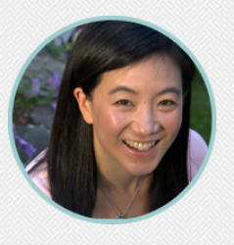
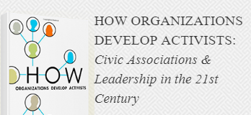
Organizing vs. Mobilizing
Organizing | Mobilizing
Transformational | Transactional
Organizing Organizers | Organizing Events
Personalized Communications (1:1s) | Mass Communications
Relationship Based | Not Relationship Based
Dr. Hahrie Han

Slide 13
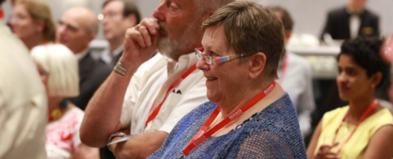
ORGANIZING
FOR
IMPACT
Relationship
Autonomy
Purpose
Create a plan for the final trimester!

Slide 14
What’s Next
Use these actions as part of your plan to bring 1-4 new people into your group by the end of the year.
Close the loop with anyone who took action on the Global Fund, people you spoke to, or RESULTS donors.
Acknowledge members of Congress who took action through letters and LTEs.
Celebrate this bipartisan success in the media.
Continue to call Reps. and Senators into action on the Global Fund and nutrition resolutions.
Organize a peer-to-peer fundraising campaign in November.
Invite people to take part in RESULTS’ free advocacy training starting on October 17.

Slide 15
Resources
Group planning form for 3rd trimester
New Global Fund blog
October Action Sheet
Global Fund & Nutrition online actions
RESULTS Advocacy Training: Oct – Nov.
November Virtual Thanksgiving Feast
Find All of These in the Weekly Update

Slide 16
Mark Your Calendars! See the Weekly Update for details.
October 16, 8:30 pm ET. New Advocate Orientation.
October 17. Launch of 6-week Advocacy Training.
October 21, 1 pm ET and 8 pm ET. RESULTS Global Free Agents Webinars (choose one).
November 6, 8:30 pm ET. Action Network Community of Practice.
November: Virtual Thanksgiving Feast Fundraising
June 20-23, 2020. RESULTS 40th Anniversary International Conference.

Slide 17
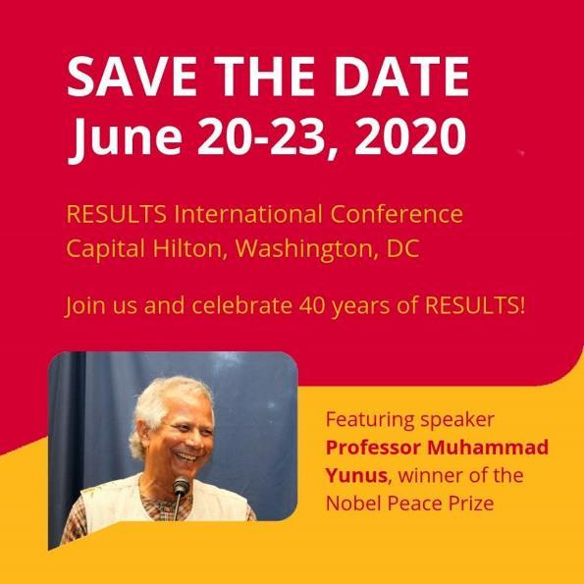
17
See survey in the Weekly Update requesting input on speakers and sessions you’d like to see.
RESULTS Global Poverty National Webinar

Slide 18
Your Reporting Matters
Check out the reporting links at the bottom of every Weekly Update and stay current!

Slide 19
Let us know how many joined you today
directly in the chat box or send to
Lisa Marchal
lmarchal@results.org

Slide 20
Our advocates change the world
each and every day.
Thank you!

Slide 21
Celebrating You
Generated majority of the 132 cosponsors on House Resolution 517 (107, Democrats, 25 Republicans)
Published 223 media in 36 states (so far)
Mobilized majority of 137 House signers on Global Fund letter to Sec. of State Pompeo earlier this year.
Generated majority of House (147) & Senate (36) signers on FY 2020 Global Fund appropriations letters
Held over 550 meetings on the Global Fund with members of Congress (175) and their staff this year.
Notes:
It was no accident that Congress was put into a position of leadership on the Global Fund replenishment. Everything you’ve been doing for that past 18 months has been to address a major dilemma—what do we do when the Administration undermines the Global Fund?

