Slide 1
October Webinar October 11, 2023

Slide 2
Our Values & Resources
2
​At RESULTS we pledge to create space for all voices, including those of us who are currently experiencing poverty. We will address oppressive behavior in our interactions, families, communities, work, and world. Our strength is rooted in our diversity of experiences, not in our assumptions.
With unearned privilege comes the responsibility to act so the burden to educate and change doesn’t fall solely on those experiencing oppression. When we miss the mark on our values, we will acknowledge our mistake, seek forgiveness, learn, and work together as a community to pursue equity.
Read our full anti-oppression values statement here at results.org/values.
Check out the Anti-Oppression Workshop Schedule for training opportunities.
Find these resources and more at results.org/volunteers/anti-oppression:
Resource Guides from our Diversity & Inclusion trainings, including:
Interrupting Microaggressions
Creating Space for Critical Conversations
Information on how RESULTS responds to oppressive incidents

Slide 3
Overview of Tonight’s Webinar
UN General Assembly meetings
What is going on in the House?! Congressional Updates
Equity & Impact Campaign
Advocacy Action: Media push to End TB Now
Closing
Notes:
Karyne

Slide 4
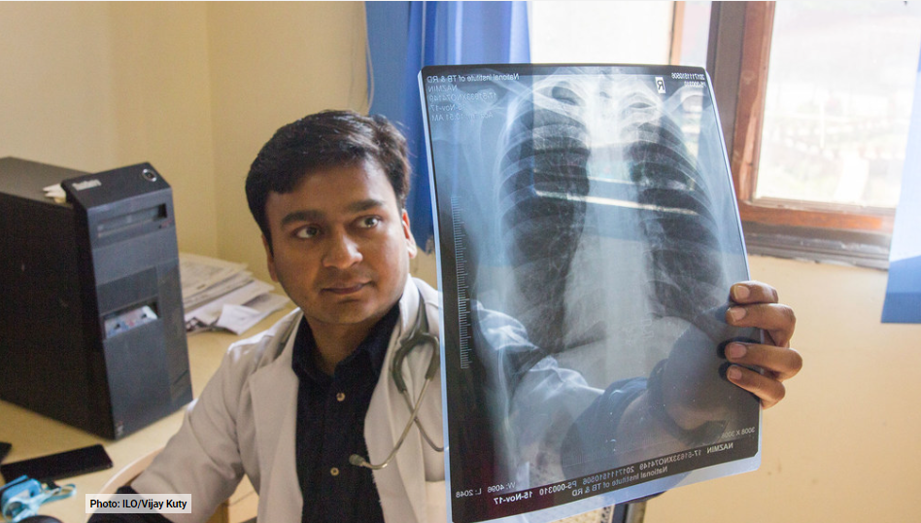
UN General Assembly High Level Meetings
Financing for development
Climate change action
#3 – Good health and well-being
Notes:
Karyne – share highlights from UN GA and TB HLM (notes from 10/5 webinar)

Slide 5
Behind the Scenes at UNGA
Notes:
Karyne

Slide 6
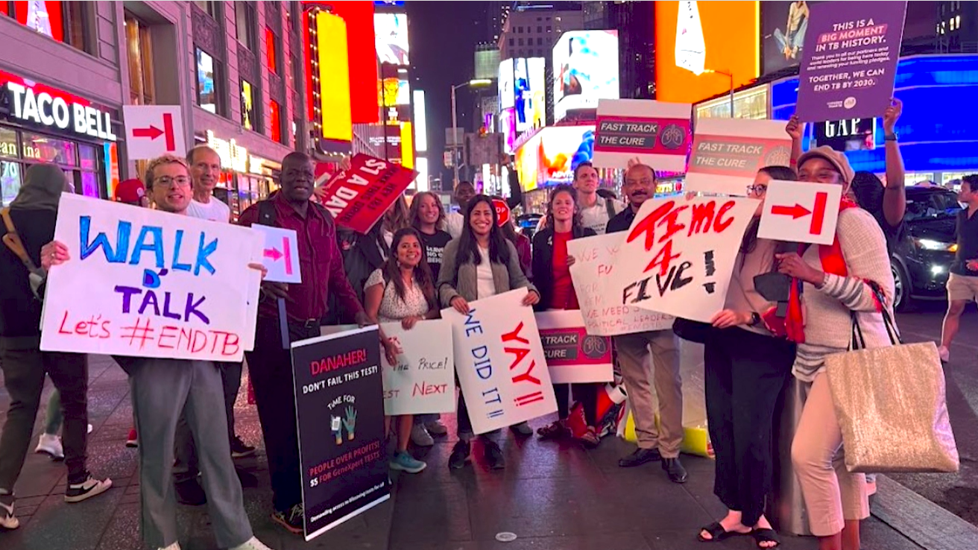
Behind the Scenes at UNGA
Notes:
Karyne

Slide 7
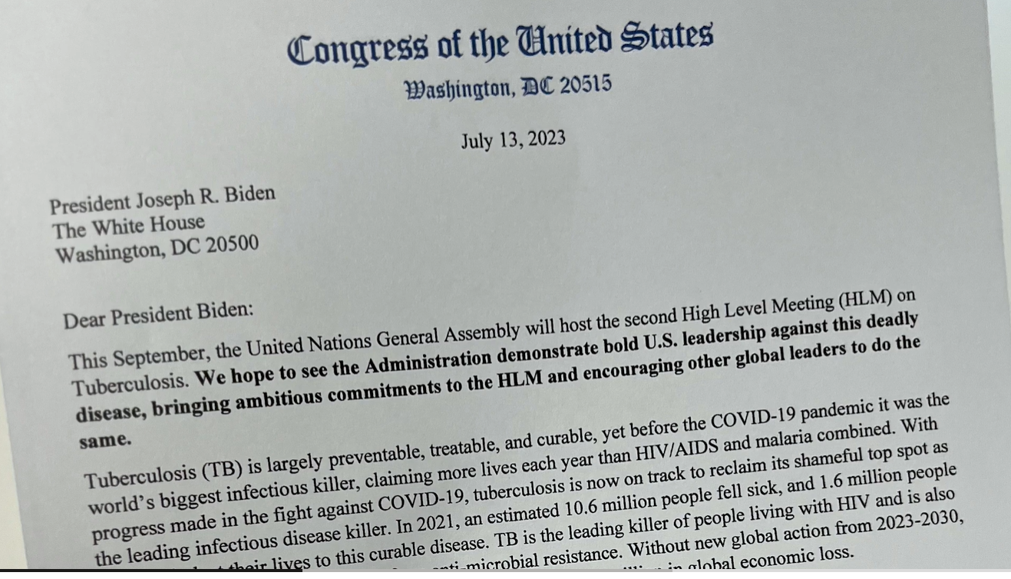
Behind the Scenes at UNGA
Notes:
Karyne – the letters you helped get signed left a tremendous impact

Slide 8
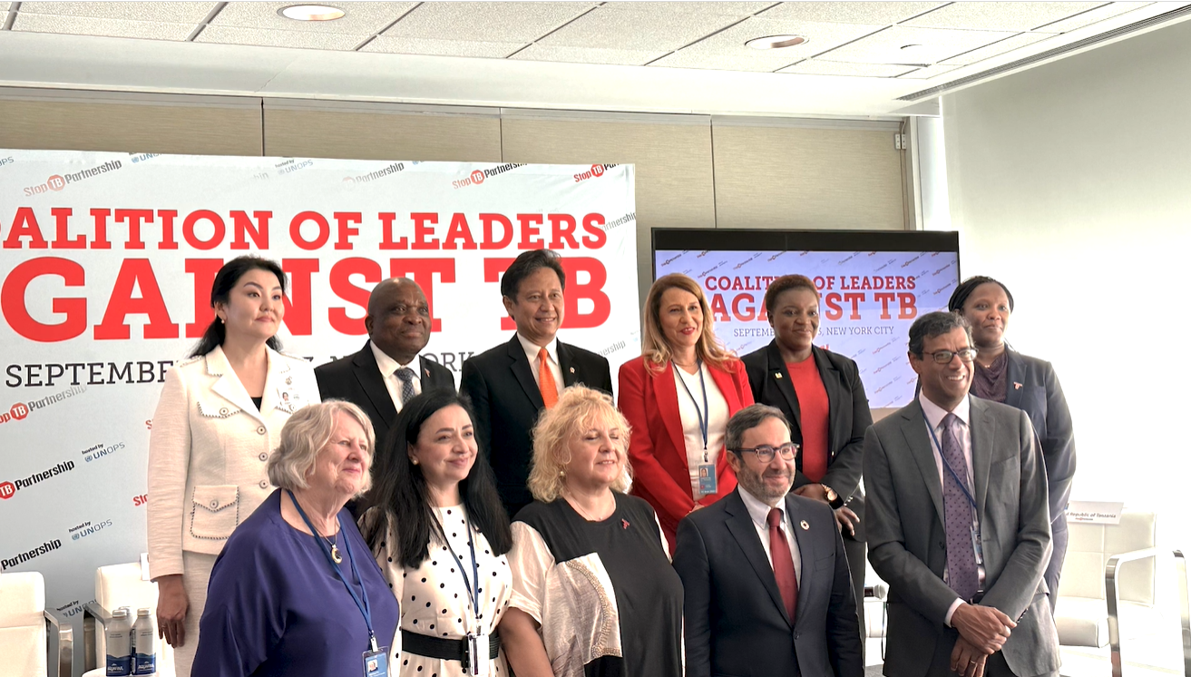
Behind the Scenes at UNGA
Notes:
Karyne – coalition against TB

Slide 9
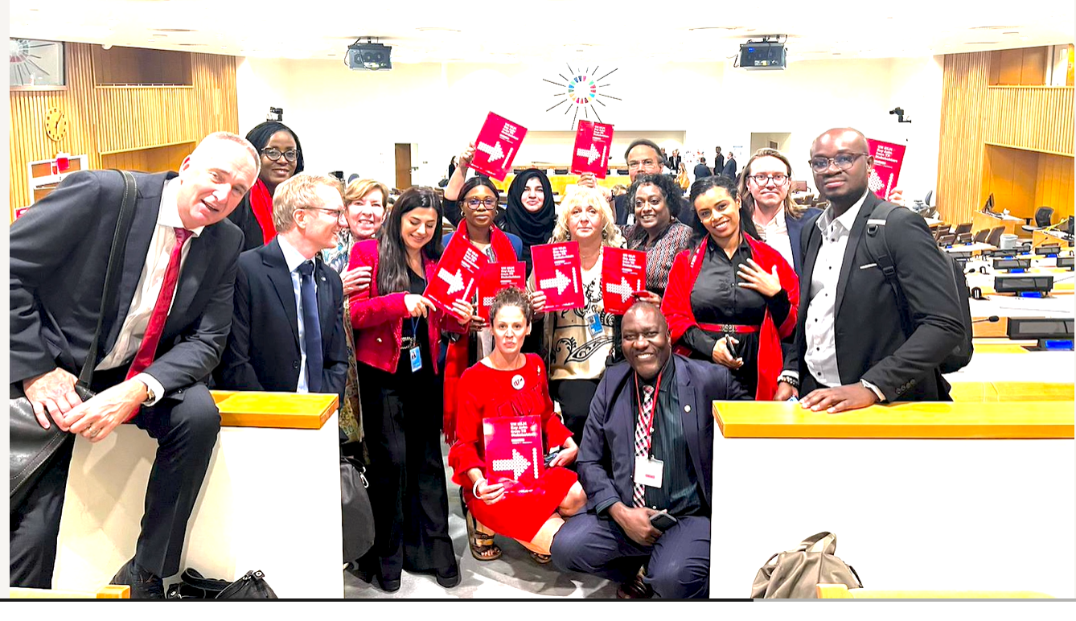
Day of UN High Level Meeting on TB
Notes:
Karyne –

Slide 10
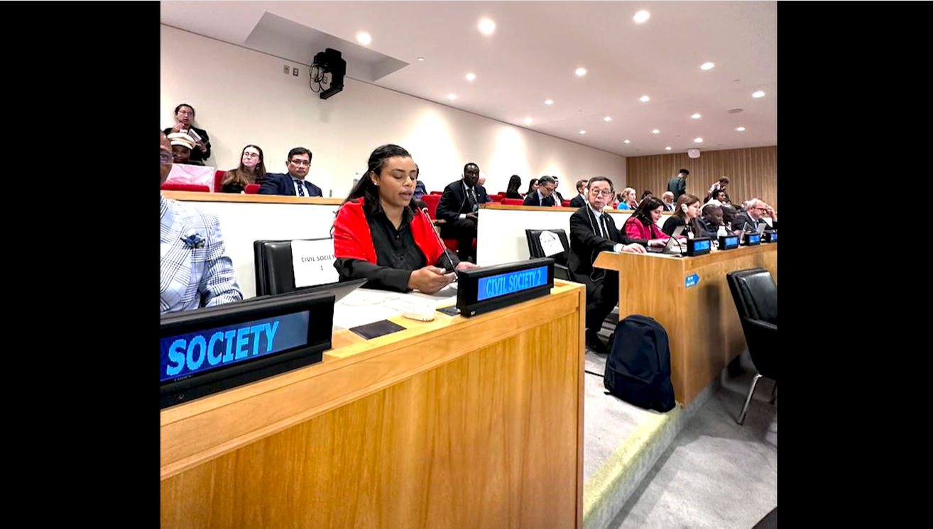
Day of UN High Level Meeting on TB
Notes:
Karyne –

Slide 11
What’s next in the fight against TB?
How can we help support sustaining ambition to end TB
How do we scale up access to treatment and the best technology for everyone
How do we further reduce the prices of drugs
Passing End TB Now Act into law
3 countries hosting G20 heavily affected by TB - making U.S. backs country leadership
Indonesia
India
Brazil
Notes:
Karyne

Slide 12
Global policy
Our Fall Goal
Congress prioritizes equity and impact in the fight against global poverty
Notes:
Do we want to preview this at the end of the call??

Slide 13
Equity & Impact
Who does it reach? Who gets left out?
Are we working in partnership?
How is funding delivered?
Are interventions based on evidence?

Slide 14
Part 1
How the U.S. government spends money and designs programs
Part 2
How the World Bank spends money and designs programs

Slide 15
Global Advocacy Campaigns
Malnutrition Prevention & Treatment Act
The End Tuberculosis Now Act
The READ Act

Slide 16
What's going on in this House?!? Congressional Updates
Notes:
Ken

Slide 17
Asks on TB Right Now
Ask Reps and Senators to cosponsor the End TB Now Act and speak to House/Senate leadership about passing it ASAP.
Tip: Leverage your work on the House and Senate TB sign-on letters:
Share final letter and thank those who signed. Ask them to cosponsor End TB Now Act and speak to leadership.
Share final letter with those who didn't sign as well and let them know they can still make a difference on TB by cosponsoring the End TB Now Act.

Slide 18
Asks on READ Act Right Now
READ in the House: Ask Reps. to cosponsor the READ Act and speak to Foreign Affairs leadership (McCaul, Meeks) about moving the bill out of committee ASAP.
READ in the Senate: Ask Senators to cosponsor READ Act and speak to Senate leadership about passing it ASAP.

Slide 19
Advocacy Action: Media Push to End TB Now
Notes:
Karyne

Slide 20
Why we use media?
Making connections between the issues we advocate on and current events
Bringing awareness of these issues to our community (more constituents)
Puts pressure on MOCs to act (they monitor what is being said about them in the media)
Notes:
Karyne

Slide 21
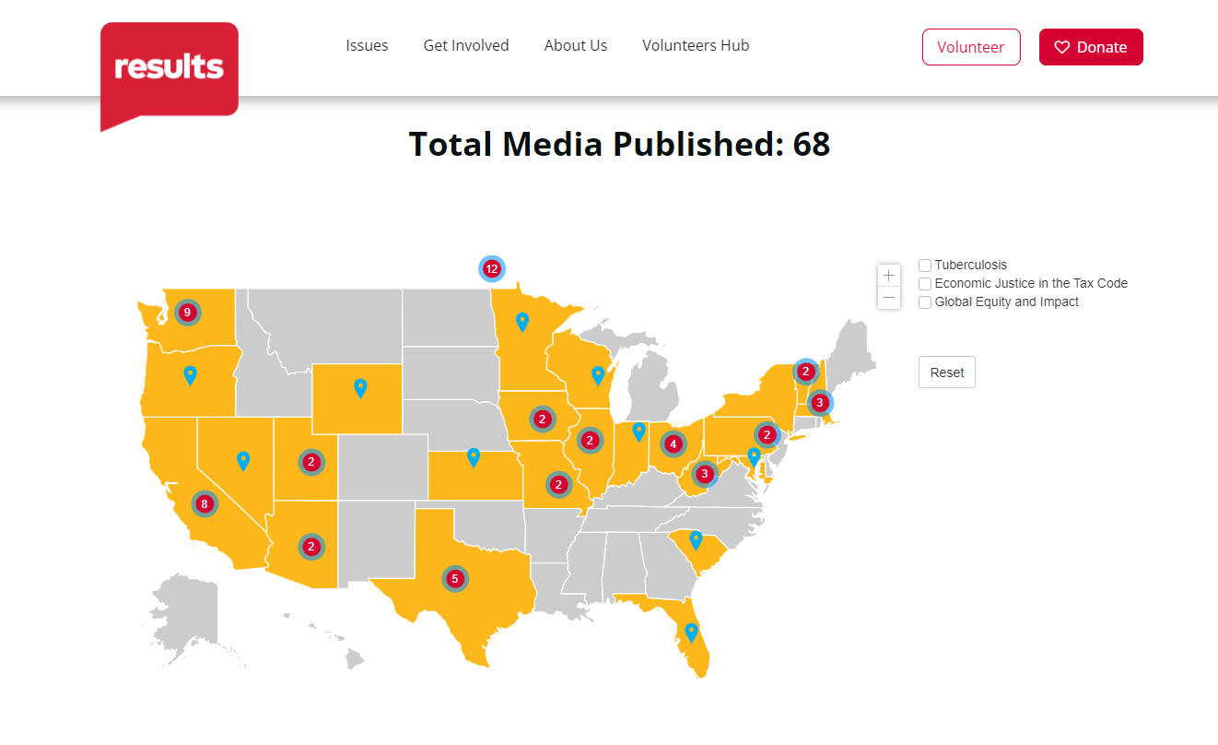
Recently Published LTEs
Notes:
Karyne

Slide 22
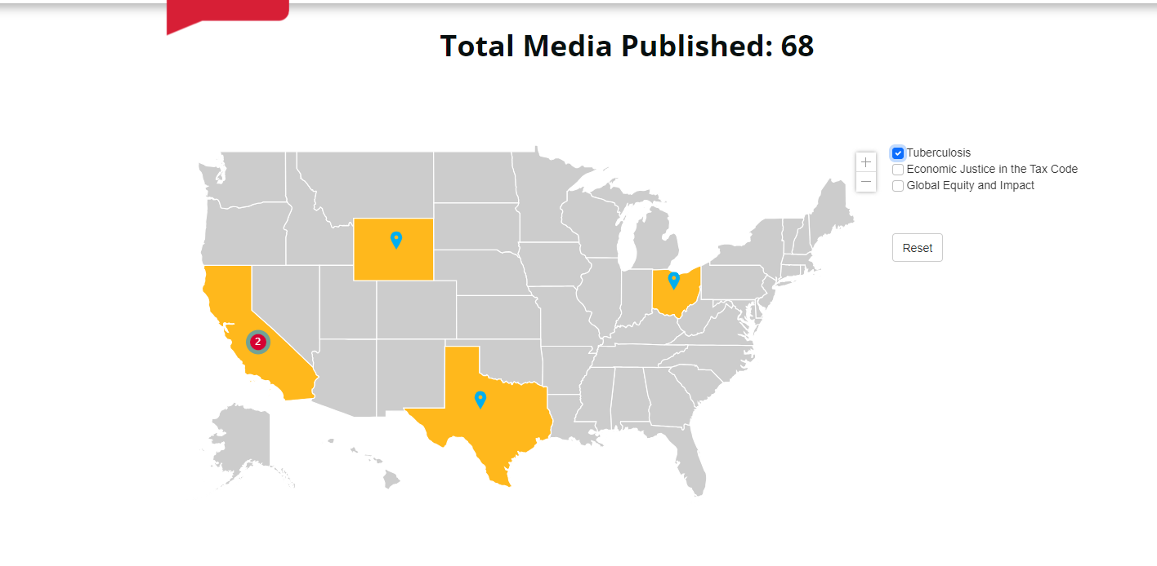
Recently Published LTEs
Only 5 published letters to the editor about TB!
Notes:
Karyne

Slide 23
Recently Published LTEs on TB
Encourage Congress to lead on TB fight
Notes:
Recently Published Media – Link to all media: https://results.org/wp-content/uploads/RESULTS-Global-Poverty-Media-Packet-current-2023.pdf
Bukekile Dube, McKinney TX - https://www.dallasnews.com/opinion/letters-to-the-editor/2023/10/07/letters-to-the-editor-school-vouchers-national-service-immigrants-rangers-chiefs/

Slide 24
How do you get started?
Find a local hook
Articles in the paper?
Respond to other published media (making connection to other health issues)
Thank you to your Rep
Notes:
Karyne – here are some ideas of hooks, any more?

Slide 25
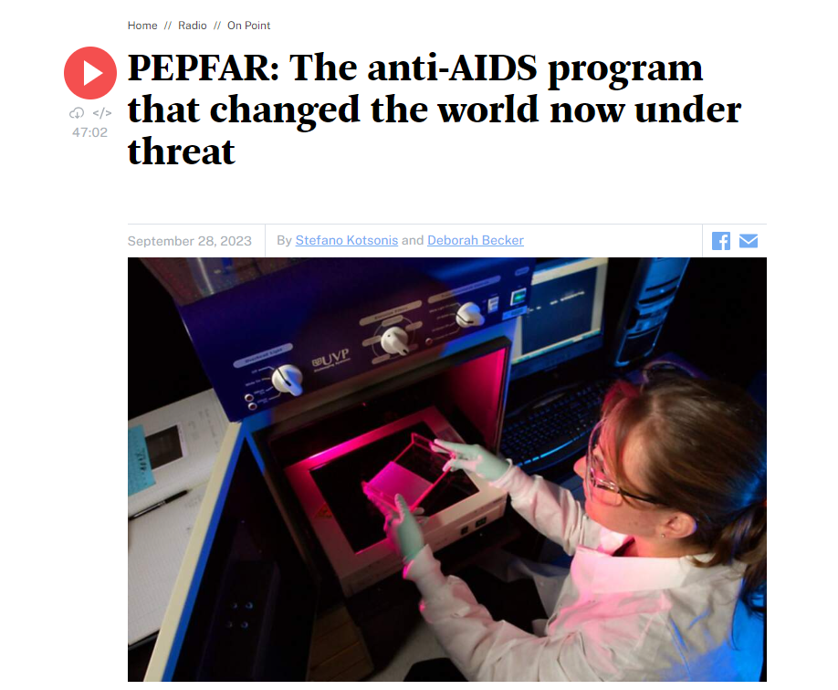
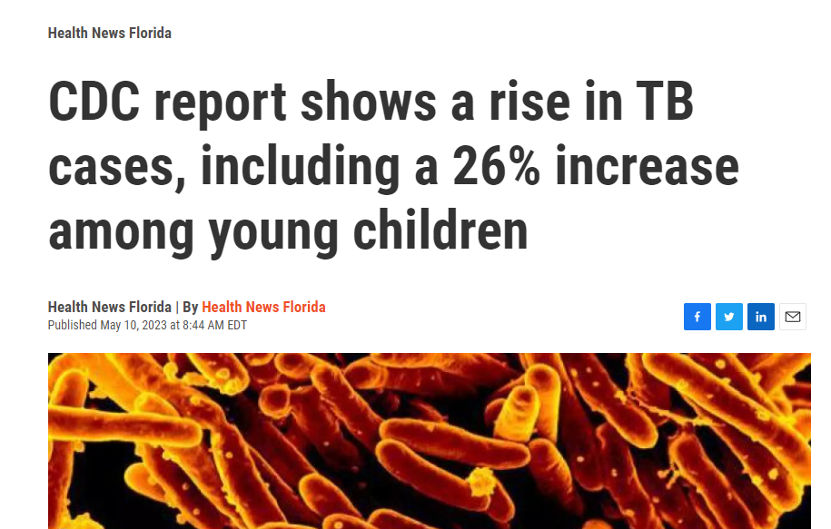
How do you get started?
Notes:
Karyne – here are some ideas of hooks, any more?

Slide 26
How do you get started?
Find a local hook
Articles in the paper?
Respond to other published media (making connection to other health issues)
Thank you to your Rep
Use sample LTE template to get you started, make it personal
Notes:
Karyne – here are some ideas of hooks, any more?

Slide 27
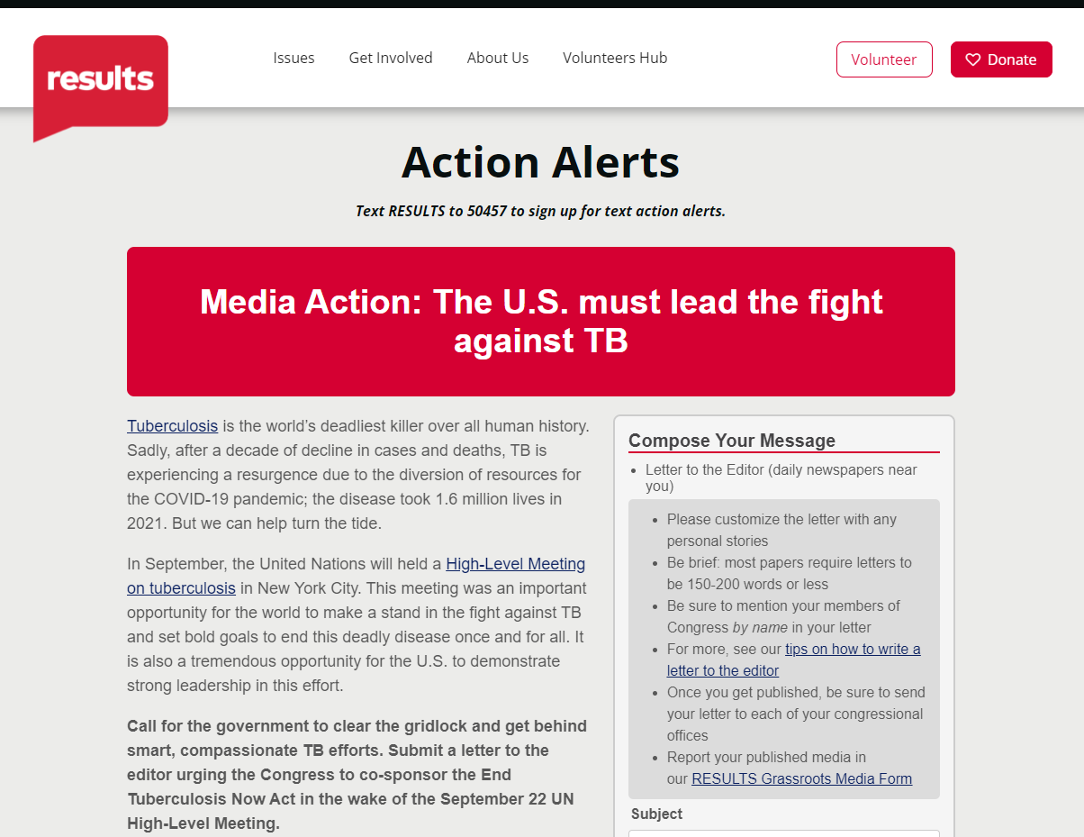
Submitting an LTE
https://results.org/volunteers/action-center/action-alerts?vvsrc=%2fcampaigns%2f63557%2frespond
Notes:
Karyne
Action Alert (direct link) - https://results.org/volunteers/action-center/action-alerts?vvsrc=%2fcampaigns%2f63557%2frespond

Slide 28
Let’s keep writing and submitting! Best of luck!

Slide 29
Reflecting on 2023
What has been the most impactful moment for you this year?
How can we bring in other RPCVs to join us in advocacy?
Notes:
Karyne

Slide 30
Global Allies Program Coaching Support
Sign up for additional coaching support between webinars!
https://results.salsalabs.org/globalalliesprogram
Notes:
Sign Up - https://results.salsalabs.org/globalalliesprogram

Slide 31
Additional Volunteer Opportunities
Notes:
GivePulse, opportunity to learn about additional volunteer opportunities with Peace Corps Affiliate groups, including ours! Sign up and research opportunities here: https://npca.givepulse.com/group/860706-the-npca-continuation-of-service-program

Slide 32
- RESULTS Global Policy Forum, October 19 at 9:00 PM ET Next steps on Global Legislation (READ Act and End TB Now Act) Register: https://tinyurl.com/OctGlobalPolicyForum - No webinar in November – have a wonderful holiday! - December 14 – 8:30 PM ET RESULTS Joint Policy Forums End of Year Event Check out Peace Corps Connect for upcoming events hosted by NPCA: https://www.peacecorpsconnect.org/events
Upcoming Events

Slide 33
Join us for our first Global Allies Program webinar of 2024 January 11, 2024 at 8:30 PM ET

Slide 34
Thanks for joining us tonight!

