Slide 1
Global Nutrition
Deep Dive
John Fawcett
Director, Global Policy & Advocacy
April 12, 2016

Slide 2
Nutrition: The Problem
Nearly half of all deaths of children under five are attributable to undernutrition
Globally 159 million children under the age of 5 are affected by stunting
Wasting threatens the lives of more than 50 million children each year
Iron and other micronutrient deficiencies among pregnant women contribute to maternal deaths and babies being born underweight

Slide 3
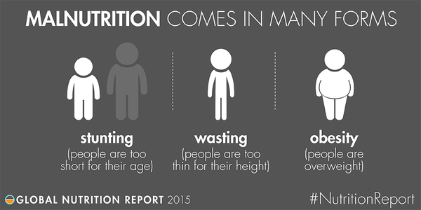
Key Concept: Forms of Malnutrition

Slide 4
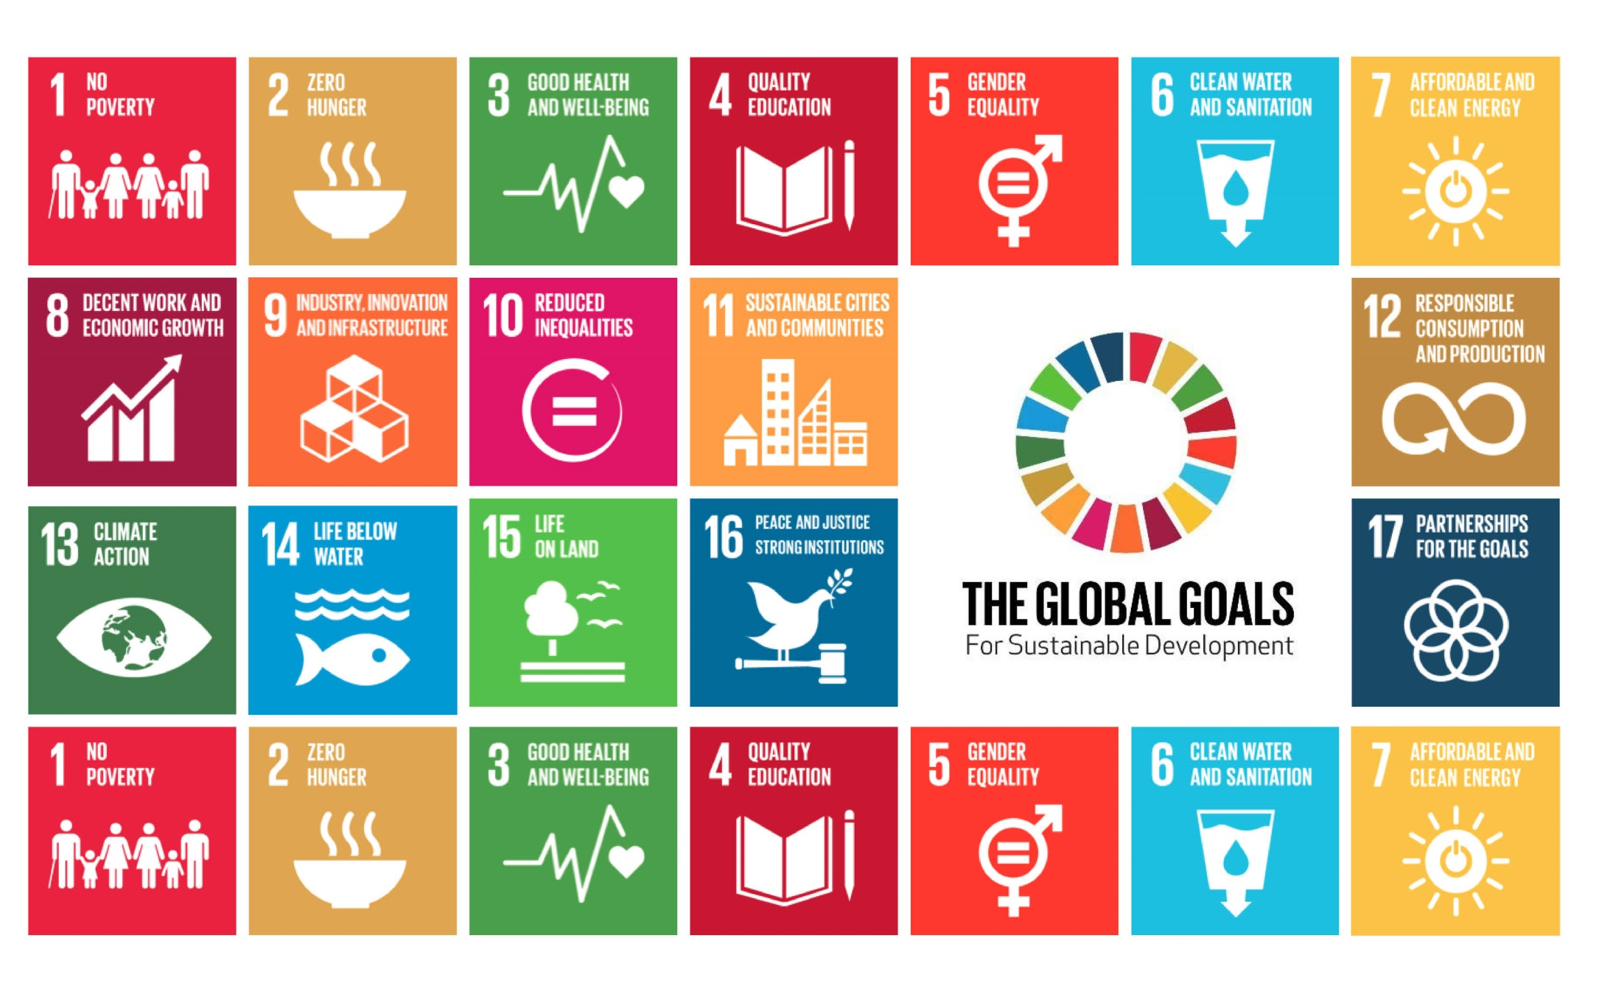

Slide 5
Nutrition: The (Partial) Solution
Scaling up evidence-based nutrition interventions could reduce stunting by 20 percent and severe wasting by 60 percent.

Slide 6
Key Concept: Specific vs. Sensitive (or, direct vs. indirect)
Nutrition-specific interventions address the immediate causes of undernutrition, like inadequate dietary intake and some of the underlying causes like feeding practices and access to food.
Nutrition-sensitive interventions can address some of the underlying and basic causes of malnutrition by incorporating nutrition goals and actions from a wide range of sectors.

Slide 7
Promoting good nutritional practices
breastfeeding
complementary feeding for infants after the age of six months
improved hygiene practices including handwashing

Slide 8
Increasing intake of vitamins and minerals
Provision of micronutrients for young children and their mothers:
periodic Vitamin A supplements
therapeutic zinc supplements for diarrhea management
multiple micronutrient powders
de-worming drugs for children (to reduce losses of nutrients)
iron-folic acid supplements for pregnant women to prevent and treat anemia
iodized oil capsules where iodized salt is unavailable
biofortification

Slide 9
Provision of micronutrients through food fortification for all
salt iodization
iron fortification of staple foods

Slide 10
Therapeutic feeding for malnourished children
prevention or treatment for moderate undernutrition
treatment of severe undernutrition (“severe acute malnutrition”) with ready-to-use
therapeutic foods (RUTF).

Slide 11
Key Concept: The First Thousand Days
Nutrition during pregnancy and in the first years of a child’s life provides the essential building blocks for brain development, healthy growth and a strong immune system. In fact, a growing body of scientific evidence shows that the foundations of a person’s lifelong health—including their predisposition to obesity and certain chronic diseases—are largely set during this 1,000 day window

Slide 12
Nutrition Financing
Coming Soon!

Slide 13
Nutrition: The Opportunity in 2016
The 2013 Nutrition for Growth summit in the United Kingdom resulted in over $4 billion in pledges to scale up high impact nutrition interventions from more than 100 countries, foundations, businesses, and civil society organizations
Prior to the 2016 Summer Olympics, Brazil will host a follow-up Nutrition for Growth summit to evaluate global progress and catalyze further action. (Maybe.)

Slide 14
Nutrition: U.S. Leadership
Double current nutrition funding to $500m
Set ambitious new targets on stunting, wasting, breastfeeding, and anemia.
Build the evidence base for nutrition sensitive interventions.

Slide 15
Nutrition: Action and Opportunities
LTE Action Sheet on Global Nutrition (link)
Editorial packet
Nutrition Outreach Guide
Bipartisan Resolution on U.S. Global Nutrition Leadership
April 25: Road to Rio Fundraising campaign
May 8: Mother’s Day

Slide 16
Questions?

