Slide 1
Motivational Interviewing 101
August Recess Edition 2023

Slide 2
Thanks for attending! Please put your name, pronouns, and location in the chat!

Slide 3
Before we begin:
3
​Motivational interviewing was designed for health behavior change, not policy advocacy.
Therapists and others who use MI spend years learning MI – but you’re in a quick workshop.
I have not gone through the certification process to train people in MI
You develop skills over time – and the best way to learn is through practice and coaching!
Please check out RESULTS six 1 hr session of "Getting unstuck with your members of Congress using MI" here
Keep an eye out for more information on another round of Motivational Interviewing sessions in Spring 2024
Notes:
Updated AO slide (2/22)

Slide 4
Webinar Objectives
Advocates will leave with a basic comprehension of Motivational Interviewing and how it can be utilized in their advocacy, regardless of their current skill level
They will leave with an understanding that finding similar values with your members of Congress can help begin to guide the conversation into a place of mutual respect and understanding
Advocates will feel encouraged to craft their own content using the OARS technique for their August lobby meetings and beyond

Slide 5
What is Motivational Interviewing?
Motivational Interviewing is a set of communication skills that foster collaboration

Slide 6
How can MI help you in your advocacy?
Can help combat resistance and inaction from your members of Congress
Can help transcend the adversarial mindset and use values-based advocacy to make the case for change.
Can help speak with difficult family members and your other interpersonal relationships!

Slide 7
TENETS OF MOTIVATIONAL INTERVIEWING APPLIED TO POLICY ADVOCACY
7
​Compassion: Empathy for the policymakers point of view and how the policymaker arrived at that view
Acceptance: Acknowledgement that the policymaker and their view has some inherent worth
Partnership: Seek to walk alongside the policymaker to guide him/her/them towards change
Evocation: Understanding that the policymaker holds wisdom on how change works in their context
Notes:
Updated AO slide (2/22)

Slide 9
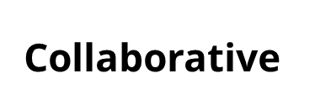
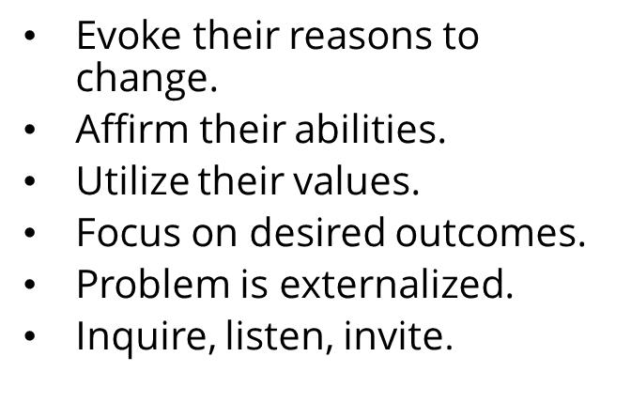

Slide 10
MI moves them through the
Stages of Change
Maintenance
Consistent, Zealous
4. Action
Moving, Engaged, Acting.
3. Preparation
Open, Looking, Interested
2. Contemplation
Maybe, Ambivalent
1. Precontemplation
Angry, In Denial, Defensive

Slide 11
What can cause a member of Congress to change their mind?
Cognitive Dissonance is often discussed in relation to a mismatch between different components of attitudes
For example, a positive attitude towards helping those in need but a contradicting behavior of not giving money or support to individuals experiencing homelessness
Creating Cognitive Dissonance can mean we feel ambivalent...we genuinely have a disconnect between two conflicting beliefs.
That disconnect makes us feel uncomfortable, driving us to resolve it.
This is where you can come in, and begin a conversation with your policymaker to make them move through the Stages of Change

Slide 12
12
​
Notes:
Updated AO slide (2/22)

Slide 13
What if my member of Congress says something oppressive during the meeting?
13
​USING MI DOES NOT MEAN THAT YOU STOP USING OTHER SKILLS!
Sometimes you DO need to call out (or in) classist, racist, sexist, ageist, and other discriminatory beliefs in ways that do not fully fit with MI … and that is fully appropriate
If this happens, please let RESULTS Staff know!
Notes:
Updated AO slide (2/22)

Slide 14
There are many Motivational Interviewing techniques... Today you'll be learning about only 1 of them, called OARS!

Slide 15
But first, any questions so far?

Slide 16
Core Skills: OARS Creating Collaborative Relationship
Open Questions
Affirmations
Reflections
Summaries

Slide 17
Open-ended Questions
Questions can’t be answered with “yes” or “no”
Instead, they evoke and invite participation
‘Curious’ questions:
“Explain …”
“Tell me about …”
“Could you say more about …?”
“Could you please clarify …?”
“How …?”
“What …?”

Slide 18
Open the Dialogue with Open Questions
Closed: "Would you please sign the Senate UN HLM Letter?"
Open: "With the deadline for the Senate UN HLM letter coming soon, I am curious to know where the Senators stands on signing on?"
Try the 6 W’s: Who, What, When, Where, Why, and How
Try it: with your MOC

Slide 19
Let's practice!
"How can we help the Representative/Senator encourage their colleagues to cosponsor The End TB Now Act to set bold targets to reach and treat the most vulnerable populations for all forms of TB?"
"Who does the Representative/Senator look to for more information about the The Child Tax Credit as a path to end poverty?"

Slide 20
Affirmations
Recognize and reinforce success, but be genuine!
Partner
Offer perspective in face of difficulties
Express optimism
See any progress as progress, use the Ladder of engagement!
“It is a challenging issue.”
“I can see that you are trying to weigh what will work best for your constituents.”

Slide 21
Sources For Affirmations
Their website
Newspapers from their area
Our own notes from building a personal relationship with the office

Slide 22
Let's practice!
“I, and our constituents, really appreciate the actions you’ve taken to support efforts to get TB prevention work back on track since the start of the COVID-19 pandemic."
"We appreciate that you understand the urgency to set bold targets to reach and treat the most vulnerable populations for all forms of TB."

Slide 23
Reflections
Mirror what the policymaker is saying
Demonstrate that you are partnering with the policymaker and understand what the policymaker is trying to communicate to you
Clarify the policymaker’s train of thought
State what the policymaker means
Show collaboration

Slide 24
Let's practice!
Amplified Reflection: Reflect what the policymaker has said in an exaggerated way. This encourages the policymaker to argue less and can elicit ambivalence.
“You believe because housing is expensive, it’s impossible to make housing affordable for everyone.”
Double-sided Reflection: Reflect the policymaker’s ambivalence.
“On the one hand, you believe that making Housing Choice Vouchers universal is a tall order, and on the other hand, you know how important affordable housing is for your constituents and your district.”
Side with the Negative: Reflect back one side of the policymaker’s ambivalence in order to elicit the other side of their ambivalence.
“I wonder if you think that because making housing affordable for all is expensive, the government should not try to improve the situation for low-income renters; affordable housing shouldn’t be available to all like food is through the SNAP program.”
Reflect a Feeling: Share what you think the policymaker’s underlying feeling is.
“It sounds like you are worried about your constituents’ wellbeing. That's wonderful, because the Child Tax Credit has been proven to improve the lives of millions in our community and state.”

Slide 25
Summaries
Let the policymaker know you’re listening and understanding
Link relevant information
Allow the policymaker to hear their own motivations and ambivalence
Help to clarify the policymaker’s stances and planned actions
Help to bridge/transition between topics
Focus on the most important aspects of your conversation

Slide 26
Let's practice!
“So, to summarize, I understand that the Senator is a bit hesitant to sign on to the Senate UN HLM letter until they speak with their colleagues, does that sound right? ”
"In summation, after this meeting, you'd like for me to follow up with the Senators foreign policy aide?"

Slide 27
In order to get more comfortable utilizing MI... practice, practice, practice!

Slide 28
Please contact me if you'd like to brainstorm ways to build your relationship with your MOC's through Motivational Interviewing Sarah Leone at sleone@results.org

