Slide 1
Global Immunization
May 15, 2024

Slide 2
vaccines save lives

Slide 3
154 million
Notes:
https://www.who.int/news/item/24-04-2024-global-immunization-efforts-have-saved-at-least-154-million-lives-over-the-past-50-years

Slide 5
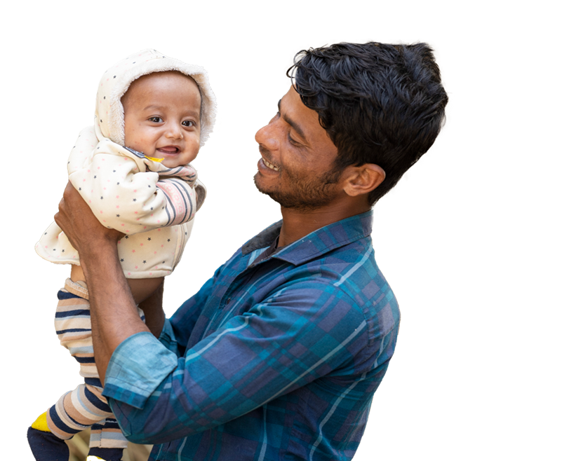
Gavi has helped prevent more than 17 million future deaths

Slide 6
why gavi? why now?

Slide 7
Notes:
The vision of RESULTS is to be a leading catalyst of rapid progress toward a world where extreme poverty no longer exists and where nobody dies of causes in one part of the world that are easily preventable in other parts of the world.
Researchers estimate child mortality rates have averaged around 40 to 50 percent across different locations and time periods

Slide 8
Notes:
For thousands of years, no matter where a child was born, about half of them died.

Slide 9
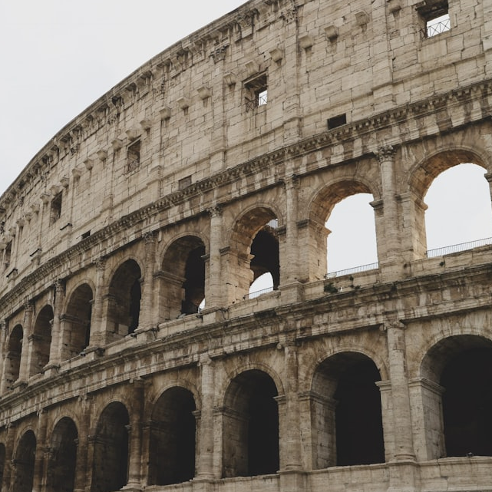
ITALY
200
JAPAN
1300
SWEDEN
1750
Notes:
This rate has been consistent – from Ancient Rome in 200 CE, to Japan in 1300, to Sweden in 1750.
1: https://unsplash.com/photos/a-close-up-of-a-very-old-looking-building-eDb4qWCvUNM
2: https://unsplash.com/photos/a-tall-building-sitting-next-to-a-forest-filled-with-trees-M-SKOk6G7bk
3: https://unsplash.com/photos/house-at-the-farm-XiHRIiwq2jY

Slide 10
Global child mortality
The estimated share of newborns who die or survive the first five years of life.
^{100%}
^{80%}
^{60%}
Share surviving
first five years
^{40%}
^{20%}
Share dying in
first five years
^{0%}
1800
1850
1900
1950
2000
Data source: United Nations Inter-agency Group for Child Mortality Estimation (2023); Gapminder based on
UN IGME & UN WPP (2020)
OurWorldInData.org/child-mortality | CC BY
Notes:
Today, that rate is closer to 4 percent (see graph below). But it is still a devastating toll. Last year there were nearly 5 million preventable deaths of children under age 5, and an additional 1.9 million stillbirths — many of which could have been prevented.

Slide 11
Vaccines are crucial for children because they are particularly vulnerable to infectious illnesses
Notes:
Children are not “mini adults” for infections. When we are babies and young children, our bodies have usually not been exposed to many diseases, and our ability to fight off infection — our immune system — is weak. Vaccines teach our bodies to have an immune response to common diseases. Your immune system keeps a memory of this, as a “blueprint” for how to respond, so you are less likely to get seriously sick in the future.

Slide 12
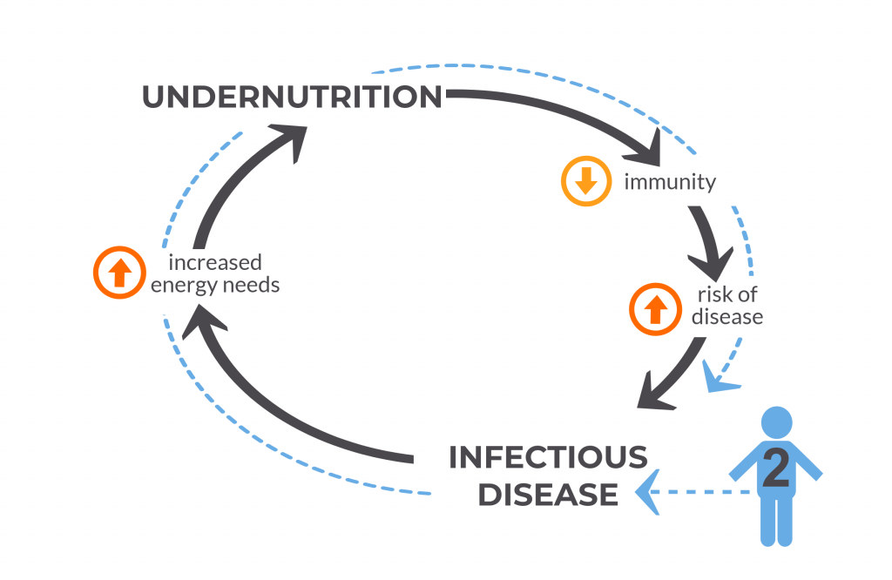
Notes:
https://immunizationevidence.org/wp-content/uploads/2022/08/NGD-VoICE-Figure-4-April-2018-1024x768-1.png

Slide 13
1920’s → 1960’s
Astounding number of new & effective vaccines

Slide 14
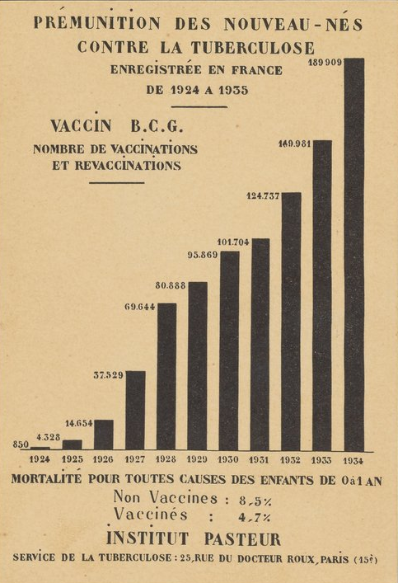
Immunization of newborn babies against tuberculosis registered in France, 1924-1935
Notes:
https://digital.sciencehistory.org/works/wp988j884

Slide 15
Child mortality by income level of country
The estimated share of newborns who die before reaching the age of five.
^{18%}
^{16%}
^{14%}
^{12%}
^{10%}
^{8%}
Low-income countries
^{6%}
^{4%}
Lower-middle-income countries
^{2%}
Upper-middle-income countries
High-income countries
^{0%}
1990
1995
2000
2005
2010
2015
2021
Data source: United Nations Inter-agency Group for Child Mortality Estimation (2023)
OurWorldInData.org/child-mortality | CC BY
Notes:
Unfortunately, progress is not reaching all communities and families at the same pace. If you take a closer look at the data, it is clear that inequality has extreme become much more extreme. In the richest parts of the world, child deaths have become rare due to improved living conditions and sustained government investment in social safety nets and routine immunization programs.

Slide 16
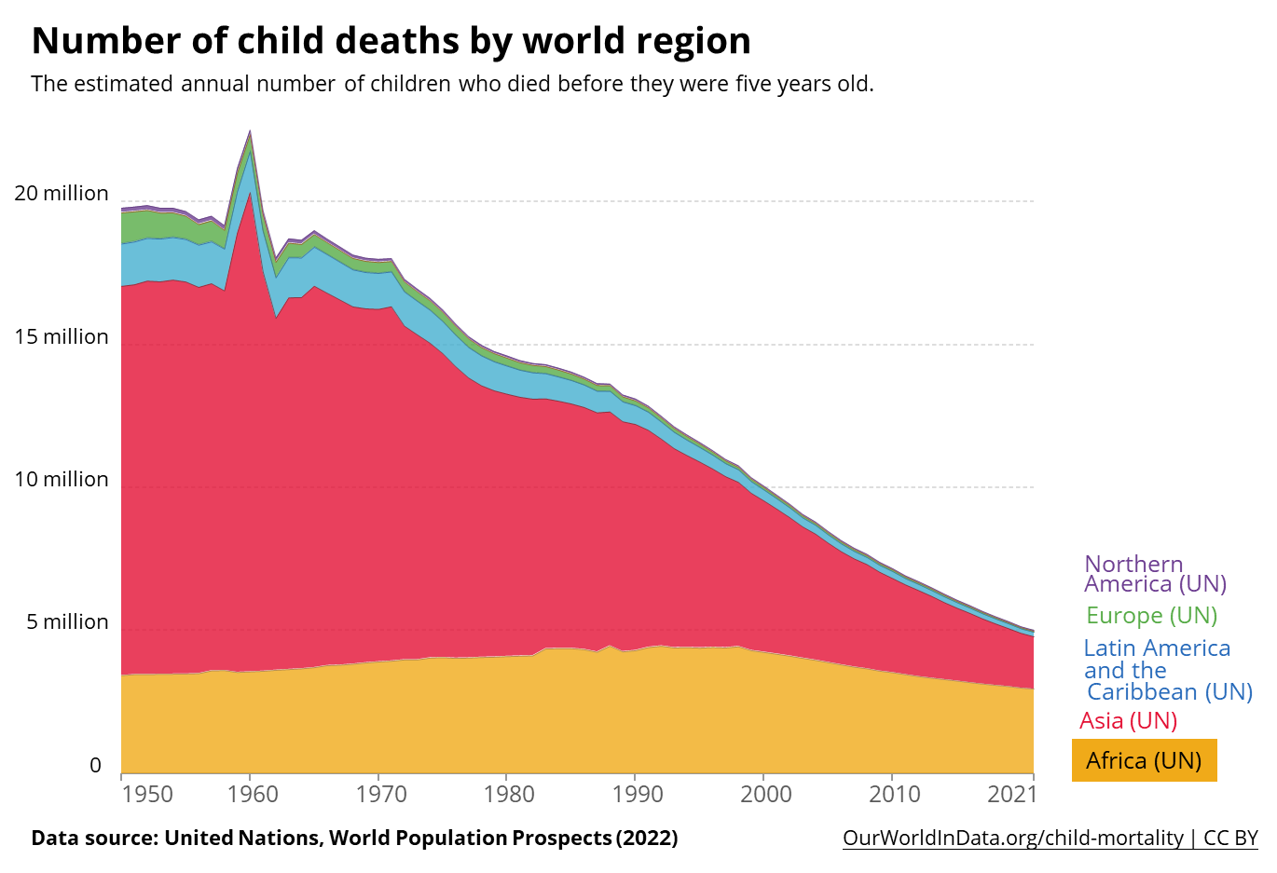
Notes:
And the vast majority of the decrease in child mortality has been due to improvements in the Asia region. There is still an extremely dire child mortality crisis, and it’s being felt especially hard in Africa.

Slide 17
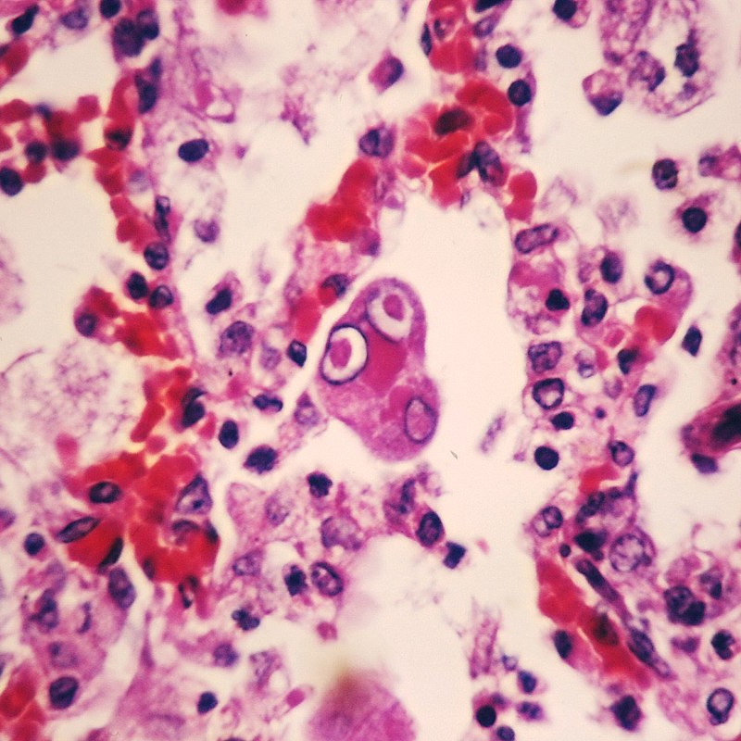
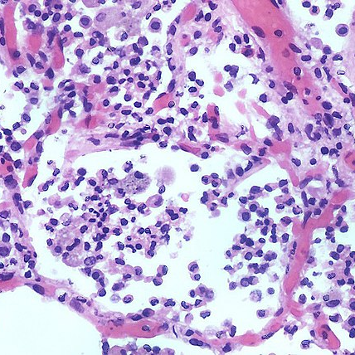
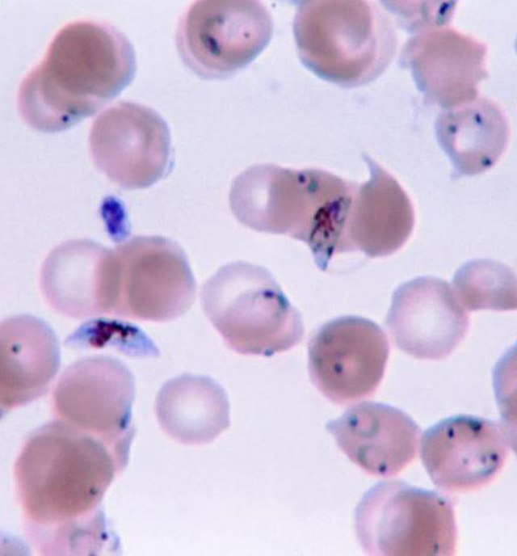
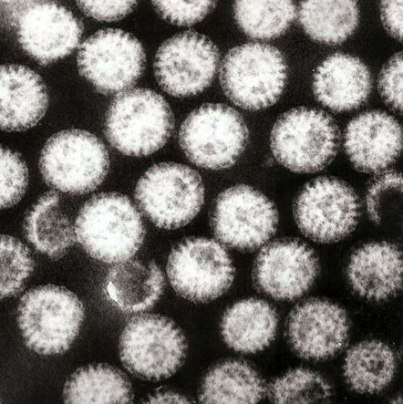
leading infectious killers
measles
pneumonia
malaria
rotavirus
Notes:
https://commons.wikimedia.org/wiki/File:Simian_measles_pneumonia_-_Case_287_(13431698195).jpg

Slide 20
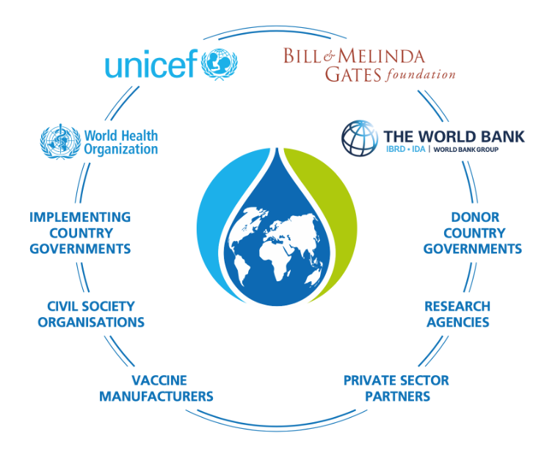

Slide 21
gavi by the numbers
1 billion children immunized
17 million future deaths prevented
50% of the world’s children vaccinated by Gavi
$54 returned for every $1 invested
19 countries transitioned out of support

Slide 22
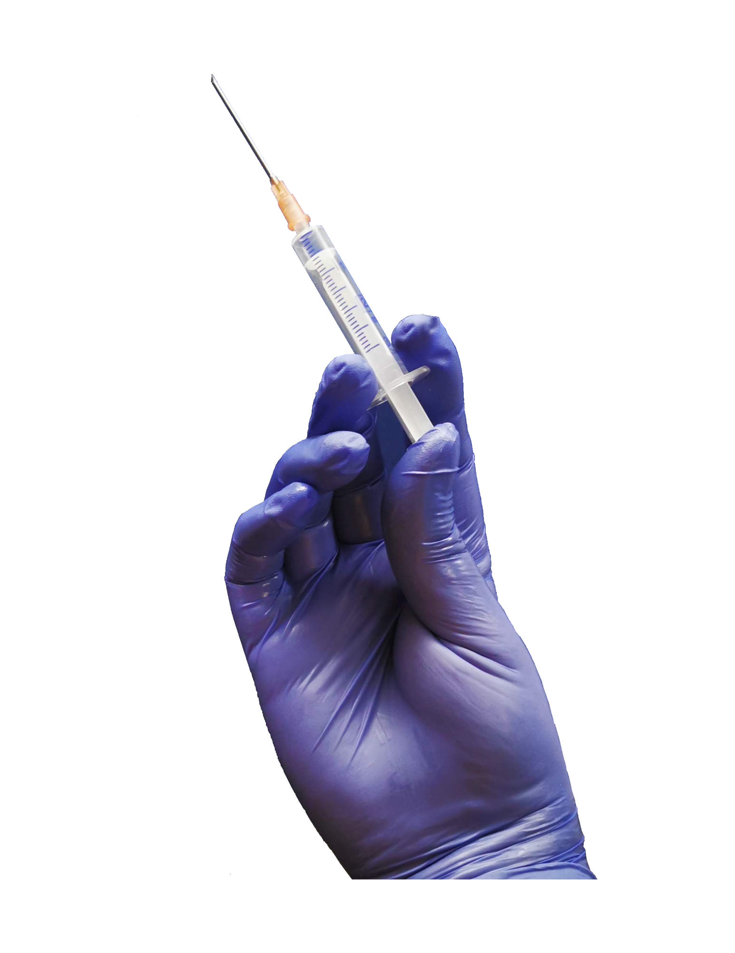
Every year, more than 700,000 children die from pneumonia. Vaccines help prevent them from getting sick.
$2.00
Notes:
Today, it costs $18 to fully immunize children in low-income countries. This price has reduced from $23 in 2013. This would not have happened on its own. It’s the result of sustained global partnership to save children’s lives.

Slide 24
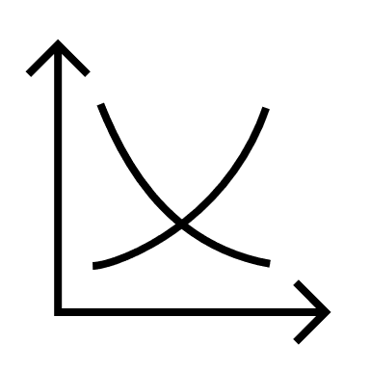
market shaping
manufacturers supplying Gavi-supported vaccines increased from 5 to 19, with more than half in low- and middle-income countries
Notes:
Making more vaccines would lower the cost per dose, but companies did not want to risk producing vaccines that no one would buy. And the countries could not commit to buying until the price went down. It was a failure of the vaccine market. Gavi was created as a solution to encourage manufacturers to lower vaccine prices for the poorest countries. Gavi shares the cost that countries pay for vaccines, which allows them to guarantee long-term, high-volume, predictable demand for the manufacturers. In 20 years, the number of manufacturers supplying Gavi-supported vaccines increased from five to 19, with more than half in low- and middle-income countries.

Slide 25
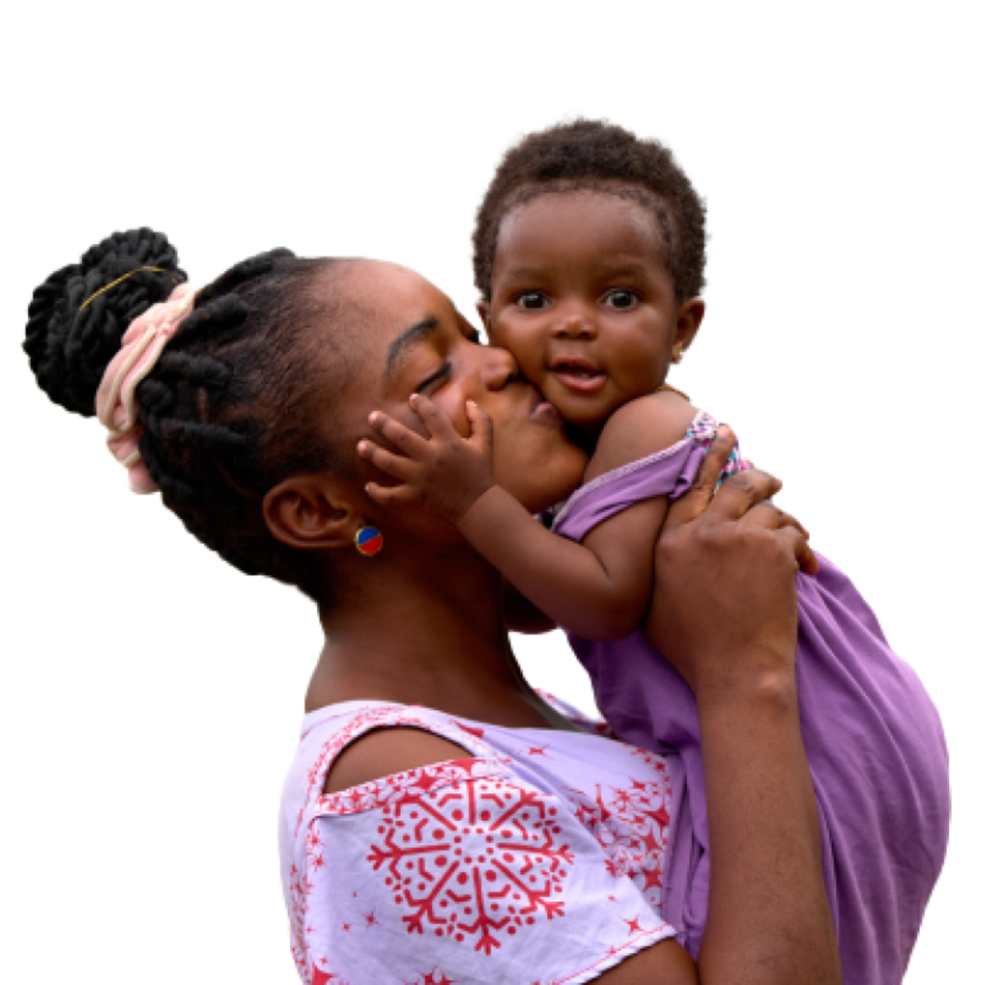
Gavi has helped immunize more than 1 billion children

Slide 26
why gavi? why now?

Slide 27
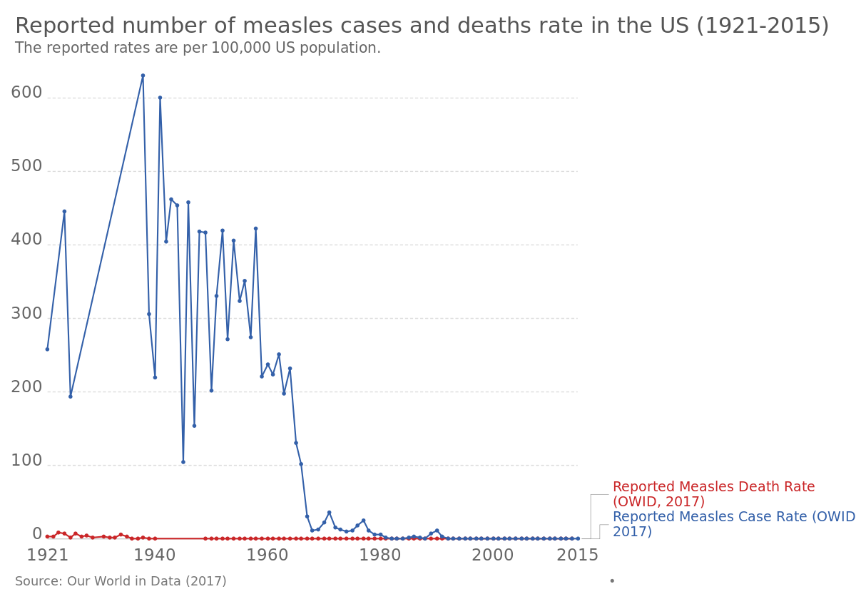
Notes:
https://commons.wikimedia.org/wiki/File:Rate_of_reported_cases_and_deaths_from_measles_in_the_USA,_OWID.svg

Slide 28
25 million
Notes:
But now, because of health service interruptions during the COVID-19 pandemic, global vaccination coverage has suffered the largest backslide in 30 years. In 2021, 25 million infants missed lifesaving vaccines. This is happening against a backdrop of rapidly rising malnutrition which is creating a perfect storm for child health. Malnourished children already have weakened immunity, so missed vaccines or falling behind schedule means common childhood illnesses could become deadly

Slide 29
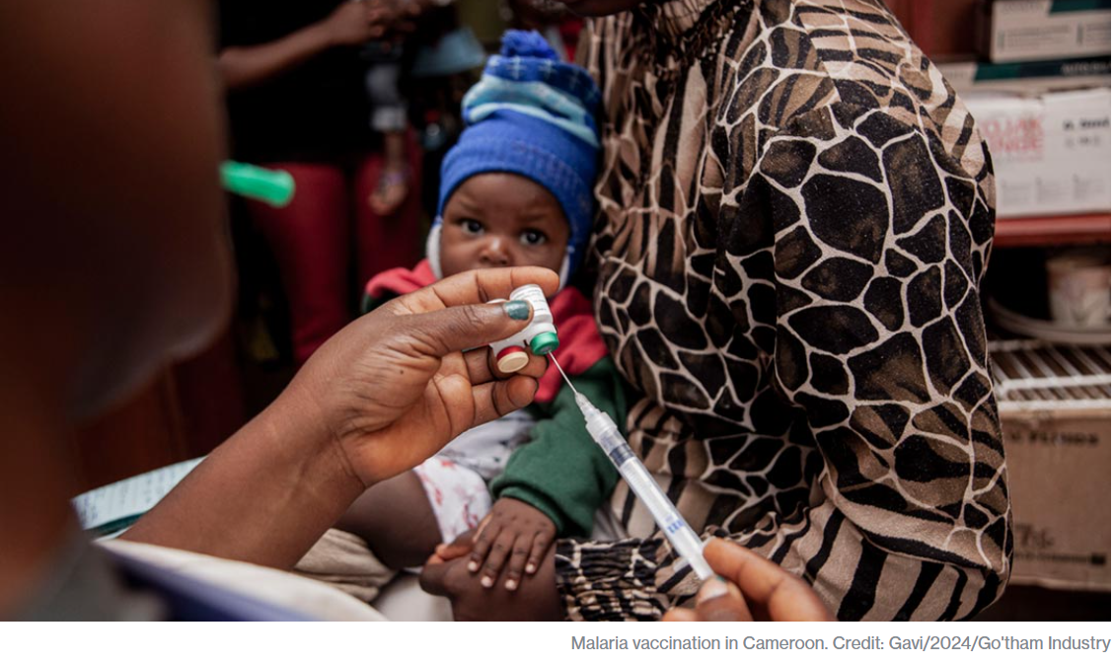

Slide 30
JUNE
Investment Opportunity Launch
Paris, France
20
Notes:
Gavi will launch their investment case to fund their next strategic period from 2026-2030.
https://www.gavi.org/our-alliance/strategy/phase-6-2026-2030

Slide 31
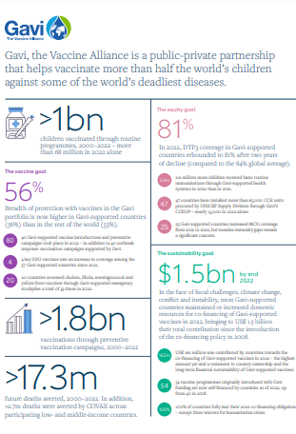
Learn more about Gavi’s amazing results here!
Notes:
https://digital.sciencehistory.org/works/wp988j884

Slide 32
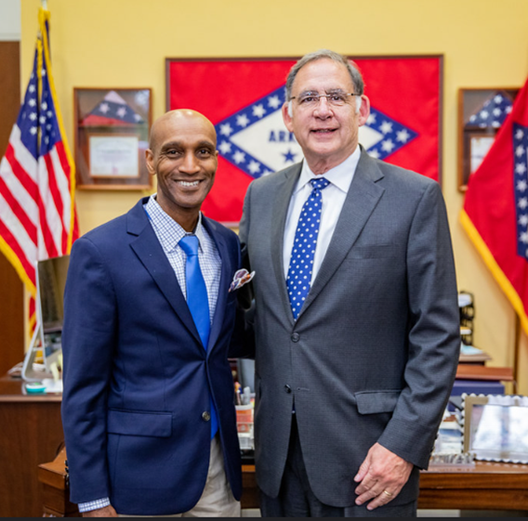
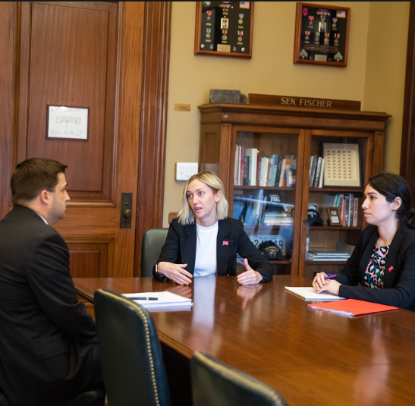
Big goal of RESULTS appropriations advocacy
OUR BIG GOAL
Inspire Congress to take meaningful actions to fight poverty

Slide 33
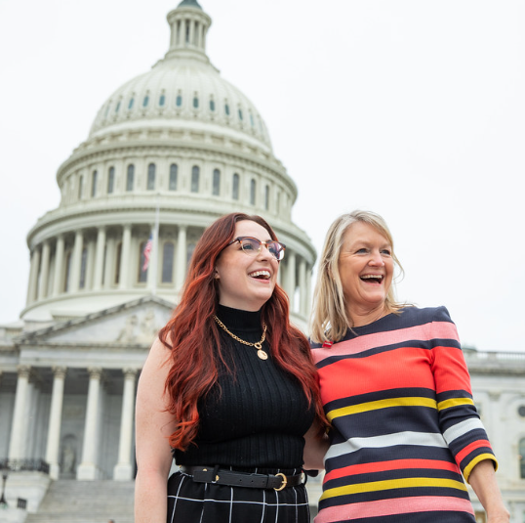
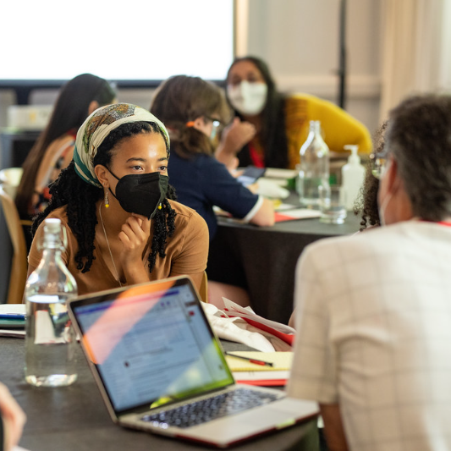
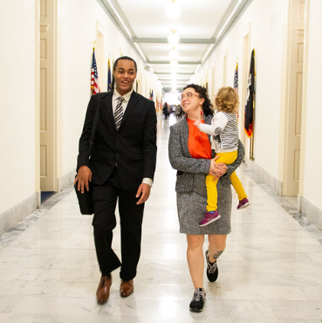
Tools for RESULTS appropriations advocacy
OUR TOOLS
Our voices, our stories, our data

Slide 34
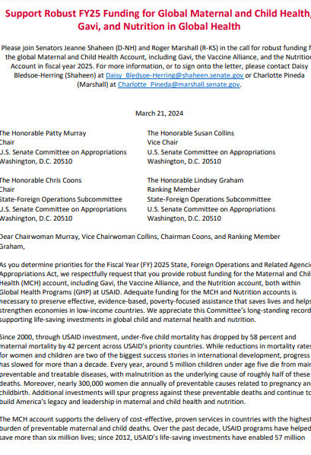
FY25 Appropriations Letters
Notes:
https://digital.sciencehistory.org/works/wp988j884

Slide 35
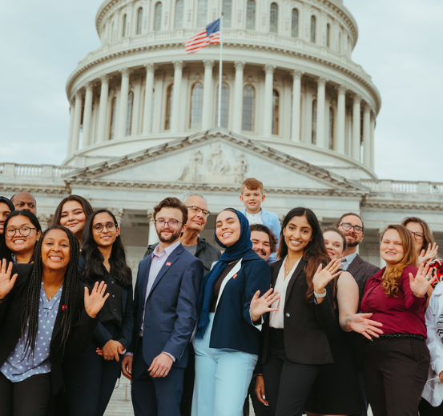
If you want to go fast, go alone. If you want to go far, go together.

